Slide 1

Notes:
For anyone not familiar with Hitman or IO Interactive, here is the launch trailer of Hitman World of Assassination for iOS

Slide 2

Scope – Hitman & G2
Internal port
Live updates - Elusive Targets
Older branch of G2
No content changes
No geometry streaming system
Aspire to have low maintenance cost
Notes:
We wanted to add mobile (iOS) capabilities to our Glacier engine and ultimately chose to work on this by porting Hitman to iPhone.
Since Hitman is a released game which still receives live updates via our Elusive Targets system we worked under pretty strict constraints.
Moreover, we are a fairly small studio for the amount of projects we have in flight, and most of us were working on other projects during this period.
This meant the iOS port had to be done with no content modifications.
On top of that, Hitman is running on an older branch of the engine which is missing some new QoL features.
All of this is to say, you should take our notes with a grain of salt and see what applies to your own projects.
Some of the decisions we made are not "optimal" and work only because of our particular setup.

Slide 3
Mobile Platforms – Smartphones & Tablets
System on Chip (SoC) design
Unified Memory
3-6W Power Budget
Peak performance is not sustainable
RAM Access is energy intensive
1W = 150-200MB @ 60fps
Notes:
A small refresher on mobile platforms and their main challenges

Slide 4
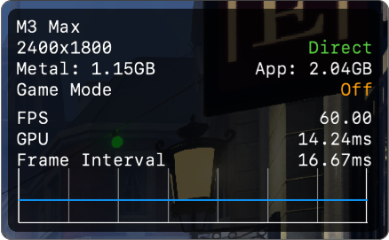
Groundwork
Game Porting Toolkit
Trying out a Windows-DX12 build on macOS
Try to find early failure points
Memory Budget
Unsupported Features
Notes:
We started out with a feasibility test using Apple's Game Porting Toolkit.
This allowed us to run our DX12 build on macOS without having to invest a lot of development time upfront.
We were looking for potential unsupported shader features and general performance.

Slide 5
Target
Min Spec
iPhone 15 Pro (A17Pro)
8GB unified memory, ~6GB usable
iOS 18.0 - “Metal3"
Argument Buffers - Tier 2
Residency Sets*
Device Capabilities
iphone-performance-gaming-tier
Entitlements:
increased-memory-limit
sustained-execution
Notes:
After testing and looking at the Apple ecosystem we landed on the following minimum spec.
The main driver for this was memory budget. Because Hitman doesn't have geometry streaming and we didn't have the opportunity to create new mobile-optimized assets, 8GB was the minimum we could aim for.
It is worth noting that we can get close to a 4GB runtime memory footprint (as we have done with our low end VR build of Hitman), but the OS takes a lot of the available resources for itself.
On top of that there seems to be quite a lot of memory reserved by the driver on behalf of the game while running, which ultimately left us at 8GB min.
We need tier 2 argument buffers for our binding model using Metal Shader Converter
Initially we were targeting iOS 17, but we later had to set the minimum spec to iOS 18 due to the On Demand Resource (ODR) system.
Residency Sets are available only from iOS 18 onwards, so our initial release did not make use of this feature.

Slide 6
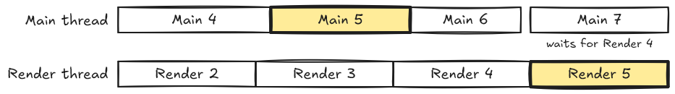
Render Thread
Main thread deals with gameplay logic and loading
Render thread culls and records GPU commands
Reflect step copies necessary data from main thread to render thread
Configurable maximum latency between main and render
Used for dealing with main thread spikes
Not 1:1 with display frames
Render thread takes over during loading & sometimes doesn’t present a frame
Notes:
Peter

Slide 7
Whose Main Thread Is It Anyway?
Apple APIs are based on event driven model
A lot of them can only run on main thread
Runs an event loop for processing I/O and callbacks
Avoid blocking as much as possible
Our main and render threads have their own event loops
Needs to do blocking waits for other threads
Game runs on its own “main” thread
Polls CFRunLoop to allow system main thread to schedule function
Schedules an update function on system main thread every frame
Notes:
Peter

Slide 8
Acquiring a Drawable
Metal term for back buffer
Various options available
nextDrawable, CADisplayLink, CAMetalDisplayLink
Threading setup makes things difficult
Consistency problems
Experienced up to 2 ms variability
Problematic when GPU downclocks to fit frame in 33 ms
Notes:
To present in Metal, you need an MTLDrawable
Contains the backbuffer MTLTexture
Display Link APIs
Allows for registering a function to be called when it’s time to render / on V-blanks
CAMetalDisplayLink
The newer, ideal option
Gives you the MTLDrawable as part of the callback
Should automatically manage some latency-related things for you
Did not work out for us due to main/render threads running in parallel
CADisplayLink
Just gives you a callback on V-blanks
Need to call nextDrawable on the CAMetalLayer
We had issues with the consistency of this callback, sometimes varying up to 2 ms
Problem is that GPU has downclocked to hit 33 ms for the frame
We’d end up missing the frame
What we ended up doing
No display link
Delay nextDrawable as late as possible, and early submit right before
That way GPU has something to do while we wait
We use maximum drawable count of 2, and let this pace the CPU side

Slide 9
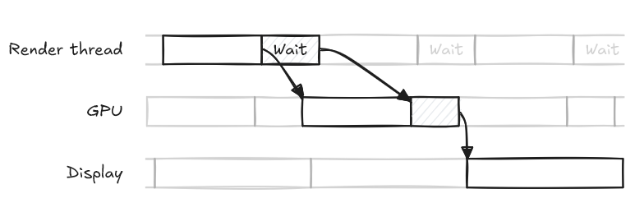
Acquiring a Drawable
Call nextDrawable as late as possible
Early submit before waiting
Gives the system a bit of wiggle room

Slide 10
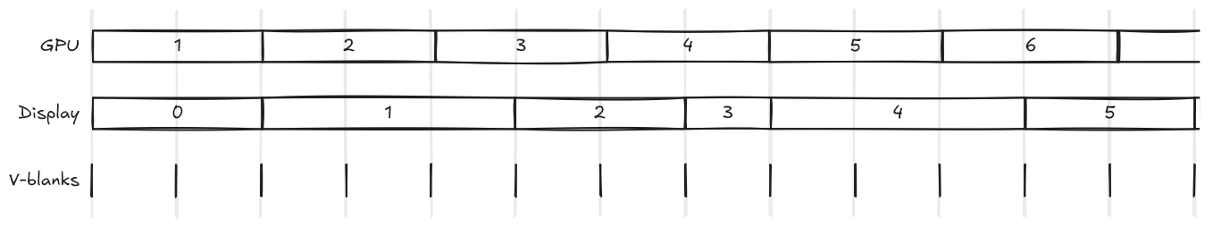
Frame Pacing
Frames should display the same amount of time
Unevenness can cause average FPS to feel lower than it is
Use presentAfterMinimumDuration:
Forces the drawable to be on screen for a minimum duration

Slide 11
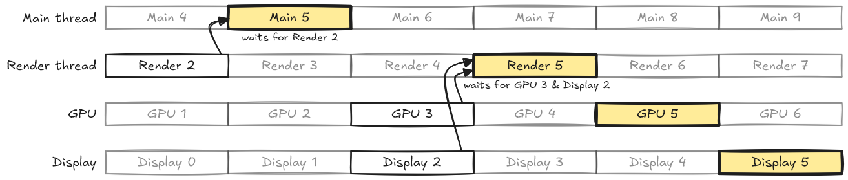
The Full Picture

Slide 12

Resource Pipeline
Dedicated resource server
Spawns custom resource packers
Runs on windows and serves data across the network
Separate blob for retail builds
Notes:
All of our assets get processed by a dedicated resource server running on our dev machines.
The resource server can spawn custom packers for each type of resource we require packing data for specific platforms.
This setup allows us to decouple runtime data from authoring data, and enables us to "cross-compile" our resources from windows machines.
This latter part makes porting easier because the main resource server logic remains on windows unchanged, all we need to add is platform specific packers if needed.
It also allows us to cache and share already packed data across the resource servers in our network, distributing workloads.
Finally, for retail builds, the packed data is packaged and embedded in the game files

Slide 13
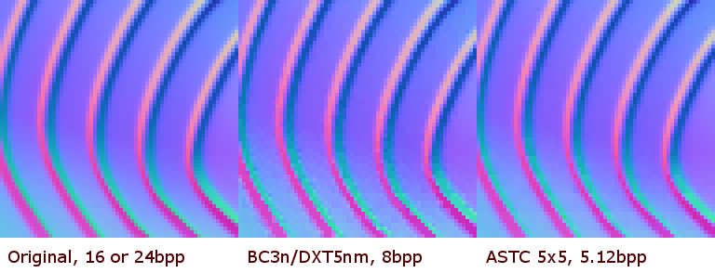
Texture Packing
ASTC: more mobile friendly
Block size heuristic for BCn->ASTC
Apple don't expose GPU swizzling
Can be very slow to compress
From: nVidia Developer Blog
Notes:
We chose to compress our textures using ASTC as it has broader support on mobile hardware and generally achieves equal or better compression ratios – to quality compared to BC.
Apple provide a Texture Compression utility as part of their game porting framework, but it seems to only wrap other 3rd party tools, so we used Arm's ASTC Encoder directly.
We have an offline resource packaging system which prepares all types of assets for our runtime.
We leverage the already existing BC assets and convert them to ASTC formats by trying out different block sizes until we achieve a total compression ratio equal or lower than the original BC texture.
It's also worth noting that for other platforms our texture packers can leverage GPU Tiling information to prepare our runtime resources directly in swizzled formats. Apple however do not expose this for their GPUs so we upload raw ASTC bytes.
Picture from: https://developer.nvidia.com/astc-texture-compression-for-game-assets

Slide 14
Shader Compilation
We author in HLSL
Thin macro layer on top to express techniques
Premade "shader nodes" that allow TAs to edit visually
Small offline tool to generate cbuffer structs
Notes:
Our shaders are for the most part HLSL with a thin macro layer on top.
We have a set of premade shaders which we expose as nodes in a visual node editor for artists. These get combined together by a tool to produce a single hlsl file.
We also have special ".decl" files to describe const buffers which we preprocess using an offline tool to generate compatible C++ and HLSL structs.

Slide 15
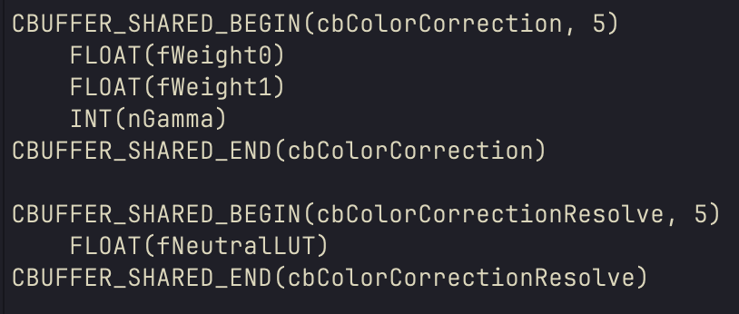
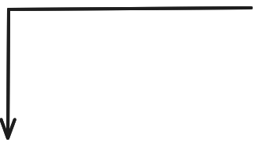
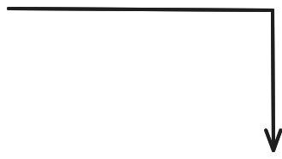


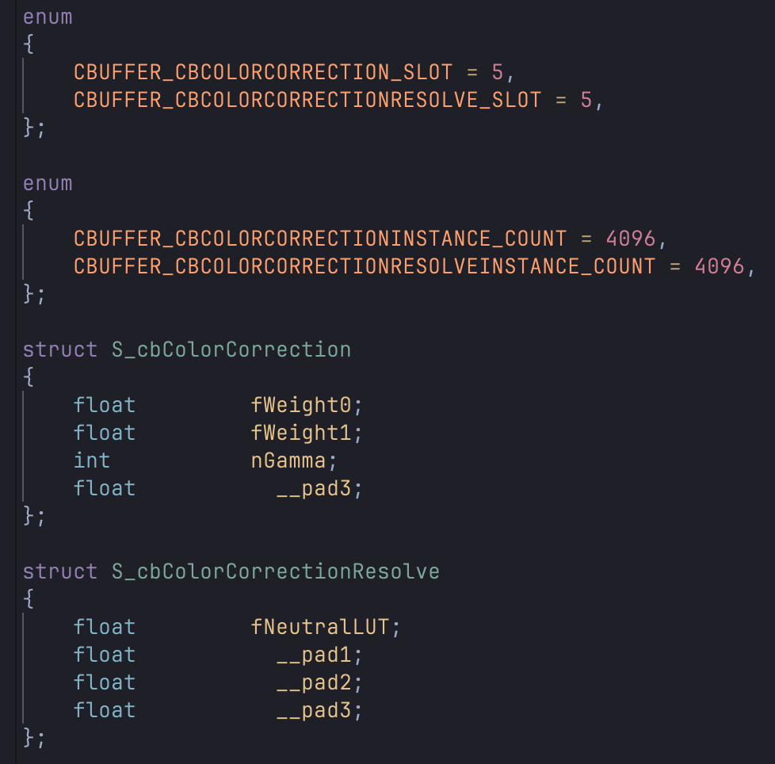
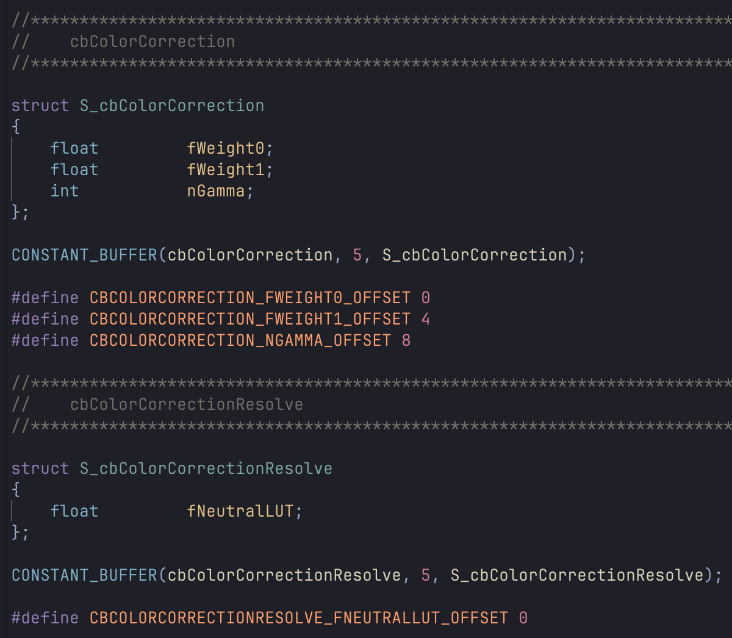
Notes:
Example on how C++ and HLSL cbuffers get generated from a .decl file

Slide 16
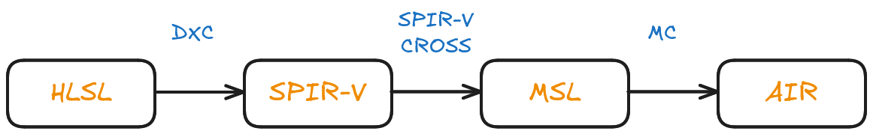
Shader Compilation
Classic approach: SPV-Cross
Notes:
We initially started investigation into shader translation via the classic SPIR-V Cross toollkit.
This is a fairly cumbersome pipeline, but it has the advantage of being battle tested.

Slide 17
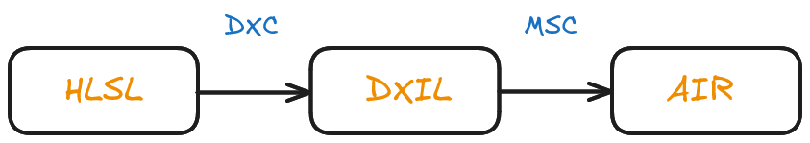
Shader Compilation
New approach: Metal Shader Converter
Official support from Apple
Can always mix in with MSL shaders
Exposes FB-Fetch
Embeds shader source (HLSL)
Notes:
Ultimately we decided to pivot to Apple's new Metal Shader Converter framework.
The switch was only considered once Apple added shader debugging support to their translated AIR code, which happened early during our port.

Slide 18
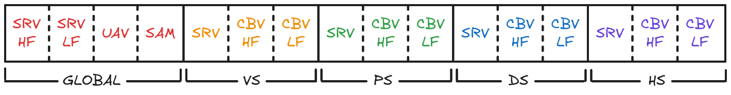
Binding Model
DX12 Root Signatures
MSC + DXC Reflection
2 Level Argument Buffers
Linear Allocator per frame in flight
Notes:
We use a 2 layer argument buffer binding model via embedded root signatures in HLSL and Metal Shader Converter (MSC)
We rely on reflection from both MSC and DXC.
MSC for information required to bind resources properly.
DXC for information about the resources themselves as MSC doesn't currently provide that.
We group descriptor tables in terms of both usage frequency and shader stage.
This gives us the capability to cache descriptor tables and reduces the overall amount of CPU work we have to do per drawcall.
We allocate all TLAB entries from a single per frame linear allocator backed by an MTLBuffer.
This coupled with the fact that we encode Domain and Hull shader entries at the end of the root signature allows us to alias memory and skip allocations for tessellation stages without requiring separate root signatures.

Slide 19
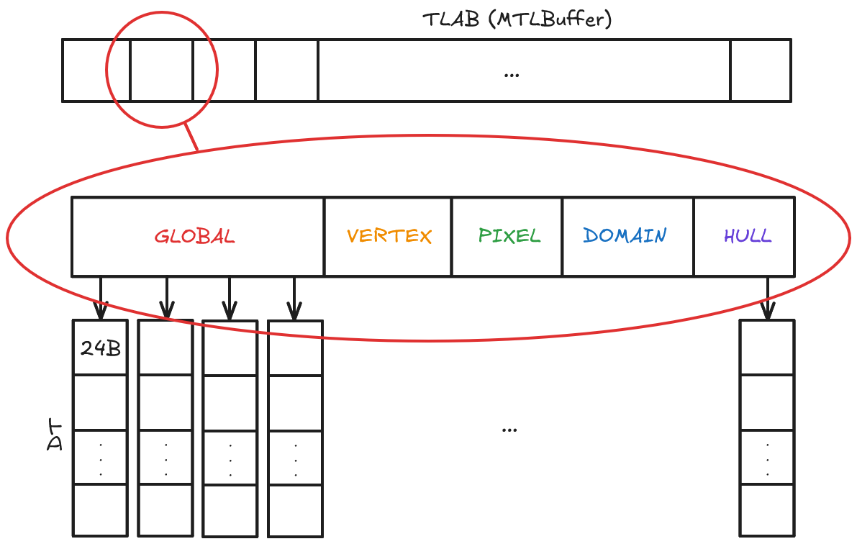
Notes:
Each entry in the TLAB is a uint64 pointing to another argument buffer encoding the descriptor tables.
Entries in the descriptor tables are 3*uint64_t which encode either a buffer address or a texture/sampler resource id along with binding metadata as required by MSC.
2nd level entries are allocated from their own linear allocator cleared per frame.

Slide 20
Resource Binding
Null Buffers & Dummy Textures are required
OOB Reads & Writes are not discarded
MSC forces texture array views (prior to version 3)
MSC Runtime header adds redundant calls
You can use setBytes: to provide data inline
Notes:
The metal shading language is a augmented subset of C++14 which makes it a bit less flexible than HLSL with respect to undefined behavior.
A lot of shader code out there assumes OOB reads will yield a 0 and writes will just be discarded, however in MSL these generate a validation errors.
Even though the game still runs with validation errors, having them spam your logs makes it harder to identify bigger issues.
A lot of work was spent cleaning up our old shader code to be compliant.
MSC (version 2) also comes with some strange constraints to address HLSL-MSL compatibilities, such as requiring all textures to be bound as texture views.
The helper MSC runtime header library also seems to do some redundant work at times which can slow down the CPU drawcall encoding.

Slide 21
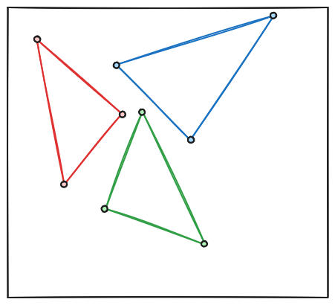
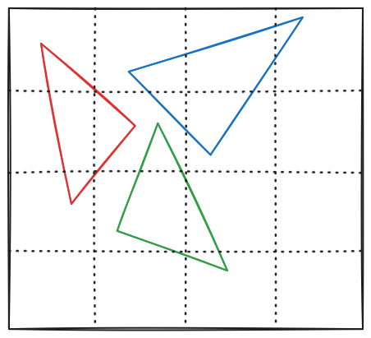
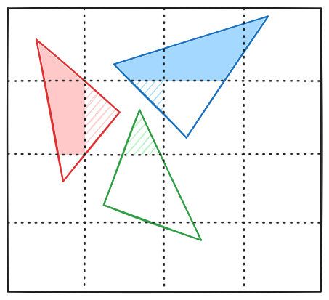
TB;DR
Tile Based Deferred Rendering
Not related to Deferred Rendering
Use fast local memory to significantly reduce bandwidth
Position-only vertex shading
Triangles are binned to tiles
Full shading locally in tiles
Notes:
Peter

Slide 22
Render Passes
Needs to be created explicitly
Frame graph ideal for this
Unfortunately not a thing in HITMAN
Too much work to refactor codebase
Create on-the-fly instead
Notes:
Peter
We decided to dynamically track render passes to avoid too big changes in shared engine code
Has worked out well, though load/store actions are very conservative
Dirty tracking of attachments
Engine uses SetRenderTargets to update these
Track which changed, and if changed do a diff at draw time
Did some minimal changes in shared engine code to bind certain textures early, so that pass did not have to break

Slide 23
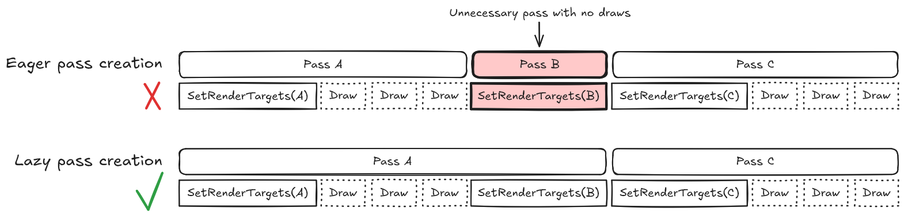
Render Passes
Set dirty bit when render targets change
If set when making a draw call, compare current & desired RTs
Notes:
Peter
We decided to dynamically track render passes to avoid too big changes in shared engine code
Has worked out well, though load/store actions are very conservative
Dirty tracking of attachments
Engine uses SetRenderTargets to update these
Track which changed, and if changed do a diff at draw time
Did some minimal changes in shared engine code to bind certain textures early, so that pass did not have to break

Slide 24
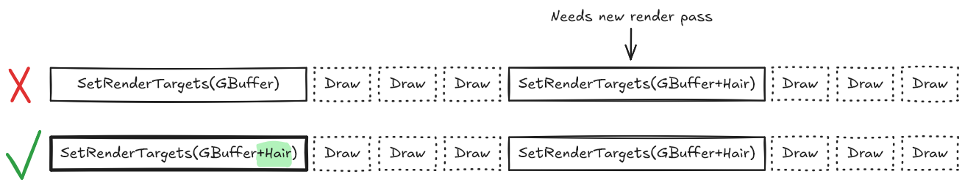
Render Pass Setup
Minimal changes made to bind textures early
Mask out writes for RTs that aren't actually bound for the draw call
Allows more passes to be merged
Notes:
Peter
We decided to dynamically track render passes to avoid too big changes in shared engine code
Has worked out well, though load/store actions are very conservative
Dirty tracking of attachments
Engine uses SetRenderTargets to update these
Track which changed, and if changed do a diff at draw time
Did some minimal changes in shared engine code to bind certain textures early, so that pass did not have to break

Slide 25
Render Pass Setup
Naïve approach, but has worked out mostly well
Helps that the high-level rendering code is already well structured
Our load/store actions are very conservative
Most stores end up being used though
Special handling for certain cases that didn't
Notes:
Peter
We decided to dynamically track render passes to avoid too big changes in shared engine code
Has worked out well, though load/store actions are very conservative
Dirty tracking of attachments
Engine uses SetRenderTargets to update these
Track which changed, and if changed do a diff at draw time
Did some minimal changes in shared engine code to bind certain textures early, so that pass did not have to break

Slide 26
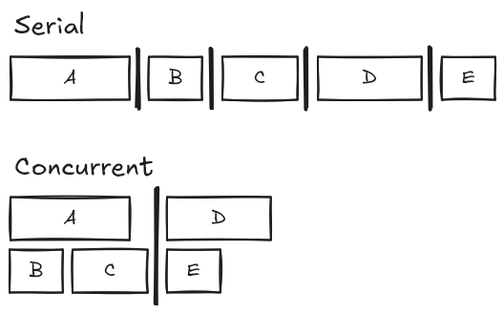
Compute Pass Setup
Metal exposes serial and concurrent compute passes
Serial puts a barrier between all dispatches in pass
Concurrent requires manual barriers
We use concurrent only
Allows for overlapping dispatches
Our deferred shading dispatches are meant to run in parallel
Less driver overhead than 1 pass per dispatch
Notes:
Peter:
MTLComputeCommandEncoder has two dispatch types:
Serial (default) forces no overlap between dispatches
Concurrent runs dispatches in parallel unless there’s a barrier
We use Concurrent only, and rely on memoryBarrierWithResources:count: for synchronization
We record resource transitions into a fixed size buffer, storing up to 32 resources
If we hit the limit or a dispatch, the buffer is flushed with a single call to memoryBarrierWithResources:count:
This allows for overlap where our render code expects it, such as running deferred shading variants in parallel

Slide 27
Compute Pass Setup
Resources are tracked between dispatches
Fixed size buffer storing up to 32 resources needing a barrier
Flush buffer on dispatch or if we hit the limit
memoryBarrierWithResources:count:
A bit conservative, but works well enough
Barrier only blocks within the same compute pass
Notes:
Peter:
MTLComputeCommandEncoder has two dispatch types:
Serial (default) forces no overlap between dispatches
Concurrent runs dispatches in parallel unless there’s a barrier
We use Concurrent only, and rely on memoryBarrierWithResources:count: for synchronization
We record resource transitions into a fixed size buffer, storing up to 32 resources
If we hit the limit or a dispatch, the buffer is flushed with a single call to memoryBarrierWithResources:count:
This allows for overlap where our render code expects it, such as running deferred shading variants in parallel

Slide 28
Command Buffer Handling
Command buffers in a ring buffer
Unwrapped index used as fence value
Used as synchronization primitive in engine for waiting on GPU
Ring tracks currently submitted, free and completed index
Stored as unwrapped uint64 values
Maximum of 4 active command buffers
Helps keep memory usage down

Slide 29
GPU Synchronization
We rely on the automatic hazard tracking in Metal
Would like to do our own, but bigger fish to fry
It's a lot of work to move away from
Ended up good enough
Tried implementing async compute
Didn't see performance gain
Metal already runs passes in parallel
Notes:
Peter:

Slide 30
Resource Allocators: Buffers
Read-Only: suballocate from large MTLBuffer
Split between per-frame and persistent
Writeable: Individual allocation to avoid over-synchronization
All buffers are shared resources
Use setBufferOffset: methods as much as possible
Notes:
We generally want to pool read-only resources in order to make residency tracking simpler and improve CPU cycles.
Write-able resources however we allocate individually because we use automatic hazard tracking.
Having them pooled means synchronization for one of the resources will trigger synchronizations for everything in the pool leading to potential over constrained render passes.

Slide 31
Resource Allocators: Textures
Read-Only: MTLHeap
Balance number of heaps: num residency calls vs upfront allocation size
Read-Only: Individual allocation + Global MTLResidencySet
Single make resident call per command buffer / queue
Writeable: Individual allocation
Pool resources
Make resident with useResource:stages:
Make sure to call the stages variant, allows for potential VS-PS overlap
Upload data via Ring Buffer
Notes:
For textures we follow the same approach.
Initially we managed the backing store of read-only textures through MTLHeaps because we were targeting iOS17.
We had to find a good balance between not preallocating too much memory (eg: single large MTLHeap) and not splitting up into too many heaps that would lead to a lot more make resident calls and fragmentation.
For write-able resources where we track residency individually, we found a lot of gains by using the stages version of the useResource API.

Slide 32
Resource Allocators: Textures
Lossless Compression:
MTLTextureUsagePixelFormatView
Linear textures
Buffer textures:
No depth formats
No texture arrays
No mips
Notes:
Due to MSL-HLSL compatibility issues and Metal in general being stricter, a lot of things can disable lossless compression of your render targets.
Bandwidth is very scarce and usually one of the biggest bottlenecks on mobile hardware, so trying to organize your resources to make use of framebuffer compression is imperative.
If you plan to pool your texture data and have it backed by a buffer like you'd do on other APIs (like DX12 placed resources) you will run into a lot of limitations on Metal making this kind of unfeasible.
Just pooling regularly used resources that otherwise would be created and destroyed every frame is a good enough alternative.

Slide 33
Upscaling
MetalFX Spatial
Very easy to integrate
Over sharpens the image
MetalFX Temporal
Integrates well with our SSAA pipeline setup
Better image quality, but can look soft at lower resolutions
Native Resolution UI
We draw our UI as part of the spatial upscaling pass
No extra bandwidth cost, since it’s needed anyway
Allows for very crisp UI on top of decoupled render resolution
Notes:
Modern smartphones (and tables) have very high resolution screens, while we would ideally like to render at native resolution, the low bandwidth available and the complexity of AAA titles makes rendering at a lower internal resolution and upscaling after almost a requirement to achieve decent performance.
The one benefit we have on our side is the small screen size, coupled with generally smaller footprint LEDs makes it such that pixel level detail is almost impossible to spot. That eases a bit the downgrade in image quality resulting from upscaling.
We integrated Apple's native solutions, offering MetalFX Spatial as a default to achieve 30fps on our min spec target and MetalFX Temporal for higher end devices.
We also make sure to draw UI after upscaling at native res for crisp text and sprites

Slide 34

Notes:
Internal Upscaling During TAA Pass (Catmull-Rom, 0.5 of native res)

Slide 35

Notes:
MetalFX Spatial Upscaling (0.5 of native res)

Slide 36

Notes:
MetalFX Temporal Upscaling – Performance (0.5 of native res)

Slide 37

Notes:
MetalFX Temporal Upscaling – Quality (0.8 of native res)

Slide 38
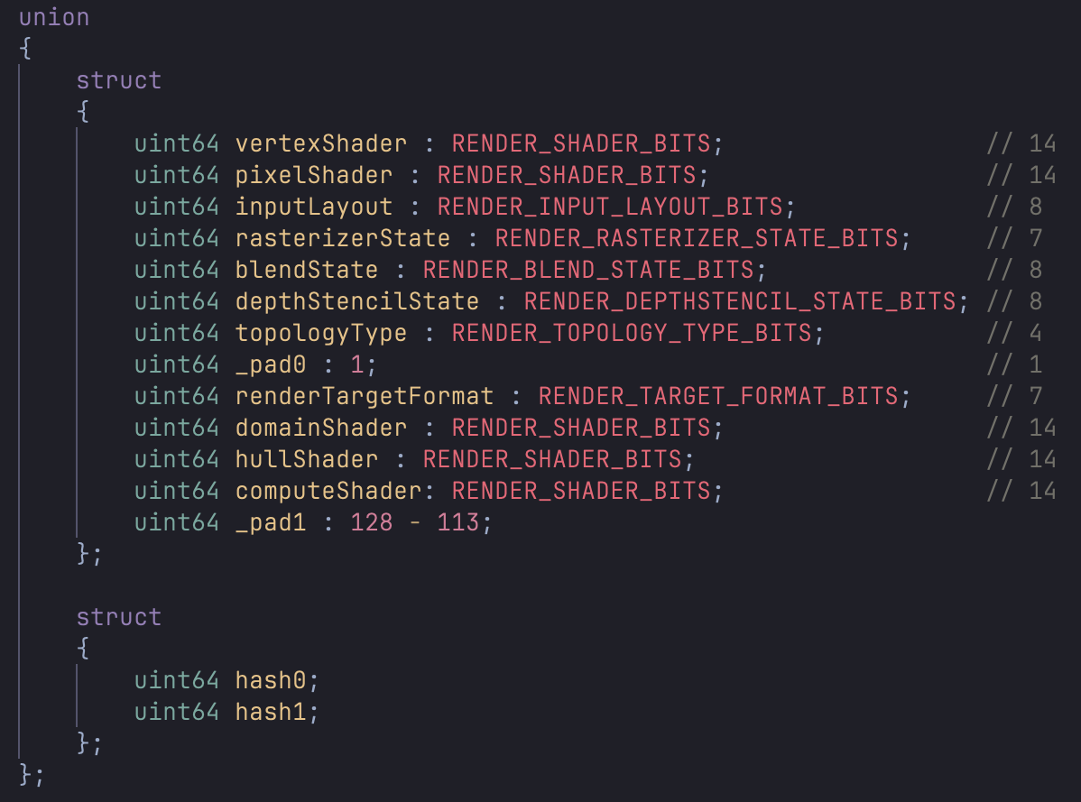
PSO Caching: Shader Prewarming
Gather PSO data during gameplay
Create helper state objects at engine startup
Create PSOs at level load time
Requires QA pass to gather all data
Notes:
For our shader prewarming system, during development, we gather pipeline metadata into a custom binary format.
Later, in release builds, the runtime parses the pipeline data and creates PSOs in 2 stages:
Stage 1: when the application launches, we create all intermediary state objects such as input layouts, raster states, etc.
These all get pooled and live for the entire app lifetime
Stage 2: happens during the level loading screen. Here we have a step that loads all shaders required by that particular level.
We parse through all the pipeline hashes that reference each shader and compile the associated PSOs.

Slide 39
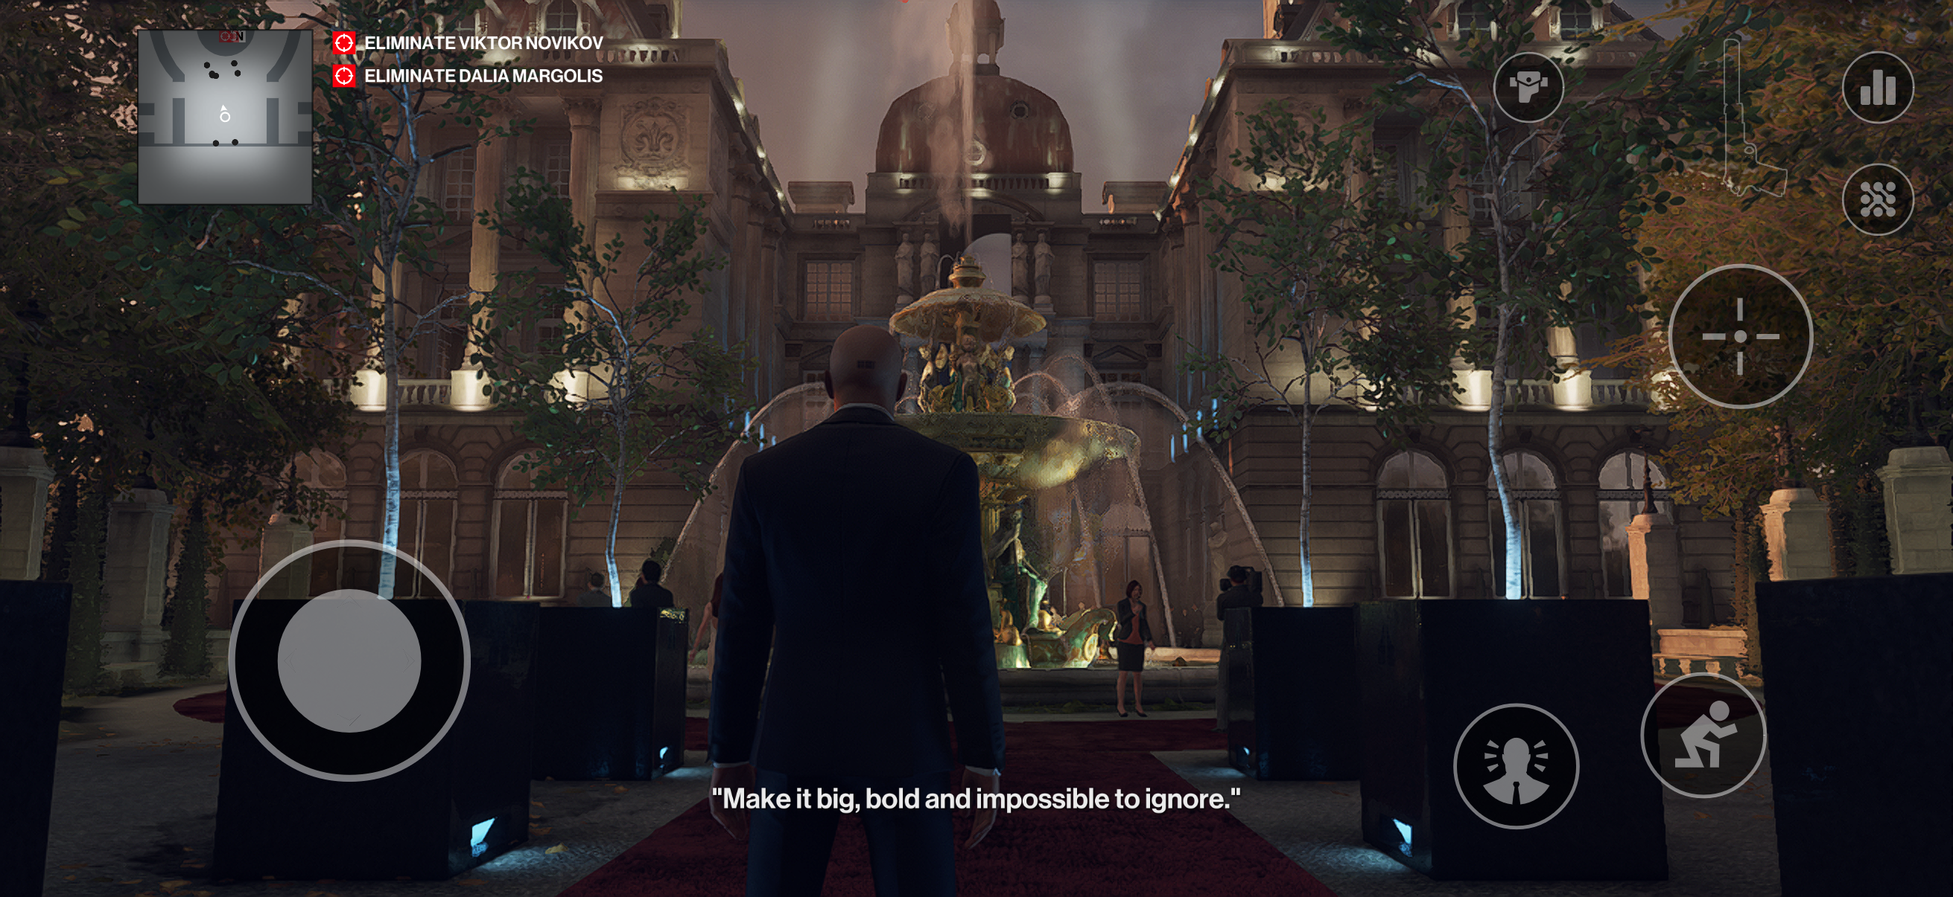
What Does It Look Like?

Slide 40
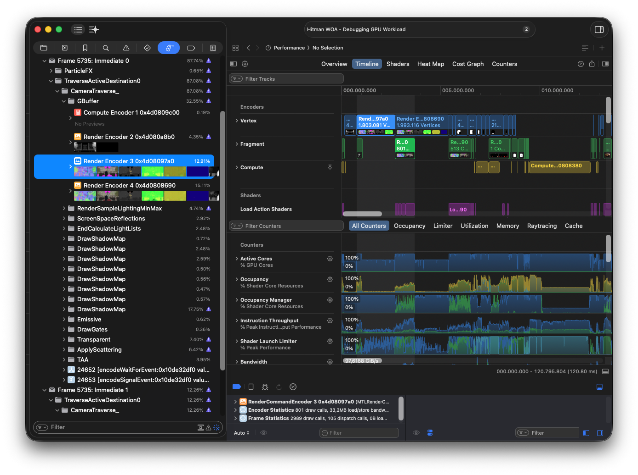
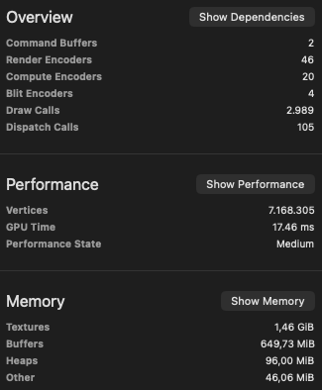

Slide 41
Rapid Fire
Aggressive downclocking
Hard to see performance improvements - device might decide to run at lower frequency
Makes dynamic resolution scaling hard to implement
CPU-GPU Load balancing - GPU saves can help CPU
Also makes performance improvements hard to see directly
Limit number of command buffers per frame
Dispatching each has a big overhead
Notes:
Mircea and Peter:
Quickfire section on small gotchas, TBDR optimizations, iOS specific optimizations

Slide 42
Rapid Fire
Use Instruments.app
Metal Frame Capture
Disables GPU downclock
Do not spin lock
Consumes battery
OS gives the thread more priority
Do not sleep
OS deprioritizes the thread, can result in ~10ms wake up delay
Rely on wake ups from other threads instead
Notes:
Mircea and Peter:
Quickfire section on small gotchas, TBDR optimizations, iOS specific optimizations

Slide 43
Rapid Fire
Clearing memory can be expensive
Prefer direct release over autorelease for Objective-C objects
Follow Cocoa memory management policy
System Clock Time
CLOCK_MONOTONIC queries time of day to increment while system sleeps
Fairly costly when used a lot
CLOCK_UPTIME_RAW does not
Notes:
Mircea and Peter:
Quickfire section on small gotchas, TBDR optimizations, iOS specific optimizations

Slide 44
Rapid Fire
Debug Groups / Signposts
MTLCommandBuffer and MTLCommandEncoder has push/popDebugGroup
But we don’t know where our passes will begin and end in the future
Ended up just putting first two levels of debug groups on the command buffer
Thin LTO / Compilation Time Comparison
Usually HITMAN compiles with unity builds, but we don’t have that working for Darwin toolchain
Thin LTO didn’t add too much extra time, and made a huge performance difference
Just add -flto=thin
Notes:
Mircea and Peter:
Quickfire section on small gotchas, TBDR optimizations, iOS specific optimizations

Slide 45
Conclusions
Shipped running at 30 FPS
iPhone 15 Pro and newer
Overall fun project to work on
A healthy dose of pain
Many interesting technical challenges
Learned a ton of things doing it ourselves
Notes:
Peter

Slide 46

Thank you!
Notes:
Peter

Slide 47

Q&A
Notes:
Peter

