Slide 1
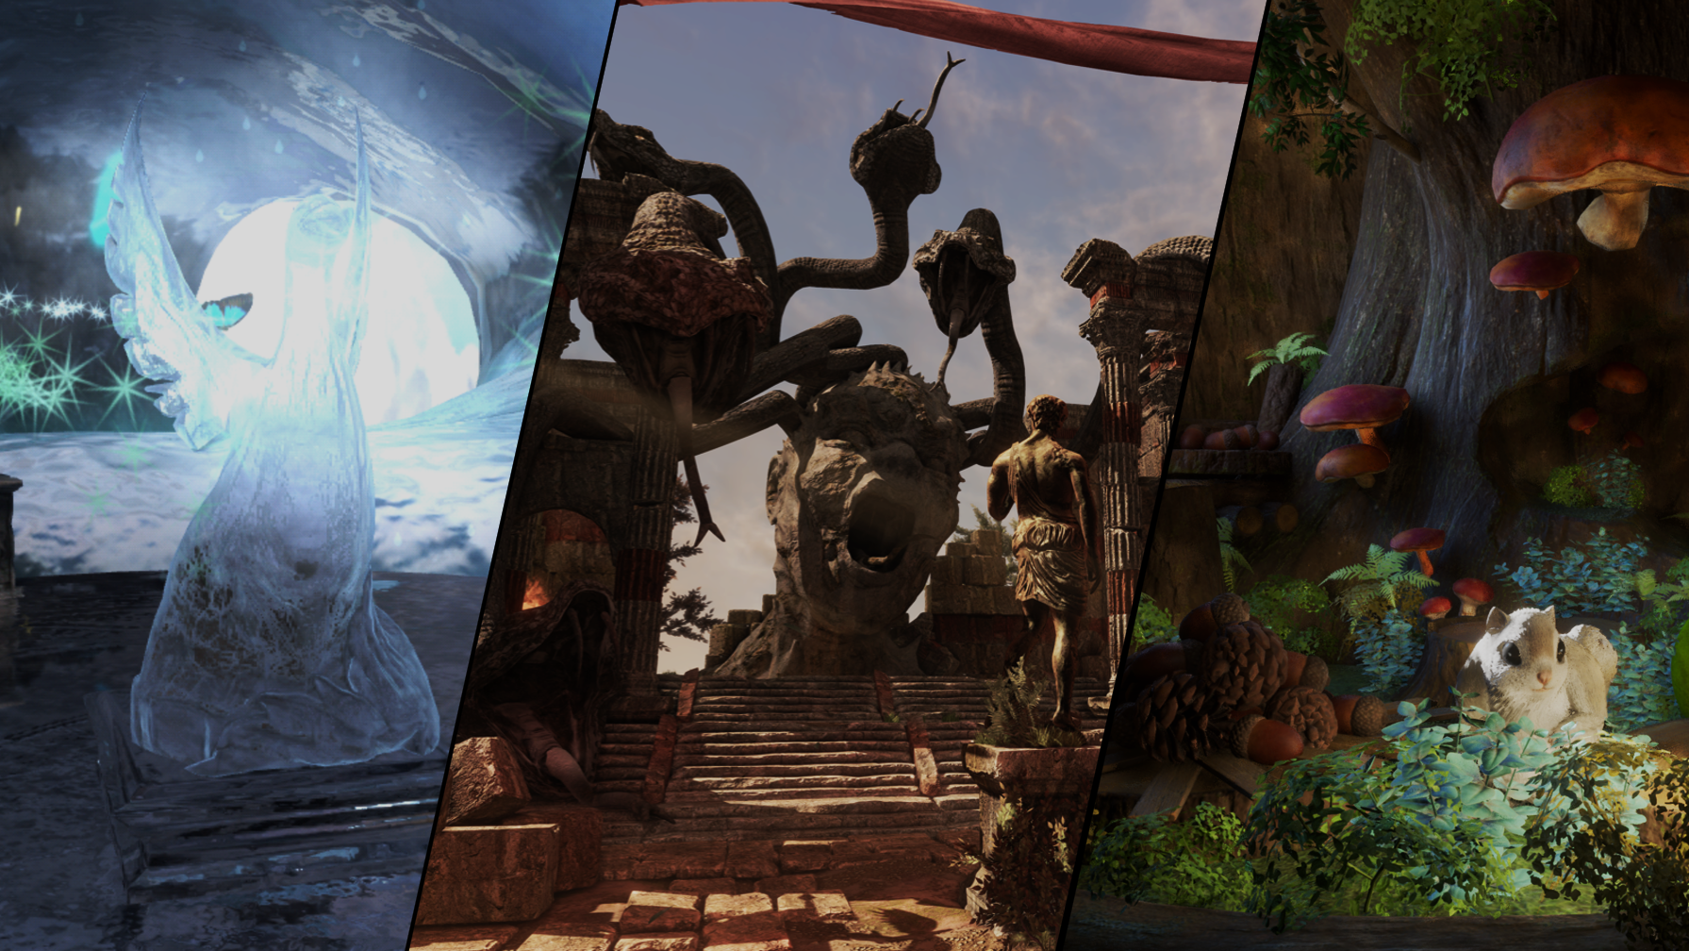


Eras in mobile graphics
Sam Martin

Slide 2
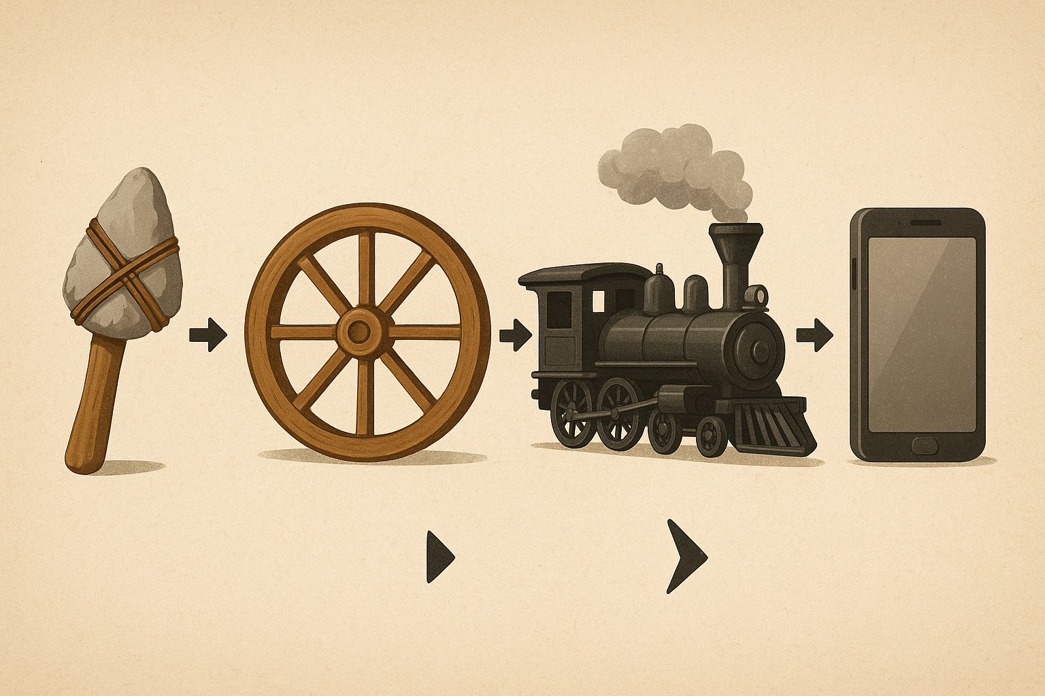
This talk
“Eras” as an excuse
  Range of topics
  Across a range of time
Not a super technical talk
Bold claims, a lot of squinting / extrapolating
Encourage thinking / talking / complaining
Kick off the conference!
ChatGPT made illustrations like this one
Notes:
“Eras” as an excuse
Range of topics
Across a range of time
Partly for fun, partly to see what lessons we can learn
Use this to observe what the new era we are entering will look like
Spoiler – this era will involve AI

Slide 3
Eras of …
API development
Rendering
AI
Notes:
Something historical
Something current
Something emerging

Slide 4

A bit about my background (so you know my biases)
Ex-Game developer (PC, PS2/3, Xbox360 era)
  Black & White 2
Ex-Geomerics
  Enlighten
12 years at Arm working on technology for mobile graphics
  On chip rendering techniques
  Various VR/AR technologies
  Future content trends and optimisations
  ~5 years now on neural graphics / ML
Biases:
I work on Arm’s Mali / Immortalis GPU line – focus on Android-Vulkan
I lead a GPU/ML technology project in Arm, bringing AI acceleration to GPUs
Notes:
Working in mobile graphics for 12 years at arm, and before that at Geomerics.
I used to make console and PC games, then went on to make games lighting technology, notably Enlighten. I’ve not actually made a mobile game as I was deep into the technology side by that point. I have however been involved in exploring most cool new technologies that came to mobile.
When I joined Arm they were in the process of transitioning to their first scalar architecture from a VLIW architecture. At that point, most content was a single renderpass and compute shaders were a new thing.

Slide 5


API development
Metal
(DX12)
Notes:
First lets start with eras of APIs

Slide 6
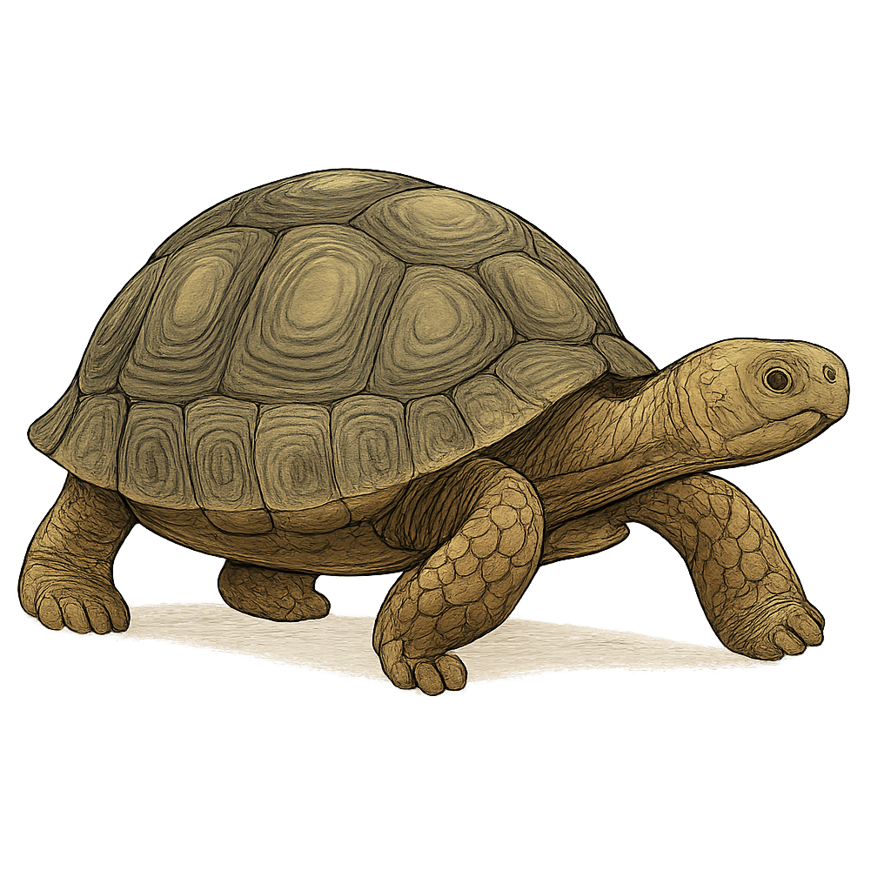
API development
Metal
(DX12)
Vulkan
Feb 2016
complexity
2018?
2022?
Bugs!
sufficient market share
various API reworks?
Notes:
Getting to “Vulkan by default” took a very very long time.
Vulkan launched Feb 2016, Metal 2014, DirectX12 2015
All required new HW
Remember - Vulkan “delivered”!
Low overhead, explicit control, predictable perf, matched to HW
But..
Bugs: initial HW being viable – maybe 2 year delay + reputation damage
Reaching sufficient market share – but that only excuses us for, say, another 4 years?
Takes us to 2022 – 3-4 years ago
Clear then that something had got a bit stuck
Descriptor model and sync all had heavy revisits – more reputation damage?
World of “device lost” pain
Complexity remains a major thorn in the side
LoC to first triangle is huge, gargantuan spec document, painful when things go wrong

Slide 7
Vulkan → Vulkan-next?
So why don’t we just fix it?
Clean it up?
Wrap it in something simpler?
WebGPU enters the chat
Vulkan is the C++ of graphics APIs
Notes:
Can we clean it up?
Very tempting but has to be via additions
Must accept as sunk everything pre-existing
Can we wrap it in something simpler?
Make simple things simple again!
Provide a simpler Vulkan-like layer on top of Vulkan?
Possible, but non-trivial investment and who would it target?
Maybe it’s already happened: WebGPU
A simpler modern API, building on and unifying existing APIs
F5 = compile + deploy, is a killer feature
Web technology isn’t really about web pages anymore
I’d observe that Vulkan is like the C++ of graphics. It’s a tool with which you can do whatever you need to, but not always without some manual pain, and has old features you want to steer away from that didn’t stand the test of time

Slide 8
That’s boring. What about the next technology frontier?
Ask yourself: What is important enough to warrant a tipping point in API design?
Full data driven API
Novel shading language
When are ready for more pain
A “Tooling first” API
Enable more offline verification – less bugs
Tooling to speed up validation - author, debug, visualise. E.g. gigi editor / visualiser
Better fit to modern patterns, e.g. render graphs
More fun!
SPIR-V was a great step forward for Vulkan – this doesn’t require an API change!
MLIR and compiler frameworks have come along way
But what should it be?
(Shout out to slang!)
E.g. as many issues as OpenGL had
Notes:
We cannot change what has already shipped, and WebGPU may address the need for a simpler API.
So what does that leave?
There is still a case for make bleeding edge development more efficient / effective
“make graphics easy again” – address an imbalance of effort to reward
Not simplification → streamlining, increasing utility/robustness
Possible visions:
A tooling-first API – a data-driven / IR-first / “No API” API
Enable verification - mechanical, offline functional verification of correctness. Do more offline, less runtime debugging
Speed up validation - tooling to author, debug, visualise data flows. E.g. gigi editor / visualiser
More natural fit to modern patterns, e.g. render graphs
Make graphics easier / more fun
Revisit how shaders are authored
Noodle-graphs have limits, text-based representations scale to greater complexity
Move to C++ or Rust?
Shout out to slang!
Challenges to consider:
GPU-driven – how on earth do we tool and debug that?
How to best harness AI

Slide 9

Eras of rendering
Notes:
Maybe we can learn some other lessons from the past though.

Slide 10
Everyone loves a renderpass!
Era of single renderpasses
Cost of multi-pass too high
Era of multi-pass content
Bandwidth costs more affordable
Compute increasing but some hesitancy
OpenGL ES 2 home turf
Deferred, post effects, etc.
Geometry increasing
Motivated “on-chip” rendering developments – mixed results
Renderpasses aren’t as expensive as they were
Mobile GPUs remain (mostly) tilers, so the concept still matters
Notes:
First, there was an era of (mostly) single forward+msaa renderpass content
OpenGL ES 2 home turf – although renderpasses not actually visible in the API!
Cost of moving to multiple passes (e.g. deferred) was non-trivial and became a barrier
Motivated “on-chip” technology developments – with mixed results
Then, we move to an era of multi-pass content
Bandwidth costs now more affordable – deferred rendering, post effects, etc. now common
Also seeing increasing geometry costs
Significant hesitancy to adopt actual compute shaders due to associated HW costs (and lack of need?)
Still a huge amount of fragment-based content today
Renderpasses exist because they remain an important concept for tilers, but they aren’t as super expensive as they used to be.

Slide 11
The big beautiful vision that was on-chip rendering
An exciting looking opportunity!
Cross vendor support?
Vulkan subpasses
Long term, viable cross vendor support matters
Having the correct timeline matters
Getting things wrong is bad
Notes:
There’s perhaps some lessons to learn from the era of “on chip rendering”.
At the start I was working on Enlighten, which we had running on mobile. Dynamic lighting was a major cost. Not much point having dynamic radiosity if you can’t render the direct lights! BW of deferred was a huge problem – 4-6 GB/s. Each GB/s was ~100mW. We started speaking to HW vendors about this. I’m not sure where exactly the idea came from, but there was something of a collective recognition that the tilebuffer in mobile GPUs could offer per-pixel read-write access (not just write access). That’s a big deal for lighting because it allows you to render your gbuffers, then render your light geometry and read back depth normal to compute lighting, all in a single pass. It can be a significant bandwidth win.
Arm were pioneers of this and there were several rounds of experimentation and API designs. Pixel local storage emerged for GLES but adoption was limited by cross vendor support. We learned late that others couldn’t support it. In hindsight it would have been better to deliver less but deliver it more broadly (e.g. framebuffer fetch), but we didn’t know this at the time.
Vulkan then came into being and with it came subpasses - undoubtedly the wrong API, which emerged from the frantic all-hands-on-deck exercise of shipping Vulkan 1.0. There was just insufficient time to get the right API.
By now, we had been working on this a long time. We were further from the original more explicit ideas in the early APIs, but also weren’t as minimal and cross-vendor as frame buffer fetch. We had to introduce a “did it merge?” API to provide feedback to developers. Significant parts of the API were of no use to any vendor, and subpasses a cost to all developers.
Sadly, this kind of sealed the fate of on-chip rendering in Vulkan, in my eyes at least, although things have since improved with dynamic rendering local read and Apple have tile shaders. There is still value in these techniques. AR/VR devices stand out as an interesting example. But for wider mobile gaming it is a technology who’s moment of peak impact has passed. We will shortly see devices with peak 100+ GB/s, and we are looking instead at different ways to do dynamic lighting.
I learned a lot from this experience. It taught me a lot about the vital importance of building and getting cross industry consensus for technology. Longer term this is essential for a technology to succeed. The role API design has in that is huge. It also taught me a lot about the timeline involved, and the costs of getting things wrong.

Slide 12
Future of tiling?
Subpasses have been killed, renderpasses live on
Moar meshes! → moar tris! → moar tris/pixel! → bad news for tilers?
Should tile-based rendering also die?
No
  Not yet justified
  Important to scale down
  Tiling has also adapted
More importantly, there are bigger shifts on the horizon
Notes:
Subpasses were then killed off. But geometry continues to increase. Should we kill off tilers as well?
No!

Slide 13

Maybe rasterising triangles will die?
Ray tracing?
SW rasterization?
Gaussian splats?

Slide 14
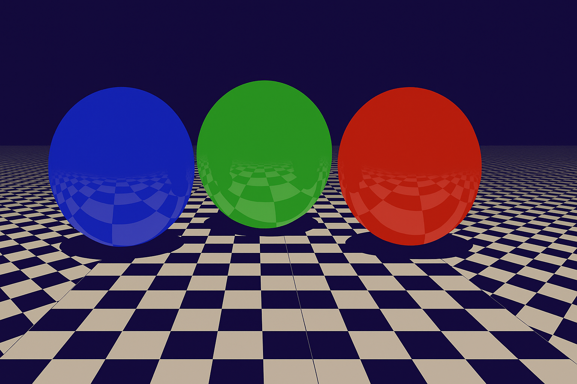
ray tracing
Notes:
The everlasting joke about ray tracing is that it was always 5-10 years away, and then when you got 5-10 years into the future, you found it was still 5-10 years away.
Well, now the HW exists.
Adoption isn’t quite here though. It’s growing bit by bit each year, a bit like Vulkan’s long dark night of semi-adoption. But it is growing, and people are exploring.
The light is close to the end of the tunnel, and we think we can see the inflection points for it.

Slide 15
First – a side point about mobile vs desktop
Strong forces exist pushing mobile to adopt desktop/console functionality as soon as it emerges
Matching technology is not necessary the wrong thing to do
Ray tracing is not poorly shaped for mobile (ie. tilers)
Notes:
Strong forces exist pushing mobile to adopt desktop/console functionality as soon as it emerges
(The reverse doesn’t happen so regularly)
Sometimes this pushes technology onto mobile even if the tech is not entirely ready or suitable
E.g. geometry shaders, tessellation, etc.
If we really want them to run well on mobile, they should be re-designed (not going to happen!)
Matching technology is not necessary the wrong thing to do – genuinely useful to many people to have a common technology platform between desktop and mobile.
Code “just works”, optimisation a secondary problem
Underlines the importance of introducing technology and APIs that work across both though
But ray tracing is not poorly shaped for mobile
Yes, it’s expensive. Yes, it’s expensive in terms of bandwidth
It’s not inherently inefficient or inappropriate for mobile though (unlike, say tessellation)
Modern mobile HW is actually really good at ray tracing and can/will get better

Slide 16
Bold Prediction #1
Desktop/console will start, or seriously consider, going all-in on RT around, say, 2028 or so.
Corollary: If it becomes a thing on desktop/console,
it will simultaneously become a thing on mobile.
(then a question of whether it’s a good idea to use it or not, and in what context)
Notes:
Desktop/console will start, or seriously consider, going all-in on RT around, say, 2028 or so
Plausible timeline for new consoles
Pain in the arse doing a bit of both. API friction, double data, etc. HW becoming more capable.
At some point, it’s just worth RT’ing everything and having one set of problems rather than two.
Finally get away from the limitations of rasterization
(I was unaware of it at the time I gave this talk but subsequently discovered that Mark Cerny of Sony has spoken publicly about their investment in RT and AI for PS6 a “couple of years” away.)

Slide 17
Bold Prediction #2
Ray tracing is most useful when it entirely replaces something,
such as primary visibility or lighting
  (Until then, it’ll see some but limited uptake)
These will be denoising / reconstruction problems
more than they are ray tracing problems
Notes:
Ray tracing is useful when it entirely replaces something, such as primary visibility or lighting
Until then, it’ll see some but limited uptake
Important problems will be denoising problems more than they are tracing problem
Tracing 1-2 rays / pixel for lighting is becoming affordable on top end devices
Tracing tens of thousands of rays for some indirect probes / etc – should be fine
Denoising is the challenge
SVGF-based solutions are expensive
Quality isn’t that great either

Slide 18
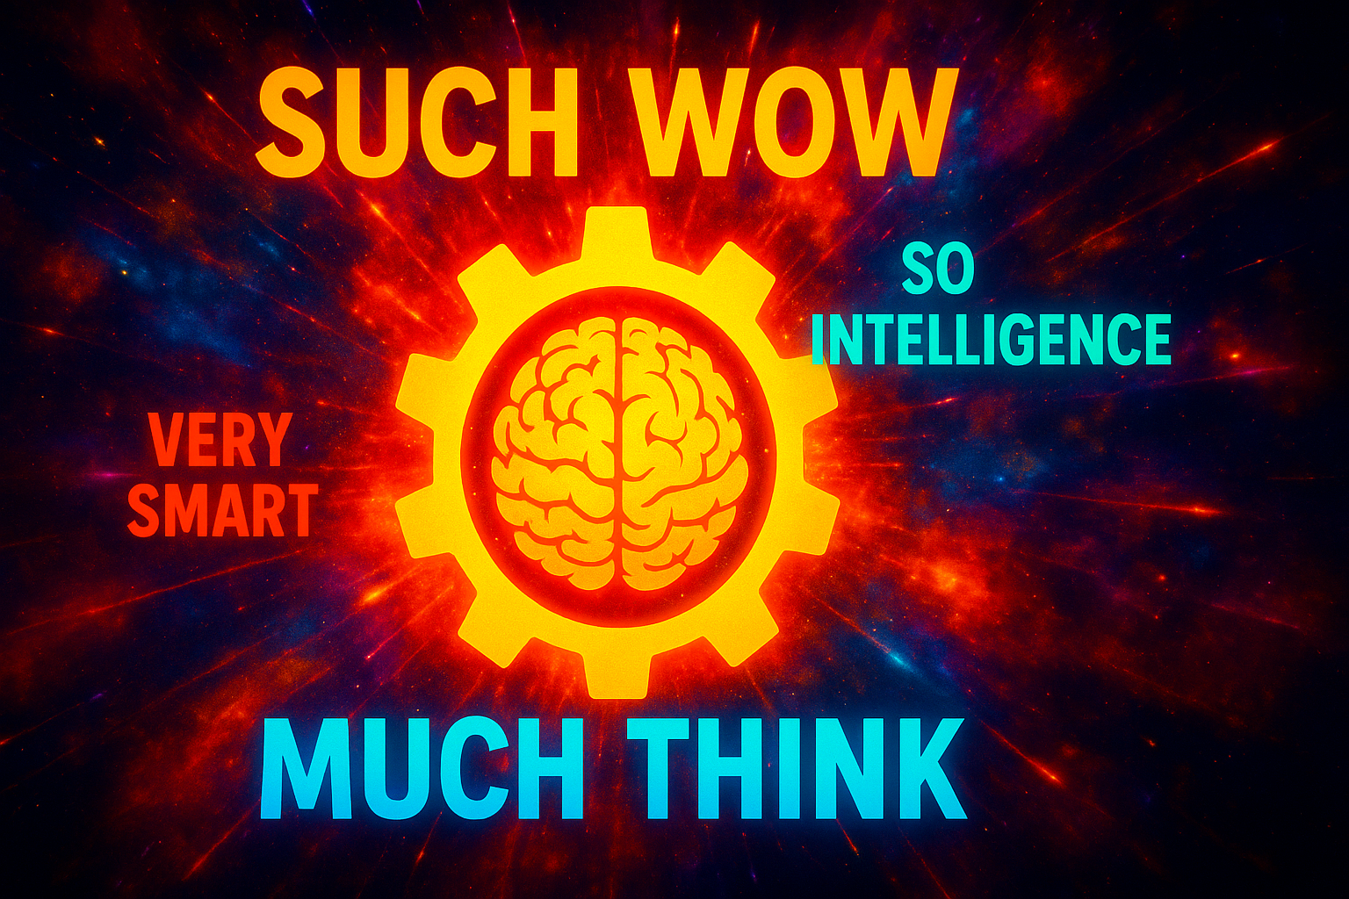
Era of AI
Notes:
And that brings us neatly to…

Slide 19
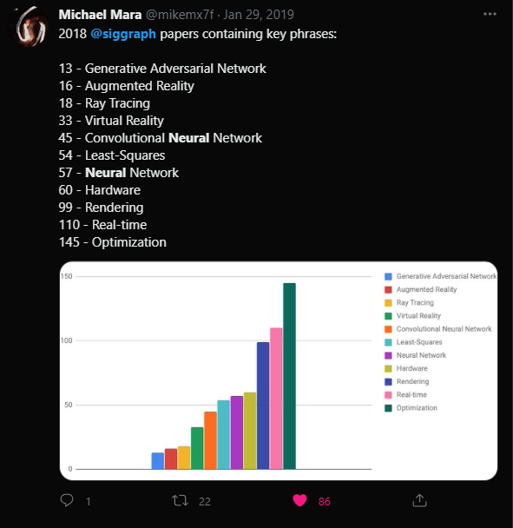
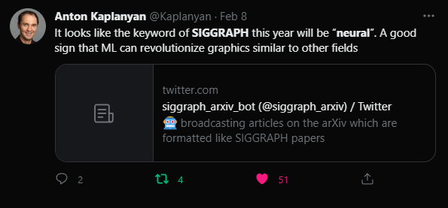
Neural Graphics at SIGGRAPH in Keywords
2022
2018
Notes:
AI / ML / neural graphics is not a small thing.
Obviously I would say that – I lead a project doing exactly this. But I it’s objectively clear that AI is having a major impact on graphics and has been for many years.
This is a moment where new technology up-ends everything we are used to, bringing disruption and opportunity.

Slide 20

What are GPUs for anyway?
They draw the pictures!
They are the coolest accelerator!
…
They are the ubiquitous deferred bulk compute accelerator
AI will shape GPUs
What can AI do for graphics?
try not to
fear this
dude
Notes:
Unless you are on console, GPUs in most consumer devices are not only for graphics.
In fact, the priority for many GPU vendors is not always graphics.
They have to do the graphics.
But they are also the best means of accelerating many workloads.
They are a ubiquitous accelerator. Sure you can do better if you target something per device, but if you want to write and release code that runs everywhere, and it needs to run faster than the CPU, then it runs on the GPU.
It’s worth noting this because the world of AI is much bigger than graphics.
There are more people working on, it has more investment.
It will shape the future of GPUs.
And we should be looking to what the world of AI can offer to graphics.
Let’s start with what AI can do for graphics.

Slide 21

Ghosting…
Notes:
I imagine this kind of image will be familiar to lots of you.
It’s what happens if your heuristics on when to reusing your history buffer get a bit over eager.

Slide 22
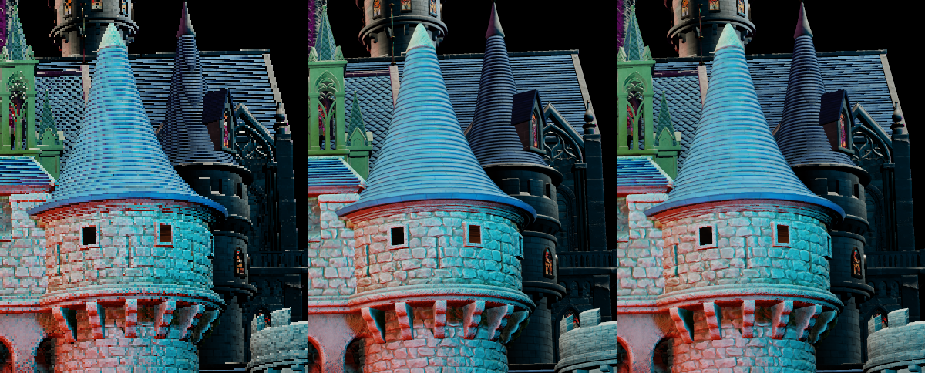
Rectification Bias
Low Resolution Input
History
Rectification Bias
Notes:
But if you reset the history too aggressively, you can induce bias towards the current sample, re-introducing aliasing (see the roof on the right)
This can be seen when applying an AABB clamp on a nicely accumulated history, with a very aliased input, aliasing returns to the output frame.

Slide 23
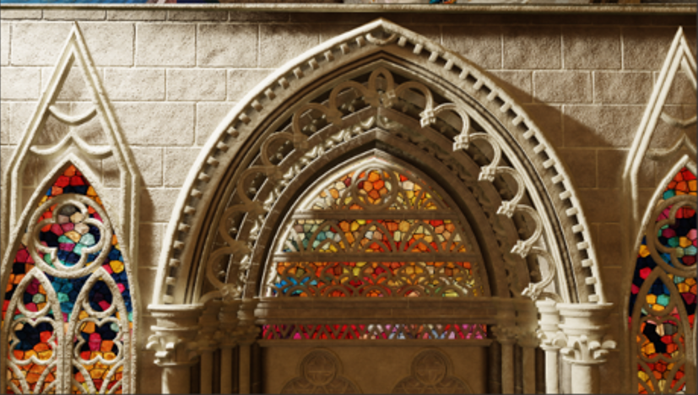

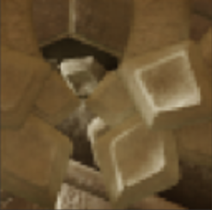

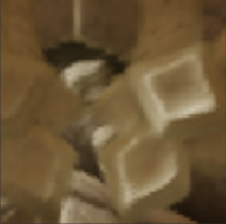
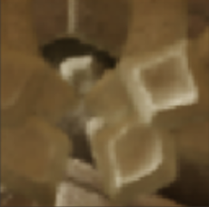




~50% uplift
Neural techniques
Enchanted Castle
Ground Truth
ASR
DLSS2
NSS
Upscaled from ¼ of the pixels
Notes:
This kind of heuristic-based reconstruction is an area where ML really excels
NSS-like algorithms are going to have a huge impact. These kind of performance uplifts are just not on the cards from any other HW technology in the foreseeable future.

Slide 24
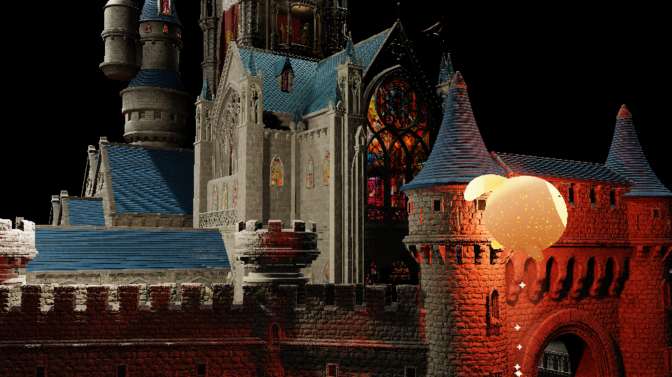
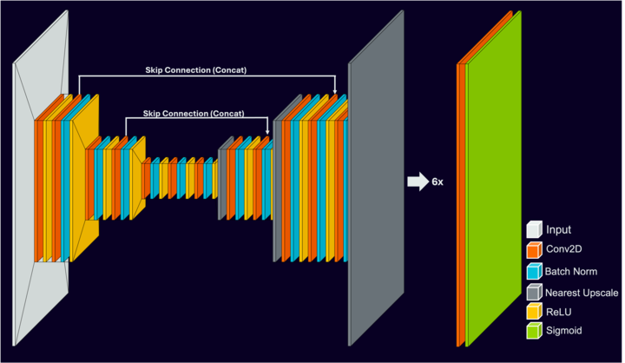


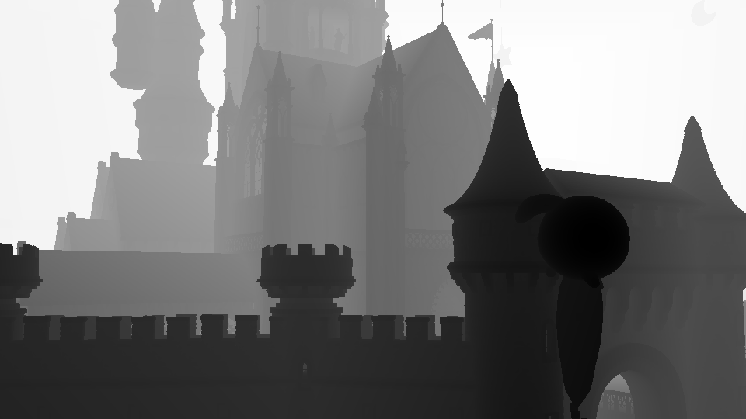
Disruption of Real Time Graphics – The Conservative View
  Neural Super Sampling and related neural graphics techniques will transform graphics efficiency
  ML processing of “full scale” images will become a major feature of most, if not all, image processing applications
NSS Model Architecture
~ 150K INT8
Low-Res Jittered
Color
Pre Process
Post Process
Low-Res Motion
Neural Network
Anti-Aliased &
Upsampled Output
Low-Res Depth,
T + T-1
History Buffer
Notes:
A lot of the discussion around ML is on the impact of it in non-realtime settings. But what about ML in real time graphics – aka “neural graphics”?
Lets look at this by bounding the future between a conservative and bold view.
We can be certain about the conservative lower bound. We can see this happening today in technologies like NVIDIA’s DLSS. This alone is transformative for real time graphics and GPUs as we know them and demands changes.

Slide 25
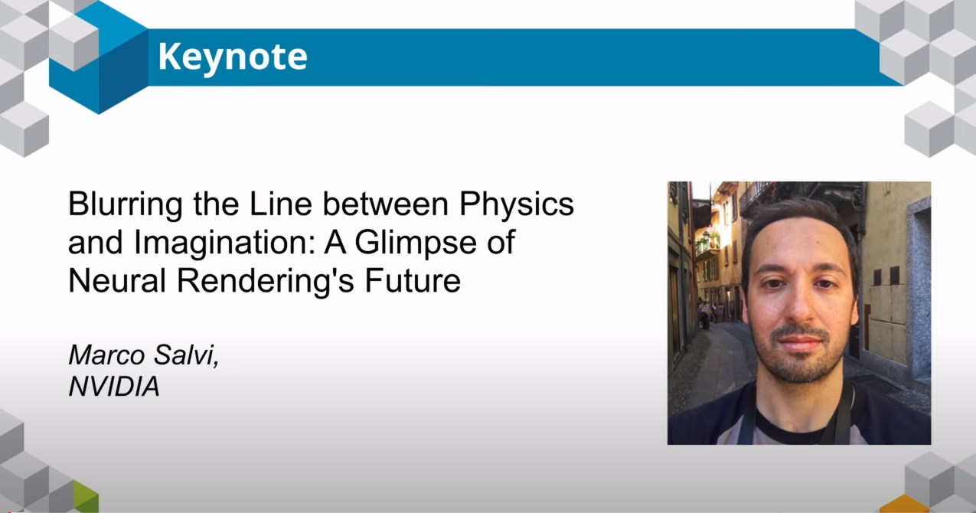
Disruption of Real Time Graphics – The Bold View
  Significant aspects of rendering will be entirely displaced by ML alternatives (e.g. triangles?)
  ML processing will be the technology that enables entirely novel applications
I3D 2023 keynote talk by Marco Salvi
Notes:
But the bold vision is alive and well at places like SIGGRAPH which is comfortable looking further out.
Here we can think about what else we are likely to see change. Will whole parts of the graphics pipeline see change or displacement due to ML, as Marco Salvi suggested a few years ago?
In graphics more generally, it’s perhaps not so bold to suggest that ML will be the technology underpinning future applications

Slide 26



(a minor digression)
Add noise!
Blur!
Sharpen!
(but don’t go too overboard)
Notes:
But first a bit of a side quest.
A good number of years ago, I think Alex Evans noted (maybe in a SIGGRAPH talk?) that making things look good was often largely down to “adding noise and blur”. This stuck with me. Years on I’d suggest one tweak: Adding noise, blurring and then sharpening, is the fundamental chain that makes things look good.
I know it’s tempting to go overboard with the sharpening / enhancement stage, but try not too ☺
So stacks of noise-blur-sharpen has a remarkable tendency to good to our eyes.
Why?

Slide 27




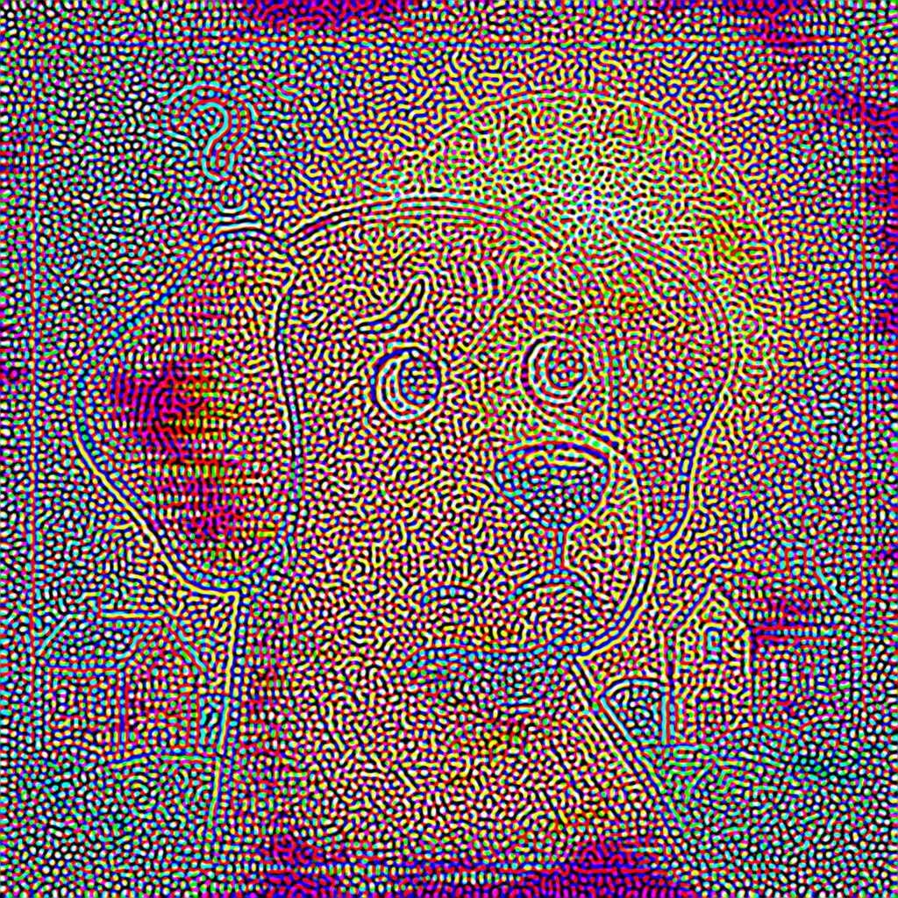
A “Turing pattern”
(vibe coding ftw)
Notes:
I don’t know but I might offer a wild hypothesis:
What happens if we repeatedly blur and sharpen an image?
Turns out we get a pattern Alan Turing first noticed, so they are known as Turing patterns.
Turing patterns are observable in biological processes, which turns out to be how Turing found them.
Biology seems to like filtering of random, diffused processes and it’s something we therefore unwittingly observe all the time.
So maybe that’s the reason!
Anyway, blur+noise+sharpen is still a thing today, but now we also have “stochastic everything + reconstruct”. That’s what underpins NSS and it so happens that this is an area where ML really excels

Slide 28
NSS Key Facts!
Network needs to be at least 10 GOPs / inference
Any viable solution will need run in <4ms for a 60Hz application – maximum!
NSS is equal parts compute/ML, so looking for 10 GOPs in <1/2 the 4ms max
Sustainable GPU power is around 1W in a mobile phone
→ 10 GOPs in 1-2ms sustainably → 10 TOPs/W @ 1W, high utilisation
This requires an NPU-class accelerator for mobile
Notes:
So what do we need to build ourselves an NSS?
Now we know it’s possible, so here’s the key figures that come out of our NSS work (all published)
Our work showed that to get good results you need a network with at least 10 GOPs/inference (quantized int8). With ML, bigger is better, so this is the baseline.
We can also observe that if we are looking to see more than a 25% FPS uplift in a 60Hz app, then we cannot take longer than 4ms.
Why 4ms? Because if you get a 2x speed up on a 14ms frame with a 4ms solution you are ~25% up (11 vs 14 ms). Anything slower than that and it’s probably not worth it
Our network is also roughly half-and-half compute shaders and ML network, so we get a target of 10 GOPs in 1-2ms
To do this in a sustainable 1W mobile budget, you therefore need good utilization on a 10 TOPs/W accelerator.
In essence, this means we need an NPU-class accelerator in mobile.

Slide 29
Different accelerator options
Most SoCs today.
Separate NPU and GPU
NPU here is not much use for graphics
NPU
GPU
Notes:
So what are the different options for doing that?
Well, there’s what we have today, which is separate NPUs and GPUs. These separate NPUs are not much use for graphics – they have different APIs, the NPU doesn’t even have a public standard API, they are largely intended for system use. It’s just not set up for this kind of use case.

Slide 30
Different accelerator options
NPU
GPU offload to the NPU
GPU
NPU now accessible
Some tensions here with NPU design
Offload not free, may not be practical
Notes:
We could try joining these things up?
Apple shipped something like this recently in Metal 4
You can compile work for the NPU offline, package it up and then dispatch it from the GPU. No runtime API to change things – just bind and dispatch.
However, there is tension here. Apple have complete ownership of their stack, HW and SW. Other vendors will have more challenges. The offload and sync is not free so there is a minimum size offload. It also requires alignment over fiddly details like how to marshal data. In many cases, the NPU and GPU are written by different teams in different companies, or are working to different strategies.

Slide 31
Different accelerator options
NPU
Small-block matmul data paths
in every core
GPU
Notes:
Another option is to extend the existing GPU with a small block matmul data path.
This is what many vendors, particularly desktop vendors, are doing today. It’s a fine-grained accelerator that re-uses the most amount of existing HW but isn’t necessarily the most optimal accelerator architecture.

Slide 32
Different accelerator options
NPU
NPU-like accelerators in
some cores
GPU
Notes:
We could tweak it a bit though.
What if we add small NPU-like accelerators into some of the cores. This gives us better efficiency – it’s now a more coarse-grained “NPU-like” in capabilities and operation – and we can vary the amount needed independently from the number of GPU cores. In practice is a dispatch-sized rather than thread- or warp-sized accelerator which affects the programming model, but brings greater throughput and efficiency.
For full disclosure, this is what Arm is doing – it’s the neural technology we first announced at SIGGRAPH 2025.

Slide 33
Different accelerator options
NPU
Fewer larger
NPU-like accelerators as peers to the shader cores
GPU
Notes:
It’s not the only option though. We could instead make NPU-like cores as peers to the GPU cores.

Slide 34
A range of accelerators
Multiple options, different trade-offs
Matmul is not the solution for everyone, particularly not in mobile
Motivations
  AI improves with scale – need the ability to reach high perf/W points
  At least on mobile, maximising performance is a battle with 1) memory bandwidth, 2) power 3) area
NPU-like architectures are strong on these point
Some converge between these architectures seem inevitable
We will need API(s) that span a range of options
NPU tech is coming to GPUs…
…and GPU tech is evolving to be more like NPUs
Notes:
The important takeaway is there is not one way to do things.
ML is “everywhere” and the “matmul” style extensions to GPUs we not the only options we will see in practice.
The motivation is largely peak throughput and power efficiency
Power and bandwidth are the main limiting factors.
NPU architectures are a lot more efficient in both respects
Particularly in terms of increasing the potential macs/byte
NPU technology is coming to mobile
But also, we can observe that in the search for greater efficiency, GPUs are also evolving to be more like NPUs
We will need API options that span the range – possibly more than one option

Slide 35
Cooperative matrix
My position: This is not yet a suitable API for the future
Strong points
  Better than baseline performance
  Available everywhere – obvious target for WebGPU
But
  Too explicit – won’t cover NPU-like approaches
  Will fail to scale up without further changes
We need a runs-everywhere API
There may be more than one API for AI on GPUs
Notes:
Looking at a couple of API options, an obvious one to look at is coop matrix.
Its strength lies in the fact it can be supported everywhere and will deliver better-than-baseline performance fairly reliably.
However, it is also unnecessarily explicit about how calculations are done in a way that would like it from scaling up or covering other HW.
Getting better macs/byte depends upon sharing data. If you are too explicit about how much sharing is allowed, or what other data movement tricks you might want to pull, then the API will become the barrier to better perf.
We need some evolution of coop matrix that is more forward looking but has the same runs-everywhere property.

Slide 36
data_graph and SPIR-V TOSA
Dispatch-level granularity – natural choice for NPU-like approaches
“Like a compute shader” for compile-dispatch-sync, using common resource types
Builds around an IR (SPIR-V TOSA), rather than C-API
A deployment path from pytorch!
Very important to align with, and leverage from, AI developments beyond graphics
Notes:
Another option is the proposal Arm has been pushing.
This is a dispatch-level API but designed to work exactly like a compute dispatch. It provides the necessary freedom to the implementation to scale up the computation and focuses programmability on an IR rather than a C or shader API. The move to IR-based APIs is an important one.
One thing that unlocks is a deployment path from pytorch. This is critical: There is a lot of effort going on around AI and infrastructure for designing/training/deploying networks. The graphics community should be tapping into this, and a key way of doing so is to build on top of the MLIR ecosystem. Extending SPIR-V is a natural choice for doing that in Vulkan.
A fast deployment path is key to iteration, and fast iteration is key to success in basically all aspects of engineering.

Slide 37
What else could we have discussed?
What other neural graphics use cases are viable?
Neural shading / coop_vector
Gaussian splats / alternative scene representations
AI’s impact on the way we create / implement / debug graphics
I look forward to hearing your thoughts throughout the rest of the conference!

Slide 38
Thanks! Q&A?
Thanks for the reviews / suggestions
Their views may differ from those expressed in this presentation
Things we touched on
Jasper Bekker
Matthaus Chajdas
Jan-Harald Fredriksen
Liam O’Neil
Lessons learned from the evolution, and landing of, technology into graphics APIs
A future beyond triangles
The incoming impacts of AI on graphics, the importance of NPU-like designs and API challenges

