Slide 1
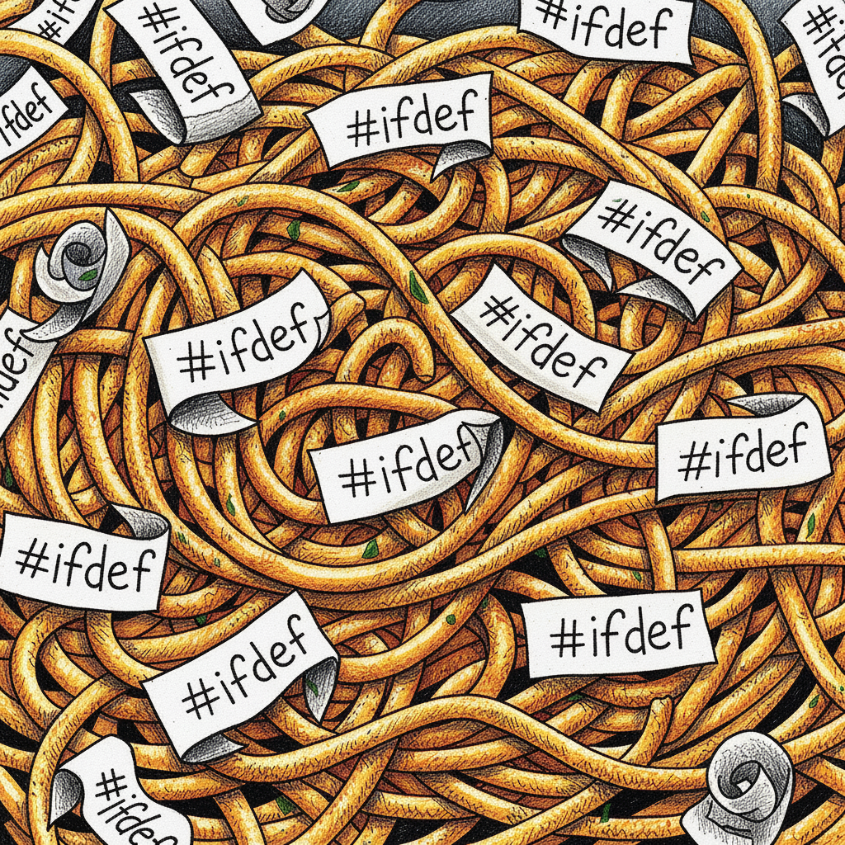
Writing Shaders Today: Complexity Abounds
Shader codebases have become incredibly large & complex
Developers need to deploy to many platforms
Shader combinatorial explosion
Fragile manual data binding models
New graphics techniques & neural graphics discontinuity
Notes:
Hi, I’m Shannon, and I’m the working group chair for the Slang shading language at Khronos. If you’re not familiar with Slang– you’re in the right room.
To set the stage, I’d like to briefly talk about the inspiration for Slang: the problems facing shader authors today. In modern engines, shader codebases have become incredibly large and complex, blending graphics, compute, and ray tracing, which makes them hard to maintain.
This scale is compounded by the 'combinatorial explosion' of all the shader permutations we use. When languages lack robust features for type-safe abstraction and modular composition, we're forced to manage every combination of materials, light types, and features using brittle macro permutation hell.
On top of that, we have to handle multi-API deployment. Every platform—be it DirectX, Vulkan, Metal, the web, or CUDA—has a completely different and incompatible API.
This multi-API problem is particularly painful when it comes to fragile, manual binding. Each platform demands a different binding model, forcing developers to manually track resource slots (t0, b1...) for every permutation on every API. This is a big source of silent, hard-to-debug runtime bugs.
Finally, the industry is facing new discontinuities. The emergence of new graphics techniques and neural graphics demands shaders that are highly adaptable and composable. This is especially true for applications like inverse rendering and differentiable programming, where we need to be able to easily write and maintain both forward and differential versions of our code. Traditional languages aren’t equipped to handle this future, and Slang was designed from the ground up to solve these specific challenges.

Slide 2






Slang: Open-Source and Cross-Platform
GLSL
HLSL
Slang
MSL
HLSL 2018
WGSL
GLSL
PyTorch
C (CPU)
CUDA
Optix
Notes:
So what is Slang? Briefly, Slang is a shading language and compiler that can take your code and target multiple graphics APIs and compute platforms. You write your shaders once in Slang, and the compiler can generate HLSL for DirectX, SPIR-V or GLSL for Vulkan, MSL for Metal, WGSL for WebGPU, CUDA if you’re doing compute with NVIDIA GPUs, and even CPU code. This means you can write graphics code once and deploy it everywhere. And for developers already working in GLSL or HLSL, Slang provides easy on-ramps to migrate existing code, so you don't have to start from scratch.

Slide 3
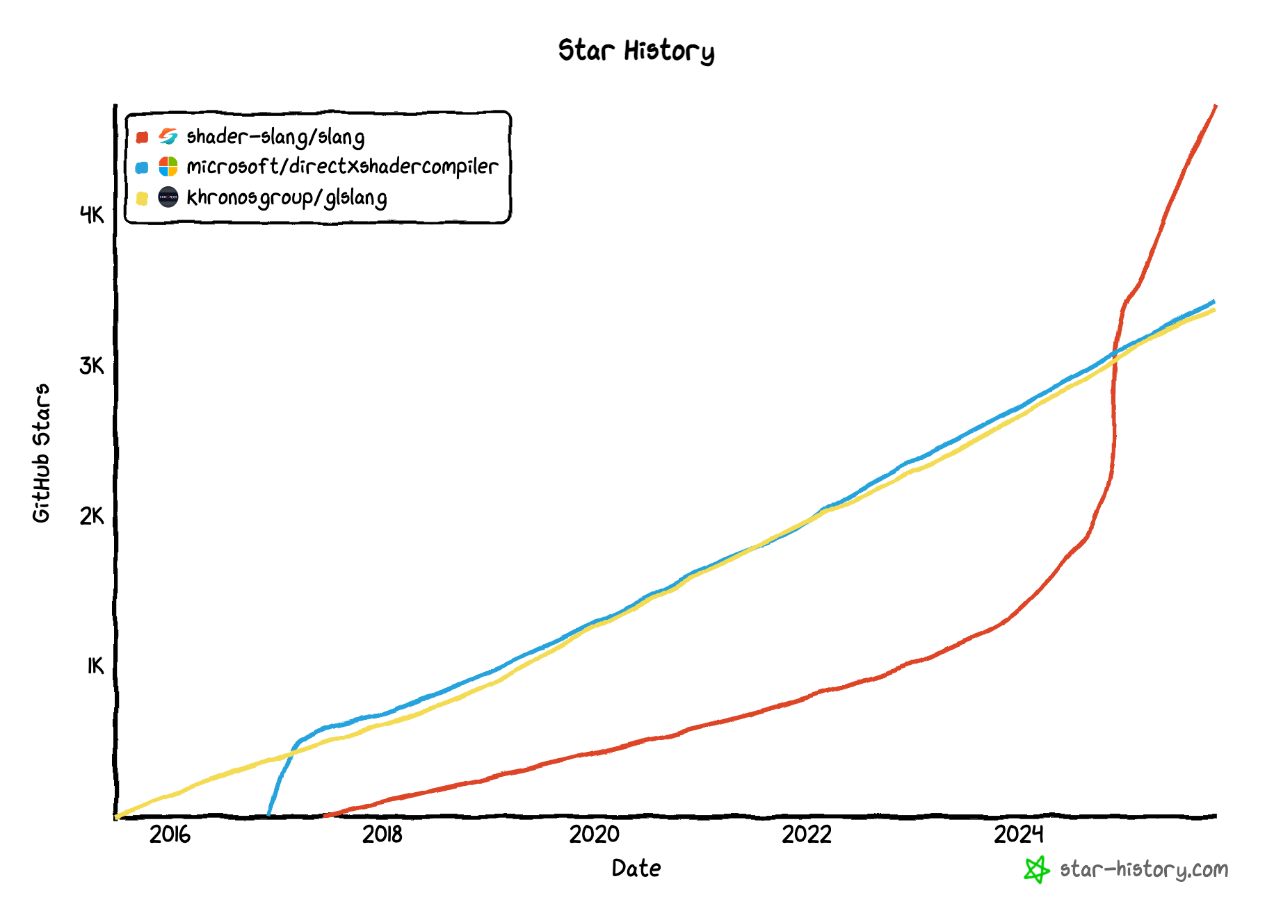

The Slang Developer Community
Developer interest continuing to grow!
4700+ GitHub Stars, >60 active contributors
>1000 Discord members, lively discussion threads
Join us on Discord!
Try it out on the web: https://try.shader-slang.org
See the documentation: https://docs.shader-slang.org
Notes:
What’s most exciting is that Slang’s community and governance are growing just as fast as its features. Slang is now an official project at Khronos, the standards body behind Vulkan and OpenGL. This gives the project multi-company governance while keeping all technical development 100% in the open.
And that open-source community is thriving. We've surged past 4,600 GitHub stars—surpassing our peers—and our Discord community is over 1000 developers strong.
That Discord is where the daily development happens. You can scan the QR code on this slide to join, get direct support from the Slang team and the community, and jump into our dev channels to discuss proposals or new features.
So it’s a truly community-driven project. While Slang started at NVIDIA, more than half of our 60+ contributors (and growing!) in the last six months came from outside NVIDIA, and their proposals are directly shaping the language roadmap.
We've made it just as easy to get started as it is to get involved. You can try Slang right now in our web playground and see your rendered results live. It even uses Slang's language server to give you full Intellisense-like support, right in your browser. Paired with our expanding documentation and tutorials, it's never been easier to start using Slang.

Slide 4
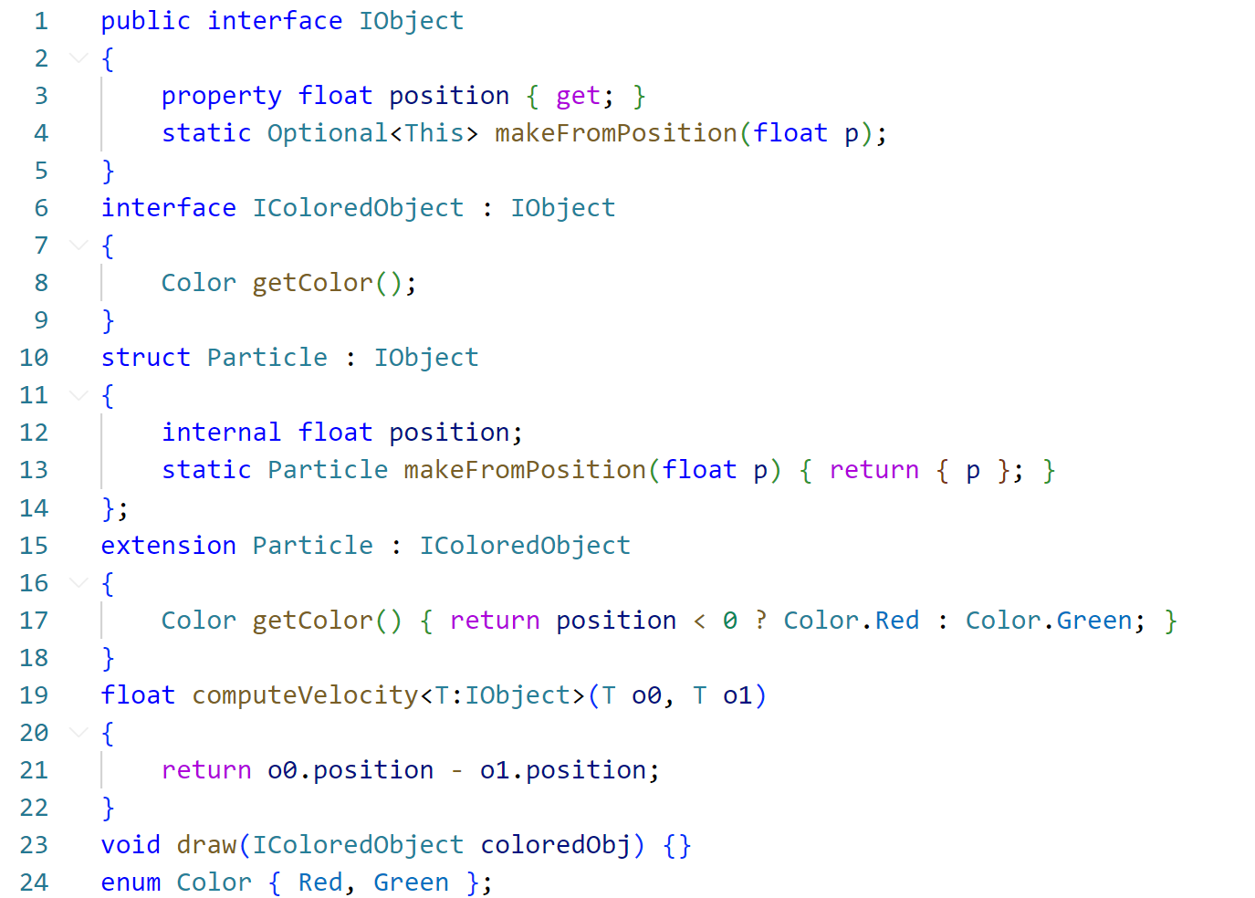
Modern Features for Modern Shaders
Interfaces
Property
Visibility
Optional<T>
Extensions
Generics
Notes:
Now, let’s take a look at the Slang language itself. To solve the massive complexity crisis facing shader authors today, you need a language that gives you the right tools. This slide is a snapshot of what 'Modern Features for Modern Shaders' actually looks like in practice.
You're seeing a lot of features here, and we'll dive into most of them in the next few slides, so don't worry about understanding every single one right now.
The important takeaway is why they exist. These features are the direct antidote to the problems we just discussed.
Instead of a brittle #ifdef hell, Slang gives you Interfaces and Generics to manage permutations and specialize code in a type-safe, composable way.
Instead of chaotic, globally-scoped code, you get Visibility modifiers and Extensions to build real modules, create clean APIs, and manage shared code safely.
And to handle the future—to build adaptable systems for new techniques—you get powerful abstractions like Properties and Optional<T>.
These aren't just features for features' sake. They are the essential building blocks for writing shader code that is scalable, maintainable, and correct in a complex, multi-platform world. Let's start by looking at a few of the most important ones.

Slide 5

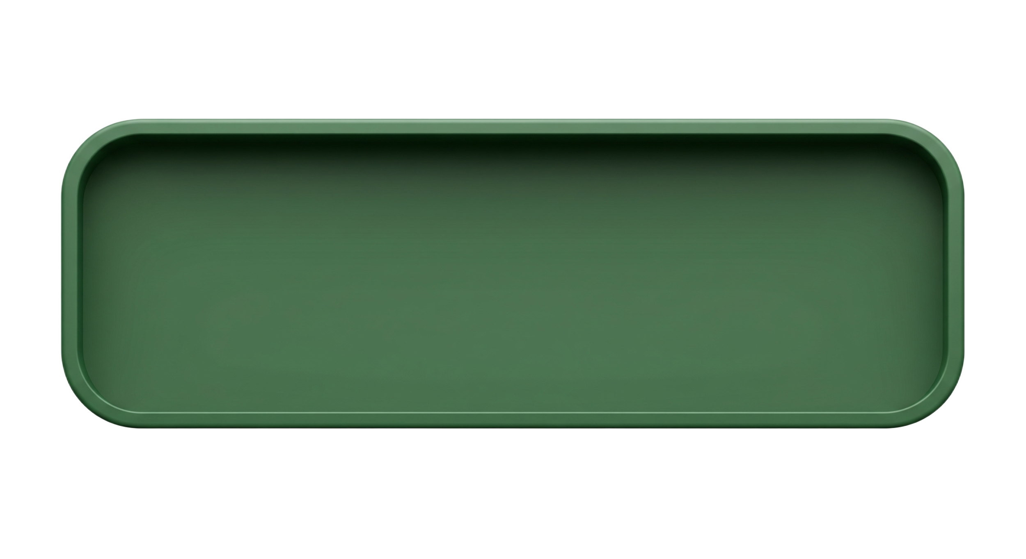

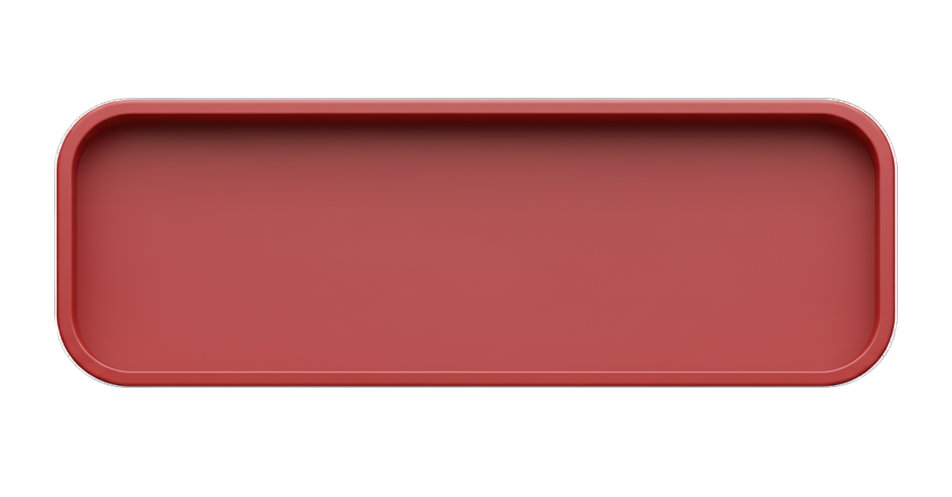

Modules
Material Properties
Camera Effects
Post-Processing
myShader.slang
Notes:
So the first tool in Slang’s toolbox to handle shader complexity is Modules.
When shaders were simple, a basic #include was fine. But that's just a 'cut-and-paste' system—like stapling together big chunks of redundant text. Today, our shaders are massive. And that 'cut-and-paste' preprocessor approach just doesn't scale. Change one file, and the entire collection has to be recompiled from scratch. Every single time.
Modern language design is solving this with first-class module systems, and Slang brings that same power to the shader world. Instead of 'cut-and-paste,' Slang compiles each module once, letting other shaders just link to them. This fixes that build-time nightmare. This approach gives you two big benefits: it helps you organize your code safely, and it streamlines compilation. Let’s take a look at how that works.

Slide 6
Modules: Organizing Your Code
// material.slang
module material;
public struct Material {
public float4 evalBRDF(float3)
{ /* ... */ }
internal float4 myPrivateMethod()
{ /* ... */ }
private float4 m_someVar;
}
Begin your module definition with module
Use public declarations to create types, methods, and functions visible to importing modules
internal declarations are only visible inside the current module.
If no visibility modifier is provided, all declarations default to internal
private declarations are only visible inside the current type
Notes:
When it comes to organizing your code, Slang gives you several powerful tools for managing complexity, and one of the most fundamental is visibility control.
This is how you create a clean, safe boundary between your internal implementation and the public API you expose to other modules.
[click]
First, you use the module keyword to begin the definition of a new module. This line establishes the module's name—in this case, material—and marks this file as its primary point of definition.
[click]
Next, you use the public keyword for declarations that you want to expose outside the module. These declarations are the only things that will be visible to other modules that import this one.
This is kind of like your module’s "official" API—the "contract" you're guaranteeing to the outside world.
[click]
Everything else is, by default, internal. Internal declarations are only visible inside the current module. You can be explicit with the internal keyword, but if you don't provide any modifier, it automatically defaults to internal.
The benefit of this is that it gives you a 'private' implementation space. You are now free to refactor, optimize, and change your internal helpers, and you can be confident you aren't going to break some other part of the codebase that’s relying on the existence of one of those random helpers.
[click]
And then finally we have the private keyword. This is an even smaller scope than internal – private declarations are visible only within that specific type, so other types within the module can’t access them – similar to private members and functions for Swift, C#, or C++.

Slide 7
Modules: Organizing Your Code
// material.slang
module material;
public struct Material {
public float4 evalBRDF(float3)
{ /* ... */ }
internal float4 myPrivateMethod()
{ /* ... */ }
}
// scene.slang
import material;
struct Scene {
StructuredBuffer<Material> materials;
void compute(float3 wi, float3 wo) {
float4 result =
materials[0].evalBRDF(wi, wo);
materials[0].myPrivateMethod();
}
}
Pull in modules with import
Visibility enforcement as you type
ERROR: ‘myPrivateMethod’ is not accessible from the current context
Notes:
So, how do we use the module we just defined? We use the import keyword. [Click] Here, in our scene.slang file, import material; makes all the public members of that module available.
It's important to note that Slang brings these symbols directly into the current scope—there's no automatic module namespace. This is similar to how Swift handles modules, as opposed to the namespacing you'd see in Python or Rust.
And this is where you see the benefit. When our Scene struct uses the public method evalBRDF, it works perfectly. But the instant we try to access myPrivateMethod... [click] we get a clear, immediate error, right in the editor: 'myPrivateMethod' is not accessible from the current context.' This is a huge win for productivity. The compiler and your IDE stop you as you type, enforcing that stable API and guaranteeing internal details stay internal. This is what makes a large codebase safe and maintainable.

Slide 8
Modules: Streamline Compilation
#include-style with HLSL, GLSL, MSL
mainShader1.hlsl
mainShader2.hlsl
lighting.hlsl
⚙️
RECOMPILING
⚙️
RECOMPILING
✏️
✏️
lighting.hlsl
lighting.hlsl
disneyBRDF.hlsl
disneyBRDF.hlsl
disneyBRDF.hlsl
surfaceIntegrator.hlsl
surfaceIntegrator.hlsl
surfaceIntegrator.hlsl
textureUtils.hlsl
textureUtils.hlsl
textureUtils.hlsl
woodMaterial.hlsl
woodMaterial.hlsl
plasticMaterial.hlsl
textureUtils.hlsl
textureUtils.hlsl
textureUtils.hlsl
stoneMaterial.hlsl
stoneMaterial.hlsl
plasterMaterial.hlsl
mainShader1.hlsl
Notes:
Now we've seen how modules help you organize your code. The second, equally critical benefit is how they streamline compilation. With the old 'cut-and-paste' #include model, every single shader file has to be flattened into one giant blob of text before the compiler can even look at it. So what does that mean for a complex production shader?
This stack of boxes you see here represents all the different files that get text-pasted together, just to build one single shader, mainShader1.hlsl. In this hypothetical shader system, we’ve got one file with all the code for gathering up the scene’s lighting, one that does the BRDF calculation itself, a surfaceIntegrator that handles putting it all together, and then a couple of specific material implementations– wood and stone in this case– and they each need to depend on some texture helper utils we’ve defined in yet another file. [click] That all ends up flattened out into one big monster shader file, like this.
Here's the nightmare: What happens if you make one tiny change to lighting.hlsl? [click]
Because it's just text-pasting, the compiler has no idea what changed. It only knows that the entire stack is now invalid[click], and it has to re-read, re-parse, and re-compile everything... just for mainShader1.hlsl.
Then, it has to do it all over again [three clicks] for mainShader2.hlsl, even though it shares 90% of the same code.
This is one manifestation of that combinatorial explosion we want to mitigate, and it's what kills build times.

Slide 9
Modules: Streamline Compilation
import-style with Slang
⚙️
⚙️
lighting.slang
surfaceIntegrator.slang
⚙️
⚙️
mainShader1.slang
disneyBRDF.slang
⚙️
woodMaterial.slang
⚙️
textureUtils.slang
⚙️
stoneMaterial.slang
Notes:
Slang, on the other hand, is intelligent about this when you use import. It understands this is a graph of dependencies, not a flat text file. When you ask Slang to load mainShader1.slang, it walks this graph and [click] compiles each module exactly once. And here's the first benefit [click]: when Slang sees that both woodMaterial and stoneMaterial import textureUtils, it doesn't need to do redundant work. It compiled textureUtils once, [click] and now both modules just link to that single, shared module. The redundancy is gone.

Slide 10
Modules: Streamline Compilation
import-style with Slang
✅
✅
lighting.slang
surfaceIntegrator.slang
✅
mainShader1.slang
disneyBRDF.slang
woodMaterial.slang
✅
textureUtils.slang
stoneMaterial.slang
plasticMaterial.slang
⚙️
plasterMaterial.slang
⚙️
mainShader2.slang
Notes:
Now, what happens when we load mainShader2.slang? [click] It needs 90% of the same modules. Slang sees that lighting, disneyBRDF, textureUtils... all of it... [click] is already compiled.It does zero redundant compilation. The only modules that need compiling are our new plastic and plaster materials, and those can also reuse textureUtils.

Slide 11
Modules: Streamline Compilation
import-style with Slang
⚙️
✏️
surfaceIntegrator.slang
lighting.slang
disneyBRDF.slang
mainShader1.slang
woodMaterial.slang
textureUtils.slang
stoneMaterial.slang
plasticMaterial.slang
plasterMaterial.slang
mainShader2.slang
Notes:
And finally, this is how we fix the nightmare scenario. [click] What happens if we change lighting.slang? [click] Slang recompiles one module. That's it. The modules that depend on it, like surfaceIntegrator, just need to be re-linked, not re-compiled.This is how Slang scales. It turns a change that used to re-compile your entire project into a tiny, incremental update.

Slide 12
Specialization with Interfaces & Generics
Interfaces
Define a contract for behavior
Swap implementations without macros or copy/paste
Enforce correctness at compile time
Generics
Reuse algorithms over a constraint
Specialize to concrete code per use
public interface IBrdf {
// Required method for evaluating the BRDF
float3 eval(float3 n, float3 v, float3 l, float3 a);
}
public struct Lambertian : IBrdf {
float3 eval(float3 n, float3 v, float3 l, float3 a) {
// ... (implementation details)
}
}
public float3 shade<T : IBrdf>(T b, float3 n, float3 v,
float3 l, float3 a) {
return b.eval(n, v, l, a);
}
float3 c1 = shade(Lambertian(), n, v, l, albedo);
float3 c2 = shade(GGX(), n, v, l, albedo);
Notes:
So, we saw how modules help us organize. But what’s at the root of our combinatorial explosion is the macro hell we use to manage shader permutations.
Slang's solution for this is Generics and Interfaces.
[Click] An Interface defines a contract. Here, the IBrdf interface requires any implementing type to have an eval method. Simple structs, [click] like Lambertian, can then promise to fulfill that contract.
This pairs perfectly with Generics, which let you write general algorithms. [Click] This shade function, for example, will work for any type T, as long as T implements our IBrdf interface.
The payoff is right here: [click] we can call the exact same shade function with a Lambertian struct or a GGX struct, and the compiler guarantees—at compile time—that it will work. When you build, Slang specializes that generic shade function into concrete, highly-optimized code for both the Lambertian and GGX versions.
Together, these features let you build a library of composable, type-safe components. And because the compiler checks these interface contracts up-front, you find errors immediately, as you type—not after a long build, or worse, only in a specific permutation you forgot to test. This is the modern, scalable alternative to managing permutations with #ifdefs.

Slide 13
Fine-Grained Module API Control
// material.slang
module material;
public interface IMaterial {
property float roughness { get; }
float4 evalBRDF(float3 n, float3 v, float3 l);
}
// A simple implementation of the interface
public struct SimpleMaterial : IMaterial {
public property float roughness { get { return 0.8; } }
public float4 evalBRDF(float3 n, float3 v, float3 l)
{ /* ... */ }
}
Properties
Typed, declarative knobs (instead of #define toggles)
Expose defaults – callers set them explicitly
Interfaces can make properties required
Notes:
So, Modules, Generics, and Interfaces are the foundational tools for solving these large-scale problems.
Now let's look at some the tools that sit on top of that foundation, giving you more fine-grained control over your module's API. I already mentioned Visibility, which allows us to prevent accidental coupling and provide clear API boundaries for our shaders.
But Slang gives you more than just that. The next one is Properties. A property is a clean way to access a value, using get and set blocks. This gives you a safe, explicit way to manage a value, rather than just using a public field. [click] And in an interface, this lets you require an implementer to provide that value. In our IMaterial interface here, we require a property for roughness. This is far safer than a global #define toggle. It's a typed, declarative 'knob' that is part of the module's official API, and the compiler can check it.

Slide 14
Fine-Grained Module API Control
// material.slang
module material;
public interface IMaterial {
property float roughness { get; }
float4 evalBRDF(float3 n, float3 v, float3 l);
}
Extensions
Add methods to existing types without editing original code
Great for optional features in separate packages
// In some other module…
import material;
extension IMaterial
{
public float3 calcRefract(float3 view, float3 normal)
{ /* ... */ }
}
Notes:
So, Properties let us safely manage our API's values. The next powerful tool, Extensions, lets us add new functionality to our types—even from outside their original module. Extensions are incredibly powerful for keeping modules clean, because they let you add new methods to an existing type without editing the original code.
[click] Here, we have a separate, optional module that import-s our material module.
[click] It then uses an extension to add a new calcRefract function directly onto the IMaterial interface. This new function is now available on any variable that implements IMaterial, as if it were part of the original. This new function will be visible an available to this module, or anything that imports the module.
This is fantastic for modularity. You can keep your core API small and clean, and let other, optional modules 'bolt on' new functionality as needed. Extensions don’t let you add new member variables– that would essentially be changing the underlying type. They merely let you extend functionality.

Slide 15
Presence Patterns
Optional<T>
Runtime presence/absence with explicit checks
Replaces sentinels/bitflags
import material;
float3 shadeObject(
MyObject obj,
Optional<IMaterial> overrideMaterial) {
IMaterial matToUse;
if (overrideMaterial.hasValue) {
matToUse = overrideMaterial.value;
}
else {
matToUse = obj.getDefaultMaterial();
}
return matToUse.evalBRDF(...);
}
Notes:
A huge source of complexity and bugs in shaders is managing optionality—things that may or may not be present. We've all used sentinels, bitflags, or even magic 'null' values to manage this. Slang provides a set of 'Presence Patterns' that formalize this in a much safer, more powerful way, and they operate at different stages.
The first is Optional<T>. This is for runtime presence. Instead of using a sentinel value, [click] you just wrap a type in Optional. The dedicated none value represents no value. This forces your code to explicitly [click] check for none—or check hasValue—before it can safely access the .value property. This eliminates 'forgot to check the bitflag' errors.

Slide 16
Presence Patterns
Conditional<T, bool flag>
Compile-time presence/absence; strips storage and code when false
public consts act as specialization params: use a source default or provide a value when compiling
public struct SimpleMaterial<bool hasNormalMap,
bool hasAlbedoMap> {
Conditional<Texture2D, hasAlbedoMap> m_albedoMap;
Conditional<Texture2D, hasNormalMap> m_normalMap;
}
fullMaterial contains m_albedoMap and m_normalMap
// in some other file...
StandardMaterial<true, true> fullMaterial;
StandardMaterial<false, true> simpleMaterial;
simpleMaterial contains only m_normalMap
Notes:
But what if you don't just want to check for a value at runtime, you want to entirely remove a piece of data at compile time?
That's where Conditional<T, bool flag> comes in handy. You can parameterize a struct, like our StandardMaterial here, on compile-time boolean flags. The Conditional type gives you a guarantee: if that flag is false, the corresponding field is completely stripped out—the storage is removed from the struct. As you can see, this allows you to create different data layouts for different shader variations, all from one clean, type-safe definition. You can create minimal data layouts without resorting to preprocessor macros. [click] In this example, we can declare a fullMaterial which contains both Texture2D variables, [click] and a simpleMaterial, which contains only the normal map, using the same base type.

Slide 17
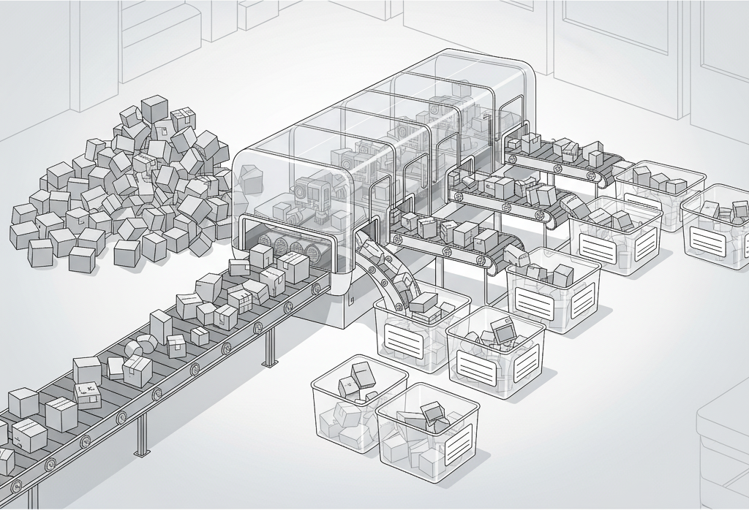
Shader Parameters & Binding Complexity
Notes:
So, the features we've covered so far are just some of Slang's powerful solutions for managing those first big challenges: taming the combinatorial explosion and organizing large, complex codebases.
Now, let's pivot to another one of those core challenges we identified: the fragile manual data binding model.
This is that classic, brittle workflow where engine-side code has to hard-code that g_myTexture is at register(t1) or g_myBuffer is at register(b0). The moment a shader artist adds one new texture, that entire host mapping is wrong, and everything breaks.
This is a huge source of bugs, and it only gets worse when you're deploying to many platforms, each with its own unique binding rules. People have written mountains of code to try to help manage this, but in Slang, our approach was to step back and think about how shader authors want to think about the data that their shaders are operating on.

Slide 18
Manual Slots vs. Logical Reflection
HLSL
Slang
// myShader_v1.hlsl
[[vk::binding(1, 0)]]
Texture2D g_normalMap : register(t0, space0);
[[vk::binding(2, 0)]]
SamplerState g_sampler : register(s0, space0);
// myShader.slang
struct MyScene
{
Texture2D g_normalMap;
SamplerState g_sampler;
};
ParameterBlock<MyScene> g_scene;
// myShader_v2.hlsl
[[vk::binding(3, 2)]]
Texture2D g_normalMap : register(t5, space2);
[[vk::binding(2, 2)]]
SamplerState g_sampler : register(s3, space2);
LoadShader("MyShader_v1.hlsl");
myCmdList->SetTexture(1, g_normalMapTexture);
myCmdList->SetSampler(0, g_mySampler);
layout = myProgram->getLayout();
normalVar =
layout->findEntryByName("g_scene.g_normalMap");
samplerVar =
layout->findEntryByName("g_scene.g_sampler");
myCmdList->BindParameter(normalVar, g_normalMapTexture);
myCmdList->BindParameter(samplerVar, g_mySampler);
✅
❌
✅
❌
Engine-side code needs to know the binding points for shader parameters
And breaks if changes aren’t made in parallel
Notes:
So let’s take a look at some concrete examples of how this compares.
Here on the left in the traditional flow, the author can't just think about their data; they're forced to manually manage physical layouts– and those are different if they’re targeting D3D versus Vulkan (or another API). So the shader defines g_normalMap at register(t1) in space0 for D3D12, and at vk::binding(1) in set 0 for Vulkan. [click]∫ The engine code then has to perfectly mirror this contract, with a hard-coded 1 for the D3D path and a hard-coded 0 and 1 for the Vulkan path. It's a brittle agreement, because there’s no compile-time enforcement, but for now, it works.
But the fragility is exposed the moment an artist swaps in MyShader_v2.hlsl. [click] This is a new, improved version of the old shader, but in cleaning it up, the artist reorganized the file a bit, and in the process, all the bindings have changed. Now it has g_normalMap at register(t5) in space2, and the Vulkan binding is set 2, binding 3. And if the engineer handling the C++ code in the engine just gets told “swap in this new shader”, and doesn’t update the bindings, it breaks, because it's still binding to the old register and descriptor set. The result is a classic rendering bug: your model is suddenly black, or it's shiny when it shouldn't be, or everyone’s face is suddenly Normals Blue or Missing Texture Magenta. You have no compiler error, just a visual disaster that can be super hard to debug.

Slide 19
Manual Slots vs. Logical Reflection
HLSL
Slang
// myShader_v1.hlsl
[[vk::binding(1, 0)]]
Texture2D g_normalMap : register(t0, space0);
[[vk::binding(2, 0)]]
SamplerState g_sampler : register(s0, space0);
// myShader.slang
struct MyScene
{
Texture2D g_normalMap;
SamplerState g_sampler;
};
ParameterBlock<MyScene> g_scene;
// myShader_v2.hlsl
[[vk::binding(3, 2)]]
Texture2D g_normalMap : register(t5, space2);
[[vk::binding(2, 2)]]
SamplerState g_sampler : register(s3, space2);
LoadShader("MyShader_v1.hlsl");
myCmdList->SetTexture(1, g_normalMapTexture);
myCmdList->SetSampler(0, g_mySampler);
layout = myProgram->getLayout();
normalVar =
layout->findEntryByName("g_scene.g_normalMap");
samplerVar =
layout->findEntryByName("g_scene.g_sampler");
myCmdList->BindParameter(normalVar, g_normalMapTexture);
myCmdList->BindParameter(samplerVar, g_mySampler);
Notes:
[click]
Now, look at the Slang solution. It's a more logical, data-oriented approach.

Slide 20
Manual Slots vs. Logical Reflection
Slang
Group parameters logically in a struct
// myShader.slang
struct MyScene
{
Texture2D g_normalMap;
SamplerState g_sampler;
};
ParameterBlock<MyScene> g_scene;
Wrap in a ParameterBlock
Host-side code queries binding by name
layout = myProgram->getLayout();
normalVar =
layout->findEntryByName("g_scene.g_normalMap");
samplerVar =
layout->findEntryByName("g_scene.g_sampler");
myCmdList->BindParameter(normalVar, g_normalMapTexture);
myCmdList->BindParameter(samplerVar, g_mySampler);
Notes:
[click] You just define data in a struct and wrap it in a ParameterBlock. [click] In essence, a ParameterBlock is how you tell Slang that this group of variables belongs together in a single descriptor table or set. Notice: no registers, no vk::binding attributes.
So, if you're not defining the registers, how are they assigned? The Slang compiler automatically assigns all physical bindings. But this isn't a scary 'black box' moving things on a whim; the layout is deterministic. It follows predictable rules and is stable, only changing when you make logical changes to the shader. For example, the compiler will typically give each ParameterBlock the next available set or space index, and then assign bindings in order within it. It’s predictable.
[click] And to read that layout, your engine uses Slang's Reflection API to read the result of that deterministic layout. So, instead of hard-coding registers, your engine just asks the API by name: 'Where did you put g_scene.g_normalMap?' The API then gives you the correct, platform-specific answer. Notice the engineer doesn't have to know the deterministic rules; they just have to ask for a parameter by name. And this provides a much safer way to fail. If an artist renames g_normalMap, findEntryByName returns null, and even if you don’t gracefully handle that, you at least get an immediate crash at load-time—not a weird visual bug in the middle of your game.

Slide 21
A Unified, Composable System
public interface IBrdf {
float3 eval(float3 n, float3 v, float3 l);
}
public struct Lambertian : IBrdf {
Texture2D g_albedoMap;
float3 g_tint;
public float3 eval(float3 n, float3 v, float3 l) {
float3 albedo = g_albedoMap.Sample(...) * g_tint;
return albedo / 3.14159;
}
}
ParameterBlock<Lambertian> g_lambertianMaterial;
Use a struct to implement an interface
…and also in your ParameterBlock
Notes:
So ParameterBlocks and reflection are a powerful tool for addressing our binding problems. And the cool thing about it is that the struct you use for a ParameterBlock is just a regular, ordinary Slang struct; it’s not some special, limited type. And because it’s a regular struct, it can participate in all the other features we’ve been talking about. This is how all the features overlap and reinforce each other.
Let’s look at our code. We have our Lambertian struct here, and because it’s just a normal struct, [click] we can have it implement an interface like IBrdf, which – as we saw earlier – lets us use it for generic functions. [click] And we can use this same struct to define a ParameterBlock, which as we just saw, gives us automated bindings and runtime reflection.
This is the big picture: Modules, Interfaces, Generics, Reflection – and all of Slang’s features – aren’t little widgets working in isolation. They’re part of a cohesive system that allow you to move from a world of brittle macros and manual rules to a modern, type-based approach that is robust, maintainable, and safe.

Slide 22
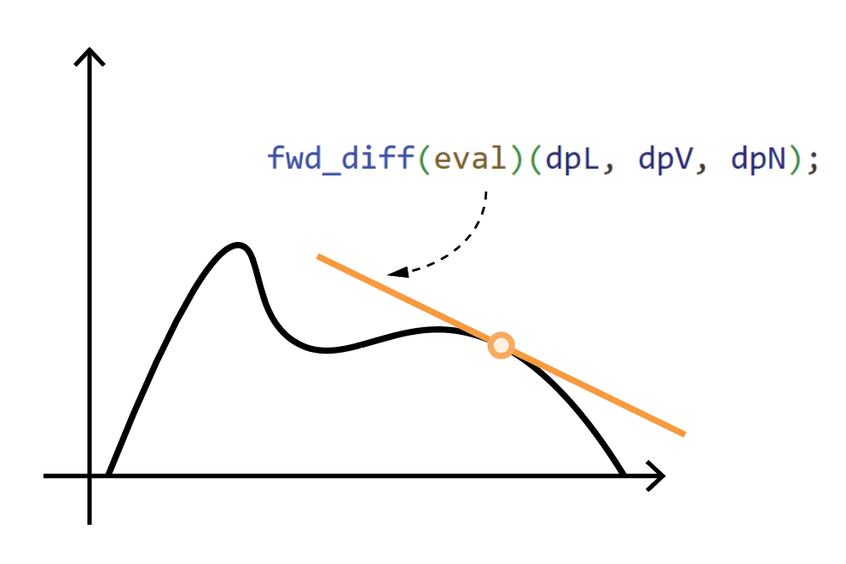
Automatic Differentiation
Your secret weapon for neural graphics
Automatically compute exact derivatives for any function
No manual gradient derivation required
Supports arbitrary control flow and dynamic dispatch
Enables any graphics function to become trainable
Notes:
All these modern features we've discussed—like modules and interfaces—also provide the robust foundation for one of Slang's most forward-looking capabilities: Automatic Differentiation.
This is truly your secret weapon for the “neural graphics discontinuity” we mentioned at the start. In short, it means you can stop worrying about the incredibly difficult, error-prone calculus of figuring out gradients by hand. Slang just... computes the derivatives for you, automatically.
And this isn't just for simple math functions. Because Slang has that deep, type-based understanding of your entire program, it’s powerful enough to handle your real shader code, with all its complex logic, branches, and even dynamic dispatch. This unlocks the entire field. It's what makes your graphics functions 'trainable,' and makes complex differentiable rendering practical, allowing you to apply machine learning and inverse rendering techniques directly to your pipeline.
Now, this talk isn't a deep dive on AD itself. What's critical to understand is that Slang's AD is the gateway that enables all these new techniques. We’re not going to cover the 'how' today, because several other talks at this conference will. They'll be showing you all the truly awesome applications of neural graphics that are built on top of this very feature, so I highly recommend checking them out.
But to quickly show how to connect these trainable functions to existing ML frameworks– and enable your shaders to make use of the data and models in that environment– let’s take a quick look at one other tool that the Slang ecosystem provides.

Slide 23












SlangPy
Machine Learning
Graphics
SlangPy
with Automatic Differentiation
Shading Languages
Using work done in the other ecosystem is extremely difficult
Notes:
SlangPy is the bridge that connects Slang’s high-performance, differentiable shaders and kernels directly to a huge open source machine learning ecosystem.
The graphics and ML domains have historically evolved in completely different spaces. ML researchers and practitioners live in Python, working with frameworks like PyTorch and JAX. Meanwhile, those of us in the graphics world typically work in C++ and shading languages, using APIs like Vulkan and DirectX. That causes real friction– you can’t just move your ML workflow into the graphics stack.
[Click]This is why we built SlangPy to bridge the gap. You can write your performance-critical, complex graphics code in Slang, and easily integrate with the Python ML ecosystem. It’s a simple pip install that gives you direct access to the Slang compiler from Python, letting you connect your shaders to ML frameworks. This makes the bridge bidirectional– it’s not only easier to apply ML techniques to your graphics code, but it’s also easier for ML developers to get real-time performance out of their rendering code.

Slide 24
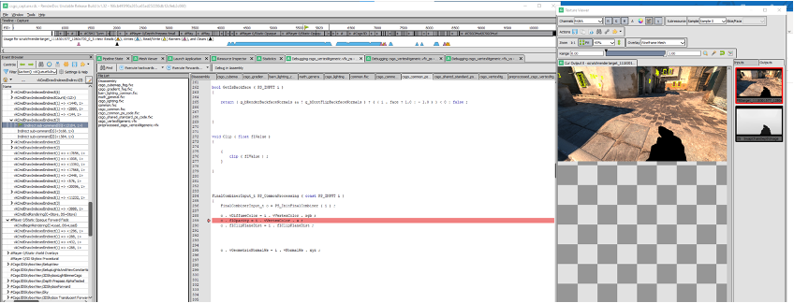
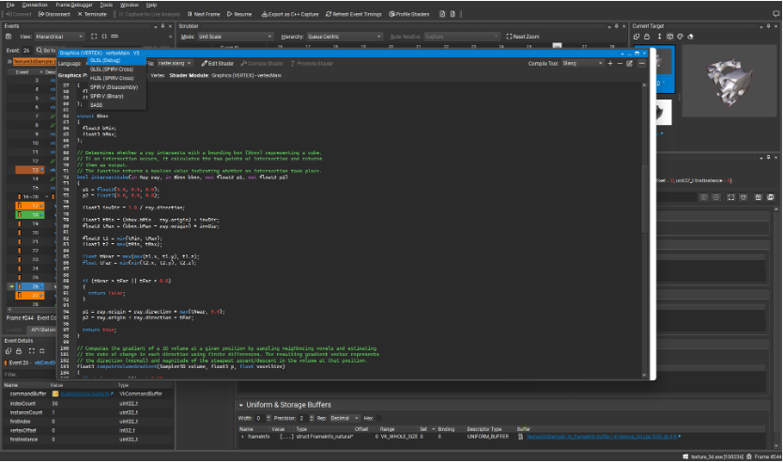
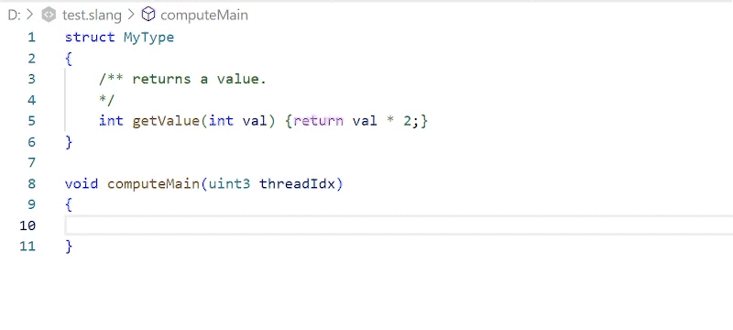
Slang Works With Your Favorite Tools
RenderDoc step-through debugging
Follow Slang->SPIR-V->assembly in Nsight
Visual Studio & VSCode Extensions and Language Server
Notes:
So, SlangPy connects you to the ML ecosystem. But on a daily basis, you're living in your IDE and your debugger. We've designed Slang to be a first-class citizen in that core workflow, too. First, let's talk about debugging. Slang isn't a black box. It fully supports non-semantic debug info, which means you get full, step-through shader debugging in RenderDoc, just like you'd expect. Not only that – even if you’re looking at the compiled output, Slang generates human-readable code, and inserts #line directives, so you can read and understand the target code that it generates, and trace it back to your original Slang, whether the output is HLSL, MSL, or SPIR-V (though of course “human readable” may vary when you’re looking at an IR like SPIR).
To support you when you’re writing code in your IDE, Slang provides a rich IDE experience through the Language Server Protocol. We have robust, official extensions for Visual Studio and VSCode that give you syntax highlighting, real-time error checking, and all the IDE features you're used to. The VSCode extension even integrates the Slang Playground we mentioned earlier, so you can run your code live, right inside your editor. And because we use the open LSP standard, the community has also been able to integrate Slang support into other popular editors, like JetBrains-based IDEs.
And going beyond runtime debugging, NVIDIA Nsight and Aftermath now support Slang, so you can do profiling and crash debugging, and follow Slang compilation through SPIR-V and into shader assembly within the tools.
All that is to say: Slang is designed to integrate directly into your existing workflow. It's not asking you to learn a whole new set of tools. It's giving you all of these powerful new language features while working with the critical debugging, editing, and profiling tools you already know and trust.

Slide 25

Resources
Find all these details and more at shader-slang.org
Try it out in your browser
try.shader-slang.org
Dive into docs
docs.shader-slang.org
Watch Slang Videos
khr.io/slangvideos
Check out SlangPy
slangpy.shader-slang.org
Watch the Neural Shading Course and other SIGGRAPH Materials
Join the Discord
Notes:
So, that's a very quick tour of the Slang ecosystem—from modules and interfaces, all the way to reflection and the Python integration. We've covered a lot, and many of these are deep topics. If you're interested in trying this out for yourself, or just want to dive deeper into any of the features we discussed today, here are the best places to start.
The best place for immediate, hands-on learning is the Slang shader playground. We mentioned it earlier, but it's a great resource that lets you get started quickly and provides a number of samples demonstrating key Slang features, like automatic differentiation.
If you prefer the written word, the Slang docs have a full 'getting started' section. And if you prefer video, there's a 'Getting Started with Slang' video series which does deep dives on specific Slang topics, and you can find them, along with other Slang presentations, on the Khronos YouTube channel’s Slang playlist.
Of course, if you get stuck or want to join the community, the Slang Discord—which we also mentioned—is a fantastic place to be.
For those of you interested in the AD and neural graphics side, I highly recommend checking out the neural shading course we presented at SIGGRAPH this year; it's available as a YouTube playlist.
And finally, for everything related to the Python integration, you can find the SlangPy docs right here.

