Slide 1



Lukas Feller
Graphics Programmer
Last year Fog, this year VFX :)
Julien Koenen
Technical Director
@ Keen Games

Slide 2



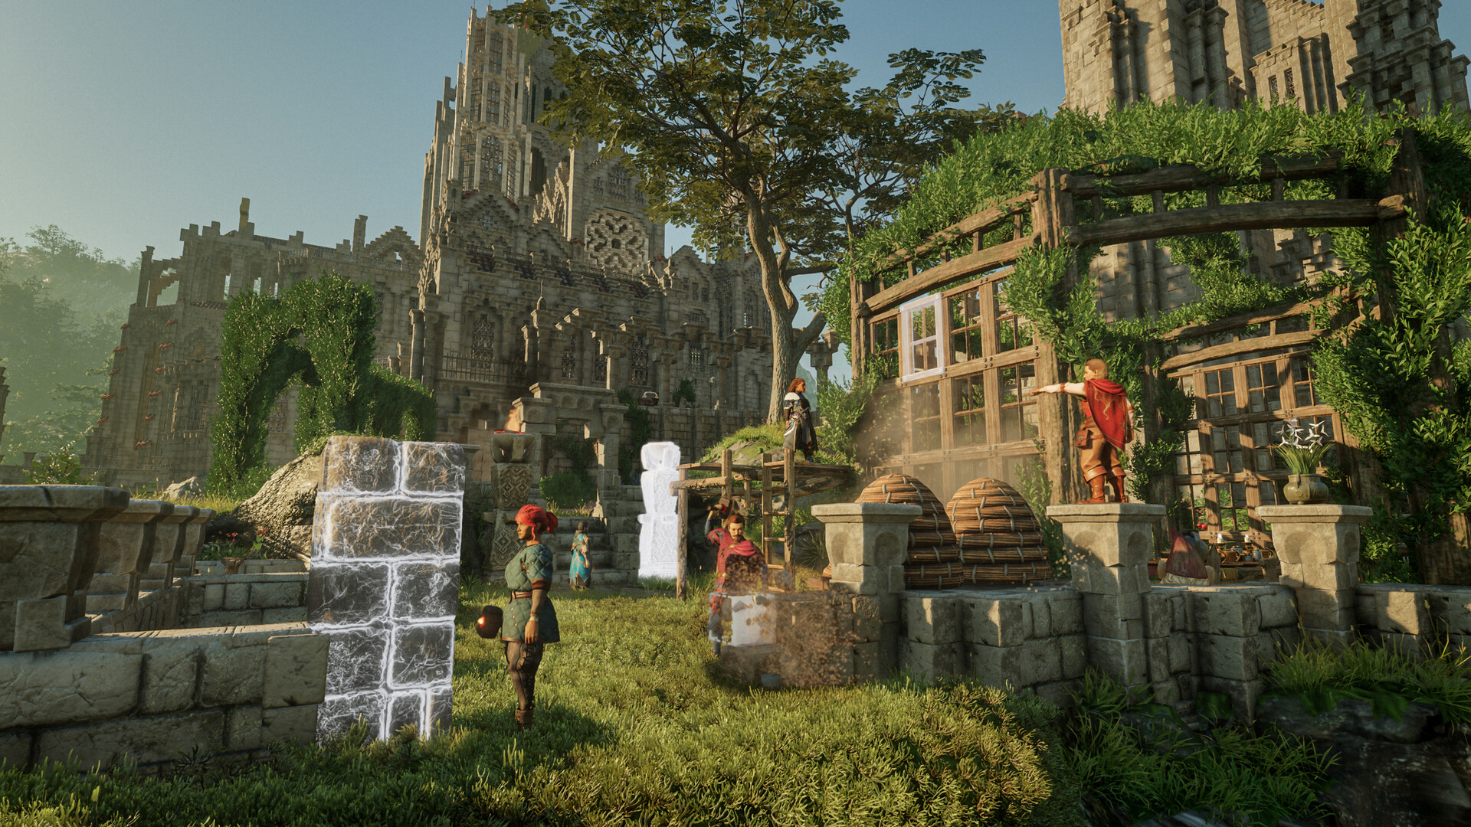
Notes:
Enshrouded is our current project which is in early access since almost two years now. It features a large, fully modifiable voxel-based world. Fog also plays a key role in our game and my colleague Phillip Krause will talk about it in detail tomorrow (same time, other room).

Slide 3
Enshrouded VFX System
Existing system showed its age
Entirely new VFX system
Designed in close collaboration with the VFX artists
Notes:
The VFX system that we had in Portal Knights shows its age. Therefore we designed a completely new system from scratch for Enshrouded in close collaboration with the VFX artists.

Slide 4
Enshrouded VFX System
Fully GPU driven
  Natural choice nowadays
  Enshrouded has a GPU driven renderer
  Reuse data which is on the GPU already
Notes:
The new VFX system is completely GPU driven. Nowadays this is a natural choice since even the low-spec GPUs that we’re targeting are well suited for the job. That is computing many instances of particles which share the same logic but operate on different data. Also is was clear early on that Enshrouded will have a GPU driven renderer. This means that the infrastructure and a lot of data is available on the GPU already and we hoped that we can utilize some of that if the particles are computed on the GPU as well. This worked out well in some instances, but we still manage GPU data that’s used solely for VFX.

Slide 5

Enshrouded VFX System
Standard HLSL for scripting
  Custom scripting language was a maintenance & support burden
  Well known
  Lots of existing resources & tooling
  Maximum freedom for the artist
Freely import Textures & Meshes
  From Houdini, EmberGen & others
Notes:
This time we decided on using bog-standard HLSL for scripting particle logic. The experience from Portal Knights has shown that a custom scripting language needs continuous maintenance and support which can only be delivered by inhouse engineers which could or have to spend their time on other tasks instead. HLSL being a well known language on the other hand comes with a lot of external resources and tooling and is more-or-less feature complete for the task at hand. This gives the artist a lot more flexibility, less reliance on colleagues and therefore enables much more creative freedom.
We’re providing a very flexible data model which allows for freely importing textures and meshes for consumption in the particle shaders. Images can naturally use the HLSL sample API and for meshes we’re providing some helpers which allow for sampling meshes (more on that later). This allowed our VFX artists to incorporate external tools like Houdini, EmberGen and others in their work.
However, given those possibilities also mean that the artists have to be more careful with what they are doing with the tools (foreshadowing).

Slide 6
Overview
Particles
  Define behavior
Effects
  Combine particles
  Parameterize
Particle
Particle
Particle
Particle
Particle
Particle
Effect
Effect
Effect
Effect
Notes:
Let’s have a look at how our VFX system is structured.
We have two general concepts:
Particles define behavior and parameters.
Effects combine multiple particles and set their parameters to form something that can be instantiated as a VFX.

Slide 7
Particle
Particle
Particle
Particle
Effect
Effect
State
  Persistent
Parameters
  Evaluated every frame
HLSL code
  Single function which is executed once per frame per particle
Notes:
A Particle consists of definitions for state (persistent across frames), parameters (evaluated every frame) and HLSL code which defines the logic (executed every frame).

Slide 8
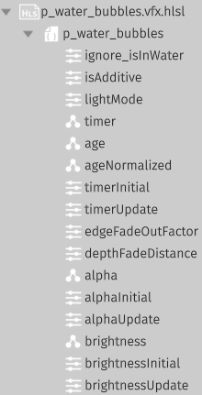
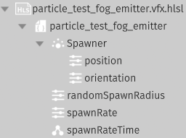
Particle Data
Particle
Particle
Particle
Effect
Effect
State, Parameters
Types:
  {Float,Int,UInt,Bool}{,2,3,4}
  Model, Mesh, Image, Sound
  Emitter
Notes:
The particle data is defined by the VFX artists in our editor. It’s just a list of named members with a type. We support the obvious basic types as well as opaque ones which represent resource data that we have to load in the runtime. The emitter parameter is a special one: It defines a set of parameters that can be passed as part of a child particle spawn operation. Which child particle is to be spawned is defined later as part of an effect which we‘ll go through shortly.
Here are two screenshots from the editor what this looks like. Whether an element is part of the state or parameters is differentiated by the icon. The data definitions are children of a HLSL file which contains the particle’s code.

Slide 9
Particle Code
Particle
Particle
Particle
Effect
Effect
Single HLSL function
  Called once per frame per particle
  Extensive API to sample data and generate output
  Return value: still alive?
    bool updateParticle(
    inout VfxParticleState state,
    VfxParticleParameters parameters,
    VfxEffectData effect,
    VfxEngineData engine,
    bool isNew
    )
Generated HLSL structs for state & parameters
struct VfxParticleState
{
float timer;
float age;
float ageNormalized;
float alpha;
float brightness;
…
Notes:
The HLSL file of a particle has to implement a single function. This one will be called once per frame by the VFX system. We provide an extensive API that we’ll go though in detail later which allows the artist to sample various data and to generate output. The return value indicates whether the particle is still alive and should be updated again in the next frame.
The particle’s state and parameters are represented via HLSL structs which we generate from the data.
Note how the state is passed as an inout argument because it’s retained across frames while the parameters are read-only.

Slide 10
Overview
Particles
  Define behavior
Effects
  Combine particles
  Parameterize
Particle
Particle
Particle
Particle
Particle
Particle
Effect
Effect
Effect
Effect
Notes:
Now on to effect definitions: As stated earlier, those combine multiple particles and set their parameters values.

Slide 11
Effect Data
Particle
Particle
Particle
Effect
Effect
Instantiated by the game for a VFX
Hierarchy of particles
  Parents can spawn children
  Defines order of execution
Define values or expressions for particle parameters
Notes:
Effects are what is instantiated by the game to play a VFX. They define a hierarchy of particles which is a fixed relationship about which parent particles can spawn which child particles. Each node in the hierarchy references one of the particle definitions that we talked about just before. In order to prevent delays we use this to define a strict execution order: Parent particles are executed before child particles, which means that child particles can generate output in the same frame that they are spawned in. Additionally, each node allows the artist to change the default value of a particle parameter to either a different fixed value or a full-fledged HLSL expression. Keep in mind that the latter is evaluated every frame which allows for pretty flexible behavior.

Slide 12
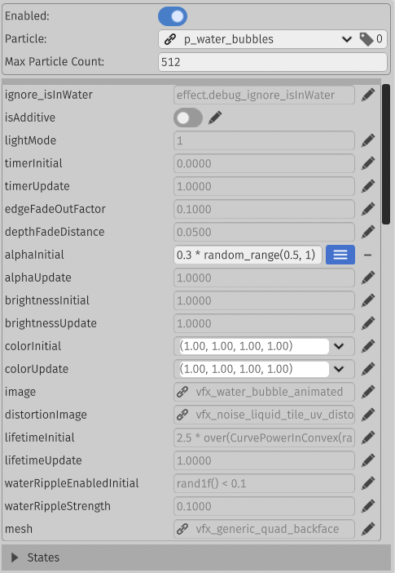
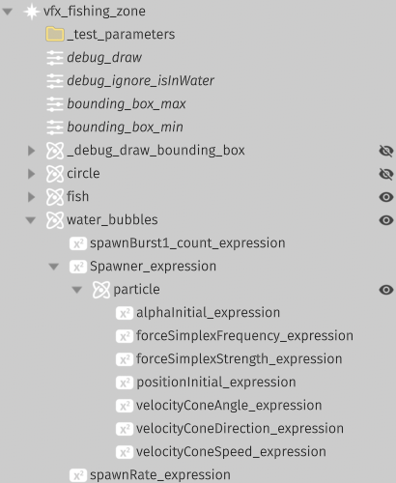
Effect Data
Particle
Particle
Particle
Effect
Effect
VfxDefinition
VfxNode (Particle)
VfxParameterExpression
Notes:
This is what it looks like in our editor:
The VfxDefinition is the root of an effect. This is what is used by gameplay code to create a VFX instance.
Effect nodes reference a particle definition and define the maximum amount of particles that can be active/alive in this node.
As part of a effect node particle parameters can be overridden with either a different value or with a HLSL expression. The HLSL expression can access particle state, effect parameters and is evaluated every frame. It is not artificially limited to anything, so it can also call other functions, most importantly helper functions that are defined by VFX artists in a shared HLSL file.
Note that at this point the emitter parameter of a particle gets assigned the particle type that is spawned as part of a spawn API call with this parameter.

Slide 13
Effect Data
Particle
Particle
Particle
Effect
Effect
Effect parameters
  Arithmetic and resource types
  Can be set/updated by gameplay code
  Available in parameter expressions
  Sourced from a global list of all effect parameters
    Game code is independent of the configured effect
Notes:
Another thing that’s part of a effect definition is effect parameters: Just like particle state and parameters, effect parameters support the basic HLSL types as well as resource types. Those can be set and updated by gameplay code and are accessible in particle parameter expressions. This way the game can influence the VFX with dynamic data (i.e. a target position). The set of possible effect parameters is sourced from a global list of all effect parameters that we have in the game. This list is what is used by the game code. That way the game code is independent of from the actual effect that’s configured. The asset build and runtime make sure that parameter updates are routed to the correct memory locations if they supported by the instantiated effect.

Slide 14
Effect Data
Particle
Particle
Particle
Effect
Effect
VfxDefinition
VfxEffectParameter
VfxNode (Particle)
VfxParameterExpression
Notes:
This is what it looks like in our editor:
The effect parameters are used in this example to define a bounding box for the fishing zone and some debug flags.

Slide 15

Video

Slide 16
Resource Format
VfxResource
  VfxParticleResource (1..*)
    Compute shader
    Storage buffer
      Patch points (meshes, images, sounds)
    Particle state size
  Particle hierarchy
  Effect parameters data & layout
Notes:
The data is converted into this structure for consumption by the runtime. There is one VfxResource per effect which can be used to instantiate a VFX.
The resource contains one or more particle resources. Those consist of the compute shader binary (SPIR-V on PC), data for a storage buffer that is accessed from the shader and information about how much memory is needed for the particle state per particle. The storage buffer resource also contains patch points which are used to load additional resources like meshes, images and sounds whose runtime indices are patched into the storage buffer before uploading it to the GPU. The particle state is initialized by the shader, so we only need its size in bytes as part of the resource.
The particle hierarchy defines the emitter-child particle relationships between multiple particles in an effect.
Last but not least a memory blob with default values for all effect parameters is output along with information about which parameter is located where in this blob. This is used to patch per-instance effect parameters in the runtime. The memory is also uploaded to the GPU as part of a storage buffer.

Slide 17
Runtime Data
Instance
  Parameters
Particle chunk
  Compute pipeline
  State buffer
  Active indices list (2x for ping-pong)
  Free indices list
  Capacity: max particle count
Pass allocation offsets via push constants
Notes:
In the runtime we need the following data to execute the effects:
Per effect instance we store the effect parameters. Those can be changed by the game at any time.
The data that is needed per per particle resource of an effect instance is stored in so called particle chunks. Right now we have exactly one chunk per particle type per effect instance. Per particle chunk we store a reference to the loaded compute pipeline, an array of particle states and index lists for active particles and free indices (more on that later). The capacity of the chunk is given by the maximum particle count that the artists define. We plan on sharing chunks between different effect instances though at some point.
All data is sub-allocated from fixed-sized buffers which are shared between all effect instances. The allocations happen when spawning a new effect instance. Should any allocation fail we just fail to spawn the effect. Each dispatch accesses the respective sub-allocations via buffer offsets that we pass with push constants.

Slide 18
Execution
Most simple approach
One dispatch per particle per instance
Group count from max particle count
Single descriptor set for everything
Push constants per dispatch
  Effect parameters, parameter values, particle state array, …
Breadth-first over all instances, sorted by pipeline
  Just one barrier in between hierarchy levels
Notes:
To execute the particle shaders we’re still shipping with the very simple initial approach: We’re doing one dispatch per particle resource of an instance. The group count is computed from the maximum particle count for this particle in the effect. We use a single (pretty large) descriptor set for everything, so we only need to bind the compute pipeline and push constants for each dispatch. Dispatches are scheduled breadth-first over all instances and sorted by pipeline. The latter has a benefit due to pipeline deduplication by our asset build pipeline and keeps the amount of pipeline binds to a minimum. This results in all particles of the first level of all instances to be dispatched first, then all particles of the second level and so on. That way we only need one compute shader barrier in between hierarchy level transitions, which yields an optimal result.

Slide 19
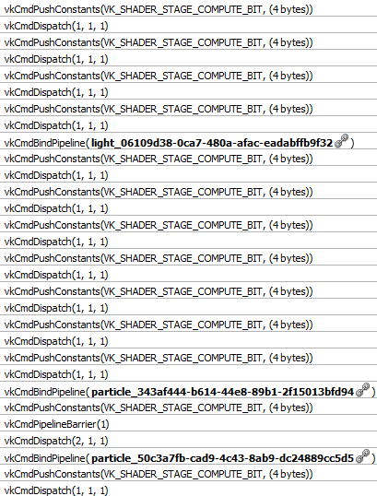
Notes:
This is what it looks like in Renderdoc. Note the one pipeline barrier which marks the transition from one hierarchy level to the next.

Slide 20
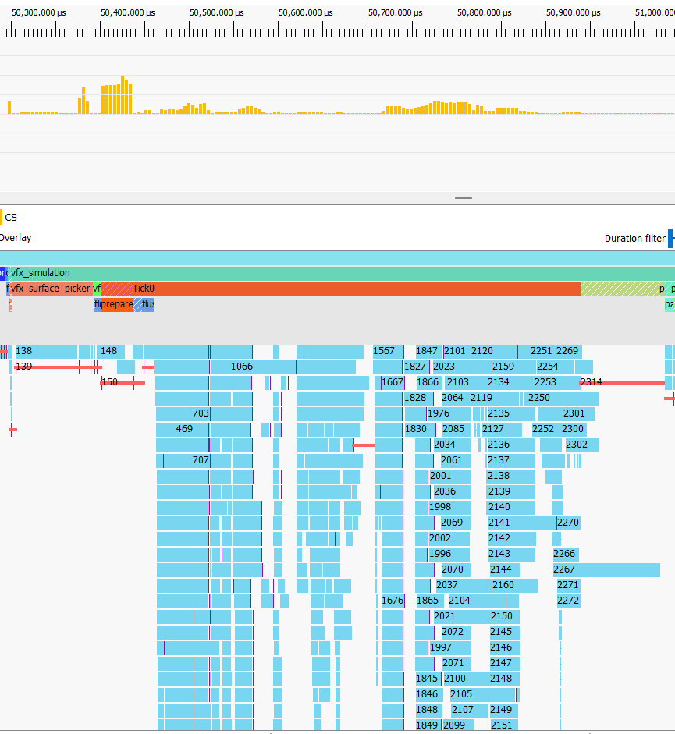
RX 480:
Notes:
And the same in (an old version of) the Radeon GPU Profiler. Note that this was captured on a AMD Radeon RX 480, which is below our minspec. I highlighted the only two barriers that are needed for our VFX dispatches. The first sits in between the first and second level in the particle hierarchy and the second (which seems to be waiting mainly on this one long dispatch) at the end of the second hierarchy level.

Slide 21
Obvious Optimizations
Many threads don’t operate on active particles and exit early
  Compute group count from active particle count (instead of maximum)
  Execute multiple particle chunks in one dispatch
    From one effect
    From multiple instances
Notes:
While this is obviously far from ideal we can see that the hardware does a good job of processing the mess that we’re feeding it with pretty good overlapping. The GPU is pretty underutilized though due to many threads that exit right away because they don’t process an active particle. This worked equally well across all vendors for the effects that we have in the game right now, so there still wasn’t enough pressure for us optimize this as we had bigger issues in other parts of the rendering pipeline.
The most obvious optimizations would be to use indirect dispatches to reduce the group count to the number of currently active particles instead of accounting for the maximum and to schedule particles from multiple chunks into a single dispatch. This would probably be easier to do for a single effect instance but could also be extended to chunks of multiple effect instances.

Slide 22
Shader code
void cs_main( uint3 dispatchId : SV_DispatchThreadID )
{
// ...
if( dispatchId.x >= particleCount ) return;
s_particleIndex = g_dataBuffer.Load( s_oldActiveIndicesOffset + dispatchId.x * 4 );
// ...
const VfxEffectData effect = fillVfxEffectData( s_effectParameters );
VfxParticleState particle = unpackParticleState( s_particleState );
const VfxParticleParameters parameters = evaluateParameters( particle, effect, engine );
const bool isAlive = updateParticle( particle, parameters, effect, engine, isNew );
if( isAlive ) { /* pack & store state, append to new active list */ }
else { /* append to free list */ }
}
Notes:
Let’s have a look at the actual shader code. With what you heard so far it should be pretty obvious. We start with fetching and unpacking the source data and evaluating parameters. Then we call the artist-supplied update function. Based on whether the particle should continue to live we append its index to the active list or the free list using an atomic add. The first is ping-ponged between frames so that we always have a tightly packed list of active particle indices. We use the free list to spawn new particles (more on that later). Of course we also have to write back the updated state in case the particle is still alive.
fillVfxEffectData, unpackParticleState and evaluateParameters are generated from data. updateParticle is provided by the HLSL file authored by the artists.

Slide 23
Generated Code
VfxParticleParameters evaluateParameters(
VfxParticleTypeParameterBuffer parameterBuffer, VfxParticleState state,
VfxEffectData effect, VfxEngineData engine )
{
VfxParticleParameters parameters;
parameters.ignore_isInWater = effect.debug_ignore_isInWater;
parameters.isAdditive.x = getX( parameterBuffer.isAdditive );
parameters.lightMode = parameterBuffer.lightMode;
parameters.timerInitial = parameterBuffer.timerInitial;
parameters.timerUpdate = parameterBuffer.timerUpdate;
parameters.edgeFadeOutFactor = parameterBuffer.edgeFadeOutFactor;
parameters.depthFadeDistance = parameterBuffer.depthFadeDistance;
parameters.alphaInitial = 0.3 * random_range(0.5, 1);
// ...
return parameters;
}
Notes:
The HLSL code generation from data is also pretty straightforward right now. Numeric values are written into the resource storage buffer and read in the shader while parameter expressions are copied as-is into the shader code.

Slide 24
Particle API
Next Slide
Draw
  Meshes
  Models
  Point lights
  Decals
  Water
  Foliage displacement
  Fog
  Sound
  No retained state
  Supports multiple draws per update
Debug Draw
Sample
  Images
  Fog
  Fog surface
  Water
  Water features
  Local heightmap
  World SDF
  Meshes
Random [PCG 2014]
Spawn Particle
… and many more
Random points from pre-process, see later
Previous transform via hashmap (for now) for motion vectors
Read back on CPU
Notes:
We provide a pretty extensive API that can be used by our artists:
There are many different functions to draw/emit/instantiate various primitives like models, lights, decals and sound. Each take a position as an argument as well as an opaque resource index (which is filled with runtime patching from resource data as we’ve seen earlier) and potentially many more parameters. There’s no limit on how often one particle can call each function (apart from global budgets of course).
Drawing meshes is the most flexible API as it allows passing textures, uv distortion, color modulation any many more parameters. We’ll have a more detailed look at those in a moment. Model draws go into the regular solid geometry pipeline just like static model draws. The fog drawing API allows for adding as well as removing fog. This is accumulated into the fog froxel volume texture (see my colleague’s talk tomorrow for details). Sound instances are read back on the CPU and send to the sound system.
All drawing API functions are implemented by atomically appending the parameters to different storage buffers.
The draws are only executed in the one frame when the API function was called. In other words we don’t retain any data of those API calls (except for sounds which are triggered by the API call and then played back until the end). If some particle wants to display something over multiple frames it has to call the respective function every frame. Model draws do retain a little bit of data: For those we need a velocity value so that correct motion vectors can be computed later on. This is important for temporal filters and upscalers. Right now we store the transform into a hash map based on a hash of various static particle state bits and the index of the draw in this particle’s invocation. This one we use in the following frame to obtain the previous’ frame transform. But we’d like to get rid of this approach soon and just use the particle state for that (i.e. by storing the previous’ frame position in there).
Other parts of the API allow for sampling various data. Of course sampling images is possible with HLSL directly. Additionally we provide functions to sample the ingame fog at any arbitrary position. We’re also doing a special preprocess pass which finds random points on the world, water and fog surfaces around the camera. This will be discussed in detail later. We also provide a heightmap and SDF of the solid world geometry around the camera. There are also functions which allow for reading arbitrary vertices from a mesh as well as helpers to obtain random points on a mesh’s surface.
For pseudorandom numbers we use the PCG family of PRNGs and hashes which we seed with a pseudorandom value from the CPU per instance and the particle index.
One key element of the API is support for spawning new particles. This is made possible via the emitter parameters as showed earlier. We call particles when can emit particles “emitters”.

Slide 25
Draw Mesh API
struct TransparentDrawParameters
{
float3 position;
Quaternion orientation;
float3 scale;
GpuCombinedImage2D image;
GpuCombinedImage2D normals;
float3 color;
float alpha;
float metallic;
float roughness;
float reflectance;
float2 uvOffset;
float2 uvScale;
UvDistortion uvDistortion;
float depthFadeDistance;
float edgeFadeOutFactor;
AlphaClip alphaClip;
int vertexAlphaMode;
bool isAdditive;
bool discardInsideWater;
bool discardOutsideWater;
bool depthFadeOnWater;
VfxSortParameters sort;
uint lightMode;
float exposureCorrectionFactor;
Flipbook flipbook;
};
enum VfxSortType
{
None,
YoungestFirst,
OldestFirst,
DistanceToNearPlane,
DistanceToCamera,
Custom,
};
struct VfxSortParameters
{
VfxSortType type;
float offset;
};
void drawTransparentMesh(
VfxMesh mesh,
TransparentDrawParameters parameters
)
Notes:
Mesh draws all end up in the transparent render pass which is somewhere after solid geometry and fog but before post-processing. (Actually VFX draws are the only source of draw commands in this pass nowadays). They support a lot of parameters which are for the most part directly consumed by the single graphics pipeline we use in this pass. One exception is the sort parameter. This allows the artist to specify and offset a sort key. From that we compute a global sort key. After all VFX dispatches are done we sort the list of all draws by this using radix sort.

Slide 26
Draw Mesh Implementation
Sort all draws by sort key using radix sort
Write new index buffers
  For above & below water
Single draw call for each pass
31-16 | 15-0
Instance index | Vertex index
Notes:
We saw that many draws are pretty small, e.g. many billboards with just 2 triangles each. Emitting a single indirect draw call for each of those caused bottlenecks on some GPUs.
To resolve this problem we’re merging all draws by writing a single index buffer which contains the instance index in the upper bits. With the water that we added in the most recent update we’re actually writing two index buffers: One for meshes that are in front of the first water surface and one for the once that are behind.

Slide 27
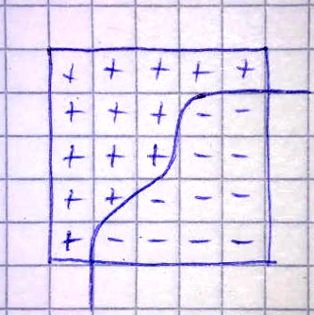
Surface Points
Water: CPU
  Waterfalls, splashes
Fog: GPU
  Sample SDF
  One thread per Voxel
  If surface: Spawn point with hash offset
  Hash map to track new points
VFX: Point list
  Spawn particles at points
Notes:
Surface points are basically lists of random points that come from some pre-process. For water we have special logic which finds interesting features like waterfalls and splashes on the CPU and writes them into a list. For the fog surface we’re putting random points on the 0-isosurface of the SDF. We’re doing that in a single dispatch which runs for each voxel of the SDF texture. As a coarse approximation it computes the intersection of the isosurface with the edges that connect neighboring voxels by solving a simple linear equation. All found intersection points are averaged using pseudorandom weights to obtain the final point for this dispatch. Using a ping-ponged hash map we’re keeping track about which points we already knew so that the artists can limit spawning particles to only new points. The hashmap is also used to kill particles whose surface points were not detected anymore (i.e. due to camera movement or changes to the fog). All surface points are made available to the VFX via the API as a simple array with varying element count.

Slide 28
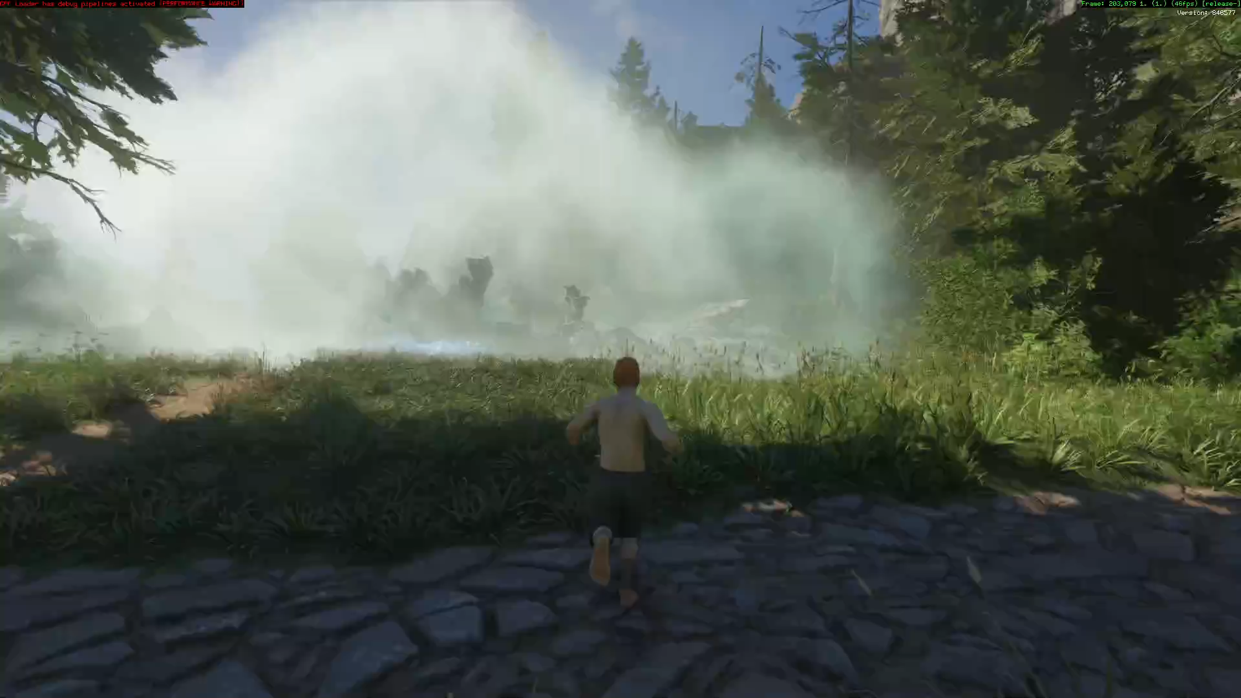
Video

Slide 29
Spawn Particle API
Spawn parameters defined via data
Spawn_Spawner spawn;
spawn.position = position + (rand3f()*2-1) * radius;
spawnParticle( state, spawn );
Notes:
As stated earlier, the parameters which can be passed to a child particle when spawning are defined in data. We generate a HLSL struct for those parameters as well.
When spawning a particle we just atomically pop an index from the target particle’s chunk free indices list (if one is available).

Slide 30
bool updateParticle( inout VfxParticleState state,
VfxParticleParameters parameters, VfxEffectData effect,
VfxEngineData engine, bool isNew )
{
if( !effect.isActive )
{
return false;
}
const uint targetSpawnCount = effect.age / parameters.spawnRate;
const uint spawnCount = min( targetSpawnCount - state.spawnCount, 4 );
for( uint spawnIndex = 0u; spawnIndex < spawnCount; ++spawnIndex )
{
Spawn_Spawner spawn;
spawn.position = effect.position + (rand3f()*2-1) * parameters.randomSpawnRadius;
spawnParticle( state, spawn );
}
state.spawnCount = targetSpawnCount;
return true;
}
Notes:
This is an example for particle code of a emitter particle.

Slide 31
bool updateParticle( inout VfxParticleState state,
VfxParticleParameters parameters, VfxEffectData effect,
VfxEngineData engine, bool isNew )
{
if( isNew )
{
const VfxSound sound = parameters.sound;
playSound( state.position, sound );
}
drawDebugLine( effect.position, state.position, 1.0 );
drawDebugCross( state.position, 1.0, 1.0 );
state.age += engine.fixedTimeStep;
if( state.age > 1.0 )
{
return false;
}
return true;
}
Notes:
And one which plays a sound a does some debug drawing.

Slide 32
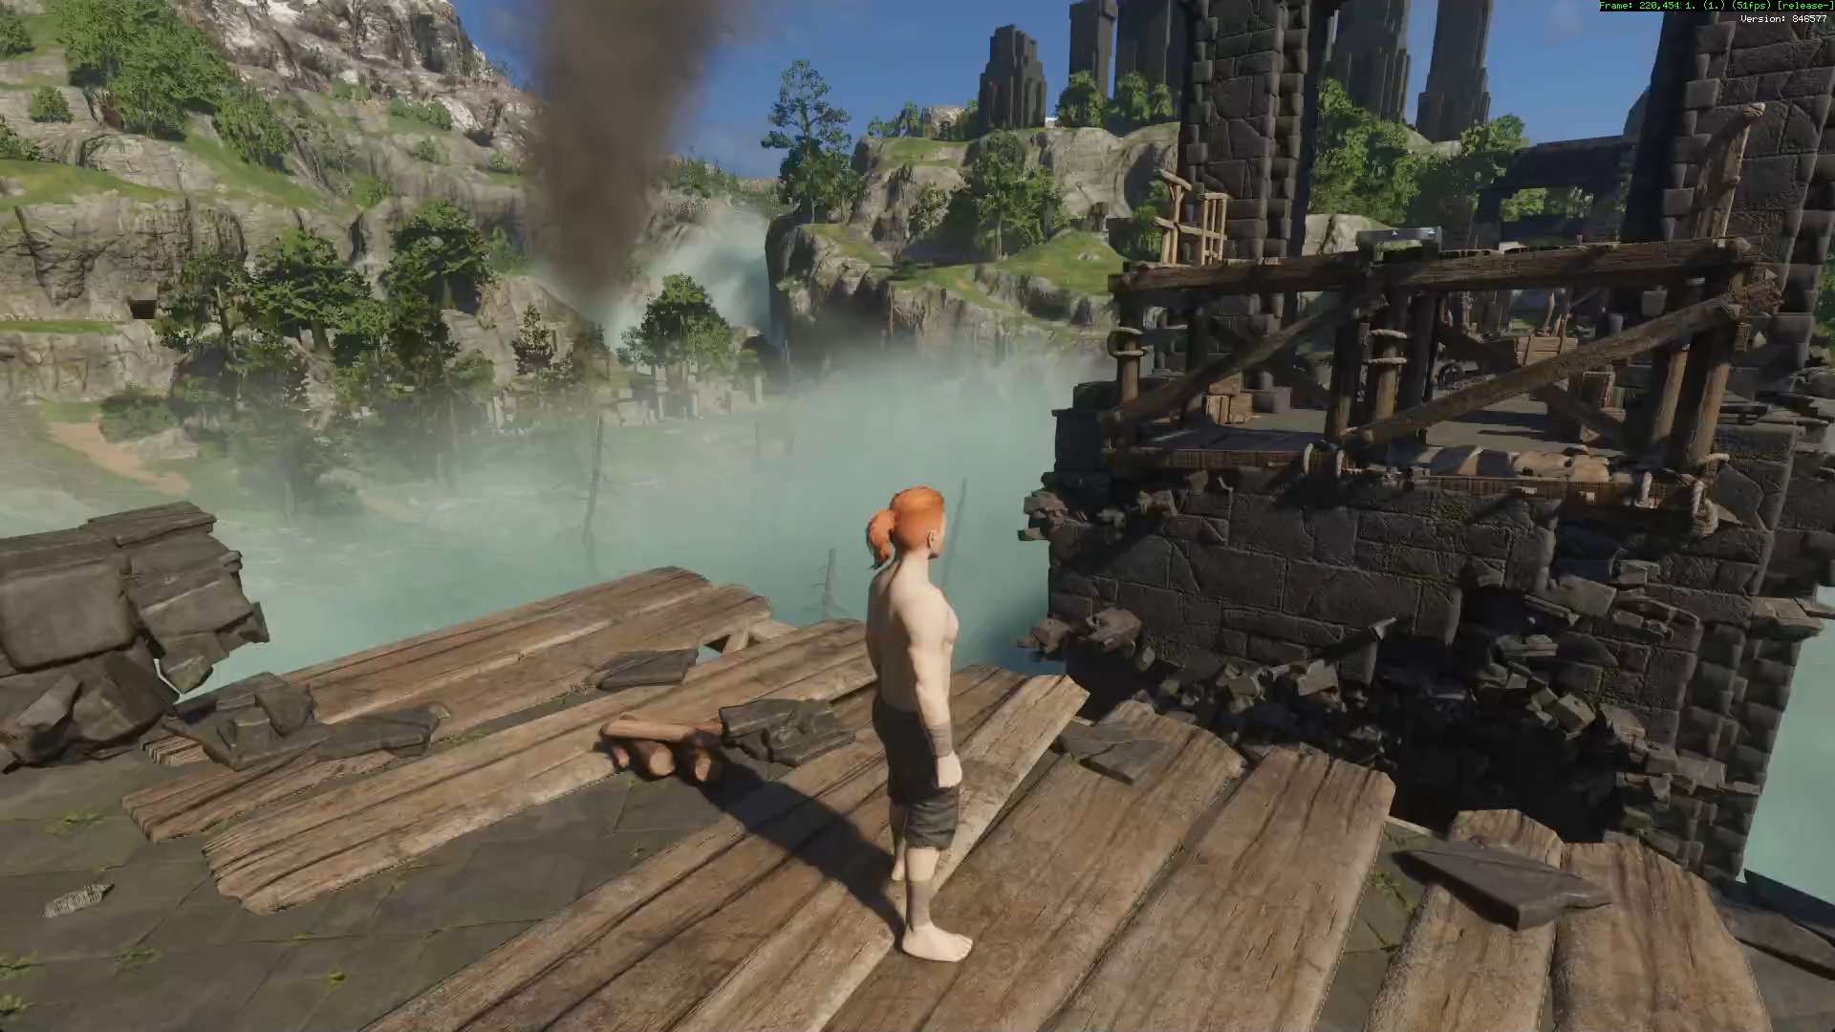
Video

Slide 33
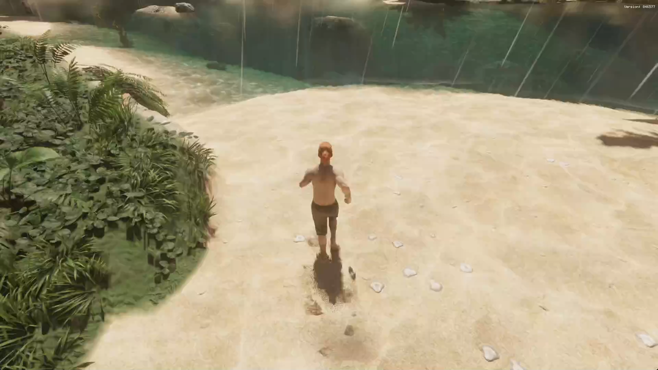
Video

Slide 34

Video

Slide 35
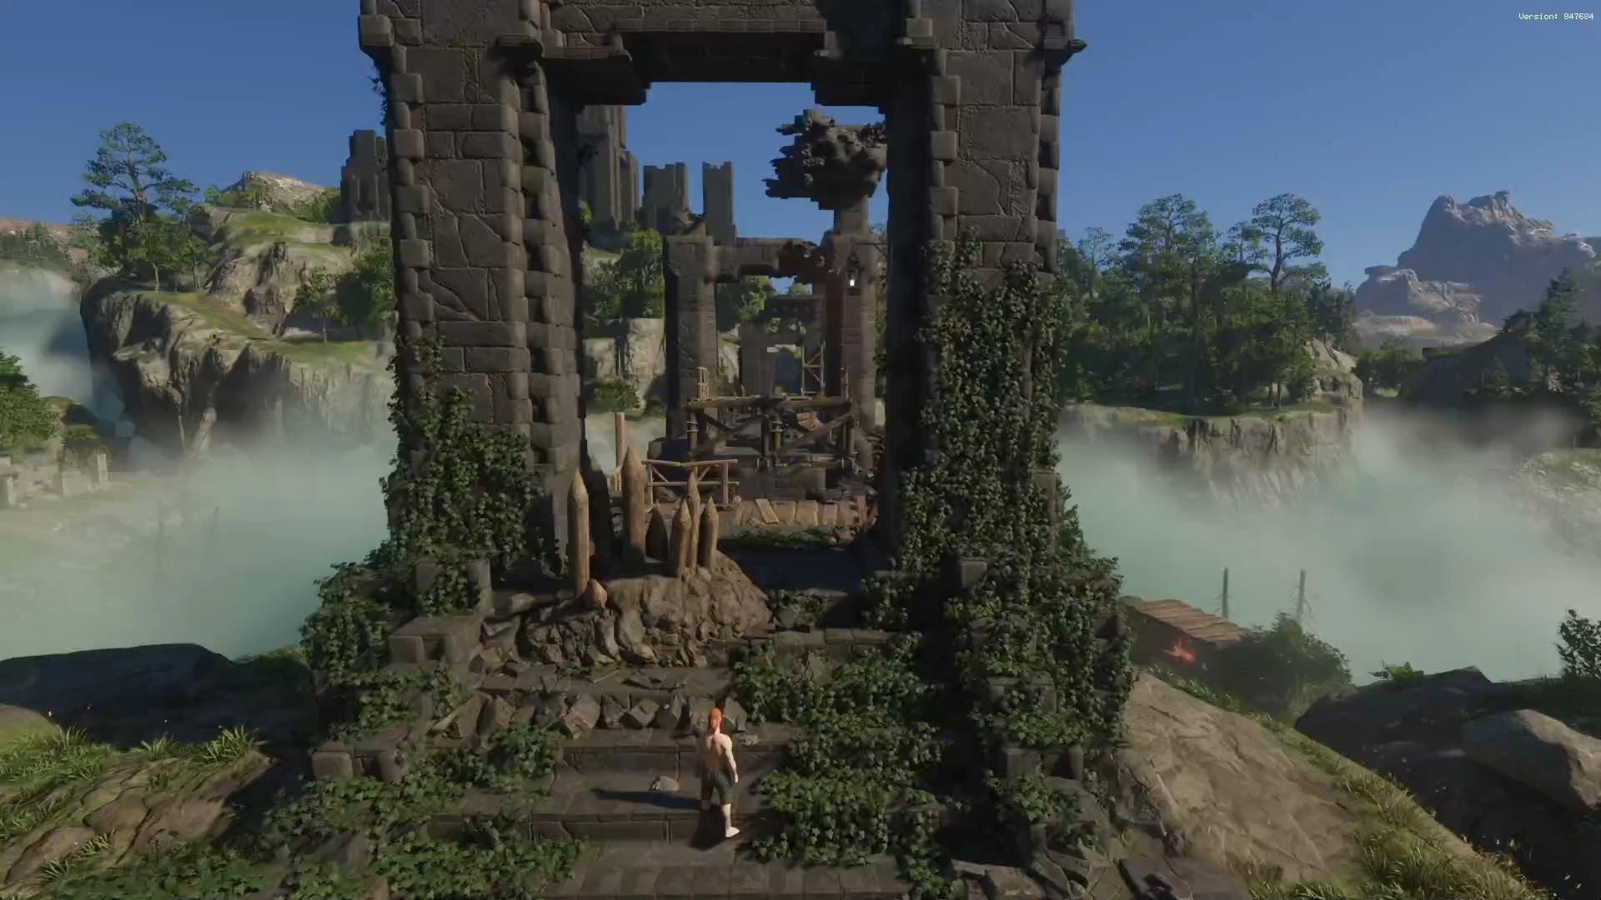
Video

Slide 36
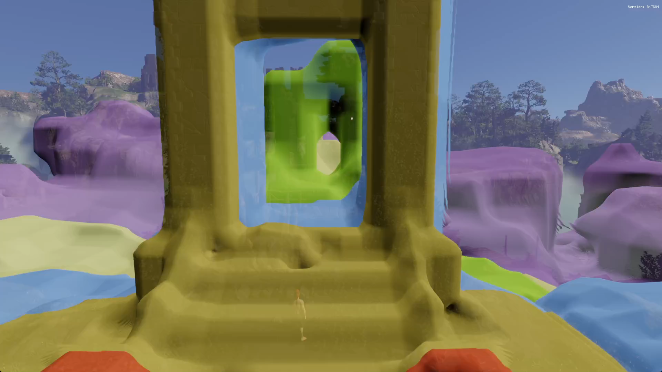
Video

Slide 37
Conclusion
Great results
Technical artistry as written in the books
No coding support from graphics programmers needed
Many feature requirements, but seldom blocks
Many small dispatches are fast
But…
Notes:
Overall the design lead to great results. It requires some deep technical knowledge of artists to come up with good and functional code logic. But our artists have that and managed to come up with inspired and astonishing results. Most of the VFX shader code was written with no support needed from any graphics programmer. We mainly had to support with new features. Of course we couldn’t fulfill all wishes with lead to cuts in some instances or creative workarounds in others.
We were also pleasantly surprised by how long this very simple method to dispatch the work on the GPU worked out. It seems like they are indeed pretty fast at executing parallel work when there a no dependencies.
But there were issues…

Slide 38
Issues
Occasional NaNs
  Checks in the API
GPU crashes and hangs
  Unbounded loops
    Find and fix
    Clamp delta-time
    Maybe add better API/helpers
  Invalid descriptors
    Type safety
    Defensive API
  Uninitialized variables remain a problem
Shader compilers struggle
Bad dependencies in the asset build
But there’s more…
Notes:
HLSL and the shader toolchain are not primarily targeted towards unhinged artistry. We observed some issue from the exposing such a low-level tool to artists. Let’s talk about the smaller issues first.
Occasionally we had unfortunate math which resulted in NaNs or other invalid values being written into the storage buffers which are consumed later in the pipeline. This lead to bad follow-up issues since most parts of the rendering pipeline are not prepared for that (i.e. NaN light colors cause interesting results ;) ). We’re trying to catch those as part of the VFX API (which ends up in the shader code). The debug build tries to make broken values very visible while the shipping build just silently drops those instances just to be extra save in case we missed some during testing.
GPU crashes and hangs are also a frequently occurring issue with VFX shaders. We found several issues:
Unbounded loops: The only solution we’re employing for those is to use GPU hang detection tools like NVIDIA Aftermath and AMD Radeon GPU Detective to find them and fix the logic. Some errors were actually caused by us not clamping the delta-time. It can become pretty large e.g. when scrubbing the time in the VFX preview and the VFX did employ some logic to catch-up. We though about forbidding raw HLSL loops in VFX code and forcing the artists to use expressions which force an upper bound via preprocessor macros, but ultimately didn’t employ that.
Invalid descriptors: Naturally all descriptors used for images in VFX code are bindless. Messing up those indices is easy which can also result in GPU crashes. At the beginning we tried to get that under control with come checks in the VFX API. But then HLSL2021 support became available we moved towards different struct types for different types of images. The new strict casting rules of HLSL2021 prevent mixing up those types at compile time now. Of course this still requires the VFX artists to mess with this data manually (i.e. by overwriting the descriptor index in those structs) but they didn’t :)
One unresolved issue are uninitialized variables. We’re advising VFX artists to program defensively and always assign some reasonable default value and this works fine now. But in the beginning this was a not the case and we’re still wondering how the shader toolchain could support us in finding those.
Some VFX shaders were apparently a bit unusual. On some platforms we need to use some special command line arguments for the shader compilers in order to prevent the shaders from crashing the GPU.
One other issue that’s totally on us is that unfortunately the iteration times are bad in some instances. This is due to some unfortunate dependencies in the asset build.

Slide 39
Some numbers
376 Particles
1689 Vfx definitions
16519 Vfx nodes
30+ Minutes runtime compilation 😱
Notes:
Here are some numbers that I got in the last month. Note that this also includes test data, that‘s why the relative amount of particle definitions vs effect definitions is quite large.
All in all the numbers are quite reasonable.
However, we spend a lot of time compiling our VFX shaders. On some PCs it takes over 30 minutes when the shader cache is empty. This happens in the background for vfx shaders so it‘s not a dealbreaker, but still not great as it can mean that some vfx are missing in the first 30 minutes of gameplay. The offline build for consoles is also not great.

Slide 40
Can you spot the issue?
Notes:
Can you guess into which kind of issues we ran?
It‘s two major issues that we found which I‘d like to discuss in the following.

Slide 41
A little anecdote (RTX 2070)
 | VK_EXT_memory_budget | vkAllocateMemory
 | 8,4 GB | 5,5 GB | +2,9 GB
-VFX | 6,9 GB | 〃
1,5 GB for VFX pipelines!!!
Notes:
While investigating our GPU memory consumption on the RTX 2070 I saw a large discrepancy between our memory usage as reported by VK_EXT_memory_budget vs what we‘re actually allocating via vkAllocateMemory. I hacked the tracking into the single location where we‘re calling vkAllocateMemory to make sure that I miss nothing. The result was that almost 3 GB of used GPU memory does not come from allocations made with vkAllocateMemory. We do have few things which we can‘t control directly (e.g. DLSS and driver internals like descriptor sets etc.), but the number was still too large. Then I thought about how one other thing that doesn‘t go via vkAllocateMemory is all the pipeline state and shader code.
At that point in time we just loaded all our VFX pipelines as fast as possible while the game was running and kept them in memory. As a quick hack just to see what happens I commented-out the creation of out VFX pipelines. This reduced the memory usage as reported by the Vulkan extension by 1,5 GB.
So the question arose: How did we manage to use 1.5GB of GPU memory just for our VFX pipelines?
We identified two large issues that I want to talk about a bit and which we‘re still working on improving.

Slide 42
A little anecdote (RTX 2070)
VK_EXT_memory_budget
vkAllocateMemory
8,4 GB
5,5 GB
+2,9 GB
-VFX
6,9 GB
〃
1,5 GB for VFX pipelines!!!
Notes:
While investigating our GPU memory consumption on the RTX 2070 I saw a large discrepancy between our memory usage as reported by VK_EXT_memory_budget vs what we‘re actually allocating via vkAllocateMemory. I hacked the tracking into the single location where we‘re calling vkAllocateMemory to make sure that I miss nothing. The result was that almost 3 GB of used GPU memory does not come from allocations made with vkAllocateMemory. We do have few things which we can‘t control directly (e.g. DLSS and driver internals like descriptor sets etc.), but the number was still too large. Then I thought about how one other thing that doesn‘t go via vkAllocateMemory is all the pipeline state and shader code.
At that point in time we just loaded all our VFX pipelines as fast as possible while the game was running and kept them in memory. As a quick hack just to see what happens I commented-out the creation of out VFX pipelines. This reduced the memory usage as reported by the Vulkan extension by 1,5 GB.
So the question arose: How did we manage to use 1.5GB of GPU memory just for our VFX pipelines?
We identified two large issues that I want to talk about a bit and which we‘re still working on improving.

Slide 43
Memory Issues
Too many pipelines
Large pipelines
Notes:
We found two big issues:
Around 90% of all pipelines in our build are VFX pipelines. This is obviously pretty stupid. (The two numbers are not precise as they were taken~6 months apart. Overall the argument still holds though. Additionally, the number of VFX pipelines differs significantly from the amount of VFX nodes stated earlier because there‘s also a 6 months gap in between when the numbers were recorded, due to deduplication by the asset build system and because it only includes shipping pipelines (i.e. no test pipelines)).
Dividing the memory taken up by VFX pipelines by the amount of pipelines that we‘re loading also yields a pretty high number. This indicates that the binary size of our pipelines is large.

Slide 44
Large shader binaries (RTX 2070)
VK_KHR_pipeline_executable_properties
“Binary Size”
∑ = 761 MB
Largest pipeline: 489 KB
Notes:
NVIDIA implements the VK_KHR_pipeline_executable_properties extension and reports a “Binary Size” for shader stages. We found the the sum of all those sizes over all VFX pipelines adds up to 761 MB. In our understanding this maps directly to device memory consumption (the whole pipeline object seems to consume even more memory though). One of the largest pipelines that we saw reported almost 500 KB for the shader binary which seemed way too much to us.
So we dug a bit deeper into what is happening there that could cause this excessive amount of memory consumption.

Slide 45
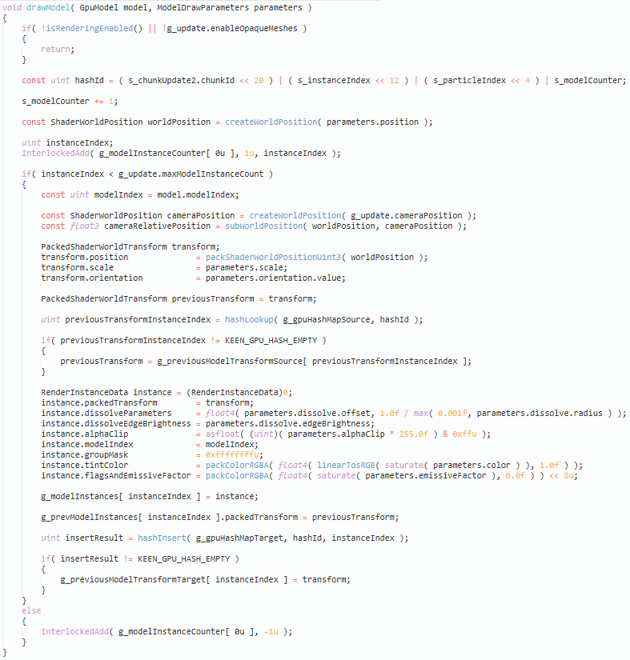
Inlining
if(floor(state.modelIndex) == 0)
drawModel( parameters.model_0, drawParams );
else if(floor(state.modelIndex) == 1)
drawModel( parameters.model_1, drawParams );
else if(floor(state.modelIndex) == 2)
drawModel( parameters.model_2, drawParams );
else if(floor(state.modelIndex) == 3)
drawModel( parameters.model_3, drawParams );
else if(floor(state.modelIndex) == 4)
drawModel( parameters.model_4, drawParams );
else if(floor(state.modelIndex) == 5)
drawModel( parameters.model_5, drawParams );
else if(floor(state.modelIndex) == 6)
drawModel( parameters.model_6, drawParams );
else if(floor(state.modelIndex) == 7)
drawModel( parameters.model_7, drawParams );
Notes:
One thing that stood out pretty quickly from the largest pipelines was the large amount of duplicate shader code on the GPU which was also present in the SPIR-V. Shader compilers do unconstrained inlining and this can very easily blow up code that reads fine on paper.
One example was this piece of code that was written by the VFX artist due to a lack of support for parameter arrays from our side. The drawModel function shown on the left might not look too problematic: A simple early out, one atomic add and then some data wrangling to record the model draw into a storage buffer along with a previous’ frame transform that we obtain from a hash map lookup (for motion vectors). However, if used like on the right, this causes the function and it’s whole call tree to appear eight times in the compiled code.

Slide 46
Inlining
GpuModel model;
if(floor(state.modelIndex) == 0)
model = parameters.model_0;
else if(floor(state.modelIndex) == 1)
model = parameters.model_1;
else if(floor(state.modelIndex) == 2)
model = parameters.model_2;
else if(floor(state.modelIndex) == 3)
model = parameters.model_3;
else if(floor(state.modelIndex) == 4)
model = parameters.model_4;
else if(floor(state.modelIndex) == 5)
model = parameters.model_5;
else if(floor(state.modelIndex) == 6)
model = parameters.model_6;
else if(floor(state.modelIndex) == 7)
model = parameters.model_7;
drawModel( model, drawParams );
Saved 60s offline compile time on one console platform 🙂
Other patterns:
  Procedural noise
Gradient calculations thereof 💀
Replaced with noise texture
Notes:
The fix in this instance was very simple though: First write the target model into a local variable (which maps to one register), and then call the function once. This helped a lot and even reduced the offline compile time of the shader that we observed on one console platform by 60 seconds.
This was not the only noticeable pattern though. Others included large procedural noise functions and 3d gradients thereof (which call the noise function 6 times) which were used multiple times in one shader and was easily replaced by a noise texture lookup. Note that the main reason why the VFX artists came up with this solution is because we were missing a feature that would allow the artists to define textures that they can use in multiple particles.

Slide 47
Inlining
Tried [noinline]
Maps to OpFunction/OpFunctionCall
Unstable
Notes:
One other thing that we tried was adding the [noinline] attribute to functions which were called multiple times in a shader. While this had some positive effects to both offline and online shader compile times and sizes it also caused weird issues and crashes both in the shader compiler and on the GPU. Since it was questionable whether this would help across the whole range of hardware that we‘re supporting for our game we didn‘t investigate this further.

Slide 48
Large amount of pipelines
VfxParticleParameters evaluateParameters(
VfxParticleTypeParameterBuffer parameterBuffer,
VfxParticleState state, VfxEffectData effect, VfxEngineData engine )
{
VfxParticleParameters parameters;
parameters.ignore_isInWater = effect.debug_ignore_isInWater;
parameters.isAdditive.x = getX( parameterBuffer.isAdditive );
parameters.lightMode = parameterBuffer.lightMode;
parameters.timerInitial = parameterBuffer.timerInitial;
parameters.timerUpdate = parameterBuffer.timerUpdate;
parameters.edgeFadeOutFactor = parameterBuffer.edgeFadeOutFactor;
parameters.depthFadeDistance = parameterBuffer.depthFadeDistance;
parameters.alphaInitial = 0.3 * random_range(0.5, 1);
// ...
return parameters;
}
Notes:
The second big issue that we have is the sheer amount of VFX pipelines.
Despite a nice separation of the source data we‘re unfortunately doing a too simple approach for generating the runtime data: Let‘s have a look again at the shader code which we‘re generating for each VFX node (so for each particle as part of an effect) that I showed earlier. It just contains the literal HLSL expressions that are part of the effect definition. Since those can access the following, we‘re also adding the generated effect parameters, parent state and spawn parameters from the parent‘s emitter parameter. This results in basically one unique shader source code for each VFX node.
We have automatic deduplication of equivalent shaders as part of the asset build pipeline, but this is not very effective due to the above.
As you can see in the generated code we‘re already loading literal parameter values from a storage buffer. This data driven approach renders the shader source code independent of the parameter values.

Slide 49
Failed: Expressions as simple data
Collect all expressions per particle
Replace with expression index
Shaders became too large and unstable
Notes:
We tried one very simple idea to get rid the many pipeline variants: As part of the asset build we’re collecting all expressions that can possibly be required in a particle shader. Then we stuff all those expressions into one big switch-case statement where each expression can be addressed using an index. We write the expressions’ index into the parameter data storage buffer and execute this statement every time there is a parameter expression.
Naturally the shaders became pretty large. Unfortunately the shaders became too large so that the compile times became too bad for working on VFX and we observed crashes on too many machines with this feature. Therefore we dropped this idea.

Slide 50
WIP: Data driven evaluation of expressions
Get rid of VfxNode -> Code dependency
Parse HLSL expression
Simplify as data
VM is too general
Parameterize common expressions
Data driven variable reads
Use GS memory to get rid of inlining
0.2 * random_range(0.3, 1)
0.2 * random_range(0.7, 1)
0.5 * random_range(0.7, 1)
1 * random_range(0.1, 1)
1 * random_range(0.2, 1)
1 * random_range(0.3, 1)
1 * random_range(0.5, 1)
1 * random_range(0.7, 1)
1 * random_range(0.8, 1)
1.2 * random_range(0.2, 1)
=> $0 * random_range($1, $2)
Notes:
We’re currently working on another possible solution which shows promising results. The goal is to make the generated shader code independent of the VFX node that it will execute. This will drastically remove the amount of VFX pipelines that we have to ship at the cost of some added complexity.
For that the initial step was to parse the parameter expressions ourselves. The obvious solution would be to use this information to emit bytecode for a VM that we’re executing in the compute shader, but we very quickly concluded that this would be too slow.
Then we had a look at our existing data again. We saw that many HLSL expressions are structurally similar and differ only in some immediate values.
This led us to the idea that instead of copying the parameter HLSL expressions directly into the target shader source we can emit more generic HLSL code replace immediate values by reads from a storage buffer. For that we’re simplifying the existing expressions as much as possible using aggressive constant-folding. That way expressions become data as well using a manageable amount of meta-expressions that would need to be supported per shader.
We also have to replace any access to the generated state structs by some data-driven storage buffer read. This means that we basically just access read the respective data from some memory offset that is computed from data at asset-build time.
To not run into the problem again that this sort of expression evaluation logic would be copied multiple times for each parameter that needs to be set we think about looping over the amount of parameters and using groupshared memory as temporary storage from which we fill the parameter struct after the evaluation for all parameters is done.
This is still very experimental and WIP but initial results look promising.

Slide 51
Conclusion Pt. 2
Artists are not graphics programmers
  Unusual shader code
  Probably should go through reviews…
GPUs are not really CPUs
  Be aware of code that looks nice but will execute horribly
Shader permutations can still be problematic
  Be aware of your dependencies
  An uber shader is not always the solution

Slide 52
Thank you!

Slide 53
References
[PCG 2014] Melissa E. O'Neill, PCG: A Family of Simple Fast Space-Efficient Statistically Good Algorithms for Random Number Generation

