Slide 1
Methodical GPU Profiling

Slide 2

Introduction
BEHAVIOUR INTERACTIVE
Leon Brands
Senior Graphics Programmer
Behaviour Interactive
Socials at the end
2

Slide 3






Who are we?
BEHAVIOUR INTERACTIVE
3
Notes:
Rotterdam studio of Behaviour Interactive
Company best known for Dead By Daylight
Also do a lot of work for hire and co-dev; which is what I’m a part of

Slide 4

Agenda
BEHAVIOUR INTERACTIVE
Motivation
Strategy
Investigate
Planning
Takeaways
4
Notes:
Here’s the plan for this talk

Slide 5
Motivation
Notes:
This talk is about optimisation strategies. So let’s talk about why that’s a point of discussion for us

Slide 6

Motivation
BEHAVIOUR INTERACTIVE
Scope
WFH
3+ years w/ 6-10 prog
Graphics support on consoles
Optimizations ☺
6
Notes:
Part of a Work For Hire team who’s been working on console support for King of Meat, a game by Glowmade and Amazon Games (out now!)
We’ve been a part of this for 3+ years, with 6-10 programmers (depending on the phase of the project), 3 of which are graphics programmers, including me.
The graphics group ports the graphics engine to various consoles and optimizes rendering workload, especially for some of the lower power platforms. Sometimes we also implement new features, but that doesn’t matter too much for this talk.

Slide 7

Motivation
BEHAVIOUR INTERACTIVE
Workload
Inherently undefined
Bottlenecks are always changing
Needed a strategy
7
Notes:
Optimization workload is inherently undefined; when I joined this project I knew that some platforms weren’t performing well… No clue where the bottlenecks are
Even if we did know them, bottlenecks are constantly changing; the game was still in active development, and optimizations may unveil previously hidden bottlenecks, or render previously notable bottlenecks irrelevant
We have 2 years to fill with an empty backlog, we needed a strategy

Slide 8



Optimization Origins
BEHAVIOUR INTERACTIVE
Origin
Ideas
1
Familiarity with code base, articles, talks, discussions
Reports
Observed performance issues by other developers & playtesters
2
Profiling
3
Hard work!
8
Notes:
Before we talk about our approach, let’s talk about how you find things to optimize
Where do optimizations come from?
*click* You might have ideas; as programmers you familiarize yourself with the project and you eventually think of something, or maybe articles, other talks, discussions with others, etc. can lead to sudden ideas
*click* Performance issues might be reported by other developers and playtesters
*click* The last source is profiling; this is manual and takes the most amount of effort
But here’s the thing *click*

Slide 9
Optimization Origins
BEHAVIOUR INTERACTIVE
Unreliable
Origin
Ideas
1
Familiarity with code base, articles, talks, discussions
Might not Happen
Reports
Observed performance issues by other developers & playtesters
2
Scientific
Profiling
3
Hard work!
9
Notes:
*click* Random ideas are not something you can rely on; they might not even come up
*click* Reports of performance issues only happen if you’re trying to solve a current performance issue; if you’re trying to optimize to increase quality, other users may never run into it. It’s also very possible that most players won’t recognize a small performance hitch, but that’s still something we’d like to find and resolve.
*click* But, profiling is scientific; it’s hard-fought but if you do it right it’s the only method that can guarantee you results
Of course all three sources play a valuable part, but the 3rd is what we’ll talk about today, because that’s only one that we can control.

Slide 10
Strategy

Slide 11

Strategy
BEHAVIOUR INTERACTIVE
while(frameTime > 16.6)
Optimizing is scientific
Clear Goal
Defined & Provable Results
Iterative workflow:
Analyze
Optimize
Confirm
Repeat
11
Notes:
Optimization is scientific; there’s a clear goal and there are defined and provable results.
The only thing we can’t guarantee is how much we’ll safe in one go, so this naturally leans towards an iterative workflow: analyze, optimize, confirm results and repeat until we hit our target.

Slide 12
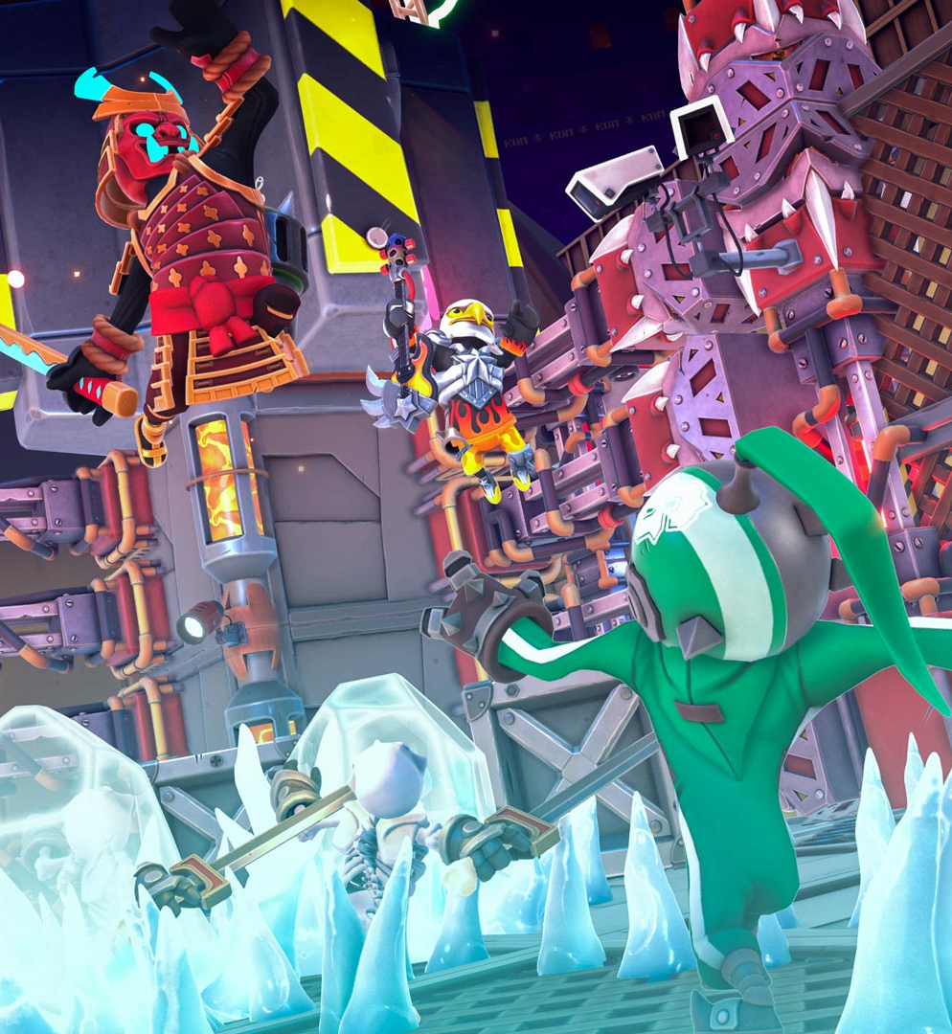
Strategy
BEHAVIOUR INTERACTIVE
Monthly Profiling Suite
Goals
Find optimization ideas
Re-evaluate status
Adjust to current phase
Do you need more data?
Don’t waste time
12

Slide 13

Strategy
BEHAVIOUR INTERACTIVE
Narrow it Down
Our Profiling Suite
Divide into steps
Work our way downwards
Scope 1: Game
Scope 2: Level
Scope 3: POI
Scope 4: Investigate
13
Notes:
What is our profiling suite like?
Divided into 4 steps. Start at the largest overarching level, way downwards.
From the game, to individual levels, to points of interests, to eventual investigation into individual render passes or shaders.

Slide 14
Strategy
BEHAVIOUR INTERACTIVE
Scope 1: Game
60 FPS
Test all levels
14
Notes:
Scope 1: Game
We want to make sure we consistently hit 60fps across the entire game. In theory this means we would we need to test all potential levels… which brings up a bit of a problem:
King of Meat is a dungeon delver with user-generated content, so uhhh *click*

Slide 15

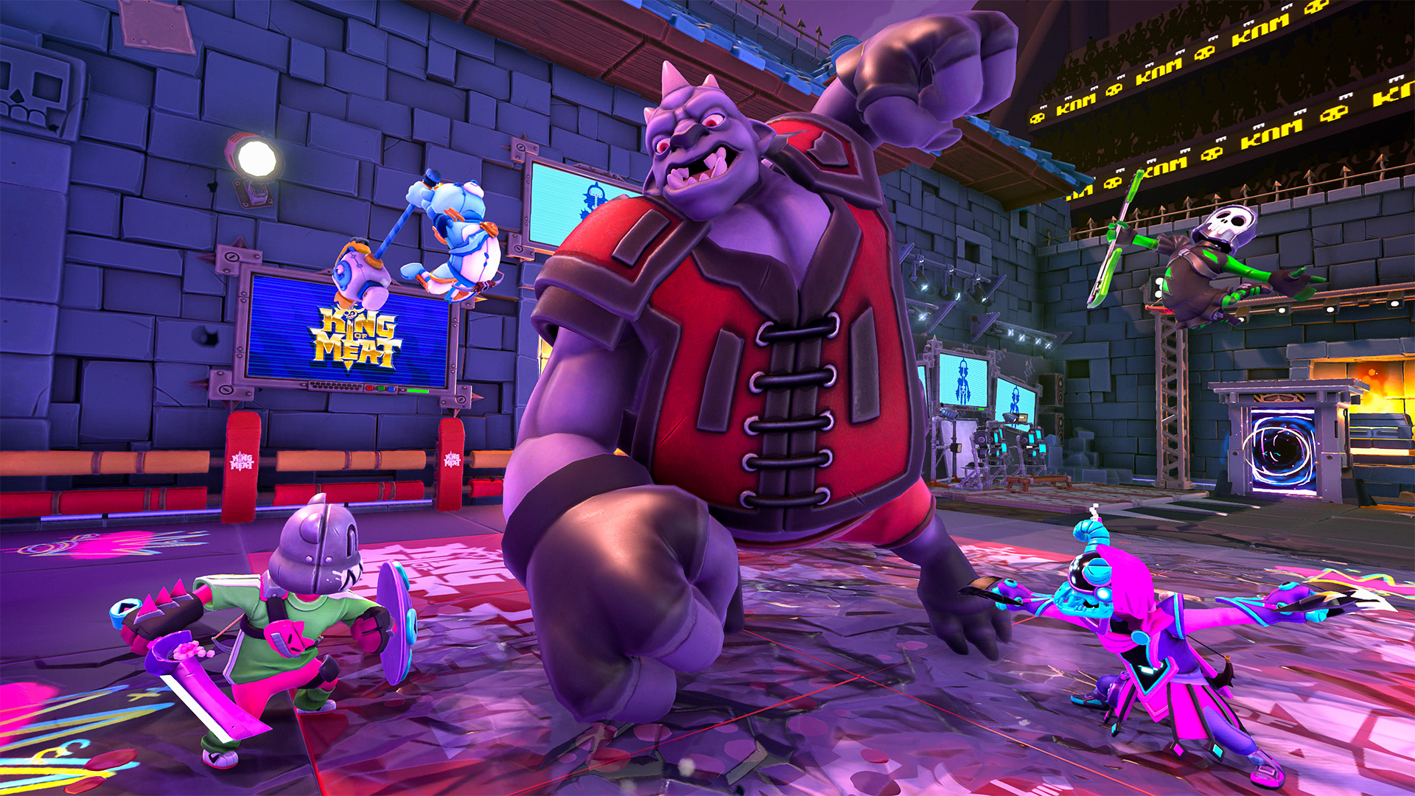




Strategy
BEHAVIOUR INTERACTIVE
Scope 1: Game
60 FPS
Test all levels
UGC…
©2024 and BEHAVIOUR and other related trademarks and logos belong to Behaviour Interactive Inc. All rights reserved. Other trademarks or copyrights are the property of their respective owners.
HIGHLY CONFIDENTIAL – DO NOT REDISTRIBUTE
15
Notes:
That’d be infinite levels to test
*click*

Slide 16

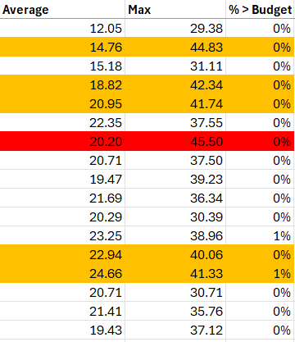
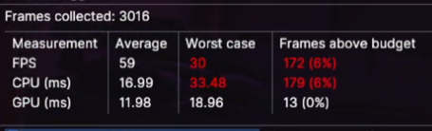
Strategy
BEHAVIOUR INTERACTIVE
Scope 1: Game
Fine, only official levels
Still tons
Quick tool for QA
16
Notes:
Fine, we won’t test all levels, only the ones paired with the game’s release…
That’s still tons of levels.
We work together with our QA to collect simple averages and statistics from levels. *click*
Not a lot of data, but enough to get a basic overview
We list those stats in an excel sheet *click*
and select the worst performing levels; either with frame-times regularly exceeding our budget, or with significant spikes

Slide 17
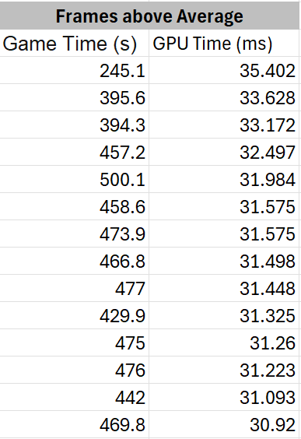
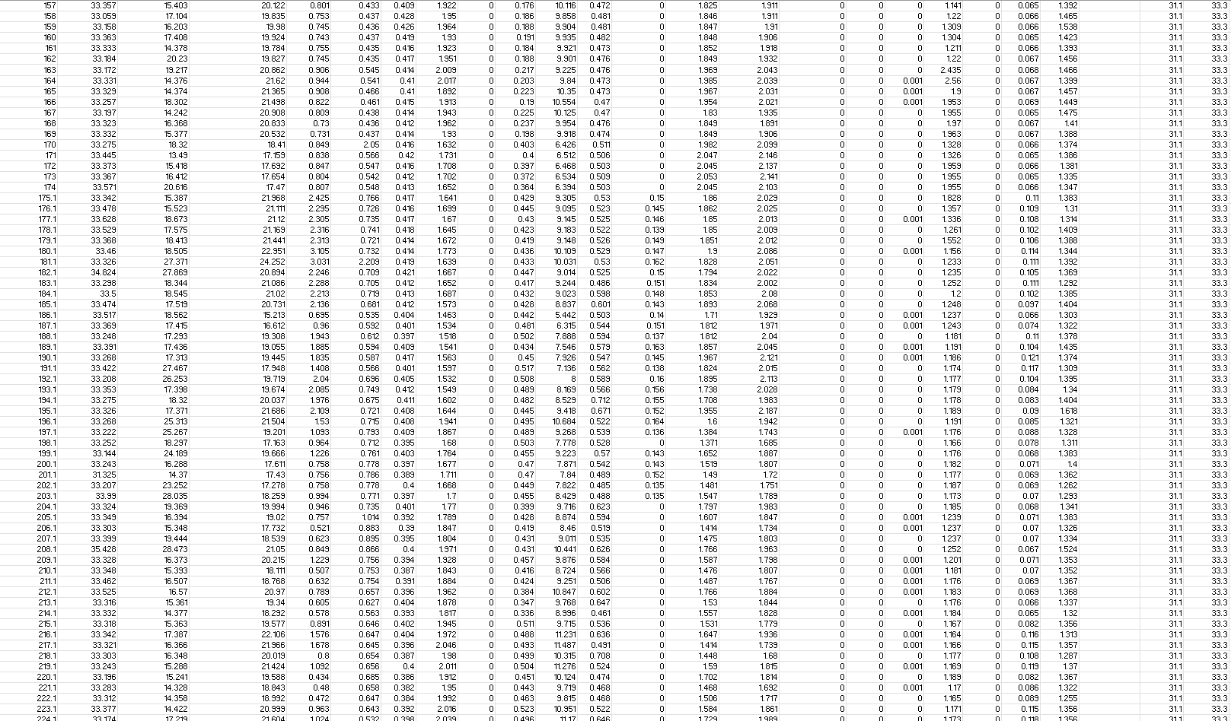
Strategy
Scope 2: Level
BEHAVIOUR INTERACTIVE
Selected some levels
Look deeper
Playthrough Profiler
Collect detailed frame data
GPU frame-time
Detailed breakdown into passes
Exported as .tsv files, imported in excel
Lot of data
Process w/ Graphs/Algorithms
Worst frames -> POI
17

Slide 18
Strategy
BEHAVIOUR INTERACTIVE
Scope 3: Point of Interest
List of POIs
Enough to start diving deeper?
Narrow down
Match with gameplay video using game time
Find new performance issues
Skip
Similar spikes
Non-prog work
Known issues
18
Notes:
We now have points of interest. This is often enough to start diving deeper.
But, if we have too many, we might need to narrow them down:
We match the data with videos of gameplay using the in-game clock.
Our goal here is to select points in the playthrough that have performance issues that we are not aware of, or we think have potential for improving.
So we use the data with the video to skip similar spikes, spikes caused by large particle systems that just need VFX work, or issues that we’re already aware of.

Slide 19

Strategy
BEHAVIOUR INTERACTIVE
Scope 4: Investigate
Look at POI
Poor performance on a render pass?
How to optimize?
19
Notes:
Looking at each individual POI, they all likely have some render pass that isn’t performing well. Usually one stands out, but if there are multiple, they might have a shared cause
How do you approach finding out what to optimize?
That’s what we’ll talk about next

Slide 20
Investigate

Slide 21
Investigate
BEHAVIOUR INTERACTIVE
How?
How do you optimize something?
Depends on what you’re optimizing
Rasterized Meshes
Full-screen Shader
Compute Shader
21

Slide 22
Investigate
BEHAVIOUR INTERACTIVE
Rasterized Meshes
GPU deals with large quantities
Draw call spawns vert shaders, spawns …
Take a top-down approach
What can you reduce?
22
Notes:
The rasterization pipeline deals with large quantities of work.
A single draw call starts thousands of workloads of vertex shaders, which then get followed by even more fragment shaders which then also iterate over dozens of lights.
In searching for optimizations, we usually take a top-down approach, attempting to reduce work as early as possible, since it can result in the most significant cuts.
What kind of things can you reduce? *click*

Slide 23
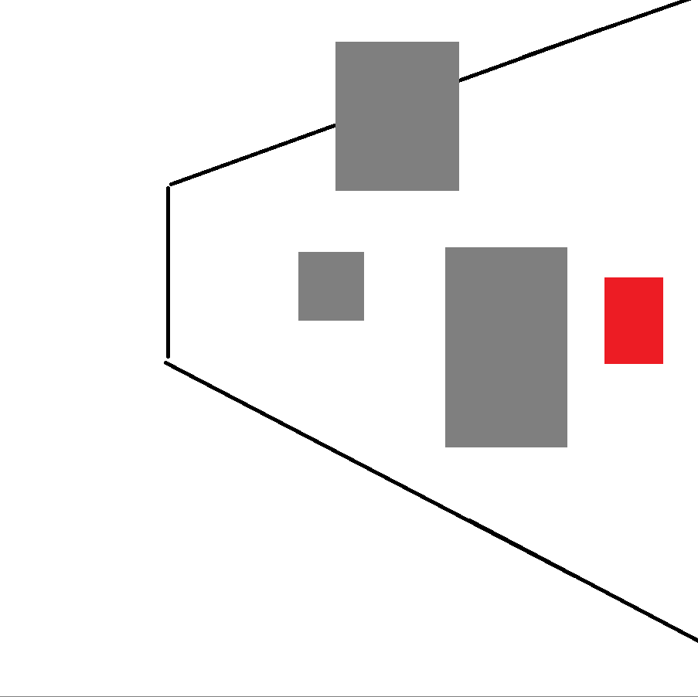
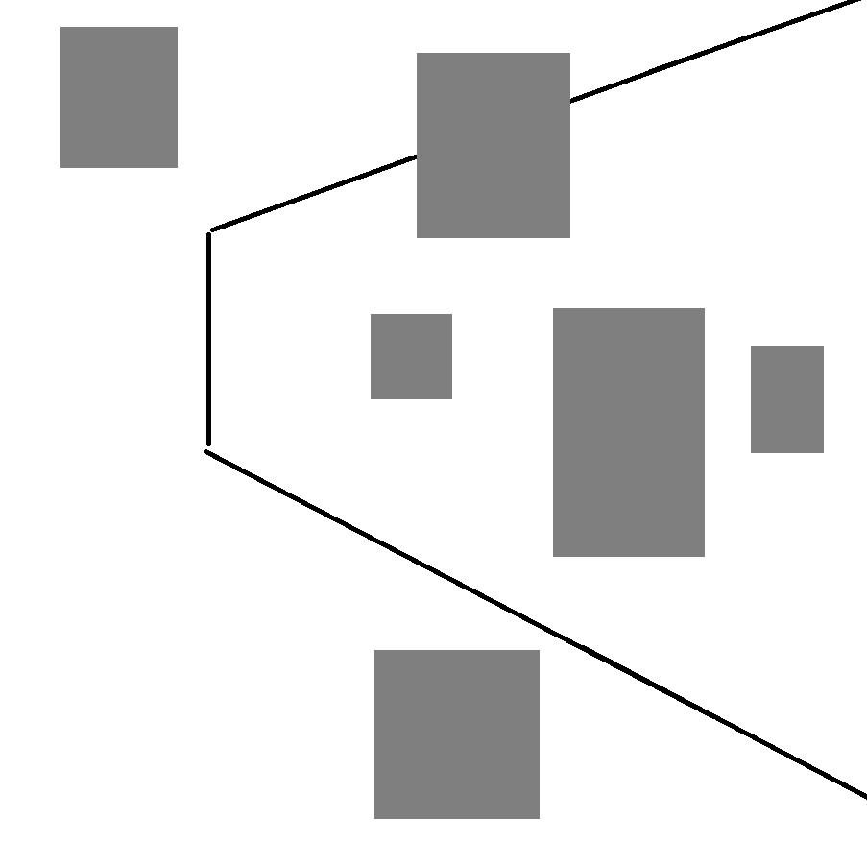
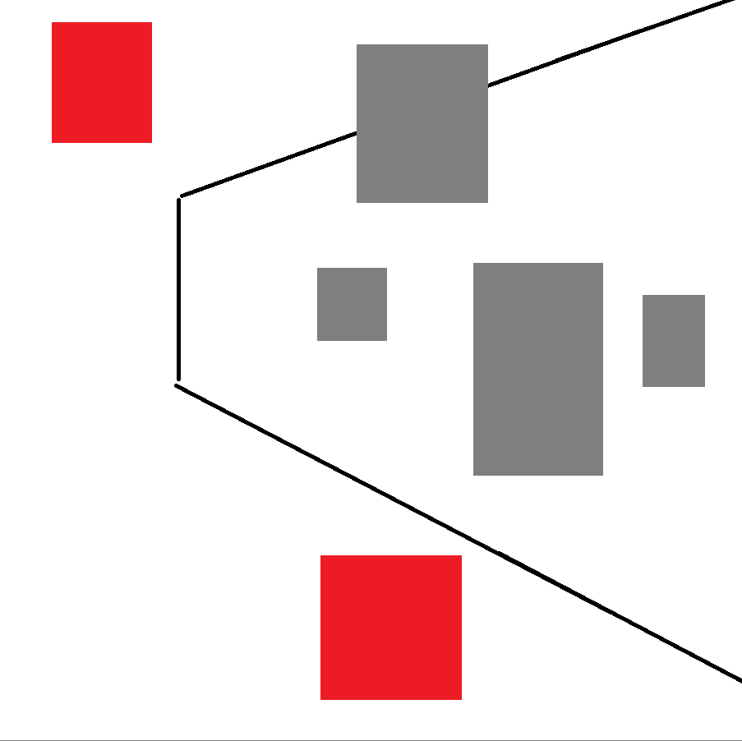

Investigate
BEHAVIOUR INTERACTIVE
Rasterized Meshes
Draw calls
Frustum Culling
Occlusion Culling
Distance Culling
23
Notes:
You can reduce the # of draw calls
For example,
*click* By frustum culling to determine if a mesh is in view
*click* And by occlusion culling to determine if a mesh is visible
*click* You can also perform distance culling for small meshes that are far away

Slide 24

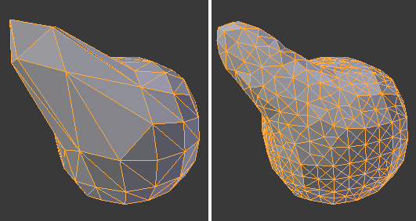
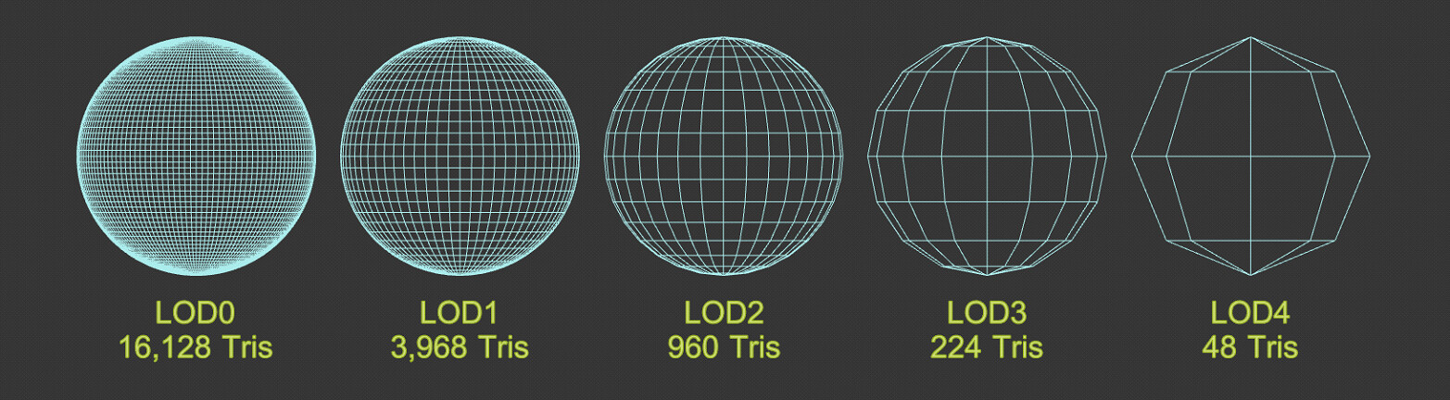
Investigate
BEHAVIOUR INTERACTIVE
Rasterized Meshes
Draw calls
Vertices
Optimize Assets
Create LODs (and implement)
Mesh Clusters
Triangle Culling
24
Notes:
*click* You can reduce the # of vertices, which is often a combined effort between the engine and art team;
Your artists can optimize assets *click*
And create LODs *click* (which you then have to implement)
From your end you can implement things like mesh clusters *click*
And perform triangle culling *click* for extra high density meshes
But those last two are only worth it if your goal is high vertex density; if you’re targeting lower end platforms, lowering your vert count through artist help might be your only path.

Slide 25
Investigate
BEHAVIOUR INTERACTIVE
Rasterized Meshes
Draw calls
Vertices
Pixels
Upscaling
VRS
25
Notes:
Or you can reduce the # of pixels
- A common approach to this is upscaling like DLSS or FSR to reduce your render res, but that comes at a quality cost, which is something that you might not always be willing to sacrifice. For modern GPUs you can use Variable Rate Shading to squeeze out performance with lower visual losses.

Slide 26
Investigate
BEHAVIOUR INTERACTIVE
Rasterized Meshes
Draw calls
Vertices
Pixels
Lights
Spawns even more work!
Lights, decals
We use clustered rendering
With a simple z-range filter
(short sight-lines)
26
Notes:
Inside the pixel shader, even more work may be spawned; iterations over point lights, spot lights, decals
There are a lot of technologies available online to reduce this. For King of Meat we use clustered rendering (tiles) clamped by a per-tile z range, which proved enough for our use case given shorter sight-lines ☺

Slide 27
Investigate
BEHAVIOUR INTERACTIVE
Rasterized Meshes
Draw calls
Vertices
Pixels
Lights
Don’t do everything blindly
27
Notes:
I’m not saying implement all these techniques; I’m saying, look at your pipeline, look at what things are fundamentally spawning work, and consider how much of that work contributes to the screen the player gets to see.

Slide 28
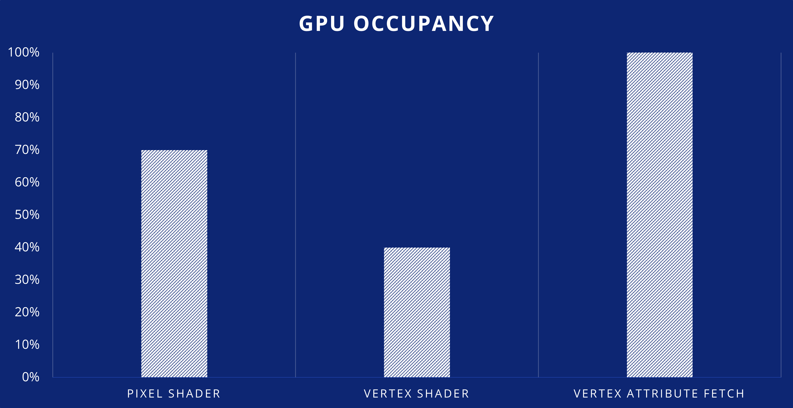
Investigate
BEHAVIOUR INTERACTIVE
Learn From Our Mistakes
Main pass slow
Bottleneck should be pixel shaders
Pixel shaders low occupancy
Vertex shaders also low
Bottleneck in VAF
28
Notes:
We identified that the main render pass was slow and needed work.
This pass performs a lot of lighting calculations and should be heavily pixel-shader bottlenecked.
But the pixel shader occupancy is low
Look at the vertex shader… its occupancy is also low. We would normally expect this in the main pass given the pixel shader work, but in this case something must be bottlenecking even earlier
Vertex shaders rely on data being pulled in from the vertex attribute fetch; this is where the bottleneck lies

Slide 29
Investigate
BEHAVIOUR INTERACTIVE
Learn From Our Mistakes
Main pass slow
Tried everything we thought we could
Don’t read attributes you don’t need
Separate vertex attribute streams
Compress vertex attributes
29
Notes:
So, we’ll do everything in our power to optimize this:
Modify shaders to reduce which attributes get read
Create separate vertex attribute streams
Compress vertex attributes (combine attributes, octahedral mapping)

Slide 30
Investigate
BEHAVIOUR INTERACTIVE
Learn From Our Mistakes
Main pass slow
Tried everything we thought we could
Nothing worked
Goal: Unlock pixel shader
Overzealous shader optimizations
Vertex workload vs pixel workload
Rebalance, change the input
30
Notes:
But none of these really had an impact.
Let’s take a step back
Our goal was to unlock pixel shader potential…
We were too overzealous and immediately dove into vertex shader optimizations.
Our first step should’ve been to move back up the pipeline by reducing vert count, because this was a problem of vertex density; the ratio of vertex workload vs pixel workload was simply off.
Reducing the per-vertex cost wasn’t enough to have an impact, whereas optimising art, adjusting level of detail, etc. made all the difference we needed

Slide 31
Investigate
BEHAVIOUR INTERACTIVE
Shader Optimizations
Can we optimize shaders now?
After you’ve done everything else
(usually)
Optimize (pixel) shaders
FS pass / Compute
No larger pipeline
1 consideration
31
Notes:
Now that I’ve discouraged you from optimizing shaders, let’s talk about optimizing shaders
Usually you want to do this after you’ve looked at all the other steps in the pipeline
But take that advice with a grain of salt; sometimes you know the exact bottleneck, or you know an easy/quick way to solve an issue. These directions are just guidelines.
This is also where full-screen passes and compute shaders come in. They don’t follow the typical rasterization pipeline, so there are fewer steps we need to look at. But do consider adjusting the resolution for these passes; off-screen effects like reflections, SSR, and SSAO, can often get away with reducing the resolution by quite a bit since these passes don’t contribute to the final result as much as the main rasterized pass.

Slide 32
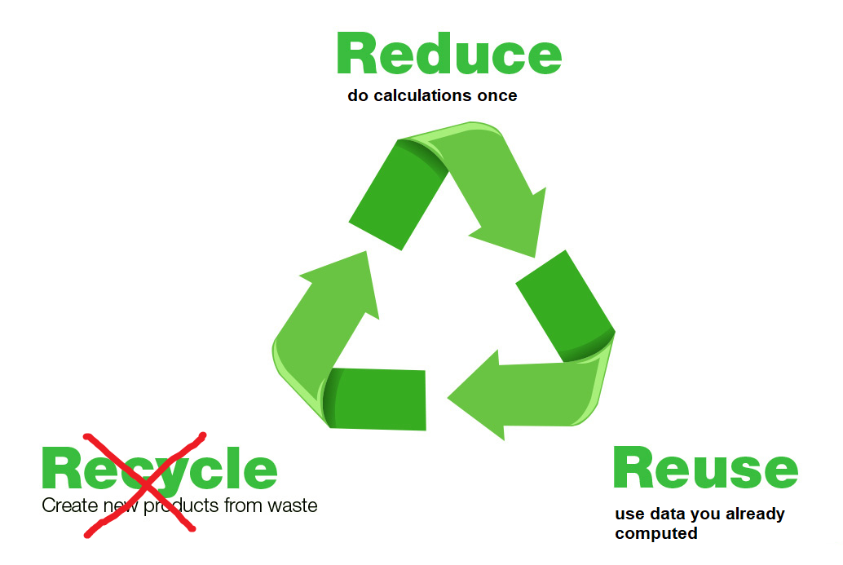
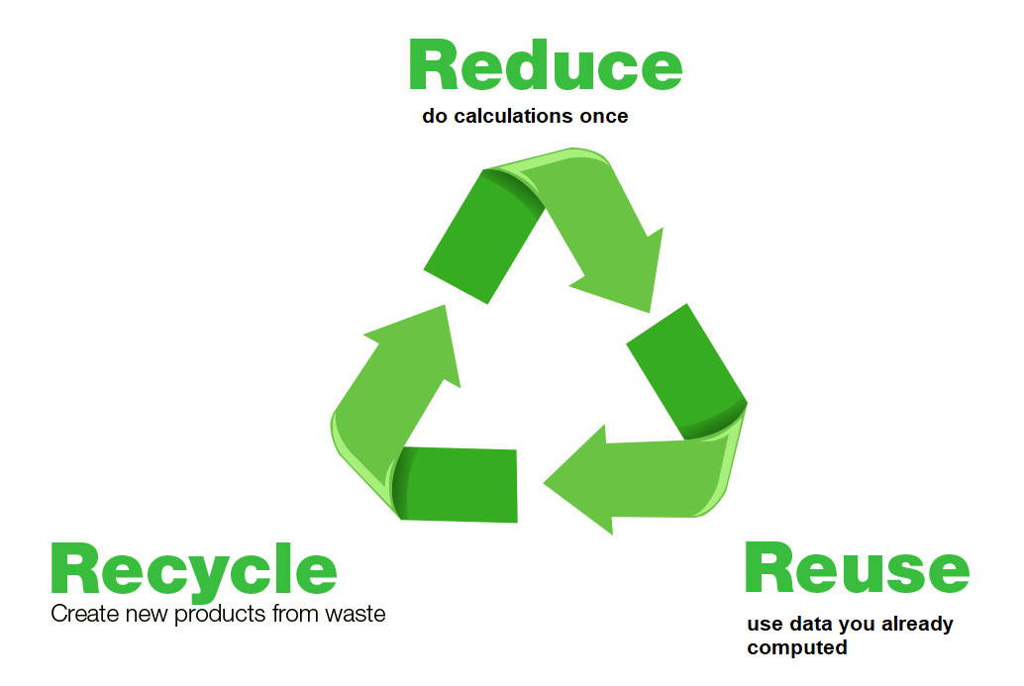
Investigate
BEHAVIOUR INTERACTIVE
Shader Optimizations
Not entirely in the scope of this talk
Quick Thoughts:
Waste less!
Reduce
Reuse
Recycle
32
Notes:
Full shader optimization isn’t in the scope of this talk
But I’ll give you some quick thoughts
Apply the same concept as the rest of this talk: Waste less, do less work.
Shaders have a lot of invocations
Reduce: Don’t compute the same work in a shader if the result is always the same. Compute it in the earliest stage possible and pass it along.
Reuse: Reusing data you’ve already calculated is great! For example, you can use your early depth buffer to also occlude objects, prevent lights from being considered, etc. In compute shaders you can often use wave operations to do less work per thread as well (there was a great talk on that last year by Alexandre Sabourin, I’ll link it at the end)
Recycle: Yeah that’s where the analogy falls apart. Moving on

Slide 33
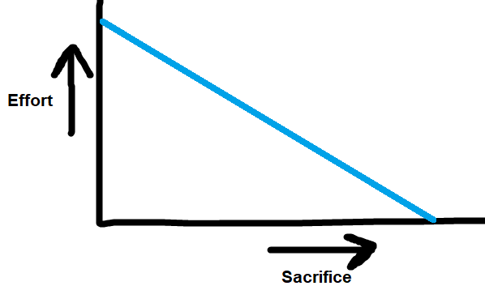
Investigate
BEHAVIOUR INTERACTIVE
Know Your Project
Consider this
You know your project the best
Optimizations are rarely without a sacrifice
What are you willing to give up?
Less Sacrifice = More Effort
33
Notes:
Finally, in finding optimizations, consider this.
You are the one who knows your project best..
Optimize = Sacrifice
What are you willing to give up?
Usually, the less you’re willing to sacrifice, the more effort you’re going to have to put in to make it happen, so the optimizations you decide to make will depend entirely on your project’s requirements, limitations, goals, and the time you have, to get it all done.

Slide 34
Investigate
BEHAVIOUR INTERACTIVE
Post-Optimization
Sacrifices were made
Don’t keep them blindly!
Prove impact & stability:
Profile before/after
Screenshot before/after
34
Notes:
Which brings me to my next point: Optimizations are a sacrifice; you shouldn’t add them blindly.
You’re often trading off against visual quality loss and increased code complexity, so verify if your results are worth it.
Every optimization we make is paired with profiling data where we measure the workload before/after to see if the optimization even had a positive effect, and screenshots / recordings of the before / after so we can judge the visual tradeoff and prevent regressions.

Slide 35
Planning
Notes:
How does this all fit into the usual planning structure of game dev?

Slide 36

Planning
BEHAVIOUR INTERACTIVE
Agile
Very agile
We had a lot of autonomy
Status update
Re-evaluate monthly
Sprint-like planning
36
Notes:
This approach is very agile and could easily slot into Scrum or anything alike.
During our development, my team had a lot of trust from our producer, but if you have less autonomy, you’ll have to work more closely with whoever’s in charge
The profiling suite doesn’t just provide us with new tasks; it also gives us a status update of our work. We re-evaluate our direction monthly after the profiling suite, and we plan our workload in a sprint-like manner on a bi-weekly basis.

Slide 37

Planning
BEHAVIOUR INTERACTIVE
Prioritize
How do you determine priority?
Discuss:
Impact
Complexity
Risk
Sacrifice
Every idea should be considered
37
Notes:
How do you determine what work’s most important?
Well that’s somewhat subjective but you can determine some loose metrics. We usually discuss and rate the potential performance impact, complexity, risks, and visual sacrifices.
Every idea should be considered and written down, even if it’s not worth it at the time, it’s something that may come to use / reconsideration later

Slide 38
Planning
Longer Term
BEHAVIOUR INTERACTIVE
How to stay on track?
Leave leeway
Determine goal
Set periodic targets
38
Notes:
How do you stay on track on a longer-term basis?
Optimization work isn’t always guaranteed to succeed; you might find yourself optimizing something only for it to perform the same or worse. Leave leeway in planning
First, we must determine our goal; what is our current situation, what is our target performance, and when should we reach said target?
Then we divide the timespan in reasonable chunks; for us we decided to work with monthly targets

Slide 39
Planning
Longer Term
BEHAVIOUR INTERACTIVE
Example
45ms -> 30ms in 4 months
5ms/month
Profile, analyze, etc. as discussed
Tasks with little visual impact
Fallbacks with worse tradeoffs
Only use fallbacks to hit targets
39
Notes:
For example
If our objective is to hit 30ms in 4 months, and our current frame-time is 45ms,
Then we might set a 5ms per month budget; leaving 1 month leeway to catch up
Every month, we profiled and analyzed like I’ve discussed.
We found optimizations that had little to no visual impact, would likely improve performance, and would potentially bring us to our performance targets,
but we also kept ideas around with worse tradeoffs; tasks that would result in visual quality losses but would result in known notable performance boosts.
These fallback tasks would only have been implemented in the case that our planned workload didn’t help us hit our targets on time.

Slide 40
Takeaways

Slide 41

Takeaways
BEHAVIOUR INTERACTIVE
Optimization is Scientific
Our decisions are backed by hard facts along the way
This helps us make the best decisions we can
Monthly results provided a record
41
Notes:
Optimization is scientific. There’s a method to the madness and if you’re doing it for longer periods of time you shouldn’t be going in headless.
The approach we used allowed us to make decisions backed by hard facts, which we were able to reference along the way
Monthly results provided a record of our work; proving we were following a good trend, and catching regressions.

Slide 42
Takeaways
BEHAVIOUR INTERACTIVE
Don’t Let It Get Stale
This workflow evolved over time
You can’t force yourself into a single workflow and never reconsider
We constantly adjusted for our needs, the project’s state, etc.
42
Notes:
Finally I’d like to press…

Slide 43
Takeaways
BEHAVIOUR INTERACTIVE
It Worked
This approach works for us
Measurable results
Backlog full of potential work
Most valuable work is prioritized
Consistent and significant performance improvements
43

Slide 44


Slide 45

Sources
For Reading?
BEHAVIOUR INTERACTIVE
Occlusion Culling: https://blog.selfshadow.com/publications/practical-visibility/
Practical Clustered Culling https://www.humus.name/Articles/PracticalClusteredShading.pdf
Siggraph 2015: Advances in Real-Time Rendering in Games https://advances.realtimerendering.com/s2015/aaltonenhaar_siggraph2015_combined_final_footer_220dpi.pdf
Octahedral Mapping https://knarkowicz.wordpress.com/2014/04/16/octahedron-normal-vector-encoding/
Harnessing Wave Intrinsics For Good (And Evil) https://youtu.be/U6t33RLa0XM?si=_KIA-EnzYVgS3ZxV
45
Notes:
Speaker’s notes on these sources:
We used Practical Visibility as our reference for implementing Occlusion Culling
Most of our view distances are relatively small, so the tile-range from Practical Clustered Culling was enough in this case, but we did play around with a z-binning approach based on https://www.activision.com/cdn/research/2017_Sig_Improved_Culling_final.pdf
We didn’t end up having high enough vert counts to consider mesh clusters or triangle culling, but they’re discussed in these sources as well.

Slide 46
We’re Hiring
BEHAVIOUR INTERACTIVE
BHVR Rotterdam
https://www.bhvr.com/rotterdam/
Senior Programmer
Principal Programmer
46

Slide 47

Let’s Connect
BEHAVIOUR INTERACTIVE
Leon Brands
Scan QR code for LinkedIn
47

