Slide 1
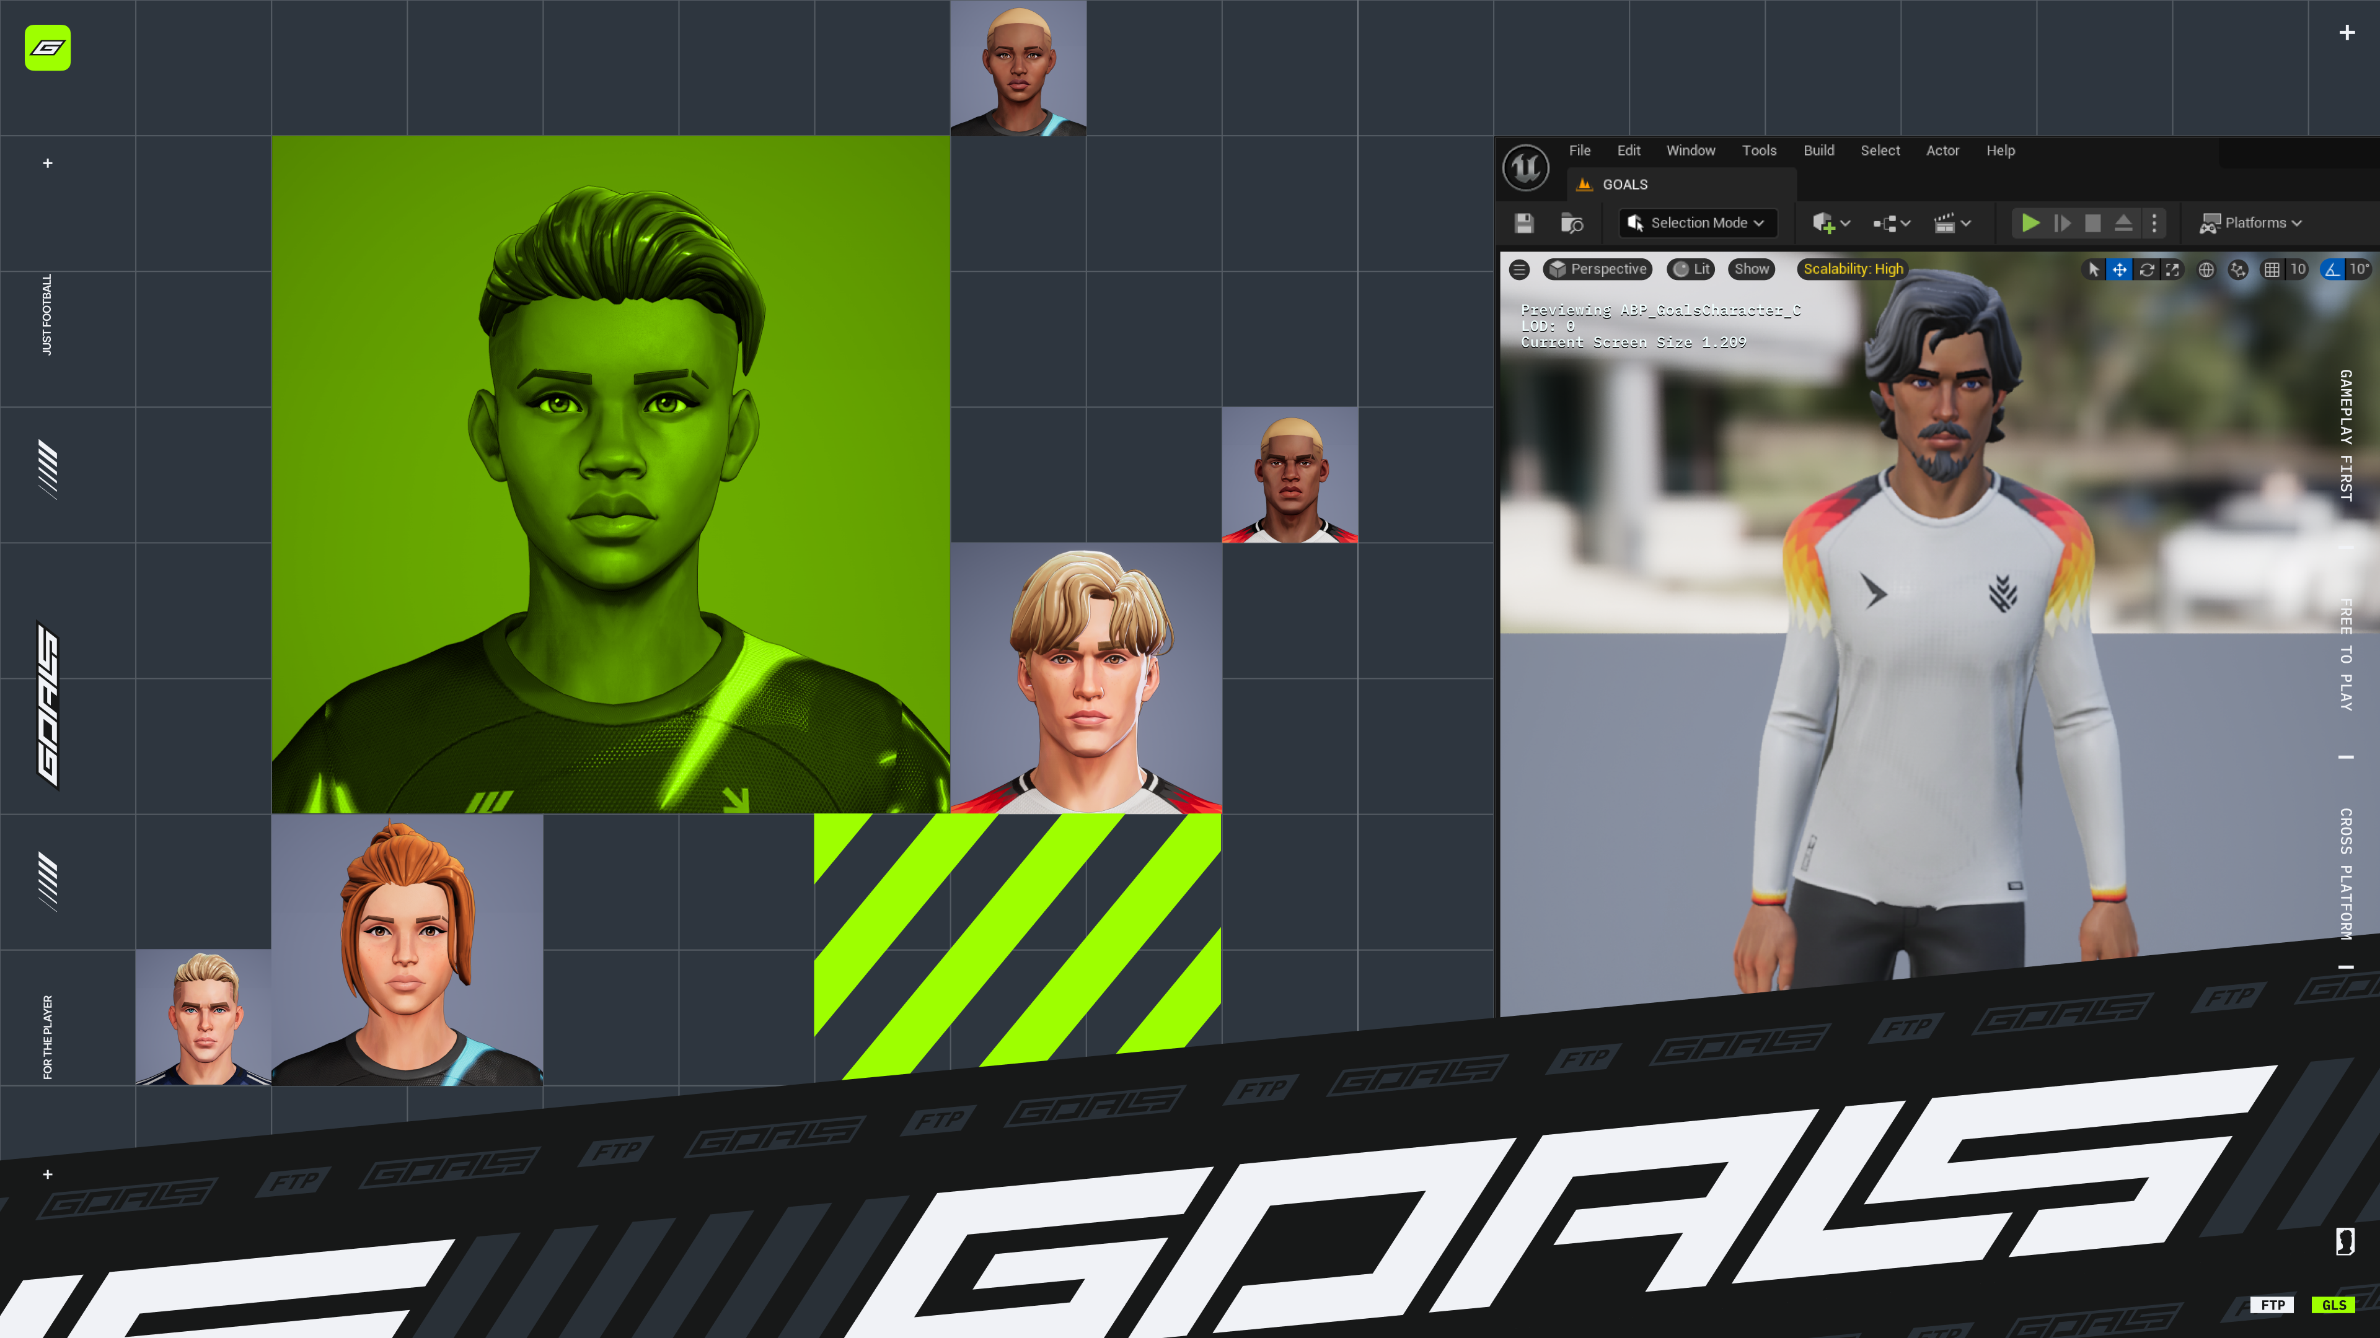

Slide 2
Seed-based Character Generation in UE5
Mario Caprino - GOALS
Notes:
Hi. My name is Mario Caprino and I am a principal programmer at GOALS. For the last year I have been working on their runtime character generation system.
Today I am happy to share our experience developing a custom solution for use with Unreal Engine.

Slide 3
GOALS
New free to play soccer game
Focus on responsive and fair gameplay
E-sports ready
To be released 2026
Notes:
View yesterday’s presentation of Split for Speed for more information about the game and it’s development.

Slide 4
Generated characters
No licensed players or clubs
All characters are generated on demand at runtime from seed
Character visuals must remain deterministic
Notes:
What makes our game unique to other football games …
[1, 2]
Seed is set when the character is generated by our cloud team. As you will see there is only a minimal amount of cloud data that affect a character’s visuals.
[3]
We need to ensure that the same visuals are always generated from the seed. We will talk more about this.

Slide 5
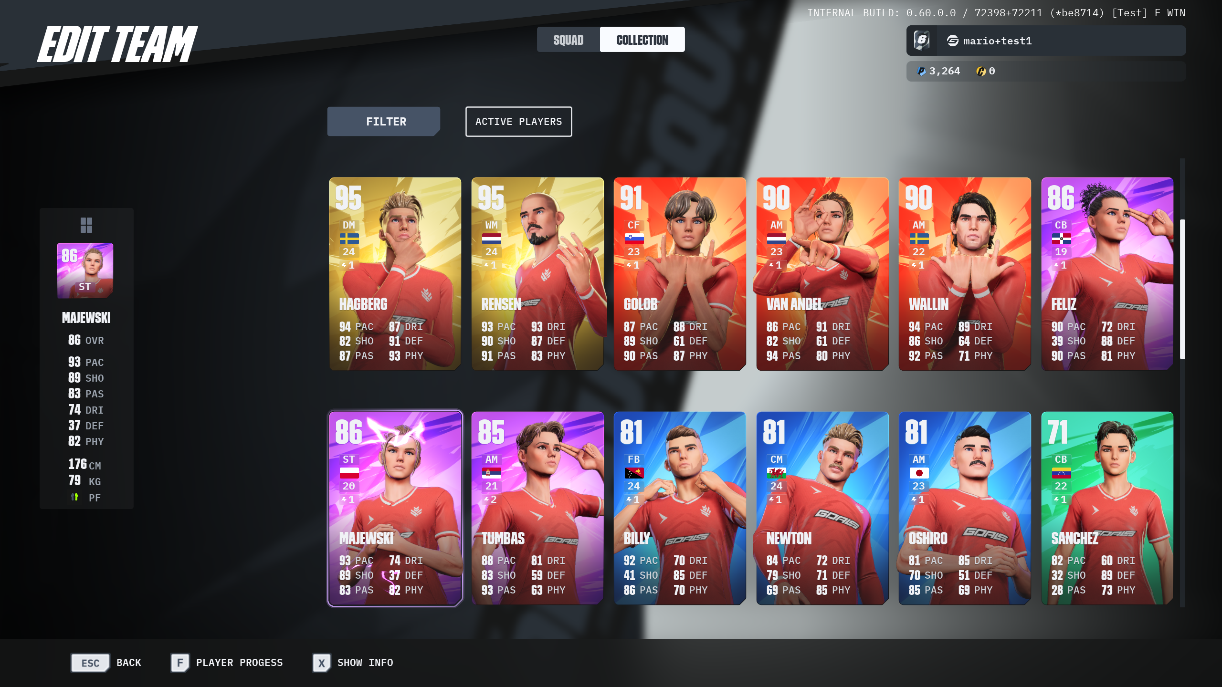
Generated characters
Screenshot
Notes:
Here is a screenshot from GOALS showing some of our generated characters.
For a game we generate 22 characters. This takes a few seconds and is performed while loading the level.
By quickly scrolling through player cards you are able to quickly request 100s (or even 1000s) of characters to get generated.
We therefore cache the generated player card image, to save us from generating character if image exists. We also allow player card generation to be cancelled if we notice that you are no longer viewing the card by the time we are about to process the request.

Slide 6
Unreal’s Mutable plugin
Seed based character generation is a main feature of GOALS
Mutable is a beta feature
Makes us dependent on an external providers road map
Better flexibility with our own solution
Notes:
Before we continue I should mention that Unreal has plugin for dynamic character generation.

Slide 7
Toolchain overview
Populate string map from character seed
Convert strings to visual data using blueprints
Combine visual data to Unreal skeletal mesh
Dividing character generation into multiple steps allow us to provide artist tools for each level
Notes:
We have split the process of generating character into multiple steps.
Each step transforms the input of the previous step, until eventually we have the visual data needed to create a skeletal mesh.
[1] This is where we randomize combinations of art assets
[2] Visual data is mesh pieces, materials and material parameters used to create material instances
[3]
I’ll now show you example of various internal tools that allow our artists to play around with the inputs at each stage of the character generation toolchain; character seed, string map and finally visual data.

Slide 8
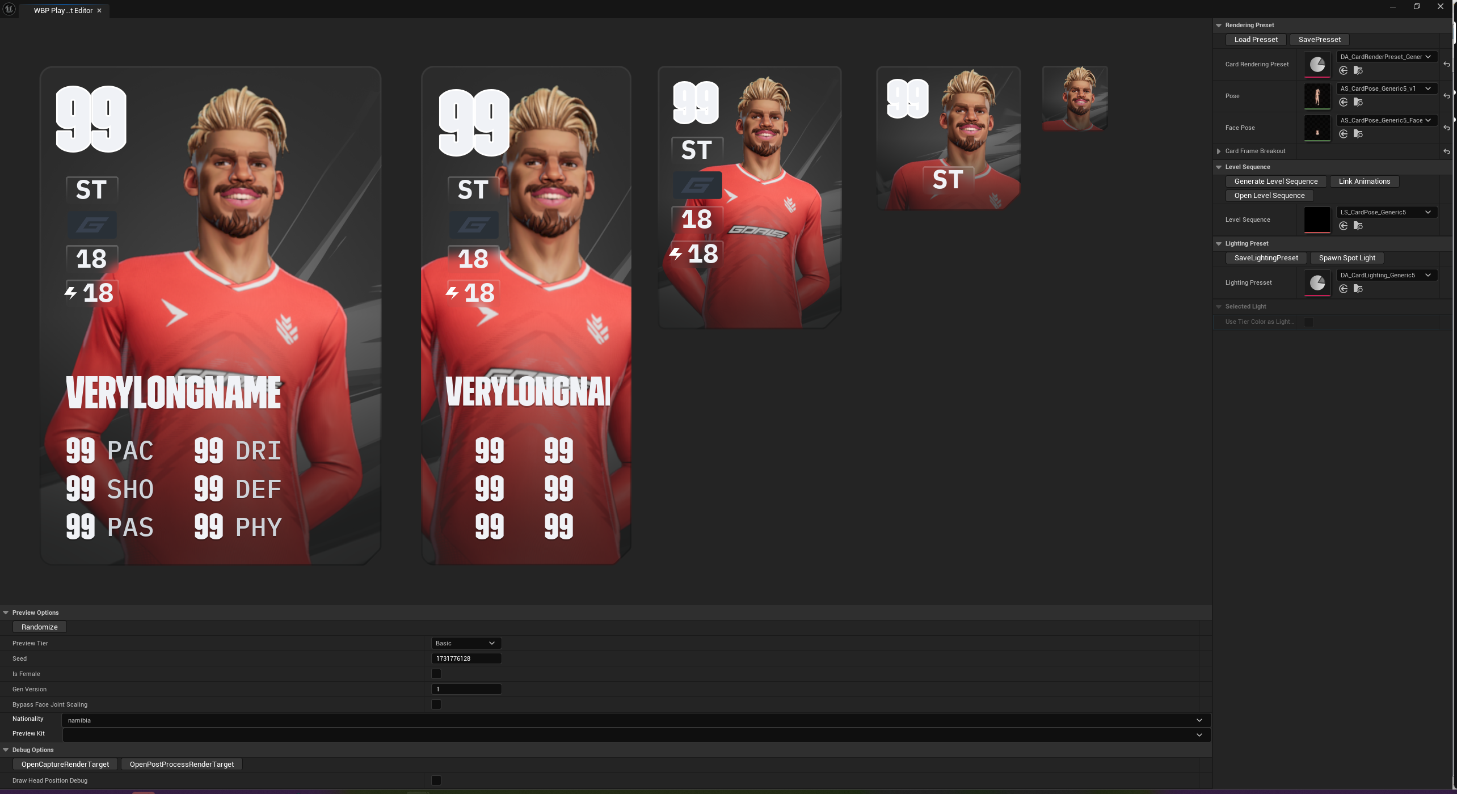
Seed input
Screenshot of portrait tool illustrating an artist tool using seed as input
Notes:
Example of an internal tool that runs of character seed (step 1). Tool is used to help artists make poses for a player card.
The tool works with the seed, gender, nationality to determine the visuals for the character.
There is also a version number that refers to the snapshot we use to generate the character. I’ll be talking more about snapshots later.
This is the only visual data we store regarding a character in our cloud data. All visual parameters are determined from these values.
Notice there is a randomize button to make it easy for artists to quickly test a variety of generated characters. You’ll notice that all our internal tools have a randomize button.

Slide 9
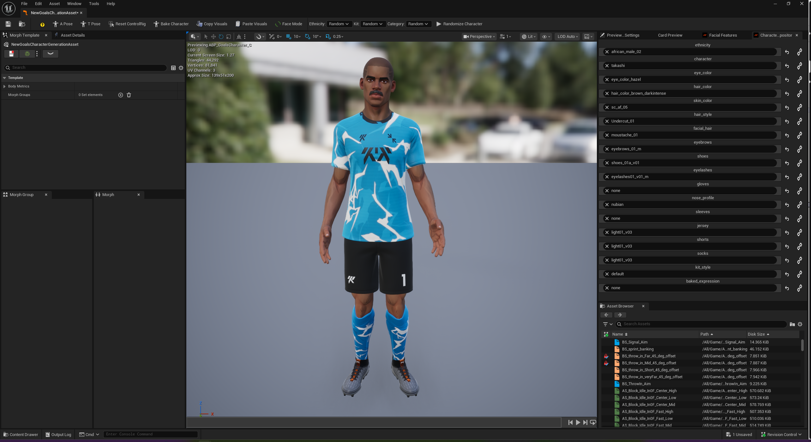
String map input
Screenshot of character tool illustrating an artist tool using stringmap as input
Notes:
Example of an internal tool that runs of string map. This tool allows our artist to test all combinations of character visuals.
On the right side bar you’ll see various body and clothing components that affect the generated character. These would normally be populated by the character seed, but here we allow the artist to set any combination they want.
The lock bar to the right of each component allows the artist to freeze one or more values, while using the randomize button in the top bar for quick testing.

Slide 10
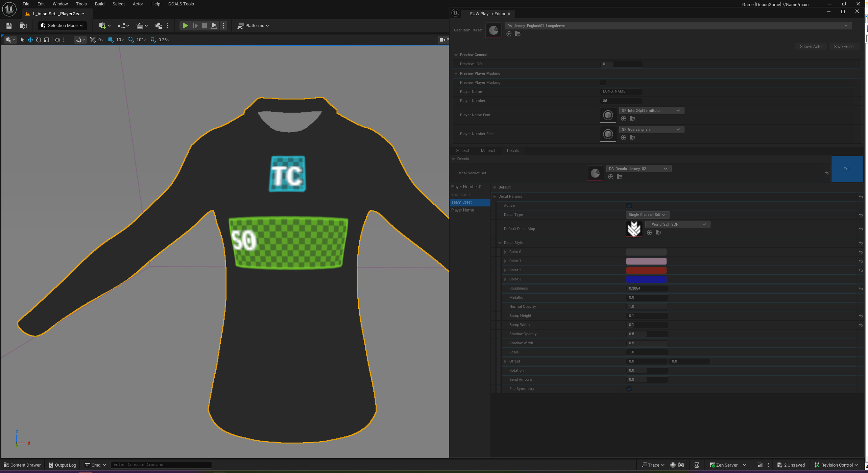
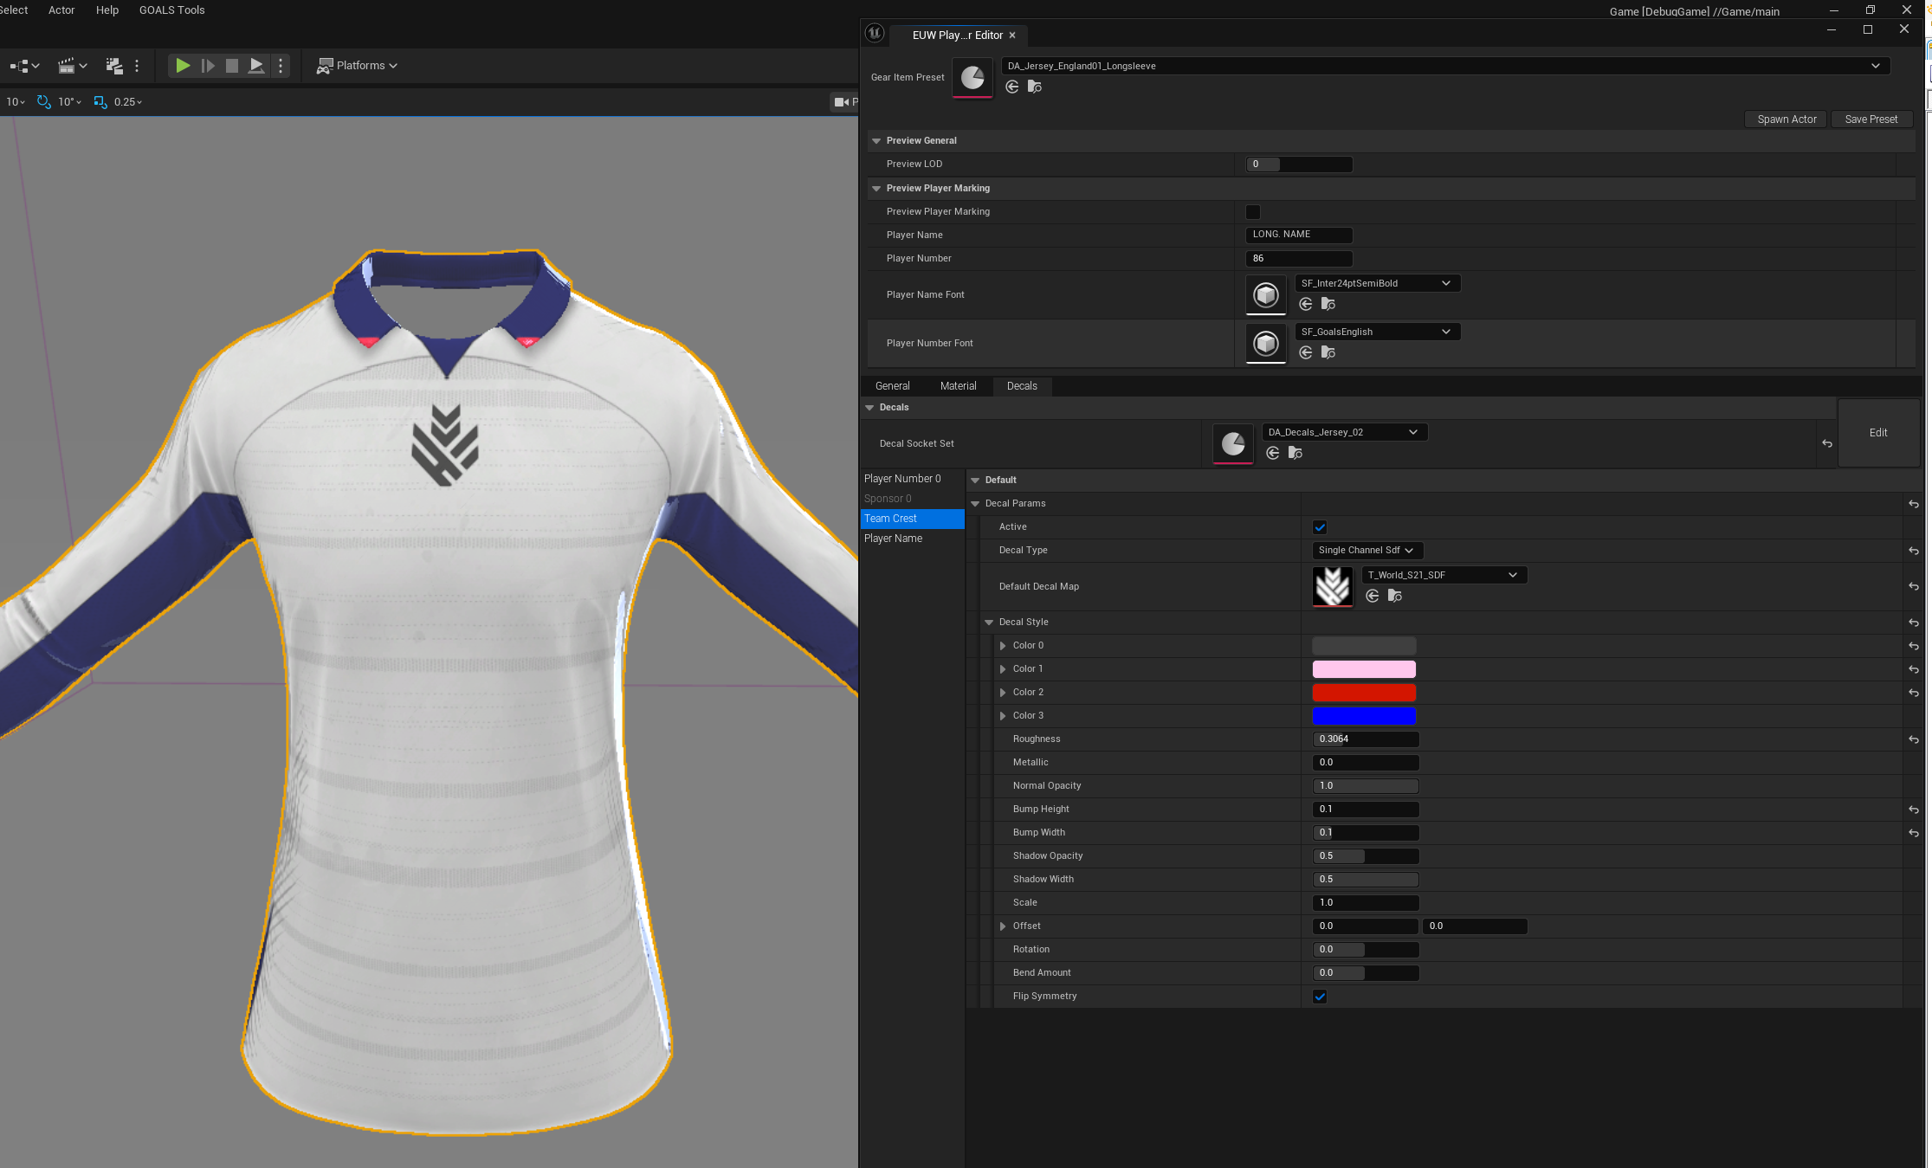
Visuals data input
Screenshot of decal tool illustrating an artist tool using visual data as input
Notes:
Example of an internal tool that works on the visual data (step 3, the final step in our toolchain). This tool allows our artist to define decal placement on the player’s clothing.
Rather than generating a full character we use the same system with limited visual data to only generate the mesh piece the artist is working on.
We’ll talk more about decals how decals fit in our toolchain later.

Slide 11
Nationalities
186 countries
France: Mediterranean 85%, Arab 10%, Bantoid 3%
England: Germanic 81%, Asian 9%, Bantoid 4%, Mulatto 3%
Spain: Mediterranean 94%, Bantoid 3%, Arab 2%, Slavic 1%
Germany: Germanic 92%, Turkic 4%, Slavic 2%, Bantoid 2%
Notes:
A characters ethnicity is determined by their nationality. We use existing population data to weight probability of an ethnicity being selected for a given nationality.
We currently have ethnicity data for 186 countries.

Slide 12
Ethnicity groups
15 ethnicity groups
Amerindian, Arab, Baltic, Bantoid, Brazilian, EastAsian, Germanic, Indian, Iranian, Mediterranean, Nordic, Sahelian, Slavic, Turkic, Uralic
Ethnicity groups describe common visual features
Base head, Eye color, Hair color, Skin color, Hair style, Facial hair, Eyebrows, Eyelashes, Nose profile
Notes:
Before generating a character we first figure out which ethnicity group the character belongs to. We currently have defined 15 ethnicity groups based on traditional ethnicities.
From the view of the character generation system an ethnicity group is just a collection of visuals that will look good together. When randomizing the character only visuals from the selected ethnicity group will be considered.

Slide 13
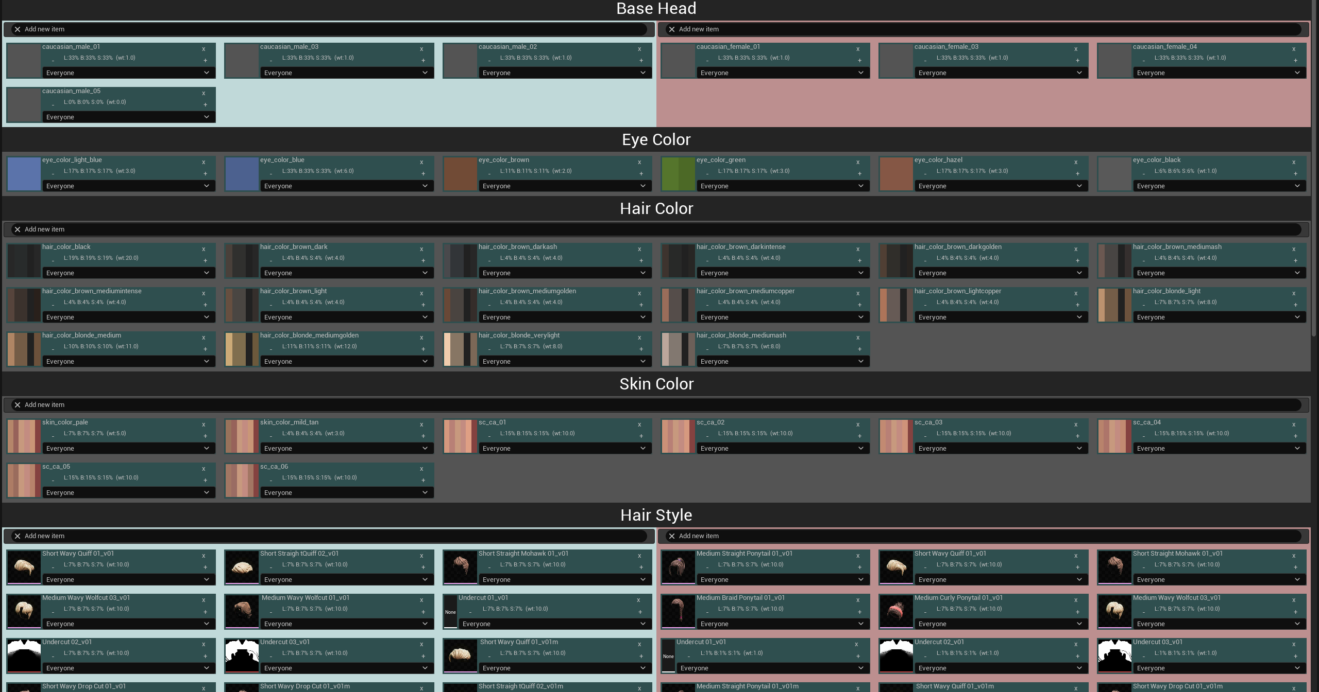
Ethnicity visual features
Screenshot of artist tool for describing ethnicity visual features
Notes:
A screenshot of our ethnicity editor. The artist may add as many items to each visual feature. Each item has a weight that denotes the probability of it being selected.
Some visual features are exclusive to gender. This avoid having the artist duplicate shared settings for both genders. Instead we perform duplication when generating the runtime assets.

Slide 14
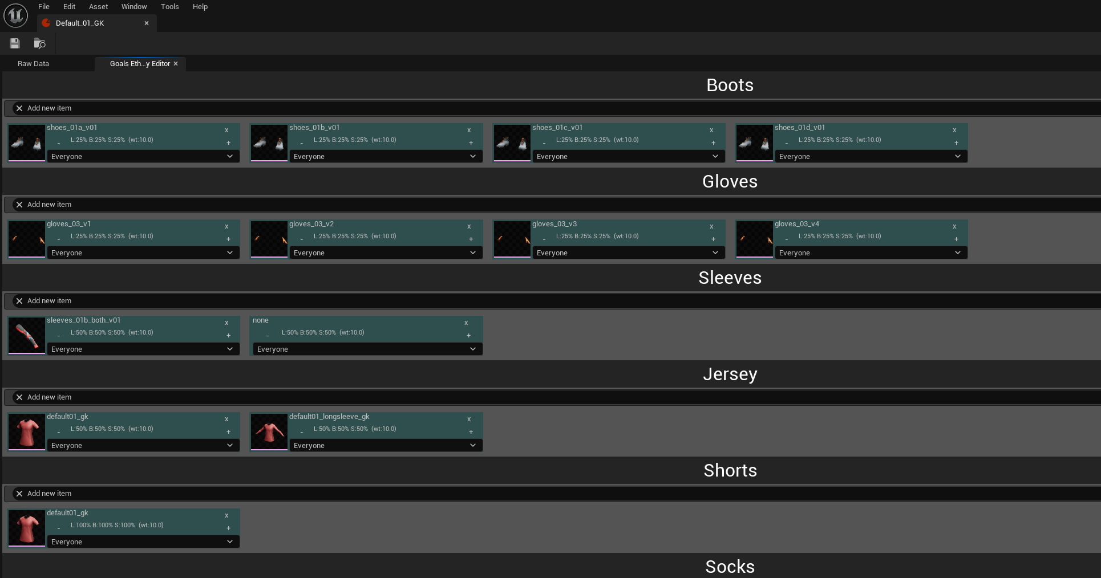
Ethnicity visual features
Screenshot of artist tool for describing ethnicity visual features
Notes:
We use the same editor for player kits. Combining the result of ethnicity and kit we have all the string values that describe the character we want to generate.

Slide 15
Weighted arrays
Weighted array entries preserve real world distributions
Randomly select an entry using the weighted sum
Used for selecting ethnicity, as well as each visual feature
Notes:
We use weights to describe the probability of a array entry being selected. We translate the nationality data and ethnicity data in our game into multiple weighted arrays that we use during runtime.

Slide 16
Weighted arrays snapshot
Snapshot contains weighted array entries optimized for runtime
Artist friendly tables are expanded into multiple weighted arrays
Entries store the weighted sum of previous entries including self
Last entry will therefore contain the weighted sum for all entries
Select random value from 0 to weighted sum of all
Use either linear or binary search to find entry represented by value
Notes:
[example 1, 1, 2]

Slide 17
Weighted arrays code sample
static FName GetRandomWeightedName(const FWeightedArray& Array, const FRandomStream& Stream)
{
const float SumWeight = Array[Array.Num() - 1].SumWeight; // last element contains weighted sum of array
const float RandomWeight = Stream.FRandRange(0.0f, SumWeight); // pick random value in range 0..SumWeight
int i = LinearSearchWeightedArray(Array, RandomWeight); // find element for RandomWeight
return Array[i].Name;
}
static int LinearSearchWeightedArray(const FWeightedArray& Array, float RandomWeight)
{
for (int i = 0; i < Array.Num(); i++)
{
if (RandomWeight <= Array[i].SumWeight) // return first element that includes RandomWeight
return i;
}
return Array.Num() - 1;
}
Notes:
You can replace linear search with STL algorithm lower_bound for binary search

Slide 18
Deterministic randomness
Must use random number generator deterministically
Always call random for visual features in same order
Must allow artists to add visual features over time
Would like to have characters evolve as their rating increase
Notes:
We use deterministic randomness to add variety. The seed used to generate a character must always produce the same visual result.
This means that how we populate our string map from a seed must remain constant. We therefore need a solution that preserves the result even though we continue to develop the game, add assets and continue to improve our character generation.

Slide 19
Snapshot and versioning
For each character content release we perform a snapshot
Snapshots contain the order visual features are calculated
On character creation server stores seed along with latest snapshot version
Snapshot contains the following tables
Nationality to ethnicity mapping
Ethnicity/gender group to visual string mapping
Notes:
We solve this problem by using snapshots, a set of frozen tables that are guaranteed to never change.
More tables may be needed frozen as we continue developing our character generation.

Slide 20
Evolving characters
Populate all features as normal
a) Hidden features (tattoos/ear-rings)
Shuffle order of hidden features from character seed
Remove features that remain hidden for evolution tier
b) Evolving features (hair style)
Artists describe evolution chains for values
Use feature value as base value
Redetermine feature value for each evolution tier
Notes:
Our character generation had support from the start for visual character tiers. We had 3 groupings that describe which tier a visual feature entry becomes available. The idea is that a character has cooler visuals available to them the higher their tier. You can see the remains of this in the screenshot of our ethnicity editor. We originally implemented this by generating a unique weighted table for each tier.
We recently added support for characters to evolve. This meant that a character could go up a visual tier. This broke how we thought about character generation as our original approach would produce a an unrecognizable character if a different table was used.

Slide 21
Blueprints
Blueprints hide how strings are translated to visual data
Provides a common interface for all visual features
Makes it easy to support new visual features with existing tools
16 feature handlers
Used for body parts and clothing
Notes:
Second step
We now need to convert our string map to visual data. That is mesh pieces, material and material parameters used to assemble the resulting skeletal mesh in our final stage.
[1]
[2] Our artists are constantly finding new ways they want to affect the character generation process. Blueprint gives them great freedom in how to express visual features, while maintaining a single interface for all of them. The string map value maps to a data table row name, and the blueprint translates the remaining row data to visual data.
[3] In addition to Get Visual Data blueprint provides a second important method, Get Options. This is used to populate UI, generate snapshots and validate snapshots.

Slide 22
Engine Subsystem
Character generation is implemented as an engine subsystem
We use Unreal’s FTask for multithreading
Subsystem caches tasks of recently generated characters
Hash of input string map is used for cache key
Avoids generating the same character multiple times
Allows result of task to easily be used with multiple task chains
Notes:
[1..3]
The advantage of caching the Task rather than the result is that we can return the shared Task immediately. Once the task has completed all tasks waiting will be unblocked.

Slide 23
Runtime asset composition
Copy mesh data
Morph mesh pieces for gender/build
Additive adjustments to facial features
Clip body mesh hidden by clothing
Add render sections for decals
Merge mesh pieces
Notes:
We are at the final step

Slide 24
Morph mesh pieces
Interpolate vertex data from base mesh to morph target
Used to support gender and bulkiness
All bodies are based of the same base skeletal mesh
We use character’s BMI to determine interpolation value
Tooling allows artists to easily provide additional morphs for clothing
Notes:
Morph targets originally only used for gender
For height and weight differences we scaled the bones. This was easy to do for all mesh pieces. Sadly the result always looked as if we had scaled the character.
To give artists more freedom in how to express a characters build we now use morph targets. This requires that all clothing pieces to adapt with morph targets. This was done manually when we only had gender, but has now been automated by our technical artists for clothing.

Slide 25
Facial features
Base head is selected from ethnicity
We use additive adjustments to make faces unique
Adjustments are achieved by modifying facial bones
Artists provide relative min/max transformations per facial feature
Each base head can have custom min/max limits
We interpolate transformations using random value per feature
We apply the resulting transformation using CPU skinning
Notes:
[1..6]
So far I have just spoken about string map, but in addition we populate a map of floats for facial features from the character seed. The floats range from -1 to +1 and map to how close to min or max limit the delta transformation we apply is.
[7]
We use a separate skinning profile for adjustments, (vs facial animations) allowing artists greater control for moving parts of the face.

Slide 26
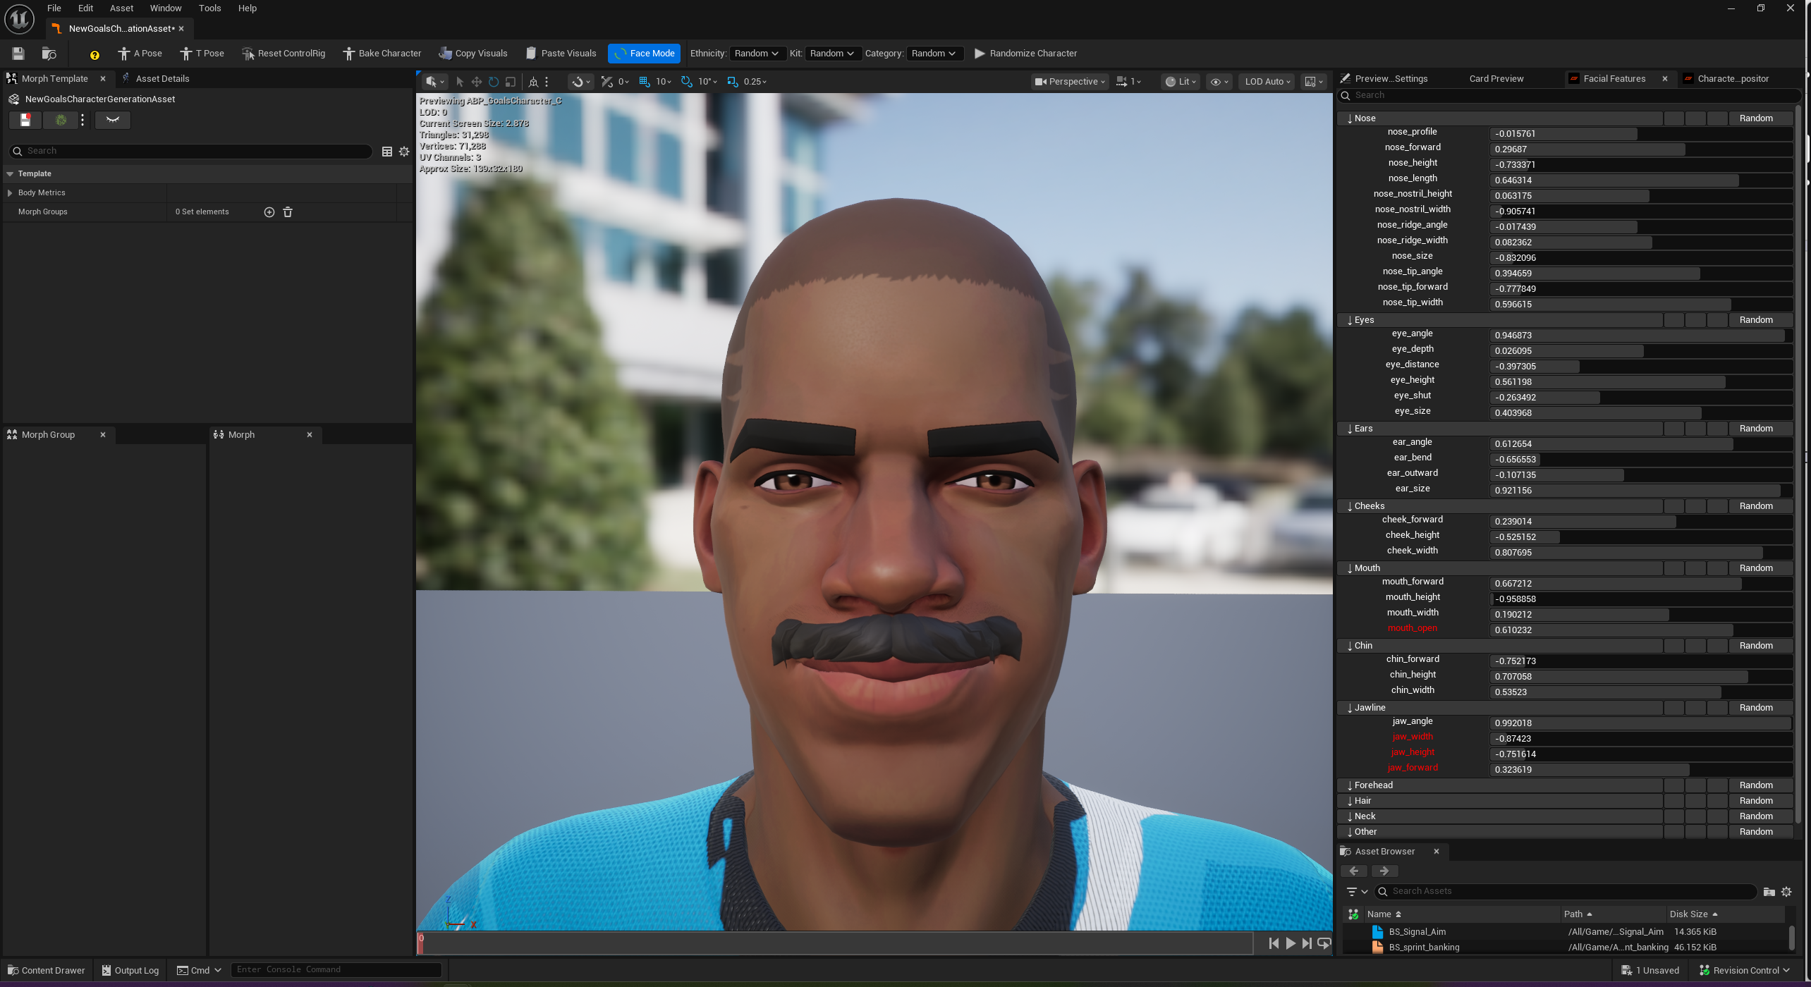
Scalar map input
Screenshot of facial tool illustrating an artist tool using scalarmap as input
Notes:
On the right side bar you can see a subset of the available facial features that we apply additive transformations to.

Slide 27
Quick side note
Originally string map population occurred on server
Avoided snapshots as cloud stored each character string map
Changes to character generation had to involve cloud team
This included art content updates, slowing iteration time
Facial features was the breaking straw that convinced us to move client side

Slide 28
Decals
Artists are free to add decals to clothing
Artists specify placement of decal in UV space
Any triangle that intersects with decal placement will be added to new render section
Split existing index buffer by moving intersecting triangles to end
Notes:
As we are generating a unique skeletal mesh for each character we support decals by producing new render sections with material for the decal.

Slide 29
Decals code sample
uint32 BaseIndex = RenderSection.BaseIndex;
uint32 EndIndex = BaseIndex + RenderSection.NumTriangles * 3;
while (BaseIndex < EndIndex)
{
bool ContainsAny = false;
for (int i = 0; i < 3 && !ContainsAny; i++)
{
const uint32 VertexIndex = LODRenderData.IndexBuffer[BaseIndex + i];
FVector2f UV = LODRenderData.GetUV(VertexIndex, UVIndex);
FVector2f TransformedUV = UVTransform.TransformPoint(UV);
ContainsAny = UnitBox.IsInsideOrOn(TransformedUV);
}
if (ContainsAny)
{
EndIndex -= 3;
for (int i = 0; i < 3; i++)
{
std::swap(LODRenderData.IndexBuffer[BaseIndex + i], LODRenderData.IndexBuffer[EndIndex + i]);
}
}
else
{
BaseIndex += 3;
}
}
Notes:
Iterate through each triangle
If any of the triangles vertex UV intersect our decal

Slide 30
Clipping
Remove triangles contained within clipping mesh
Test if ray from vertex hits clipping mesh an odd or even amount
Use an acceleration grid to reduce ray intersection tests
Assume triangles are evenly distributed within the clipping mesh bounding box
Project along the shortest axis of bounding box
Find optimal cell size that gives us desired triangle count per cell
Store clipping mesh triangles per grid cell
Notes:
As we do not know ahead of time what clothing a character will wear we perform clipping of the body mesh on character generation.
We use an acceleration structure to avoid exponential performance hit when artists use detailed clipping meshes.

Slide 31
Clipping code sample
ClippingMeshAccelerationGrid AccelerationGrid = GenerateClippingMeshAccelerationGrid(ClippingMesh);
FVector3f Direction = FVector3f::ZeroVector;
Direction[AccelerationGrid.ProjectedAxis] = 1.0f;
UE::Geometry::FIntrRay3Triangle3f Intersector(FRay3f(FVector3f::ZeroVector, Direction), UE::Geometry::FTriangle3f());
for (int i = 0; i < LODRenderData.PositionVertexBuffer.Num(); i++)
{
// Ignore vertices outside AABB
const FVector3f& Point = LODRenderData.PositionVertexBuffer[i];
if (!FMath::PointBoxIntersection(Point, AccelerationGrid.AABBox))
{
continue;
}
Intersector.Ray.Origin = Point;
const FIntPoint IntersectingCell = AccelerationGrid.GetCellPoint(Point);
if (IsInClippingMesh(Intersector, ClippingGeometry, AccelerationGrid.GetCell(IntersectingCell)))
{
OverlappingVertices[i] = true;
}
}

Slide 32
Merge mesh pieces
Based of Unreal’s SkeletalMeshMerge
Combines render sections referencing the same material
Notes:
Unreal’s Skeletal mesh merge code is a great place to start looking if you want start producing skeletal meshes dynamically at runtime.

Slide 33
Your done!
That’s an overview of our character generation pipeline
We have just generated a character from a seed to be used in UE5

Slide 34
Thanks to my colleagues
Torbjörn Söderman
David Serrat Jiménez
Andrei Kushner
Nikolaos Kaltsogiannis
Marco Musto
Albin Lundahl
Daniel Noll
Notes:
I’d like to thank all my colleagues that have worked on GOALS character generation system with me. It is an amazing group of programmers, artists and technical artists. They have allowed me to come here and speak to you today about our work.

Slide 35
Bonus slides

Slide 36
Texture baking
Optimization for low detail characters
Merge render sections with generated texture atlas
Texture atlas is BC7 encoded using compute shader
Compute shader writes encoded block to R32G32B32A32_UINT
FComputeShaderUtils::AddCopyTexturePass does not allow copying between different pixel formats

