Slide 1

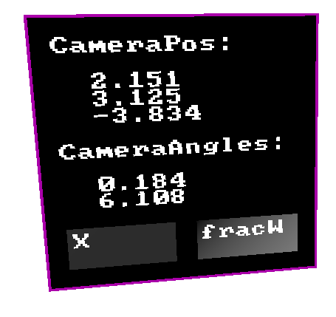
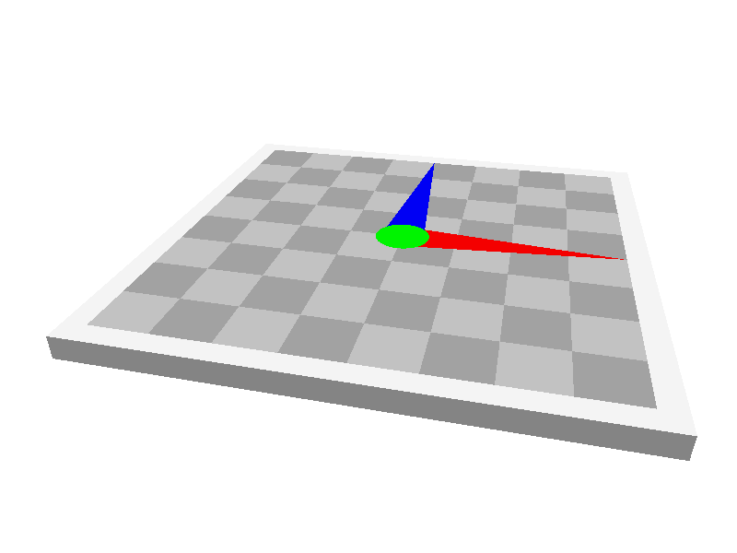
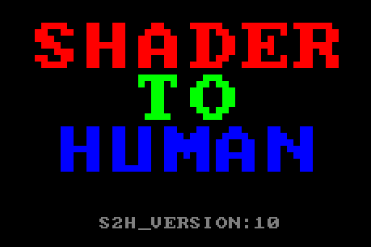
Shader To Human (S2H)
SEED
Martin Mittring MMittring@EA.com Anushka Nair AnuNair@EA.com
https://github.com/electronicarts/ShaderToHuman
Notes:
Graphics Programming Conference 2025

Slide 2
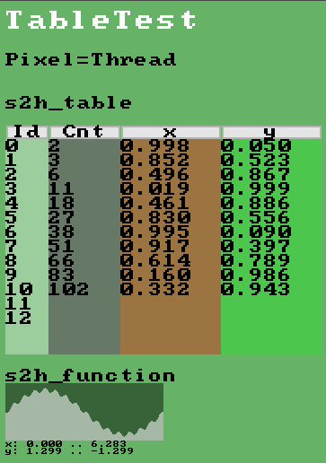
TL;DR: A library for debugging shaders
Think of PrintF for shaders
With shader hot reload it’s like a debugger watch window
Programmable visualizer 2D / 3D / UI
Caution: DIY, performance
Integrate HLSL in few includes
Integrate GLSL using preprocessor defines
Unit tests with screenshot comparison
Notes:
This easy to integrate (soon open source) tool is designed to help engineers with shader writing and debugging. Documentation and examples get you started quickly. Working best in a shader hot reloading environment like Gigi, rapid prototyping becomes straightforward. We show you how to integrate in your codebase and you can use it for PrintF debugging, drawing 2d and 3d shapes with few lines of code. No C++ code changes required.

Slide 3
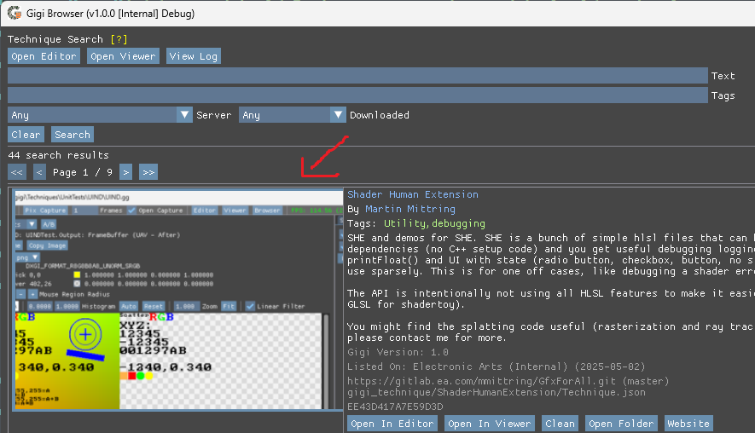
Where to get it?
GitHub: https://github.com/electronicarts/ShaderToHuman
Gigi browser: search “Human”
Installation: copy “include” folder (1-4 files)
Target Frameworks
Gigi: https://github.com/electronicarts/gigi
Shadertoy: https://www.shadertoy.com
Notes:
https://electronic-arts.slack.com/archives/C043Y2FK2AF/p1746207162106139?thread_ts=1745611295.712519&cid=C043Y2FK2AF

Slide 4
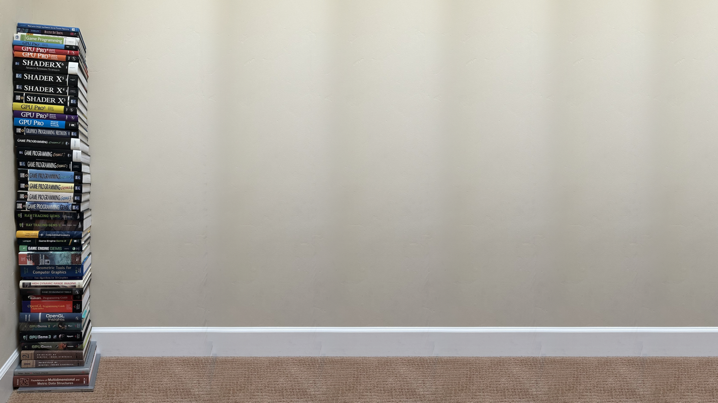

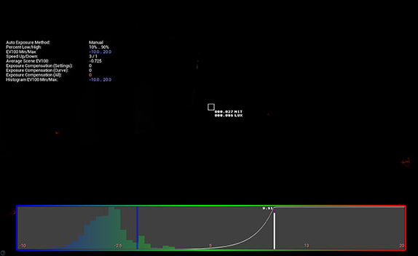
My SW Development Experience
C++: Debugger, PrintF debugging
CryEngine: Visualize Texture, CVars, LUA & C++, logging
Unreal Engine 3..4: CVars, ShowFlags, Visualizer
Meta: Unity, Transform math, Quaternion
EA SEED: GPU driven, Persistent Thread, ThreadGroup, Wave Intrinsics, Phases => needed tooling
000.027 NIT 000.086 LUX
Notes:
Image from: https://www.unrealengine.com/fr/tech-blog/how-epic-games-is-handling-auto-exposure-in-4-25

Slide 5
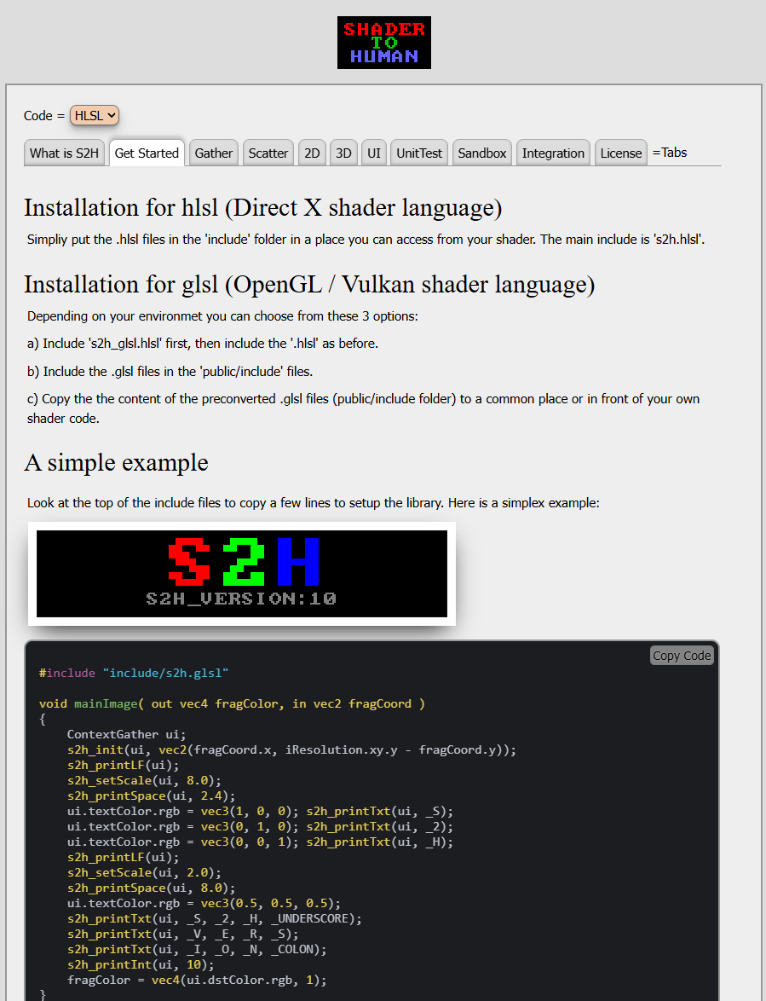
Documentation
HTML docs using JavaScript, WebGL
User can copy HLSL or GLSL
WebGL has no define support => We use cl.exe as preprocessor, copy .glsl files
GLSL files outside HTML / JS => no local html file, NodeJS / server hosted

Slide 6
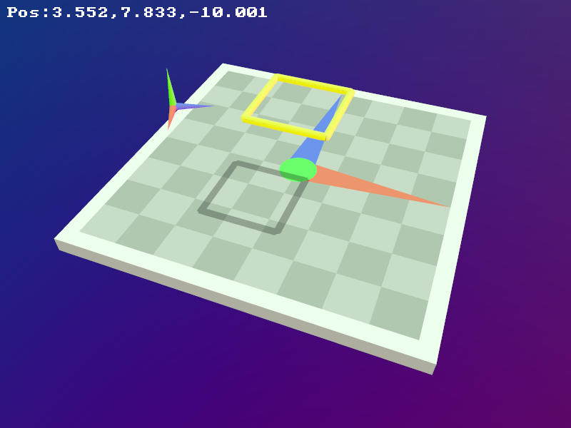
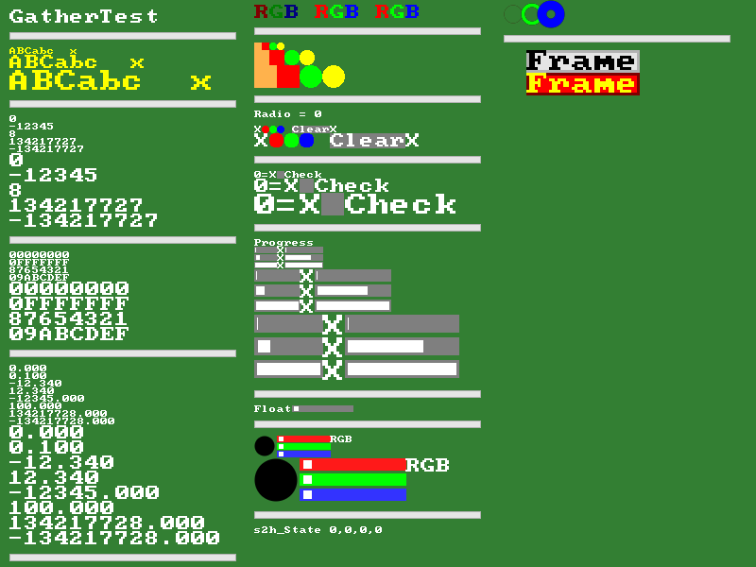
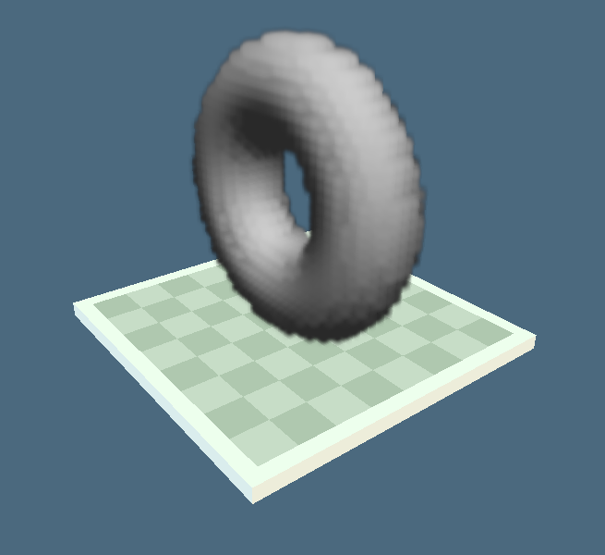
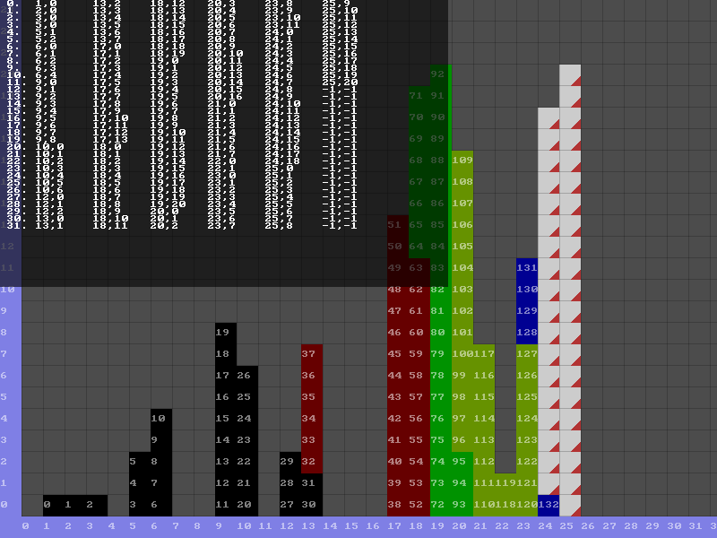
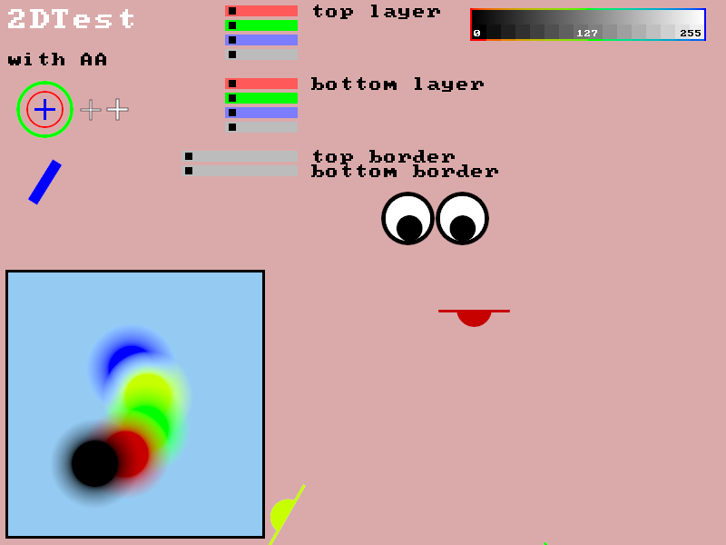
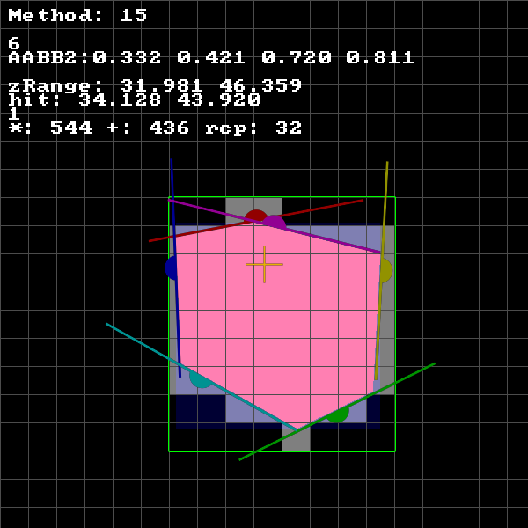
Demo
Notes:
EA Posts When it was called UIND
https://electronic-arts.slack.com/archives/C043Y2FK2AF/p1740174391302239
WaveSerializer
https://electronic-arts.slack.com/archives/C043Y2FK2AF/p1749261570952039
Conservative rasterization of a AABB in compute shade
https://electronic-arts.slack.com/archives/C043Y2FK2AF/p1747962618023229
Gigi WebGPU https://electronic-arts.slack.com/archives/C043Y2FK2AF/p1746483869997619?thread_ts=1745611295.712519&cid=C043Y2FK2AF
Splat rendering
https://electronic-arts.slack.com/archives/C043Y2FK2AF/p1745611295712519
MMG slack group post https://electronic-arts.slack.com/archives/C03U6SX90BV/p1733188298807679
I visualized the order for a 4x16 thread group block
first image: GTidx : SV_GroupIndex, as expected
second image WaveGetLaneIndex(), I am surprised to get a wave size of 32, new AMD hardware has the feature but drivers should be careful using it, maybe my thread group size triggered it. Also the 2x2 block swizzle is good for texture cache but makes coding different from NVidia. I did not see this described in docs. Point me at a good reference, if you know.
The images are from a AMD Radeon Pro W6600.
On my NVidia it would be like the first image but %32.
This surprising wave lane layout makes coding a bit more difficult, mostly when using WaveActiveBallot()

Slide 7
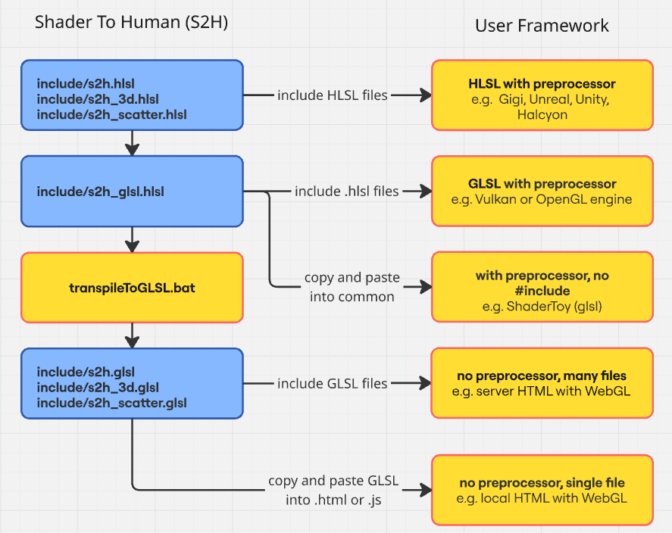
Integration Options
Notes:
https://miro.com/app/board/uXjVIoC6d4k=/?share_link_id=220461789975

Slide 8
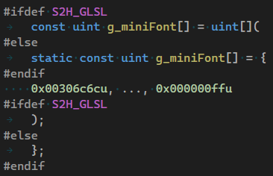
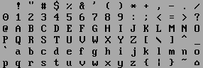
Print strings from a shader language
Implementation
Font in texture, fast but adds complications => optional
Font in array, no integration needed => default
Drivers can implement fast path => had to find it
Data is stored in 32 bit array
Avoid defines and templates
Usage
s2h_printCharacter(ui, 65u) // basis function
s2h_printTxt(ui, 'X', '0', ' ', 'x') // only work in HLSL
s2h_printTxt(ui, _X, _0, _SPACE, _x) // works in GLSL too
s2h_printTxt(ui, "X0 x") // not portable (yet)
s2h_printLF(ui) // goto next line (LineFeed)
Notes:
Image from https://stackoverflow.com/questions/30359451/html-css-use-dos-codepage-437-font-missing-glyphs
This is not actually the font we use

Slide 9
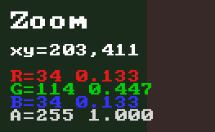
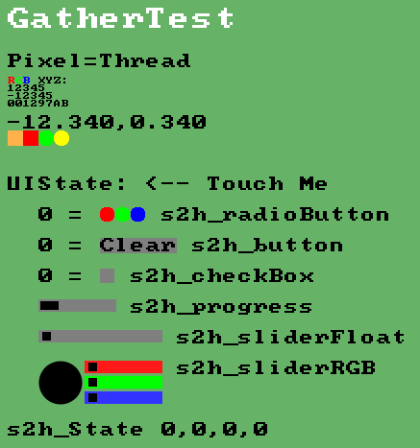
Gather (s2h.hlsl)
Implementation
struct to pass state and dstColor
Setup (see top in s2h.hlsl) #include "s2h.h" … ContextGather ui; s2h_init(ui, pxPos); … float4 linColor = background * (1.0f - ui.dstColor.a) + ui.dstColor; fragColor = float4(s2h_linearToSRGB(linColor.rgb), linColor.a);
Usage
s2h_setCursor(ui, pxPos)
s2h_setScale(ui, scale)
s2h_printInt(ui, value)
s2h_printHex(ui, value)
s2h_printFloat(ui, value)

Slide 10

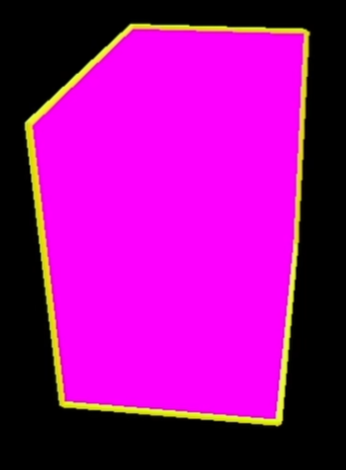
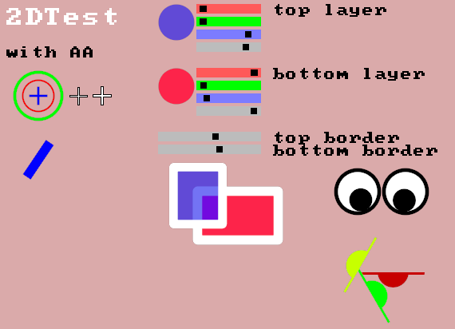
2D (s2h.hlsl)
Implementation
Linear color (not sRGB) for AA
Setup (same as Gather) float4 linColor = background * (1.0f - ui.dstColor.a) + ui.dstColor; fragColor = float4(s2h_linearToSRGB(linColor.rgb), linColor.a);
Usage
s2h_drawRectangle(ui, a, b, color)
s2h_drawRectangleAA(ui, a,b, borderColor, innerColor, r)
s2h_drawLine(ui, a, b, color, r)
s2h_drawCrosshair(ui, pos, size, color, r)
s2h_drawHalfSpace(ui, plane3, pos, color, k0, k1)
s2h_drawArrow(ui, a, b, color, k0, k1)
s2h_drawTriangle(ui, tri, color)

Slide 11
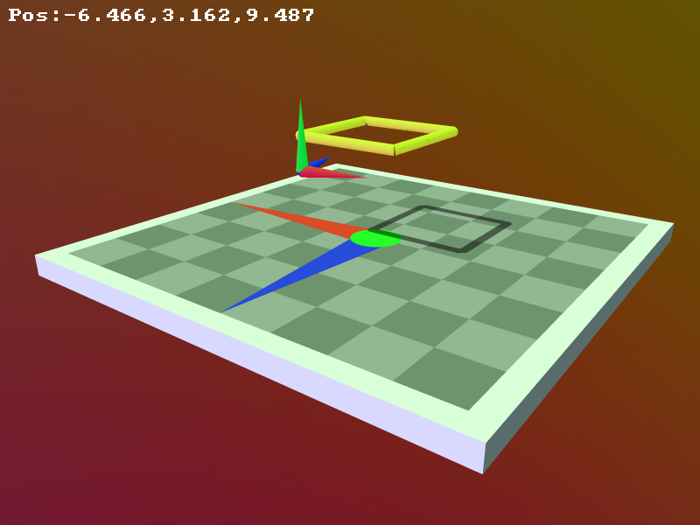
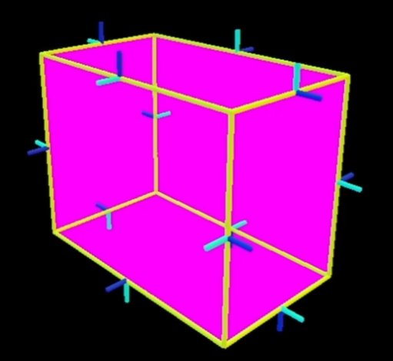
3D (s2h_3d.hlsl)
Implementation
Ray tracing
Struct to store ray, color and z
Setup (see top in s2h_3d.hlsl) #include "s2h.h" #include "s2h_3d.h" … struct Context3D context; s2h_init(context, rayOrigin, rayDirection); float4 linColor = background * (1.0f - context.dstColor.a) + context.dstColor; fragColor = float4(s2h_linearToSRGB(linColor.rgb), linColor.a);
Usage
s2h_drawLineWS(context, a, b, color, r)
s2h_drawArrowWS(context, a, b, color)
s2h_drawBasis(context, mat, r)
s2h_drawSphereWS(context, pos, color, r)
s2h_drawCheckerBoard(context, pos)

Slide 12
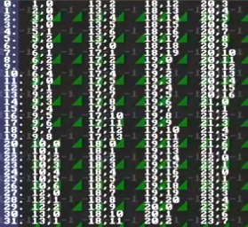
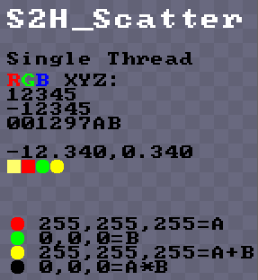
Scatter (s2h_scatter.hlsl)
Implementation:
UAV write to another 2D texture
Assumes single thread or offset per thread
Setup (see top in s2h_scatter.hlsl) #include "s2h.h" #include "s2h_scatter.h" void onGfxForAllScatter(int2 pxPos, float4 color) { g_computeOutput[pxPos] = color; } struct ContextScatter ui; s2h_init(ui);
Usage (most of Gather functions):
s2h_setCursor, s2h_setScale, s2h_printTxt, s2h_printInt, s2h_printHex, s2h_printFloat, s2h_printBlock, s2h_printDisc, s2h_drawCrosshair

Slide 13
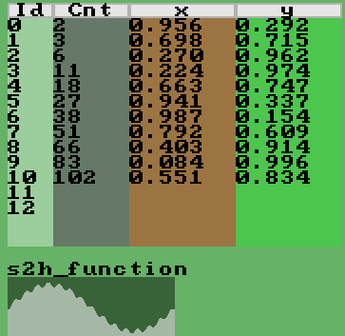
Interactive UI and Tables (s2h.hlsl)
Implementation
Need to store state => Gigi buffer UAV
ImGUI inspired
no GLSL yet
Usage
s2h_progress(ui, width, fraction)
s2h_button(ui, width)
s2h_radioButton(ui, checked)
s2h_checkBox(ui, checked)
s2h_sliderFloat(ui, width, value, min, max)
s2h_sliderRGB(ui, width, value)
s2h_sliderRGBA(ui, width, value)
s2h_function => s2h_floatLookupFloat()

Slide 14
Tipps
Gather: don’t forget to composite color = ui.dstColor; // ui.dstColor is premultiplied! color.rgb = color.rgb * (1-ui.dstColor.a) + ui.dstColor.rgb;
Scatter: offset per lane / thread s2h_setCursor(sui, float2(0, GI * 8)); s2h_setCursor(sui, float2(0, WaveGetLaneIndex() * 8)); float2 p = sui.pxCursor; s2h_printInt(sui, nodeId); s2h_setCursor(sui, p + float2(10 * 8, 0));
Assert if(!ok) InterlockedAdd(pos[12], 1); if(!ok) InterlockedExchange(pos[13], nodeId);
Don’t forget inout e.g. inout ContextGather ui, inout ContextScatter sui,
Debug endless loop for(;;) for(int i = 0; i < 200; ++i)
Notes:
uint GI : SV_GroupIndex

Slide 15
Next
Open source!
Adapt to other engines ? left/right handed, Y/Z up, reverse Z, infinite zFar, Y up/down, V up/down …
High level features e.g. state for log, 80x25 text, timer, record and playback
More backends ? GLM for C++, Unity C# ? Unreal Engine C++
It’s up to you™™™

Slide 16
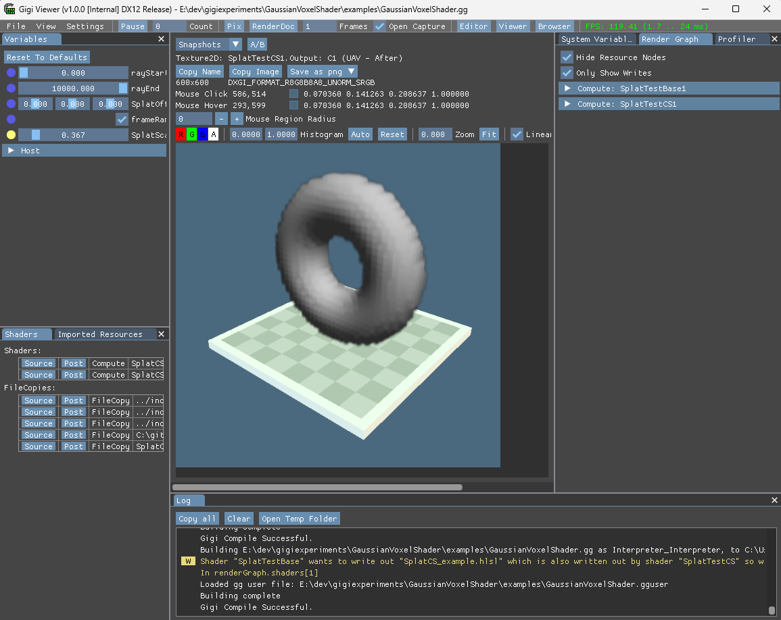
Questions, Thanks
Shader To Human Code: https://github.com/electronicarts/ShaderToHuman (see "include" folder) Interactive Documentation: https://electronicarts.github.io/ShaderToHuman
Gigi https://github.com/electronicarts/gigi
Martin Mittring MMittring@EA.com Anushka Nair AnuNair@EA.com

