Slide 1


VARIABLE-RATE COMPUTE SHADERS
in DOOM: The Dark Ages
Martin Fuller
Principal Engineer
Xbox Advanced Technology Group
Philip Hammer
Principal Engine Programmer
id Software
Notes:
Intro
I‘ll briefly talk about the context and motivation why we need variable rate shading in DOOM
Also explain the basic technique and some implementation specifics
Martin will take over in the middle of the talk and deep-dive into the details of the technique and many of the obstacles we had to overcome
Stories about a great collaboration between id and atg and why it’s sometimes great to work in larger corporation

Slide 2
Motivation
60 FPS on Xbox Series X|S, PlayStation 5 + PC, recently also ROG Xbox Ally X
Much more complexity, more content, more advanced rendering features
  See other talks!
Compute expensive pixels only if really necessary
Notes:
Our goal in DOOM was to ship the game with stable 60 FPS on our target plaforms, no matter what.
At launch those were Xbox Series X and S, PS5 and raytracing-capable PCs
Recently we also shipped the game for the new ROG Xbox Ally X on its launch
Performance is key for us and a first-class citizen during development
However, this time we had much larger maps, more content on screen and generally a much higher scene complexity
Balance pixel-quality, resolution and performance.
We really want to compute those expensive pixels only when necessary

Slide 3
Recap: VRS in DOOM Eternal
idTech7 uses Clustered Forward+ rendering
  Hardware VRS on Xbox Series X|S (2022)
  (unsupported on base PS5 and many PC GPUs)
  Added with the Gen9 update along with Raytraced reflections, 120 Hz mode, etc
idTech7
GPU Triangle Culling
Depth Prepass
Build Clusters
(Lights, Decals)
Opaque Pass
(Forward+)
Deferred Passes
Transp. Pass
(Forward+)
...
Compute VRS
Rasterized Pass
Rasterized Pass
(VRS enabled)
Notes:
Let‘s continue with a bit of history to set the ground
DOOM Eternal was originally released on Xbox One and PS4 level hardware in early 2020.
When we ported DOOM Eternal to Gen9 consoles in 2022 (with RTR, 120Hz, etc), we also added VRS support
Two of our main passes (opaque / transparents) were rasterized, benefitting from Hardware VRS.
This is where we evaluate all materials, run lighting, blend decals, etc., basically outputting the final color

Slide 4
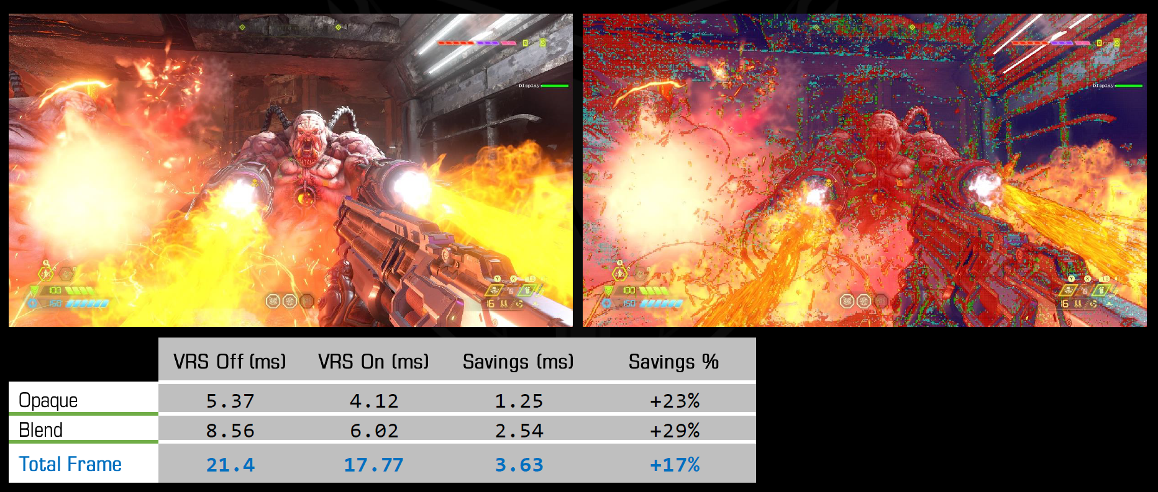
Recap: VRS in DOOM Eternal
VRS is a great fit for forward rendering
  Lots of expensive pixels avoided in DOOM Eternal
  Watch Variable Rate Shading Update Xbox Series Consoles
Notes:
We found that VRS was a great fit for our forward rendering pipeline in particular
Expensive pixels were calculated in the forward pixel shaders and VRS helped us to minimize their invocation count
This is also where the collaboration with Martin first kicked off
He invited me and Chris to contribute to one of his talks on YouTube in the middle of the pandemic (go watch the talk, still some good info today)
This is a screenshot from that presentation showing some nice performance gains

Slide 5
Recap: idTech7 vs. idTech8 pipeline
idTech7
GPU Triangle Culling
Depth Prepass
Build Clusters
(Lights, Decals)
Opaque Pass
(Forward+)
Deferred Passes
Transp. Pass
(Forward+)
...
Compute VRS
idTech8
GPU Gather
GPU Triangle Culling
Visibility Pass
Build Clusters
(Lights, Decals)
Opaque Pass
(Deferred)
Deferred Passes
Transp. Pass
(Forward+)
...
Compute VRS
Deferred Texturing
Tiled G-Buffer Update
Tiled Deferred Lighting
Rasterized Pass
Rasterized Pass
(VRS enabled)
Compute Pass
(new in idTech8)
Notes:
What changed from idTech7 to 8?
Replaced our main opaque pass with deferred texturing + lighting
Note, that this formerly rasterized pass now changed to a series of compute shaders.
Only transparent rendering remains forward, pretty much what we had in before sincein DOOM Eternal

Slide 6
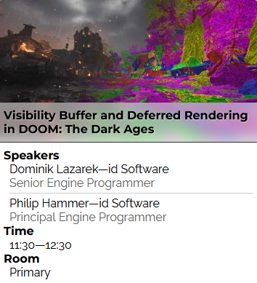
Recap: idTech8 Deferred Rendering
Visibility Buffers + Deferred everything
  Other DOOM:TDA talk today:
  Visibility Buffer And Deferred Rendering in
  DOOM: The Dark Ages
Perf gain by minimizing raster work
  Minimize Helper Pixel waste
  Move heavy duty work to compute
  Remaining raster work remained lightweight
  (Depth/Visibility Buffer, Shadows)
Notes:
Btw, replacing the opaque pipeline with a visibility buffer and deferred rendering approach was part of our other talk early today together with Dominik
Quick recap of our approach from the “Visibility Buffer and Deferred Rendering in DOOM: The Dark Ages” talk
Our main idea there was to minimize the amount of Helper Pixels
Helper Pixels are pixel shader invocations that won’t end up in a visible pixel on screen, but are needed mainly to support hardware derivatives on primitive edges (e.g. for mip calculations, etc.)
Heavy lighting calculations affect helper pixels as well, since they run the same code
Moving that work to compute helped a lot here, since we only dispatch work for the visible pixels.
The remaining raster work (visibility generation, shadow map rendering) remained lightweight (=no expensive shader work)

Slide 7



Recap: idTech8 Rendering vs. (hardware) VRS
Great results at first
But (hardware) VRS doesn‘t work with compute
Forward+ | 17.5 ms
Visibility Buffer | 14.8 ms
Now what?
Forward+ (with VRS) | 14.5 ms
Visibility Buffer (with VRS) | 14.6 ms
Notes:
Seen great results with that new approach first
We‘ve seen a solid 2-3 ms win of overall GPU frame time
Hooray, we‘re done, right?
If you know that meme, you can imagine this is not the end of the story
For quite a while we were very happy with how much our new render pipeline was performing better than Forward+
We optimized everything with VRS disabled for a fair comparison. But we knew that we needed to adress the missing VRS on the new pipeline at some.
* click *
A real-world comparison of our new rendering pipeline efforts showed that our new optimized pipeline was outperformed by the old F+ approach with VRS enabled
* click *
So, now what? I‘ll explain our approach in the following

Slide 8
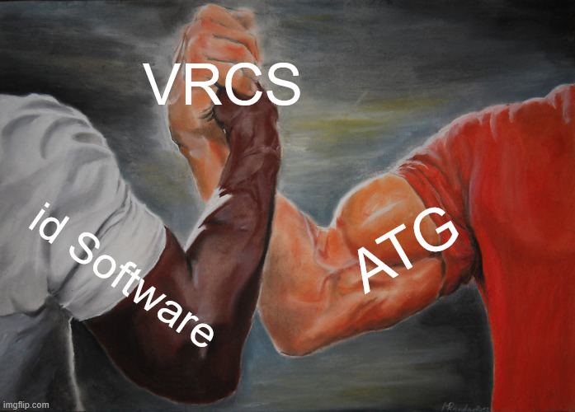
Variable-Rate Compute Shaders
VRCS to the rescue!
Initial implementation within 2
weeks from Martin‘s prior work
Proof-of-Concept !=
Production Ready
Direct collab at the id Frankfurt
office
Notes:
We knew from the beginning that we need some sort of software Variable Rate Shading in our new rendering as well
We gravitated towards looking into Variable-Rate Compute Shaders, but there were no shipped games.
* Click *
Uncharted territory, we only have Martin’s talk from 2022 and an ATG research sample
On the good side, we managed to get the technique implemented in around 2 weeks and we’ve seen very promising results
However, a proof-of-concept is very rarely ready for production
After the initial excitement, we’ve found many edge cases where VRCS didn’t work as intended, also quality issues
* click *
One of the benefits of working for a larger organization is that you’re not completely on your own.
Martin offered to fly over to the id Frankfurt office. Stayed for 8 days and together we finalized the implementation and shipped the game

Slide 9
Variable-Rate Compute Shaders
Goal = Save performance!
(by retiring compute waves early)
Unique calculations only for a subset of pixels
Copy the result to the neighbor pixels
Apply to heavy-lifting compute passes replacing opaque forward rendering
Notes:
What’s the purpose of VRCS? Save Performance by retiring entire compute waves early
We reduce the number of unique pixel calculations based on shading rate
Uniquely calculated pixels might copy their result to neighbors so we don’t get “holes”
We apply VRCS to fullscreen compute passes with expensive / ALU heavy pixels.
Lightweight pixel passes such as visibility and shadowmap generation do not benefit much from VRCS, so they just don’t use it

Slide 10
Variable-Rate Compute Shader Passes
Deferred Texturing (material evaluation)
Deferred G-Buffer Update (decals, rain, blood)
Deferred Lighting (lighting, shadows)
(initially) Deferred Composite (GI, Fog, Reflections, etc)
idTech8
GPU Gather
Triangle Culling
Visibility Pass
Build Clusters
(Lights, Decals)
Opaque Pass
(Deferred)
Deferred Passes
Transp. Pass
(Forward+)
...
Compute VRS
Deferred Texturing
Tiled G-Buffer Update
Tiled Deferred Lighting
Rasterized Pass
Rasterized Pass
(VRS enabled)
Compute Pass
(new in idTech8)
Compute Pass
(VRCS enabled)
Notes:
We use VRCS for the following passes now in idTech:
Deferred Texturing: material evaluation & blending, generates the base G-Buffer
Deferred G-Buffer Update: blend geodecals, projected decals, triplanar blood and environment wetness/rain on top of the base G-Buffer
Deferred Lighting: Run lighting calculations, check for shadowmap occlusion, output final lighting
Initially we also used this on our Deferred Composite Pass (that blends Global Illumination, Environment Probes, Fog, Reflections etc.) on the final color
However, the benefit wasn‘t that high
Also this pass used a lot of temporal noise dithering for upscaling things like fog and reflections. This noise caused lots of quality issues with Coarse Pixels, so we ultimately disabled VRCS on this pass post-launch
Martin will cover some of those edge cases in the second half of this talk

Slide 11
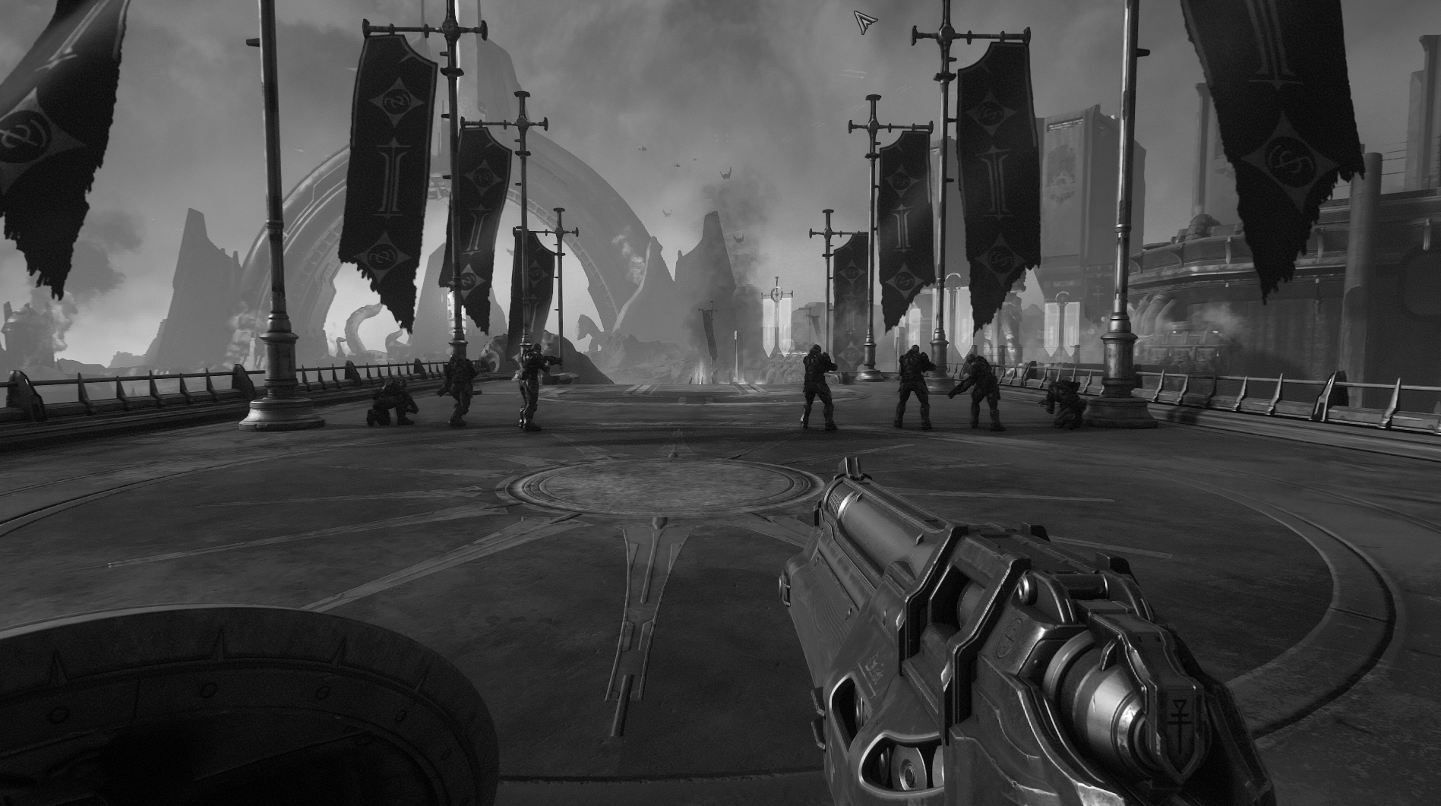
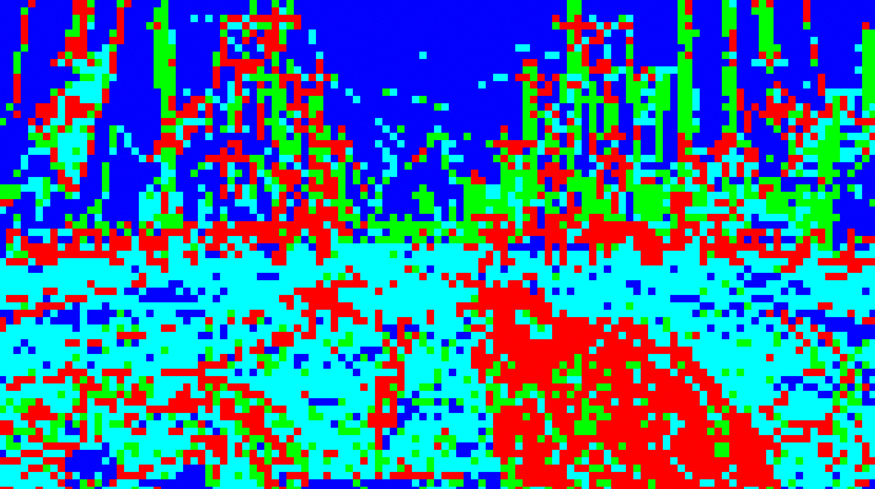
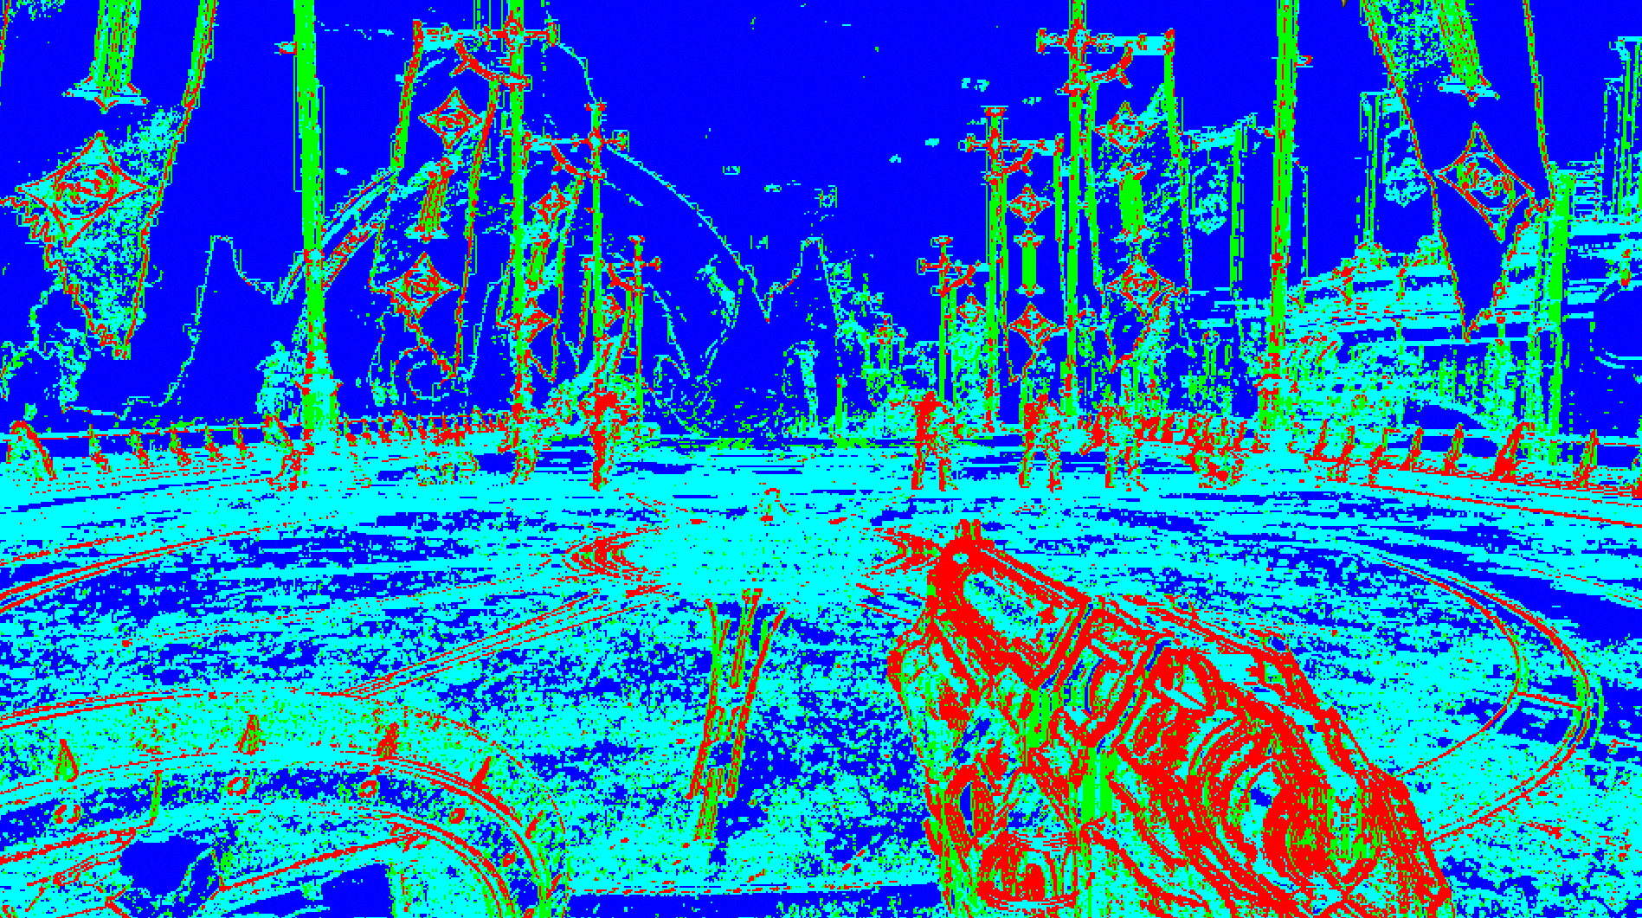
VRCS - Shading Rate Image
Scene Luminance
2x2 Shading Rate Image (SRI) 8bpp UINT
Analyzing luma gradients (think Sobel filter)
Assign shading rates to each 2x2 tile
1x1
2x1
1x2
2x2
8x8 SRI for HW VRS (on AMD)
2x2 SRI for VRCS (any IHV)
Notes:
Let‘s get into the trenches and go over how VRCS actually work
Referring to [Fuller22a], quick summary here
We create a 2 shading rate images
Both are 8 bits per pixel, based and on the fullscreen scene luminance
First one - Hardware-VRS SRI: 8x8 on Xbox, varying tile sizes on PC GPUs
Second one – VRCS SRI: 2x2 on all platforms, result = half-resolution screen image with shading rate classification
To generate those, we analyze a luma image for gradients to determine what minimum shading rate is needed.
E.g. low-contrast, low-frequency quads (all 4 pixels in quad very similar) can be reduced to 1 uniquely calculated pixel for the whole quad and copied to the neighbors
Similarity metric is configurable via „VRS Tolerance“ setting
When the image filtering is done, we determine one of 4 different shading rates for each tile

Slide 12
Shading Rate + Coverage -> VRCS Buffer
Primary vs. Duplicate Pixels
Shading Rate + Coverage determines uniquely calculated pixels
Primary Pixel result gets copied
1x1
2x1
1x2
2x2
Primary Pixel
Duplicate Pixel
Notes:
Here‘s the mapping between tile shading rate and quad configuration.
The green pixels on the right column depict „primary pixels“, that means they run a unique calculation, means the full shader
The blue pixels however are „duplicate pixels“, means they receice a copy of the their respective neighboring primary pixel
The Tile Shading Rate in combination with primitive coverage determines the uniquely calculated pixels and is defined like this
1x1 Shading Rate = every pixel in the quad is uniquely calculated
2x1 Shading Rate = 2 pixels are calculated and copied to their respective horizontal neighbors
1x2 = same as above but copied vertically
Note that those half-rate pixels are arranged in a checkerboard pattern that we flip per frame so TAA can converge them
2x2 = only one pixel in the quad is uniquely calculated and copies its result to all 3 neighbors
Speaking of duplicates, the compute threads that calculate the primary pixels will also perform the copy to their neighbors, but more to that later

Slide 13
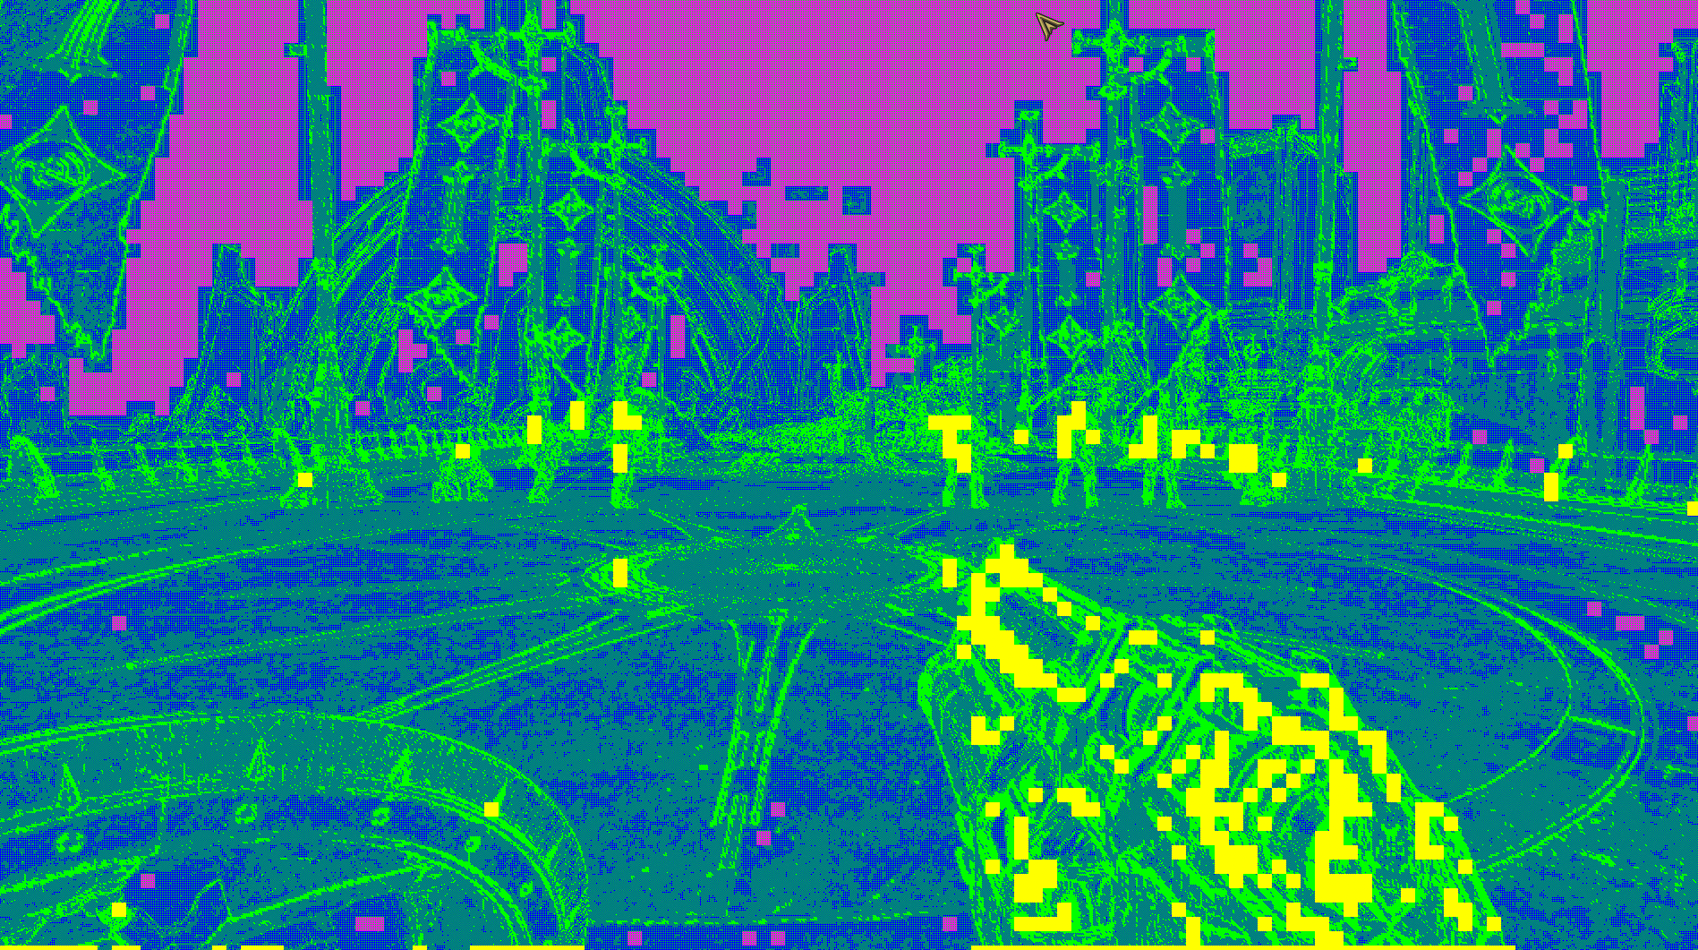
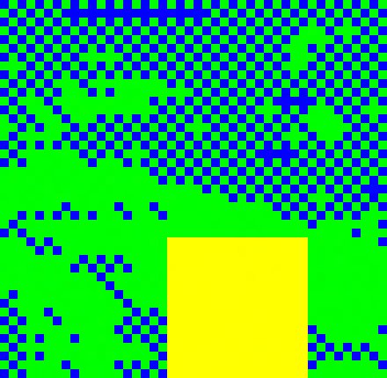
VRCS 16x16 Tile Debug
Primary pixel
Duplicate pixel
Tile entirely 2x2 rate
(1 primary, 3 duplicates per 2x2)
Tile entirely 1x1 rate
(4 primary pixels per 2x2)
Notes:
In fullscreen, we can visualize primary and duplicate pixels with this debug view.
Same color coding, but additionally highlighting the full 1x1 and full 2x2 rate tiles in yellow and pink
When zooming in to the green/blue areas, you can spot the checkered setup with 1-2 primary pixels in green and 2-3 duplicate pixels in blue

Slide 14
VRCS Compute Scheduling
GPU work scheduling
No gain when mixing primaries and duplicates in the same wave
Must compute primary pixels together in waves
Goal: Uniform early-out for one or more waves
wave 0
wave 1
wave 0
wave 1
Notes:
So far so easy, we have a set of pixels that run the full shader and another set of duplicates that early-out the shader invocation.
One invocation is expensive, the other is cheap. The more cheap invocations we get, the more performance. Right?
Unfortunately, this is not exactly how modern GPUs work.
If we compute primary and duplicate pixels mixed within the same wave, we gain nothing at all, so we pay the cost as if all pixels were primary.
* Click *
In order to gain an advantage, we have to group primary and duplicate pixels together.
The goal here is to it have full waves of duplicate pixels that can early-out and be recycled by the command processor as soon as possible.

Slide 15
VRCS: Coordinate Remapping
Segment screen into 16x16 pixel tiles
8x wave32 with 8x4 threads each
All threads tile local => scalar light load
Store primary pixel count per tile
Store per pixel payload:
8 bits tile-relative XY offset (4 bits per dim)
3 bits copy commands (vert, horz, diag)
wave 4
wave 0
wave 1
wave 5
wave 2
wave 6
wave 3
wave 7
Notes:
In order to group primary and secondary pixels, we have to schedule them in a different way by remapping their coordinates.
To pull this off, we have to add another preprocessing step.
We segment the screen into 16x16 pixel tiles, where each tile can be represented by 8 wave32s with an 8x4 threadgroup layout
One interesting property here is that all threads are tile-local, so we still getting scalar light loads
For each of those tiles we store the primary pixel count
Additionally, we have to store some data per pixel:
8 bits for a tile-relative offset (4 bits X + 4 bits Y) that locates that pixel within the tile
3 bits for copy commands, telling us later where to copy the result of the primary pixel (vertical, horizontal or diagonal)

Slide 16
VRCS: Coordinate Remapping
Tile-relative offset to remap the pixel coordinate
Not moving any memory, just remapping threads
2x2
(1 prim)
2x1
(2 prim)
00
01
02
03
00
02
13
20
10
11
12
13
22
23
31
32
1x2
(2 prim)
1x1
(4 prim)
20
21
22
23
33
01
03
10
30
31
32
33
11
12
21
30
2x2 SRI Tiles
Primaries / Duplicates
Dispatch: wave-packed pixels
Notes:
And this is how shading rate and coordinate remapping are related to each other
On the left we see an example with 4 different Shading Rate tiles
Each tile relates to a pixel quad, so in this illustration we‘re dealing with 16 pixels total
In the middle we see how the shading rate tiles unfold into primary and duplicate pixels.
If we‘d schedule this work as-is, we‘d not see any perf gains, because of wave divergence
Therefore, we do the coordinate remapping on right diagram so all primary pixels are ordered sequentially
This illustration is not yet related to actual compute waves - we‘ll do another example on the next slide

Slide 17
VRCS: Wave Packing Example
Example 16x16 tile:
132 primary pixels
124 duplicate pixels
wave 0
wave 4
wave 1
wave 5
Every wave processes both primary and duplicate pixels
-> Full cost for all 8 waves
wave 2
wave 6
wave 3
wave 7
Notes:
This is again our 16x16 tile, covering 256 pixels computed by 8x wave32
In this example we have 132 primary pixels and 124 duplicate pixels (abitrary)
The diagram shows the work scheduled in screen coordinates as they would be dispatched without any remapping
As explained before, when mixing primary and duplicates in all waves, we pay the full costs, won‘t see any gains even if VRCS is operating

Slide 18
VRCS: Wave Packing Example
Example 16x16 tile:
132 primary pixels
124 duplicate pixels
wave 0
wave 4
wave 1
wave 5
4 full waves of primary pixels
-> Full cost for shader execution
1 partial wave (4 primary pixels)
-> still full cost
3 full waves of duplicate pixels
-> very cheap (uniform early-out)
wave 2
wave 6
wave 3
wave 7
Notes:
If we now remap the threads to process the primary pixels in batch, we get
4 full waves with primary pixels
1 partial wave, which is still processed at full cost, despite only running 4 primary pixels
And 3 full waves of duplicate pixels. This is where we gain performance, since it‘ll be very cheap. It‘ll early-out fast since all threads uniformly hit the early-out branch and the CP can use the wave for other work

Slide 19
VRCS: Optimization
No storage need for wave 7
Need to save at least 1 wave to realize a benefit
Otherwise execute whole tile 1x1 rate
Storage per tile = 256–32 = 224 entries
wave 0
wave 4
wave 1
wave 5
wave 2
wave 6
wave 3
Notes:
One more detail here.
We can leverage the fact that we need to save at least 1 wave in order to get a win.
If a tile has more than 224 (256-32) primary pixels, we have to execute a 1x1 shading rate for the whole tile anyway
We don‘t have to store and remap the coordinates
Therefore, we only have to allocate memory for 224 entries per tile

Slide 20
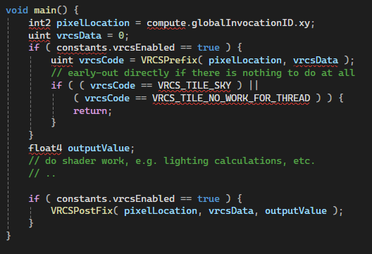
VRCS: Implementation – Simple!
VRCSPrefix: Remap the pixel location and retrieve vrcsData
VRCSPostFix: store outputValue, potentially copy to duplicate pixel
Notes:
How do we implement this?
Again, we follow the approach from the original idea.
Once everything is setup, we have a buffer with the coordinate remaps and copy bits, all we have to do is adding a „Prefix“ and „Postfix“ functions to the shaders where we want to use VRCS
The Prefix function remaps the original pixel location and retrieves an uint32 “vrcsData”, which contains the bitpacked tile-relative offsets and copy bits.
After that we run the shader as usual, no other changes needed
mind the pixel location is now different!
Caveat: things like quad shuffle subgroup operations will not work as intended, so you may want to find an alternative
At the end of the shader, we call VRCSPostFix, that writes the output value and does the copies to the duplicate pixels

Slide 21
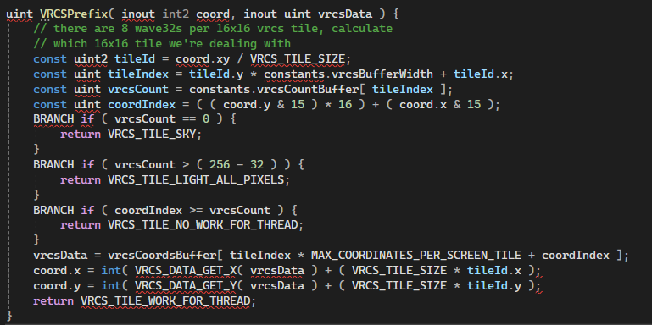
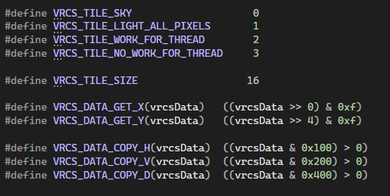
VRCS: Implementation
Compute tile index
Evaluate early-out conditions
Remap pixel coords
Notes:
The prefix function essentially computes the tile index to query the primary pixel count (that is vrcsCountBuffer) and the vrcs data (vrcsCoordsBuffer).
The vrcsData is used to to remap the original pixel coordinate. That is the tile coordinate + the precomputed tile-relative offset.
The data is also returned so we can retrieve the copy command later

Slide 22
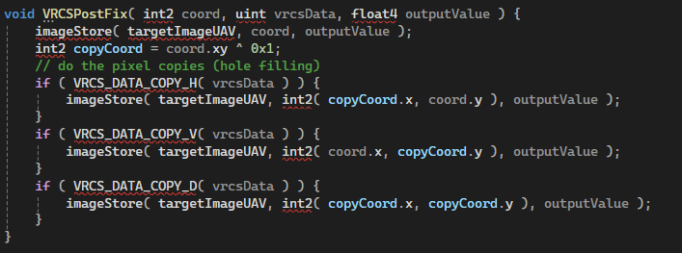
VRCS: Implementation
Store primary pixel
Check copy bits & store to copy location(s)
Notes:
The Postfix function is rather trivial:
It stores the output value to the target image UAV.
Then it checks what kind of copy is needed (horizontal, vertical or diagonal): Note, it can be all 3 of them, based on the original shading rate.

Slide 23
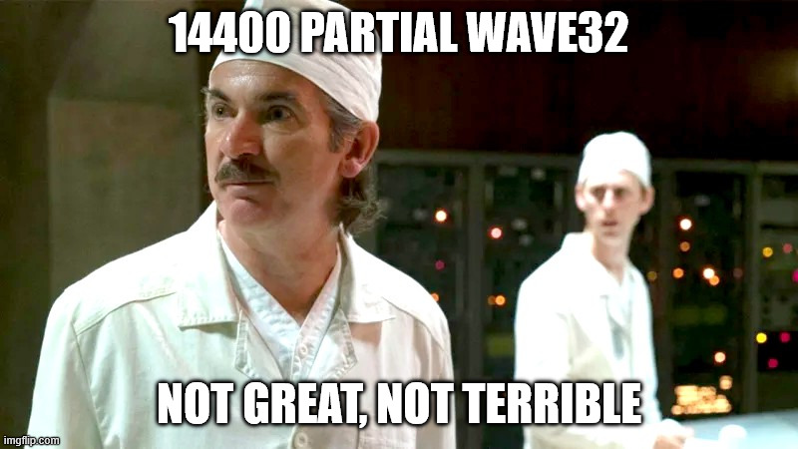
VRCS: Dispatch (Tiled Data)
Typical scenario: fullscreen dispatch
  Dispatch all threadgroups needed
  Early out for duplicate pixels
max. 1 partial wave per 16x16 tile (on average 1/8 of waves)
e.g. 14400/115200 partial waves @ 1440p
  Nitpick - not 'quite' correct
  Sometimes (numPrimaryPixels % 32) == 0
  Including tiles flagged 1x1 or 2x2
Nitpick - n
  STILL
Notes:
Typical scenario is a normal fullscreen compute shader, e.g. what we‘re using for our deferred lighting passes
We dispatch as many threadgroups we need to fill the screen (as usual)
However, we want to cash in on early-out waves (full waves with early-out threads)
Usually we have 1 partial wave per 16x16 tile
that means, in average 1/8 of all waves for a fullscreen dispatch are partial waves
* CLICK *
No way around partial waves in this scenario, though.
With a 1440p screen resolution, we get 14400 tiles on screen: (2560 * 1440 = 3686400 pixels / 115200 wave32), (160 * 90 = 14400 tiles).
Partial waves steal us some performance, but not a huge deal or even catastrophic.
CLICK *
For everyone still paying attention, you might notice that we don‘t always have 1/8 partial waves. Sometimes our primary pixel count is exactly a multiple of 32, so some tiles might not have a partial wave at all.

Slide 24
VRCS: Dispatch (Pixel Commands)
But we can do better ..
Deferred Texturing processes a single list of primary pixels („Pixel Commands“)
Only atomic-add primary pixels + copy flags
no early-out waves, no tile flags
= max. 1 partial wave per screen!
2x2
1x2
00
01
02
03
10
11
12
13
2x1
2x2
20
21
22
23
30
31
32
33
00
02
13
20
22
23
31
32
33
2x2 SRI Tiles
Primaries / Duplicates
Dispatch: primary pixel list + copy flags
Notes:
However, we have a better opportunity with our Deferred Texturing dispatch setup.
Because here, we‘ll maintain a compact list of pixel commands that will be dispatched in a later step.
And we don‘t do lighting or decals here, so we don‘t rely on scalar light loads, which would require a tiled layout in order to be efficient
The idea here is to only add the primary pixels when collecting those pixels.
This way, we never dispatch early-out pixels (duplicates), which is even more efficient
Since we the pixels aren‘t organized in this 16x16 tile setup, we reduce the amount of partial waves to a maximum one per screen!
Our Deferred Texturing approach is quite interesting and we talk about it in detail in our other talk today about Visibility Buffer and Deferred Rendering.

Slide 25
VRCS: Dispatch (The Future)
Observation: VRCS on Compact Pixel List turned out to be very efficient
  Max. 1 partial wave
  Duplicate pixel threads are not launched at all
Idea: Compact Pixel Lists also for other deferred stages (Lighting, G-Buffer, etc)
  Need more memory
  Need to solve uniform cluster reads (tile system improves uniform access to lights)
Idea+: Run Texturing, Lighting, G-Buffer update in one shader
  Similar shader setup like F+, but in compute
  Actually tried this, but ran out of time
  VGPR issues, difficulties with very long programs
Notes:
Overall, we’re not done here. We already have ideas how to make this even more efficient.
We’ve seen VRCS being most effective with our pixel dispatch commands in Deferred Texturing.
We essentially eliminate partial waves and always launch fewer compute threads in the first place.
Consequently, we were toying with the idea of using that dispatch scheme also for the other deferred stages, such as deferred lighting, G-Buffer Update etc.
However, it’s again a larger architectural change and we need more GPU memory that we don’t have
Another idea is to run Deferred Texturing, Lighting and G-Buffer update in the same shader program again, similar to Forward+.
Actually, we’ve tried this already but it was slightly slower than separate dispatches.
This was mainly due to a much higher VGPR usage.
Also, we’ve again seen difficulties with very long GPU programs that were also present with F+. e.g. very long shader compile times and inconsistent codegen (trivial change will result completely different assembly, etc.)
This is something we’ll look into in the near future, so stay tuned.
I’m now handing over to Martin who will go even deeper into the weeds.

Slide 26
Fighting the Good Fight (Image Quality)
5 weeks to code lock, Rip and Tear until it's done!

Slide 27
Pixel Offset Problem
Hardware VRS invokes the PS at the center of the ‘coarse pixel’
  Covered pixels receive copies ( = PS invocation location)
VRCS shades first covered pixel, other pixels receive copies
  Problem – VRCS introduces a 'half pixel offset'
2x1
1x2
2x2
2x1
1x2
2x2

Slide 28
Modify Shaders to HW VRS behaviour?
Problem could be corrected by sampling with an additional halfPixelOffset.xy, but
  Requires modification to every shader using VRCS
  Requires 2x extra long-life vector registers and extra math
  Not needed if running 1x1 rate...
  Little enthusiasm*

Slide 29
Rotating Pixels
Per frame rotate which pixels are primary & converge?
  Improvement for 1x2 and 2x1 rate, flip the checkerboard
  2x2 rate requires 4 frames to converge = 15hz = too slow
    Instead, alternate primary pixel between top left and bottom right
    +ping pong sequence for 3 covered pixels
  Improvement != fix

Slide 30
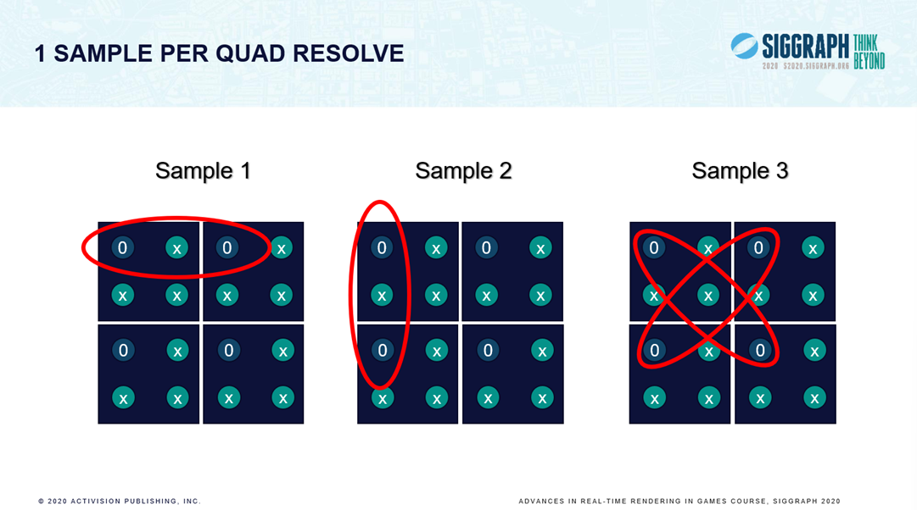
Activision's Deblocker - Michal Drobot Siggraph 2020
“Software-based Variable Rate Shading in Call of Duty: Modern Warfare.”
Execute a thread per entry in the VRCS coordinate buffer
  2x1 – average two pixels horizontally
  1x2 – average two pixels vertically
  2x2 – average 4 pixels diagonally
Run before transparency
  Solves half pixel offset

Slide 31
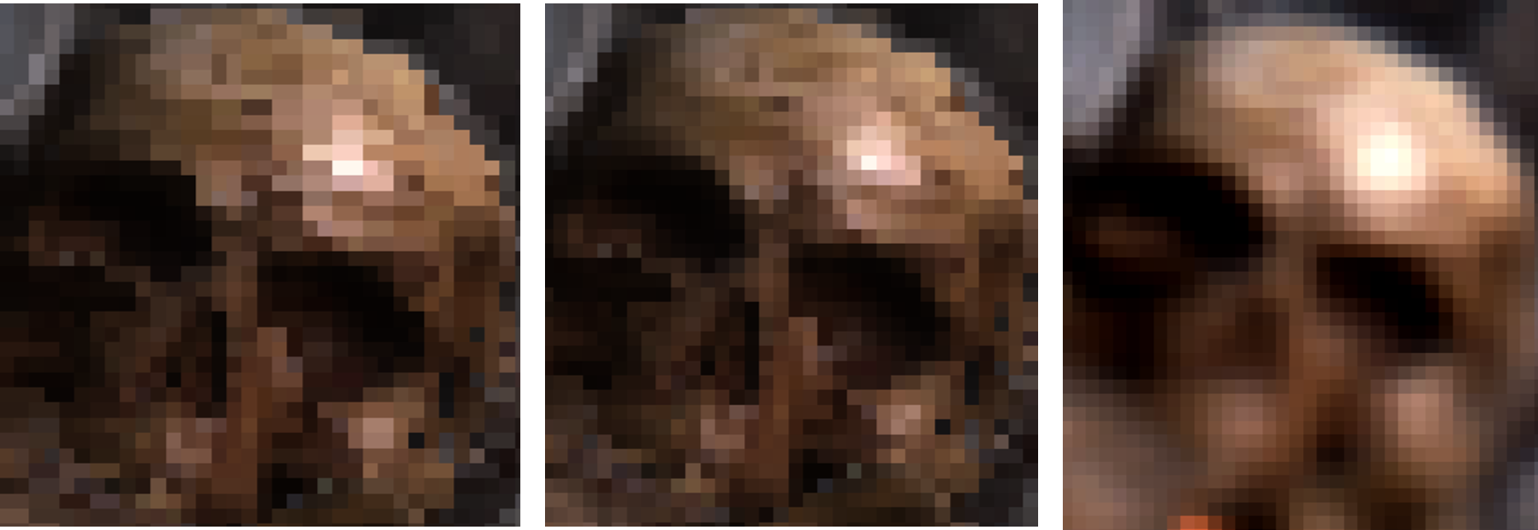
Results: XSS – Deblocker cost 97us @ 736p
Raw
Deblocked
Final
Very little 1x1 rate on XSS at low resolutions, mostly half rate or 2x2

Slide 32


Coverage?
Raw
Deblocked
We let the deblock spill over triangle edges
  Incorrect for surface silhouette...
Did try respecting coverage:
  Slow...
  Fixed silhouette, but interior problem

Slide 33
Coverage?
We let the deblock spill over triangle edges
  Incorrect for surface silhouette...
  But CORRECT for interior surfaces!
  e.g. deblock spec highlight across triangle edge

Slide 34

Coverage?
Raw
Deblocked
Final
TAA fixes our sins!
  Or at least this sin...
Proper fix would be dissimilar depth
  But cost, shader B/W limited
  And time, ~5 weeks to ship, wasn't a priority...

Slide 35
Squeezing in Just One More Sin!
The Deblocker uses the same Input & Output UAV...
  Shader is bandwidth limited
  (also writes Luma for SRI generation)
  Same input & output buffer = big optimisation
But
  Race condition - pixels changing value (output) which have yet to be used as inputs
  Imperceptible in practice

Slide 36
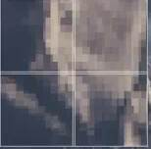
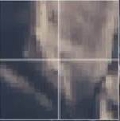
Activision's Deblocker Worked Extremely Well!
Cheap!
Fixed half pixel offset issue
  No mod to existing shaders
Allowed us to be WAY more aggressive on shading rate!
  Especially on XSS
  Especially at low DRS res
Digital Foundry called out some blockiness
  Strange, far distance only?!?
  Oh... we accidentally turned off the deblocker for lightly fogged screen tiles....
  Quickly fixed in post launch patch
(The idTech8 Magnifying Glass!)

Slide 37
Noise is from Hell!
idTech8 uses per-frame rotating blue-noise for 'Fog' and Shadow Cascade blending
  Single pixel 'fizz' becomes objectionable at Macro scale (2x2 rate)
    Randomness unpredictable by VRS/VRCS
    TAA helps with single pxiel 'fizz', but not blown up to Macro scale
Key observation - half rates are 'ok'
  Added a LOT of 'extra half rate shading' to VRCS shading rate image (but not VRS image)
    Compute shading rate as normal
    If shading rate is 2x2, compute again, with reduced tolerances
      But this time 1x1 is disallowed, 2x1, 1x2 or 2x2 only

Slide 38
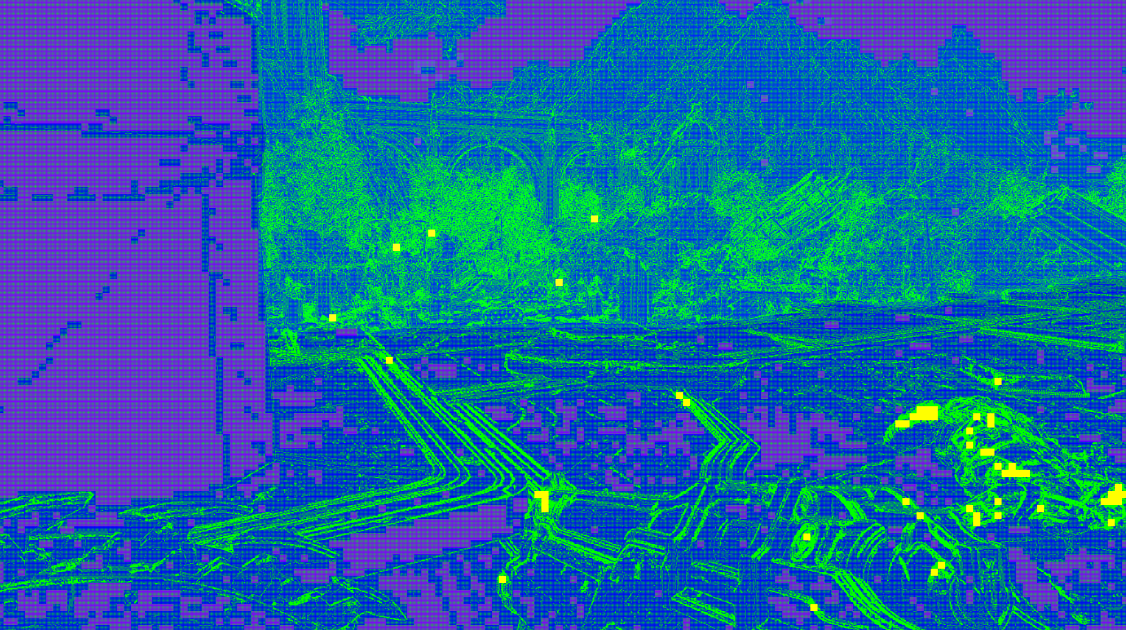
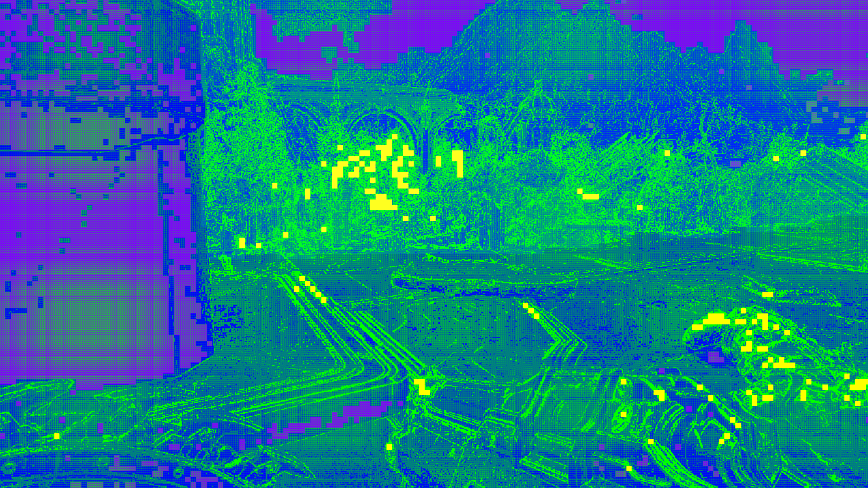
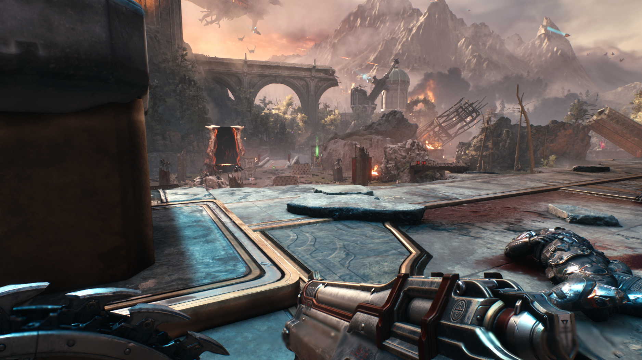
Extra Half Rate Shading – But The Cost!
Also helps with SSR
  Particularly sensitive to variation in normal direction
XSX 1440p
Normal Half Rate 17.4ms
Extra Half rate 18.0ms

Slide 39
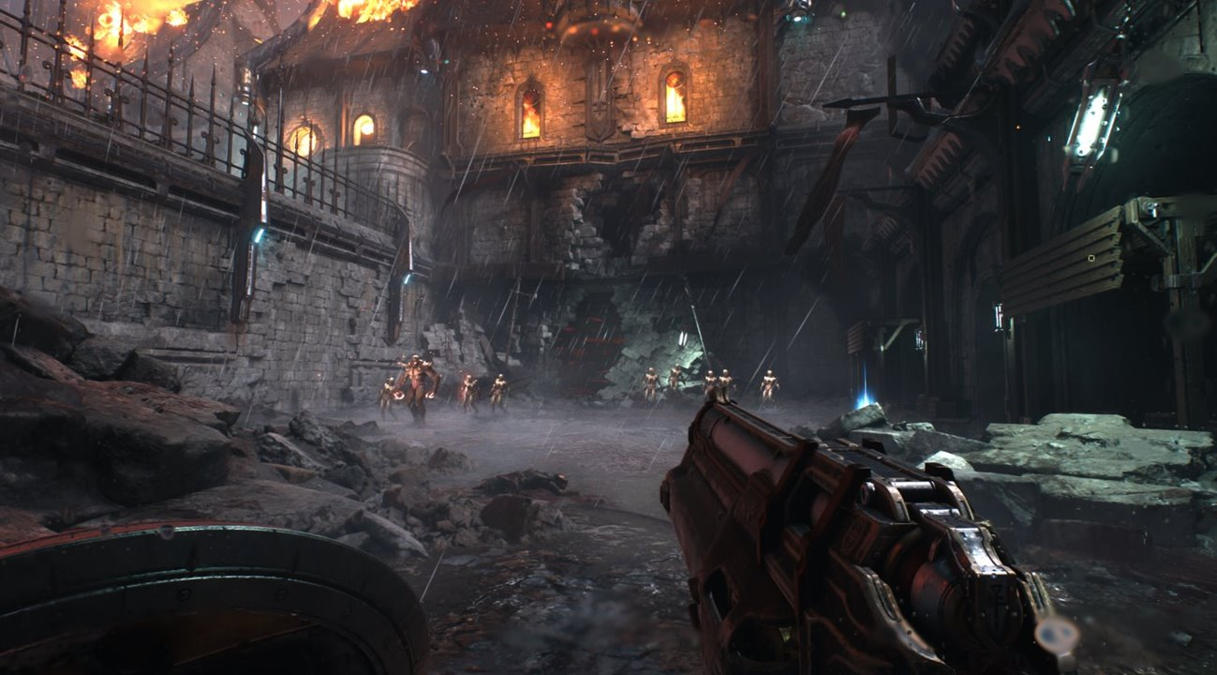
Clawing Back Performance
Because fixing the noise issue cost a lot of performance

Slide 40
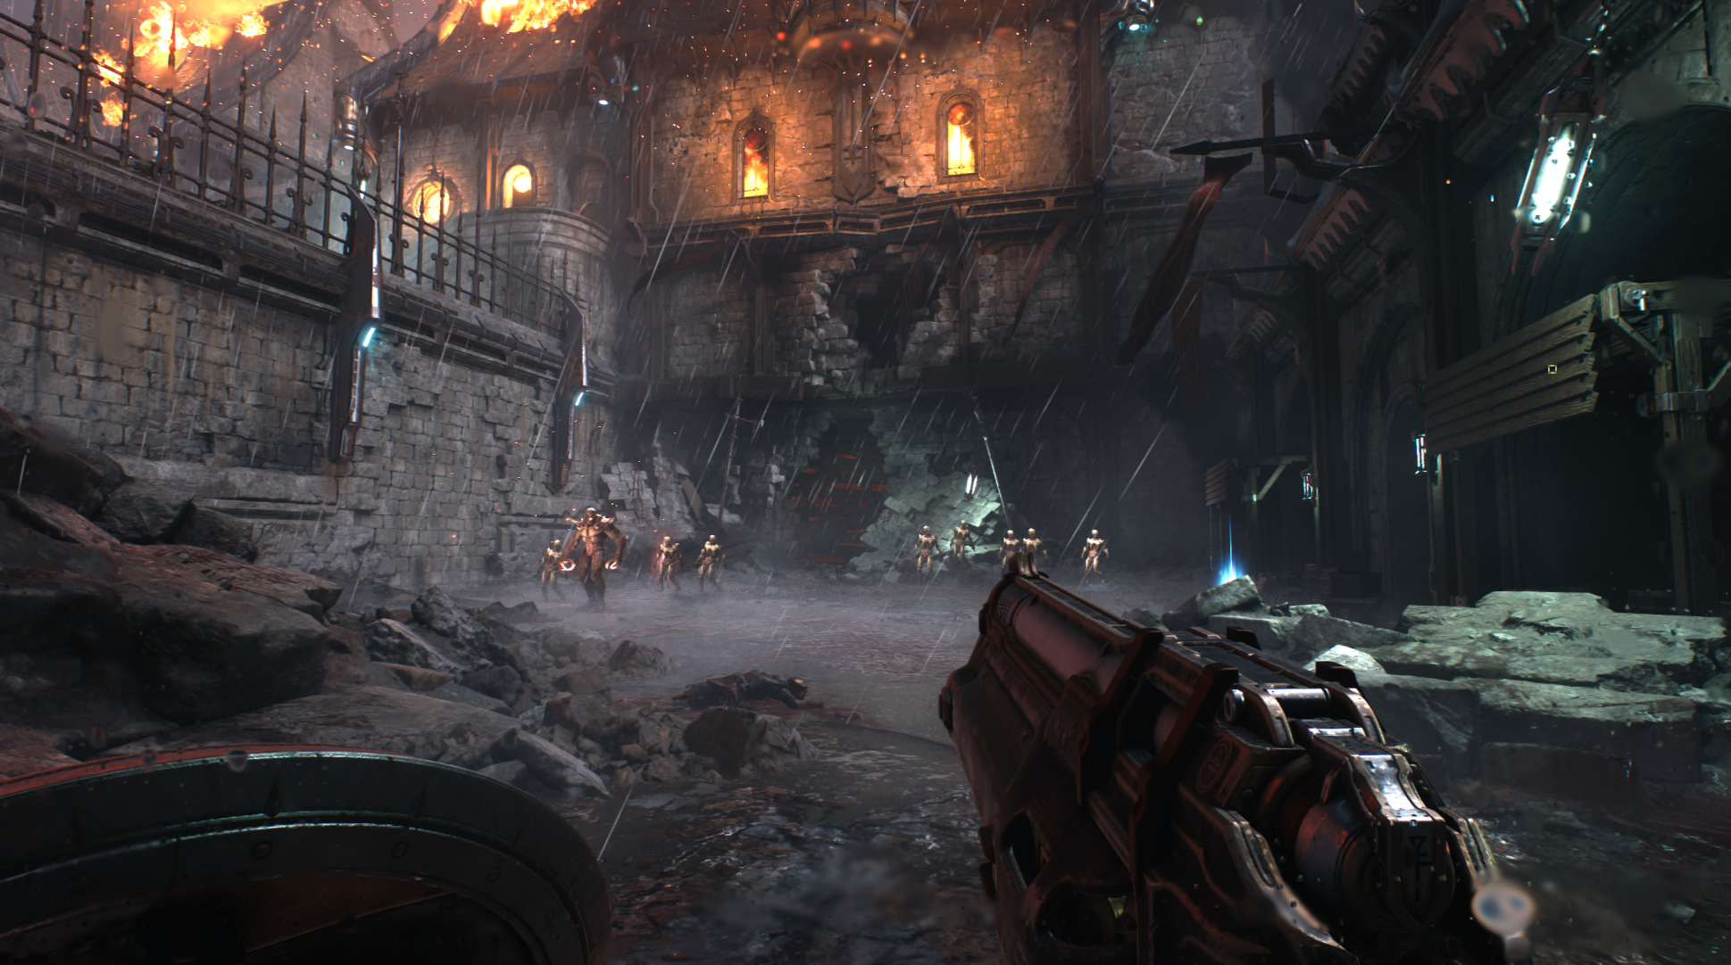
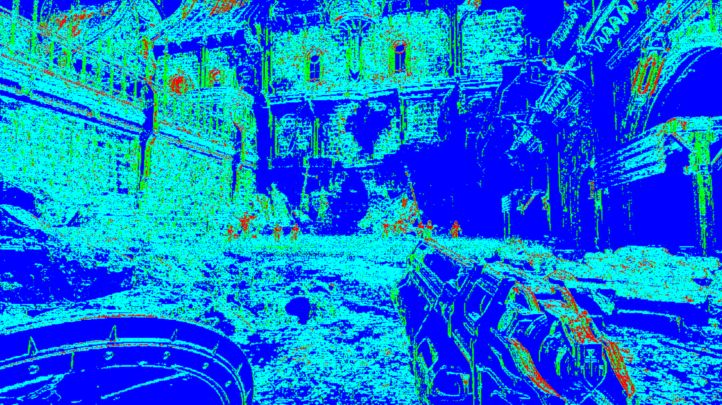
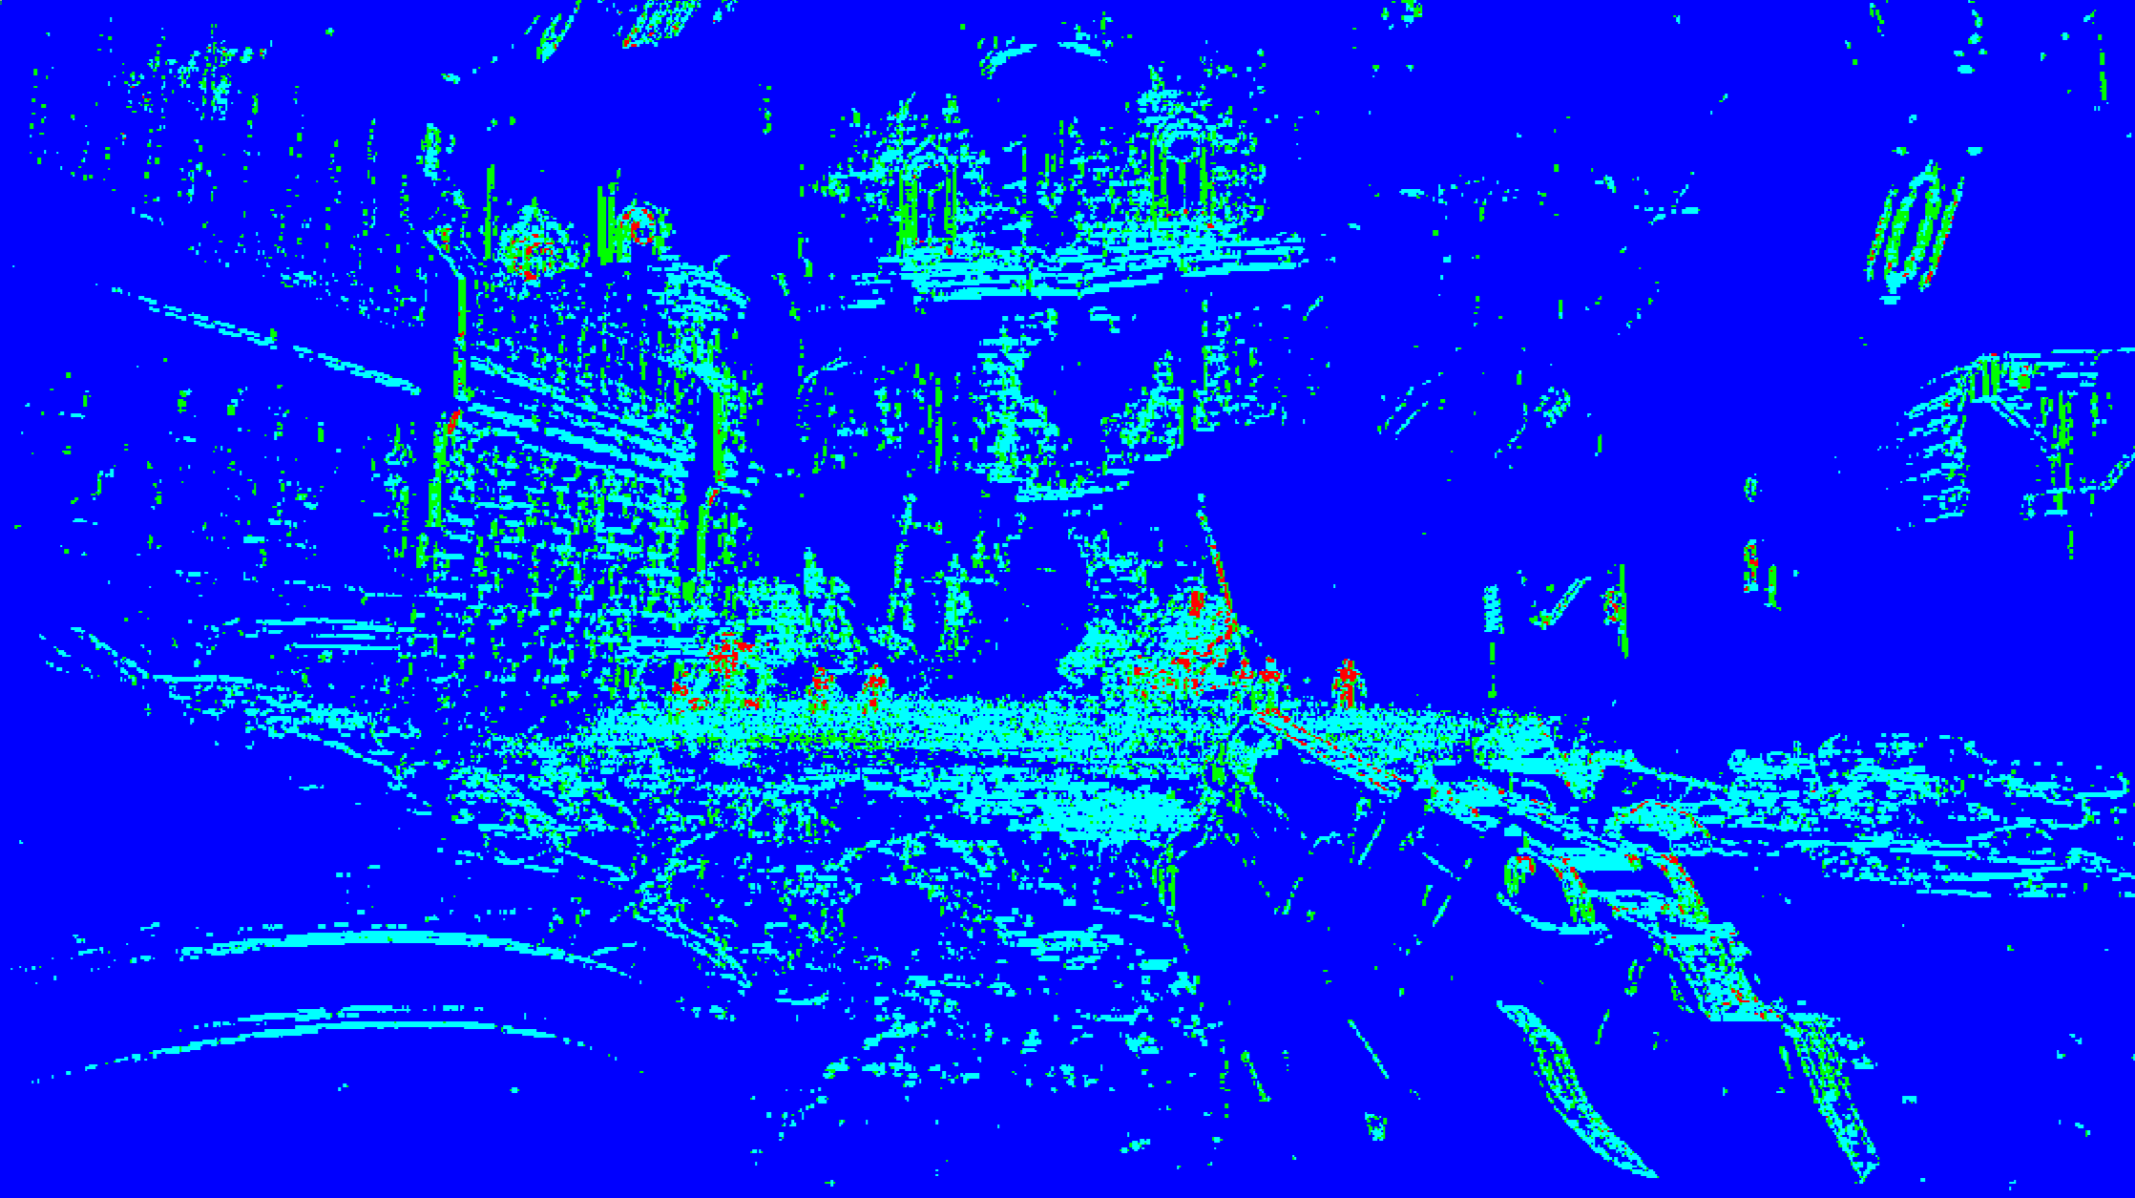
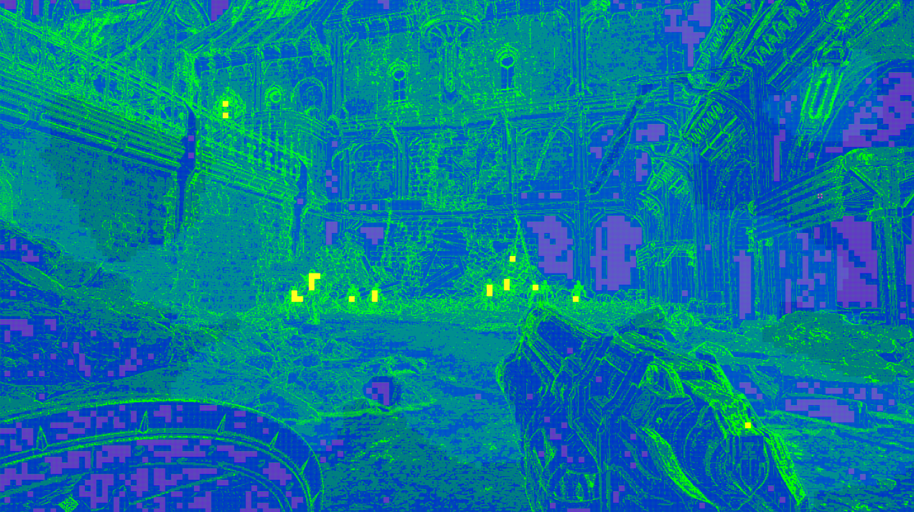
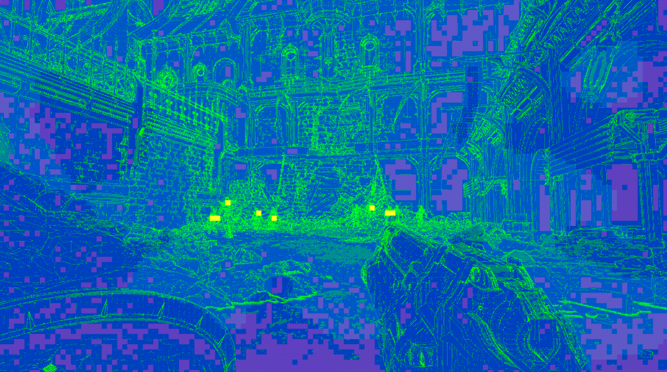
Foveated Shading Rate linked to DRS (VRS & VRCS)
Shading Rate linearly scales with DRS whole resolution range
Foveated reduction kicks in at <= 75% res
VRCS + DRS = large reduction in number of processed pixels!
XSX 1440p
XSX 1170p

Slide 41
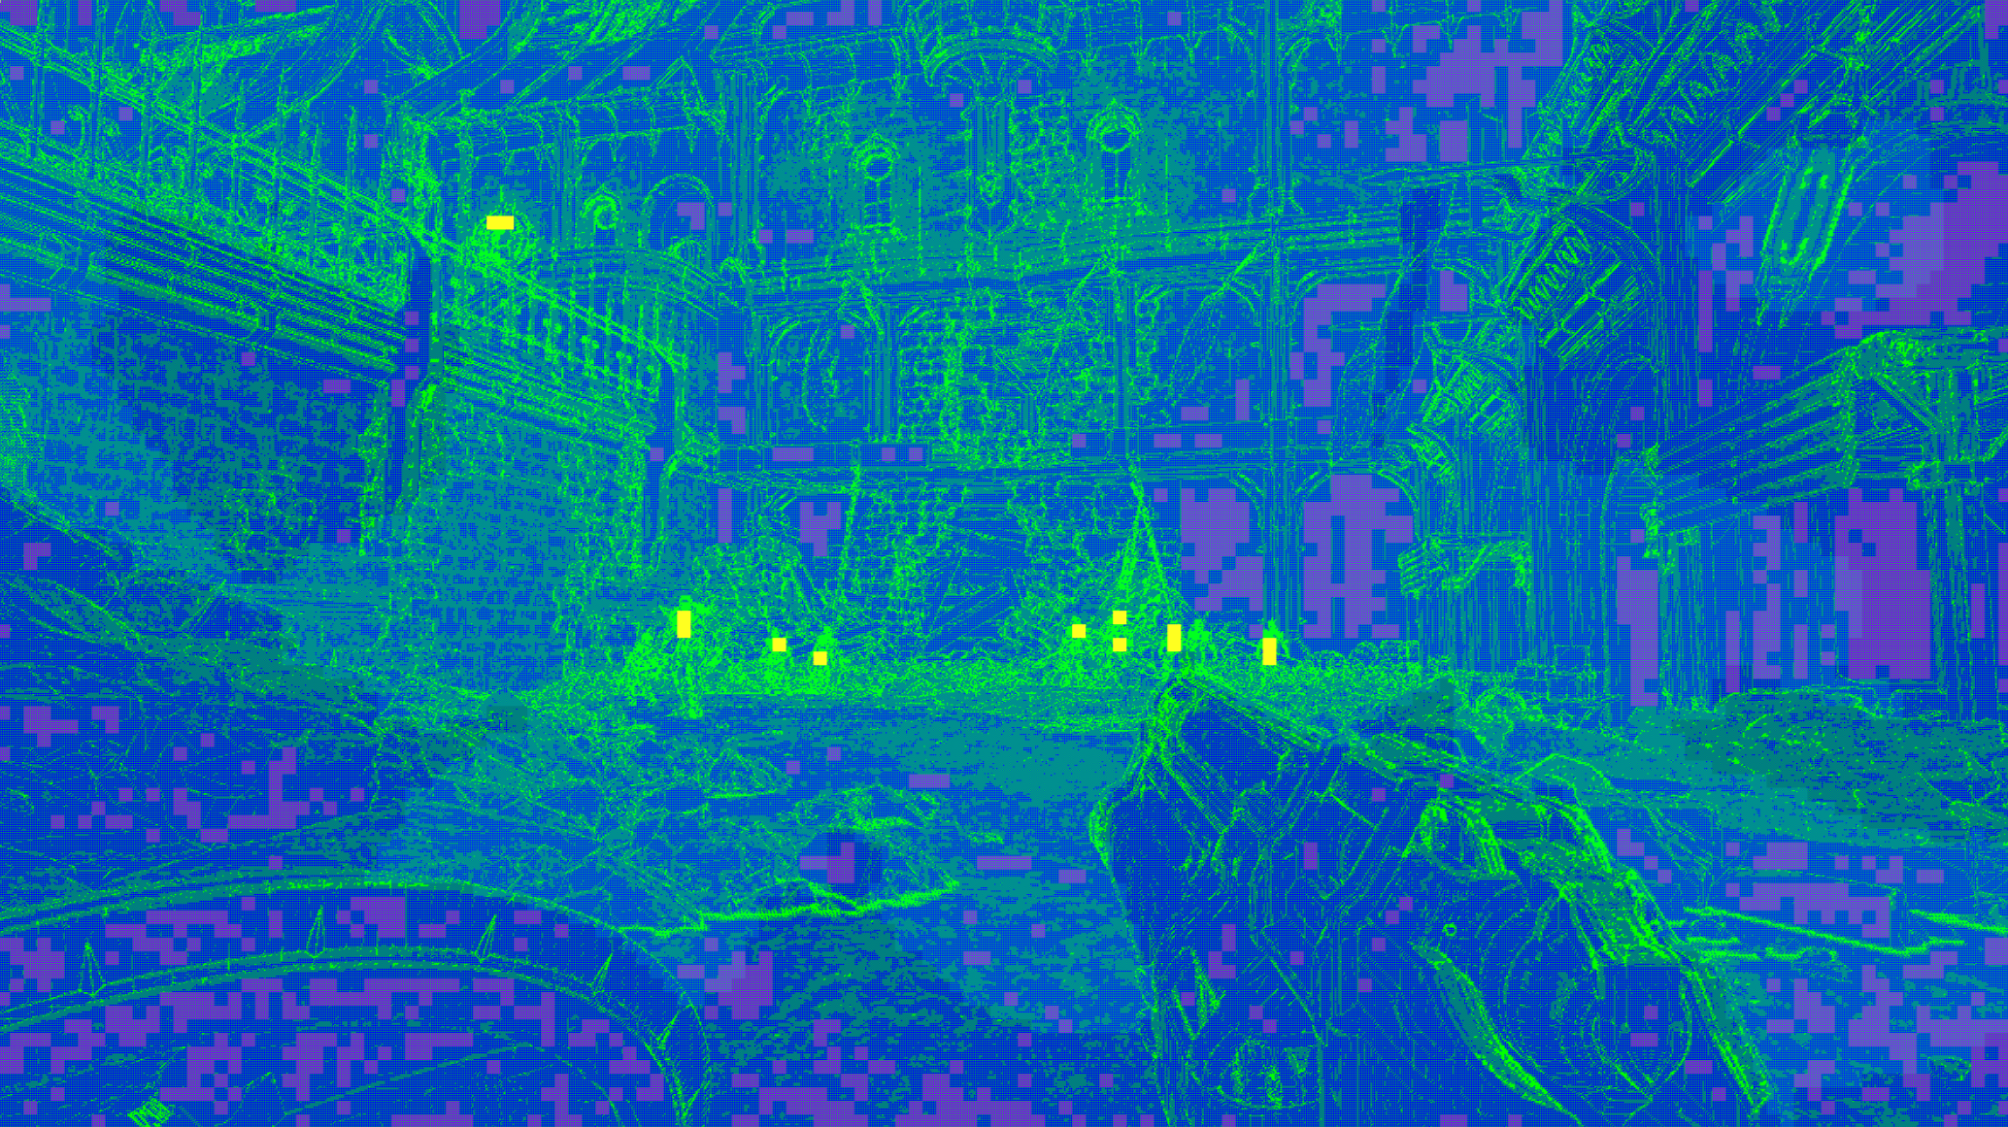
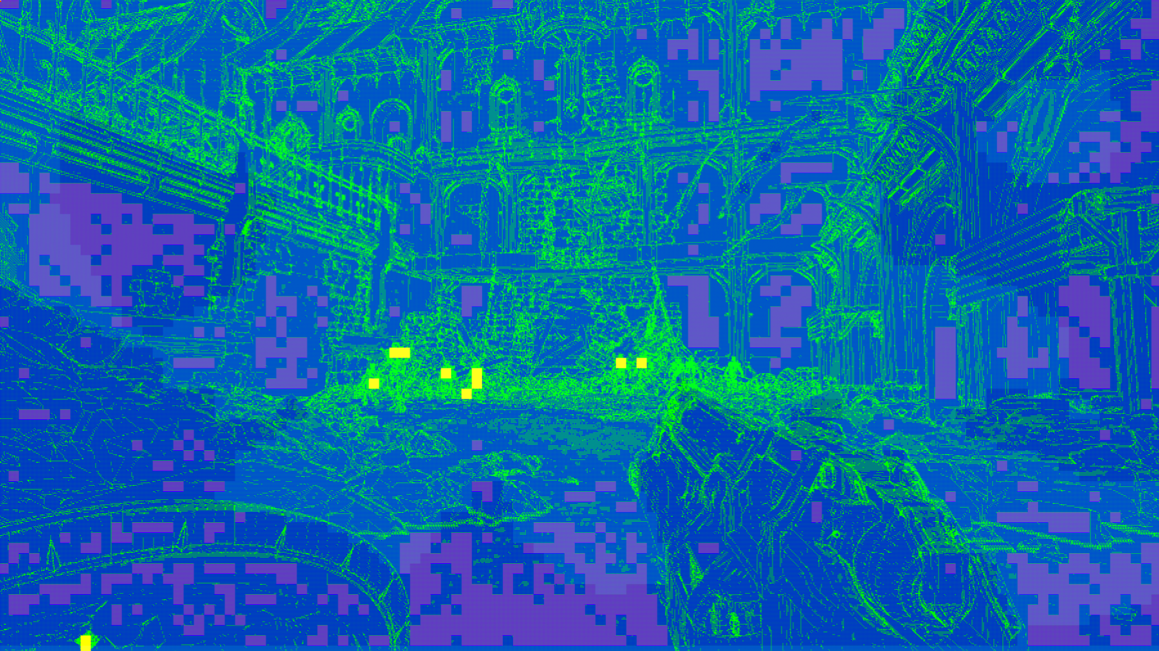
Foveated Shading Rate linked to DRS (VRS & VRCS)
XSX 1440p
XSX 1336p
XSX 1020p
Q. What is VRCS worth?
Depends on resolution + we added a VRCS quality overshoot
    Above 85% resolution, increase VRCS quality above what we considered needed for image quality, because why not?
    Sometimes VRCS barely a win at max res, ok fine!

Slide 42
Best Wins are Not Necessarily at Min or Max Resolution
XSX 1440p
VRCS on 18.55ms
VRCS off 19.70ms
Saved 1150us
XSX 1336p
VRCS on 15.54ms
VRCS off 17.57ms
Saved 2030us
XSX 1020p
VRCS on 10.00ms
VRCS off 10.93ms
Saved 930us
Quality overshoot active
No quality overshoot
No foveated shading rate reduction yet
Full rate triangle edges limit win
Lowering resolution always provides diminishing returns

Slide 43

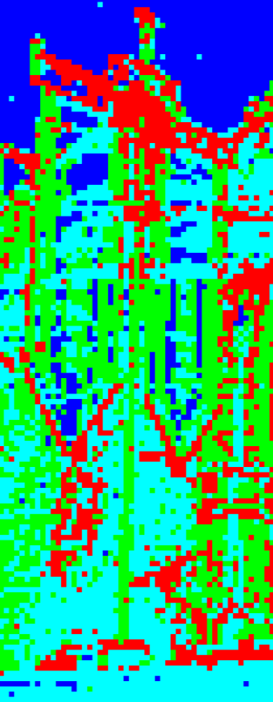
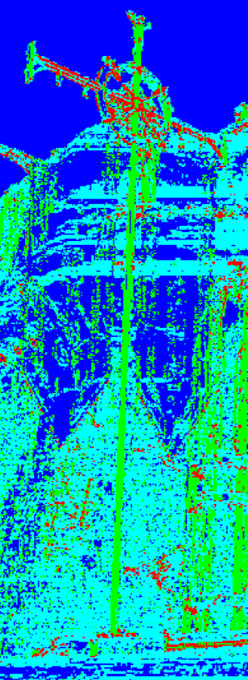
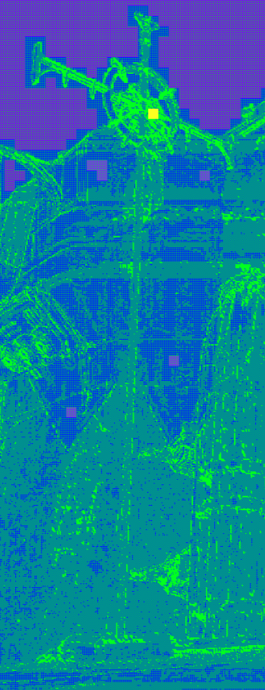
Transparencies Can Reduce Solid Shading Rate
Luma stored twice before and after transparent (R8G8) VRCS shading rate computed twice
VRS uses after transparent luma for shading rate
VRCS uses the lowest of either shading rate
Transparents can reduce shading rate on solid but cannot increase it
= Profit!
(Particularly in combat)
Final
VRS SRI
VRCS SRI
VRCS Buffers

Slide 44
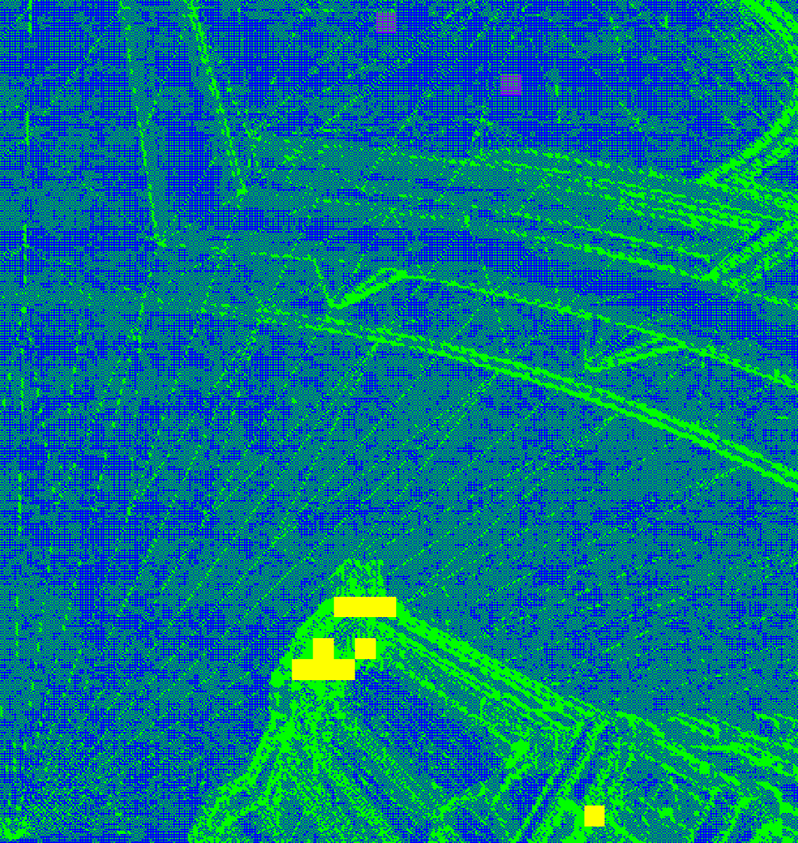
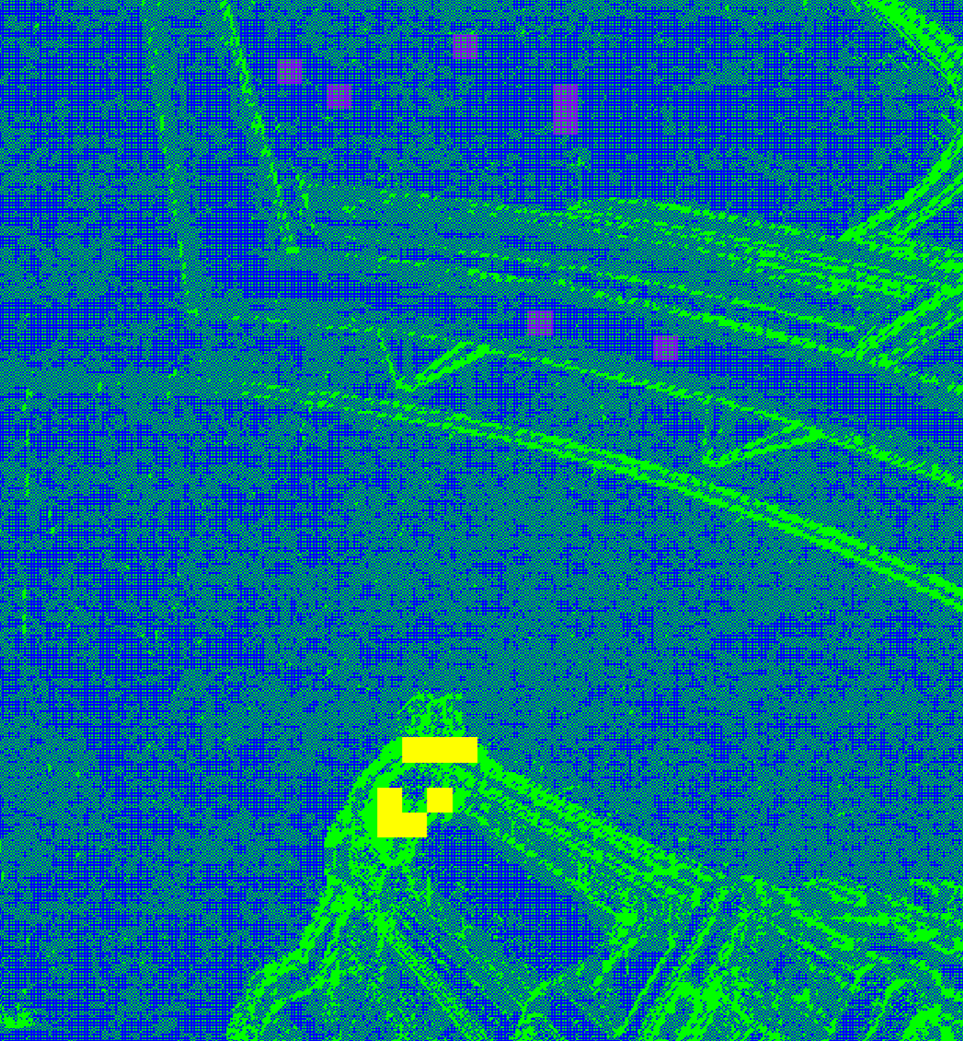
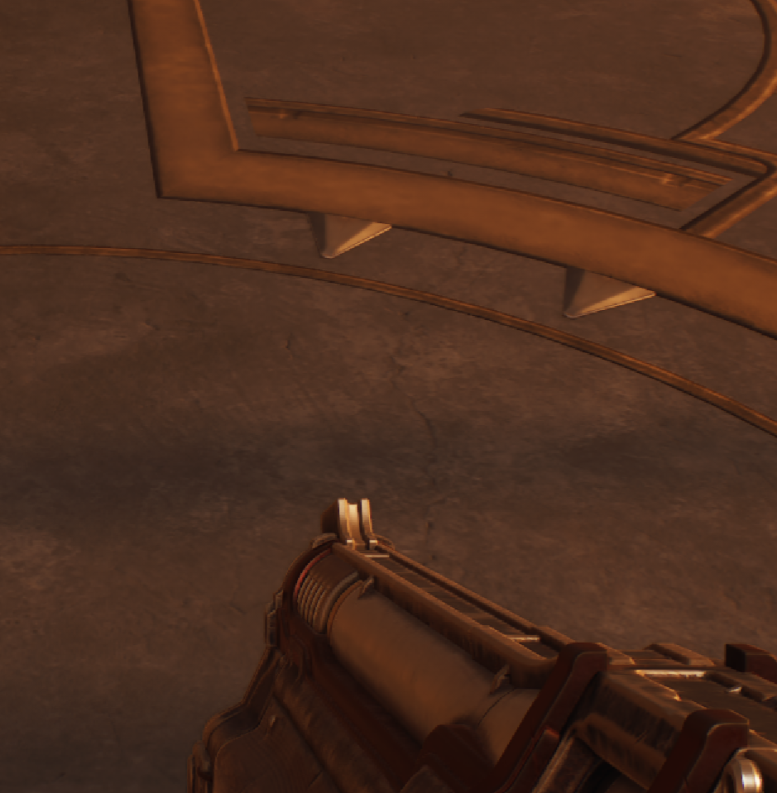
Remove Overshading of ~co-planar Triangle Edges

Slide 45
Zoomed in, in-case of Bad Projector Quality!

Slide 46
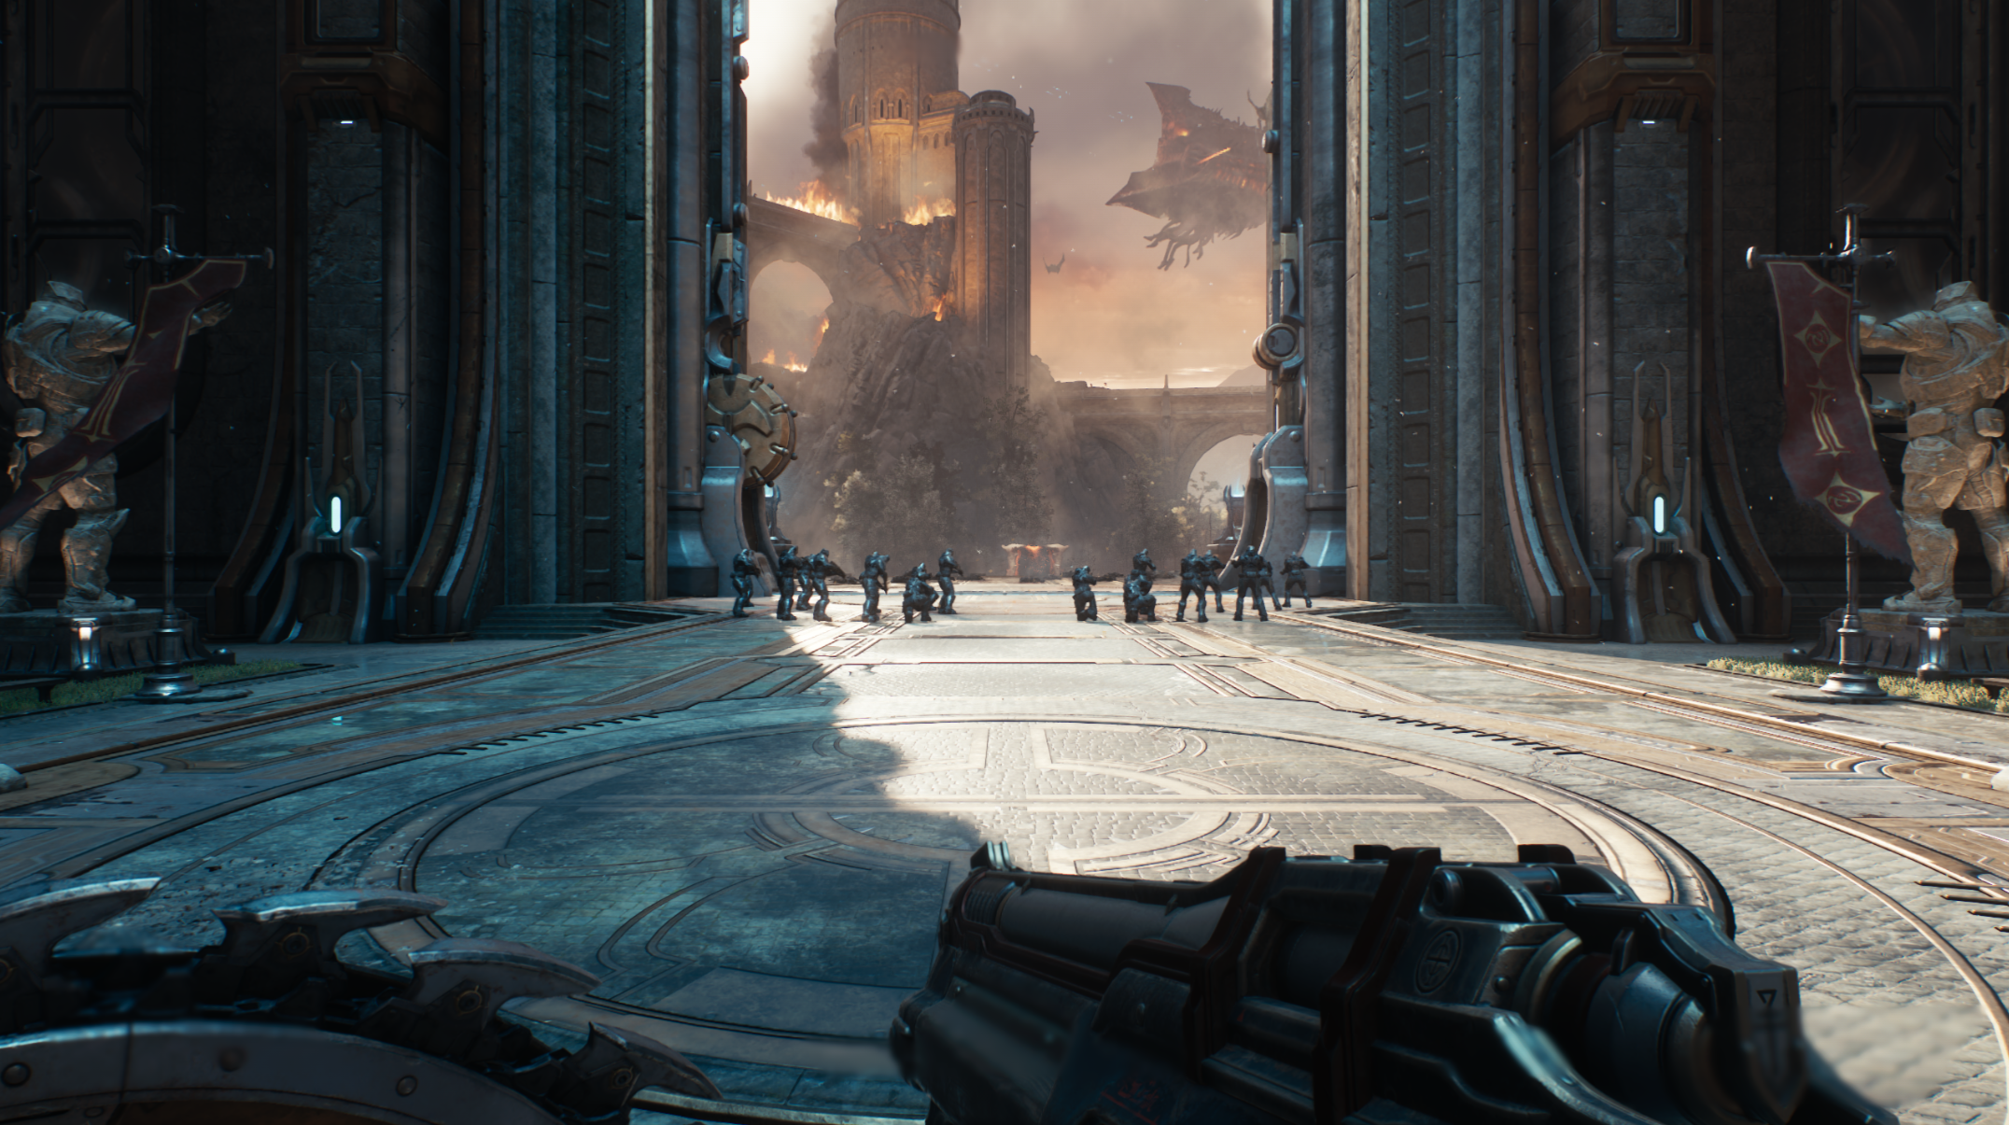
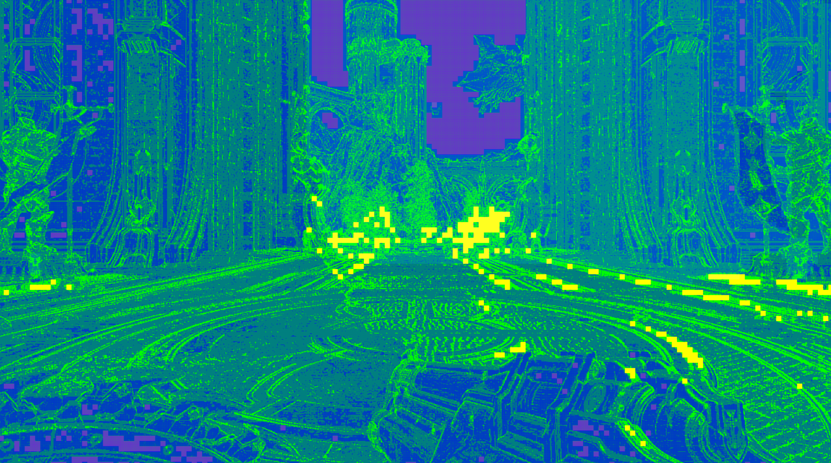
Remove Overshading of ~Co-planar Triangle Edges
Dot product face normals and compare depth
  Allow shared shading if close (and low rate)
  Worked great except...
Had to Reconstruct Face Normal
  (Terrible 'knocked up in an hour' algorithm)
    Load triangle ID + depth to 8x8 groupshared
    Search for 3x3 for three identical triangle IDs
      Cannot be in a straight line
    Build face normal from 3x positions.xy+depth
    Zero normal if not found
XSX 1440p
Normal VRCS time 18.10ms
Overshade reduced 17.95ms

Slide 47
Other Performance Wins
Increased Shading Rate tolerance in 'Safe Area'
  Border screen tiles have slightly lower shading rate = v.small win
  Not forced 2x2, because noise...
VRCS Tile Flags: (stored or derived from tile count of primary pixels)
  1x1 – process every pixel, pixel.xy = SV_DispatchThreadID
  2x2 – tile is entirely 2x2, pixel.xy computed, not loaded from buffer
  Sky – tile is entirely sky, early out if shader doesn't want to process sky (Sky is not necessarily 2x2)
  Fog – tile is fogged, composite shader runs 1x1 rate, other shaders run with stored pixel.xy (unless additionally flagged 1x1 or 2x2)

Slide 48
Fog Tile Flag Optimisation
Fog Volumes are 3D
Building VRCS buffers runs 1 thread per 2x2 pixels
  Fog volume sampled once per thread = half res
  Still expensive though....
Post launch ended up dropping VRCS for the composite pass – which also calculates fog
  Meh,
  But - reclaim expense of calculating fog tile flag

Slide 49

Results
Where did we land?

Slide 50
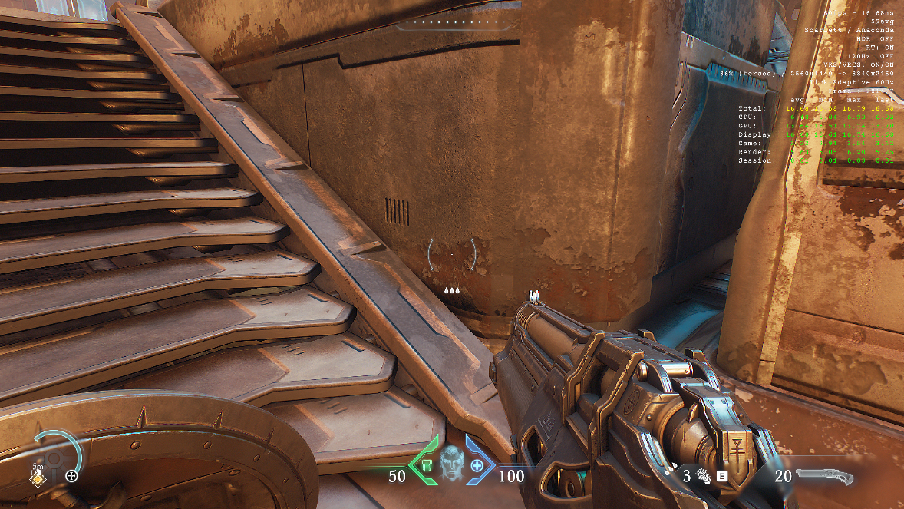
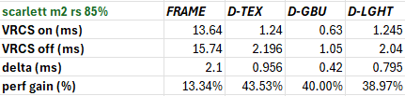
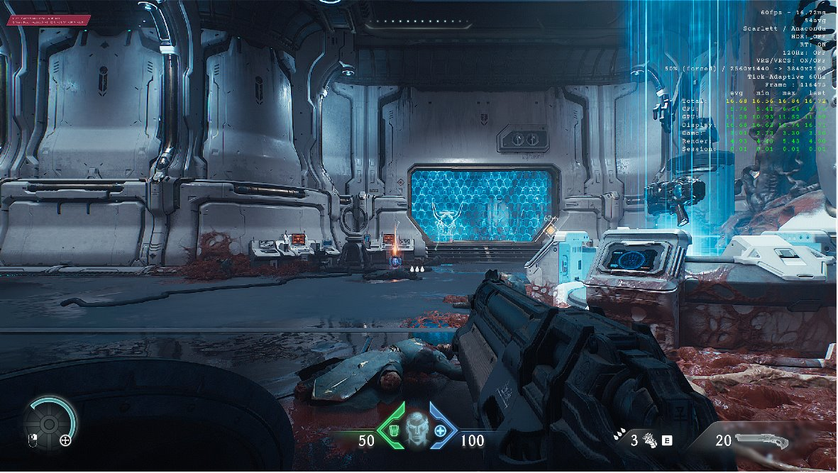
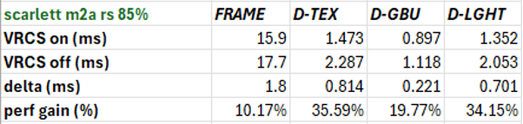
Perf Numbers
Case with good gains
Case with average gains

Slide 51

Worst VRCS Gains
Always foliage!
1336p XSX
600us win
85% res
Worst scene I found
(non-exhaustive sampling, but DF called out the same area)

Slide 52
VRCS Performance Figures
Xbox Series X|S and Playstation5
  Huge gains in VRCS enabled passes
    Frequently 33% saving for deferred texturing and lighting
  Typically, 1-2ms overall GPU frame perf gain
  Depends on content and DRS scale
    Best gains at 85% resolution, by design
    Worst gains in foliage heavy areas
ROG Xbox Ally X
  Similar gains without costly upscaler (simple TAA) as on Xbox/PS5
  No great VRCS win with FSR upscaling
    Cost of FSR pushes down internal resolution
    VRCS win dependent on finding duplicate pixels
      Overshading of triangle edges problem becomes much worse at low resolutions

Slide 53
Future Potential
Buckle up, there is a lot!

Slide 54
VRCS to Accelerate Ray Tracing
Use VRCS to fire fewer rays originating in the view frustum
  Reflections
  AO
  Shadow rays
  Screen space probes
Totally viable, potentially MASSIVE saving
  As normal - fire rays from primary pixel, copy results
  Or - reduced ray count per pixel
    Non-binary use of VRCS!
      reducedNumRaysPerPixel = numRaysPerPixel / (1 + numPixelCopies);
    (for GPUs that can fire multiple rays per pixel...)
Notes:
Martin slide

Slide 55
2. Reduce Internal Shading of Triangle Edges
Reconstructing face normal from adjacent samples ‘worked’
  Requires finding three samples from the same triangle + precision issues
  Not great, not terrible
Improvements:
  Store face normal with visibility buffer?
    OctEncodeLowPrecPosZOnly(cross(ddx(SV_Pos), ddy(SV_Pos)));
  Or output with barycentric buffer?
    Pass accesses triangle data – visible triangles only
    Tangent frame normal?
We can do even better!
Notes:
Martin slide

Slide 56

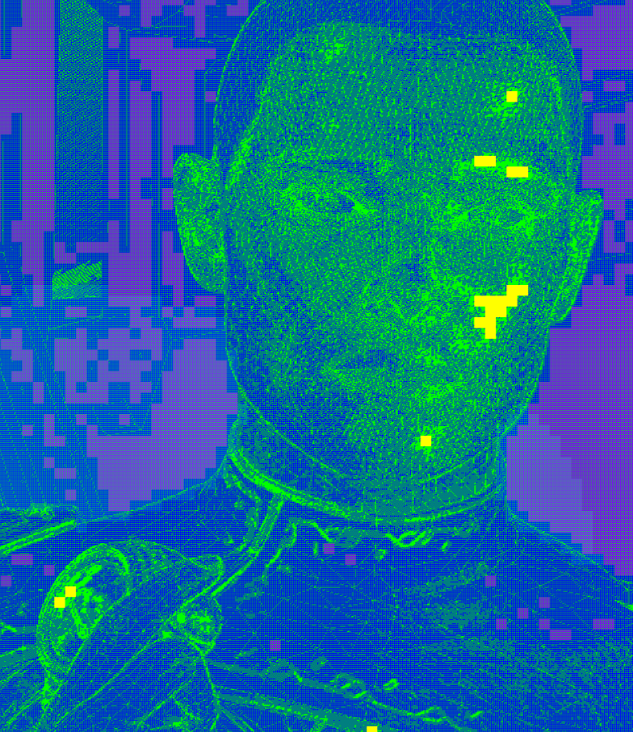
Unwanted Extra Shading on 'Internal Edges'
E.g.
Face
Fingers
Cloak
XSX 1440p
Regular 13.9ms
VRCS 12.2ms

Slide 57
Not Co-planar Triangles, but 'Same Surface' Triangles

Slide 58
Solution : Stop using TriangleID !
Triangles are an artificial representation of the true geometry of a surface, we actually care about:
  Increase quality on surface silhouette (where MSAA wins)
  Surface is continuous (depth check)
  Shading detail/lighting etc.. (shading rate image)
  E.g.
    shareShading = lowRate && zClose && (surfID == adjSurfID)
Would significantly reduce unnecessary additional shading
  Foliage, cloth, skin, floors, walls, any smooth surface!
  Particularly helpful at low resolution / detailed meshes / small triangle sizes
Tooling problem, how to assign surfaceID?
You could use VRCS without a Visibility Buffer!
  G-buffer SurfaceID
Notes:
Martin slide

Slide 59
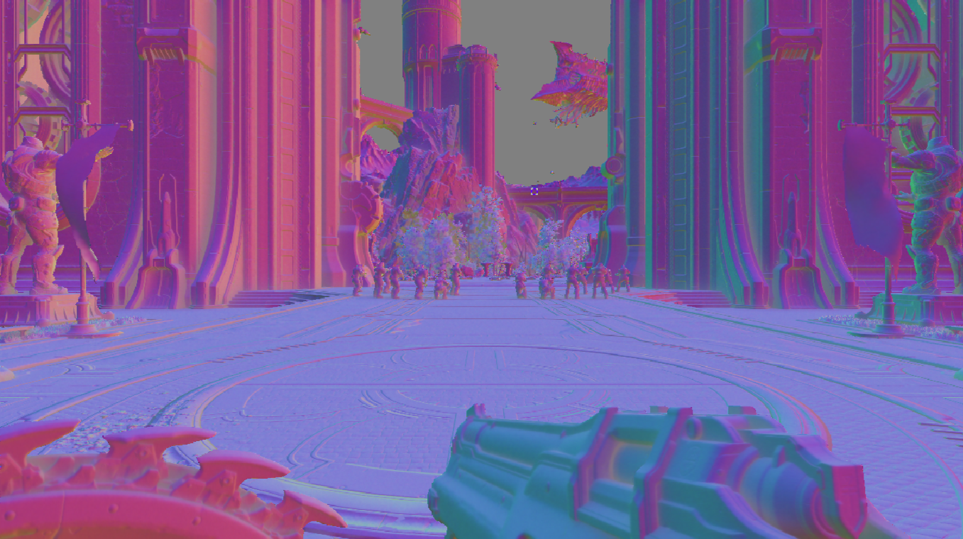
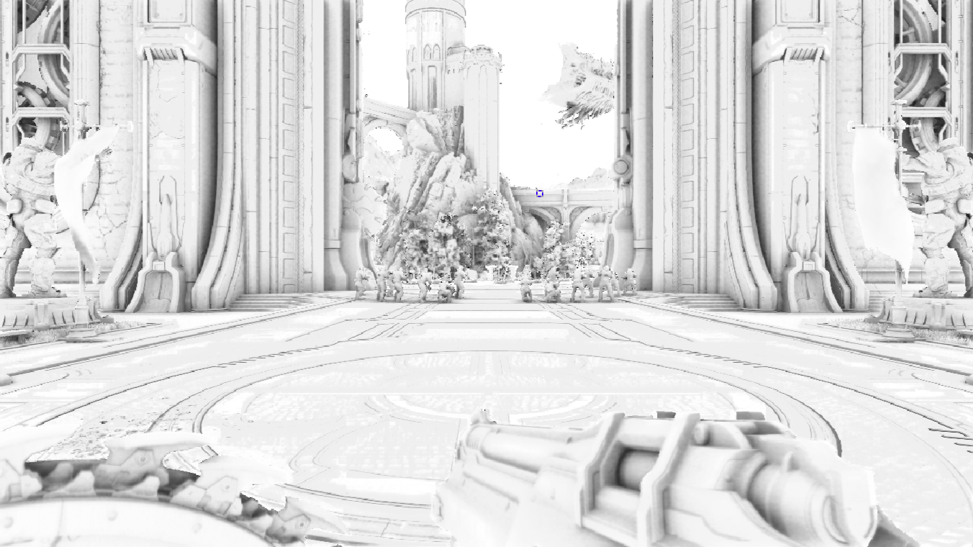
3. VRCS on Half Res?
SSDO is half res, and expensive (~1.3ms)
  Half res shading rate image
    Additional output from current shader
  Half res VRCS coordinate buffer
    Simplified VRCS buffer gen shader
    Requires half res visibility buffer or custom sample
    Hide cost on async compute ofc!
  No Deblocker?
    Result is blurred anyway
  Would VRCS be a win?
    Guestimate net 100-200us saving with triangleID's
    Guestimate net 250-300us saving with surfaceID's
    (Triangles a lot smaller at half res! Surfaces still relatively large)
Notes:
Martin slide

Slide 60
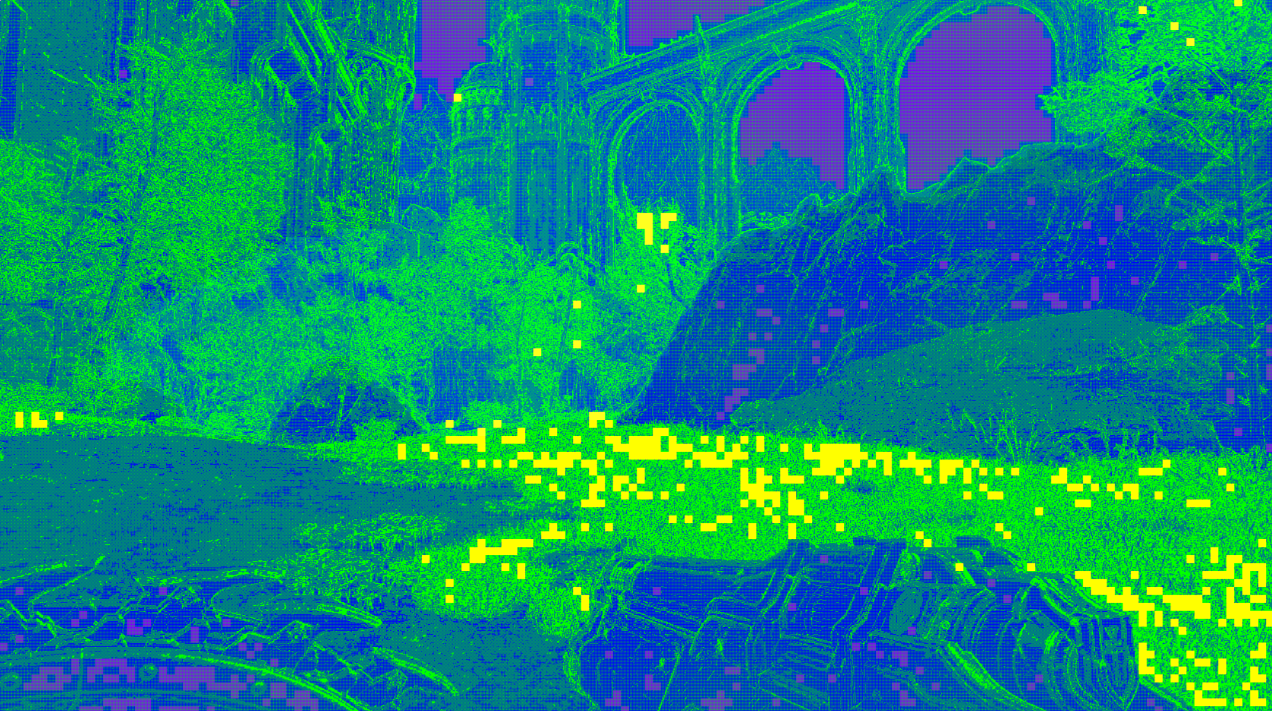
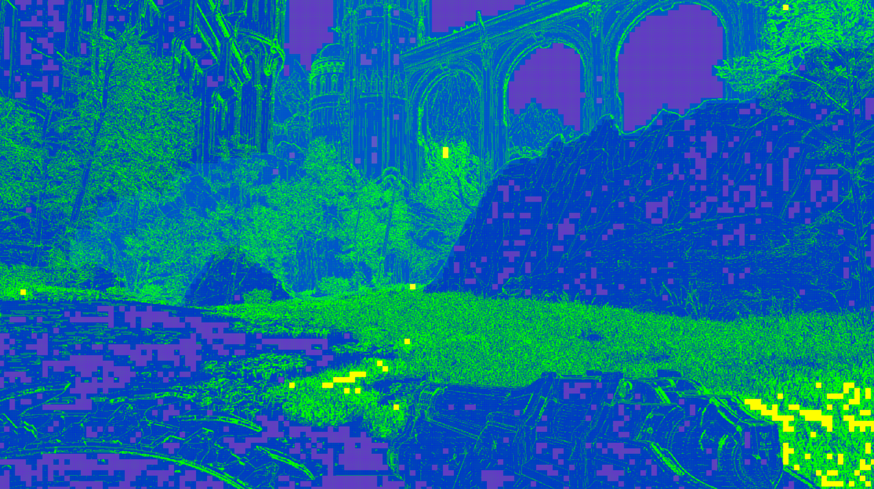
4. Foliage: Reduce/Remove Extra Half Rate
With Extra Half Rate
Fullscreen No Extra Half Rate
How much extra half rate on Foliage?
  1. Less? Relax shading rate tolerance
  2. None? :-)
XSX 1440p
Extra Half rate 17.2ms
No extra Half Rate 16.5ms

Slide 61
5. Sending Noise back to Hell!
Potential solutions:
  Produce a screen space mask of where noise is being applied (does not need to be binary)
    e.g. where shadow cascades are transitioning
    Next frame - boost half rate shading only on masked areas
  Disable extra half rate on certain materials
    e.g. foliage
  Disable extra half rate when the camera is moving fast
    Foveated?
    (If only we had captured motion blur in the Shading Rate Image)
(Or remove use of noise..? #JustSaying...)

Slide 62
6. If We Can't Fix the Noise Issue?
Observation – noise added in lighting pass, not texturing
Per-pass SRI and VRCS buffers?
  Deferred texturing – no half rate boost
  Deferred lighting – half rate boost
Problem?
  Reflections particularly sensitive to normal direction
  SSR runs thread per pixel - no VRCS
    But it does use duplicate g-buffer normals
    Not great, not terrible
Solution:
  Output normal g-buffer thread per pixel – no VRCS
  Run VRCS for the rest of the shader, waves retire
  Only for screen tiles with reflective materials - re-project from last frame

Slide 63
7. Post Process Blurs
Shading Rate Image doesn't know about:
  DOF, Motion Blur, Bloom etc..
  (Major VRS win on other titles => increased internal resolution)
Why?
  idTech8 overlaps frames => GREAT optimisation!
  But... post blurs not reliably done by the time Shading Rate Image required...
Solution?
  Coarse DOF calculation in Shading Rate generation shader?
    Small VALU cost => but only when DOF is turned up high = profit!

Slide 64
VRCS Conclusions
1-2ms saving is huge for a 60hz title!
  Increased internal resolution on PS5/XSX/XSS
  Required on XSS to hit frame time+resolution targets
  Worked well on ROG Xbox Ally X only with a cheap upscalar (same as console)
  Best wins require a reasonable resolution
  Deblocking is essential
We have only scratched the surface!
  Apply to RT and half resolution passes
  Improvements
    Pixel selection algorithm - surfaces not triangles
    Better fix for the noise issue - reduce half rate shading boost
    Foliage - remove internal triangle edges and remove/reduce half rate boost

Slide 65
Thank You For Listening!
Acknowledgements
Thanks to the amazing team at idTech, especially for being open to big changes very late in the day!
idTech engineers:
Allen Bogue, Billy Khan, Bogdan Coroi, Carson Fee, Dominik Lazarek, Ian Malerich, John Roberts, Jean Geffroy, Johan Donderwinkel, Mel-Frederic Fidorra, Oliver Fallows, Dr. Peeter Parna, Philip Hammer, Regan Carver, Seth Hawkins, Stefan Pientka, Thorsten Lange, Tiago Sousa and Yixin Wang
id Software leadership (Marty Stratton, Hugo Martin)
Everyone else at id Software, ZeniMax and Xbox
We are Happy to Take Questions!

Slide 66
References
“Variable Rate Compute Shaders - Halving Deferred Lighting Time”, Martin Fuller. Microsoft Game Dev YouTube Channel, 2022, https://www.youtube.com/watch?v=Sswuj7BFjGo
“Variable Rate Shading Update Xbox Series X|S”, Martin Fuller, Philip Hammer, Christopher Wallis. Microsoft Game Dev YouTube Channel, 2022, https://www.youtube.com/watch?v=pPyN9r5QNbs
“Variable Rate Shading, A Deep Dive”, Martin Fuller. GDC 2019. https://www.youtube.com/watch?v=2vKnKba0wxk.
“Software-based Variable Rate Shading in Call of Duty: Modern Warfare”, Michal Drobot. SIGGRAPH 2020. https://research.activision.com/publications/2020-09/software-basedvariable-rate-shading-in-call-of-duty--modern-war
“Rendering the Hellscape of DOOM Eternal” Jean Geffroy, Axel Gneiting, and Yixing Wang. SIGGRAPH 2020. https://advances.realtimerendering.com/s2020/RenderingDoomEternal.pdf
“Visibility Buffer and Deferred Rendering in DOOM: The Dark Ages”, Philip Hammer and Dominik Lazarek. Graphics Programmer Conference 2025

Slide 67
Bonus Slides

Slide 68
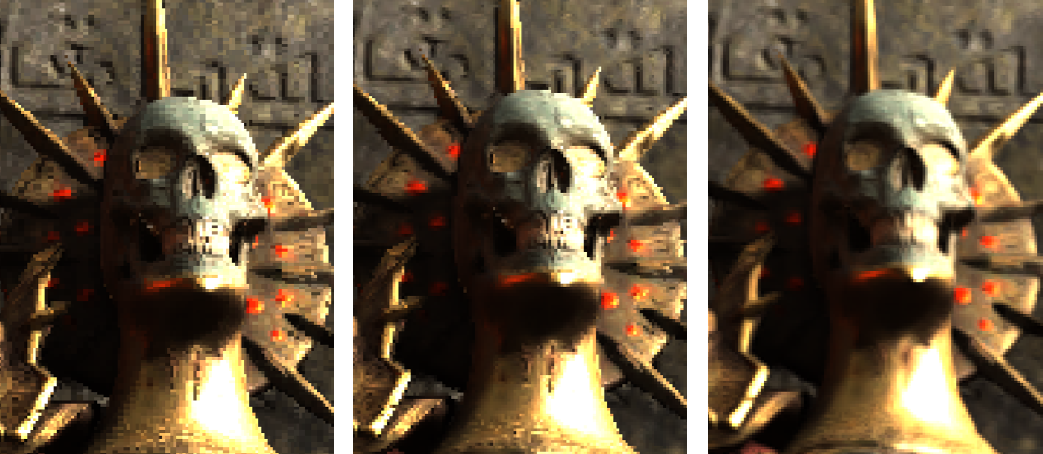
Results: XSX – Deblocker cost 119us @ 1320p
Raw
Deblocked
Final

Slide 69
Future Potential
Buckle up, there's even more!

Slide 70
8. Reduce Single Buffer Coordinate Count
Build single compact VRCS coord buffer at the same time as tile relative VRCS coord buffer
  Tile relative coord buffer only stores max 224 entries (256-32) per 16x16 tile
    Otherwise tile based system is not saving a wave, process all 256 pixels
    (Yellow tiles in debug view)
  Leads to unwanted additional processing when executing single list per screen
Foliage heavy scenes generated the most full rate tiles, though that could be improved

Slide 71
Additional Minor Perf Wins Available
Utilise 21 spare bits for linearZ
  Tile relative coords have 21b free – enough for unorm linearZ (near plane to far plane)
  Reading coord anyway, no point also reading depth and linearizing?
VRCS buffer of tile count + tile flags is 32b
  R8G8_UINT texture would be enough, 8b count | 8 flags
  RAM saving + bonus saving on bitwise OPs
    (yes, we are that obsessed)
Optimise SRI and VRCS coordinate gen shaders (didn't get time!)
  Removing face normal reconstruction hack + fog flag will help a lot
Read smaller mip level for primary pixels with duplicates
  HW VRS does this automatically, VRCS does not
  Doesn't need sample divergence, Deferred Texturing can tweak length of gradients

