Slide 1
How to Decimate your textures
BCn compression tricks in Horizon Forbidden West
hugh.malan@guerrilla-games.com
Notes:
Hi, my name’s Hugh Malan. I’m a graphics programmer at Guerrilla. I joined in 2013, at the end of Killzone Shadow Fall, worked on Horizon Zero Dawn and Horizon Forbidden West.
The trick I’m going to talk about is compressing high-quality 16bpp scalar values into low-quality 4bpp BC1. Doing that reduces that texture’s size by 75%, which is helpful if you’re trying to fit more things into memory, like every game ever. It also reduces that texture bandwidth by 75%, which is helpful if your game is struggling to do a bit more with the render budget, like every game ever.
Obviously there’s a quality tradeoff. And it’s also not as general as you might hope, but I’ll cover the limitations.
This tech was developed to meet needs we had when developing Horizon Forbidden West.
So I’m going to start with the problems we needed BCn compression tricks to solve.

Slide 2
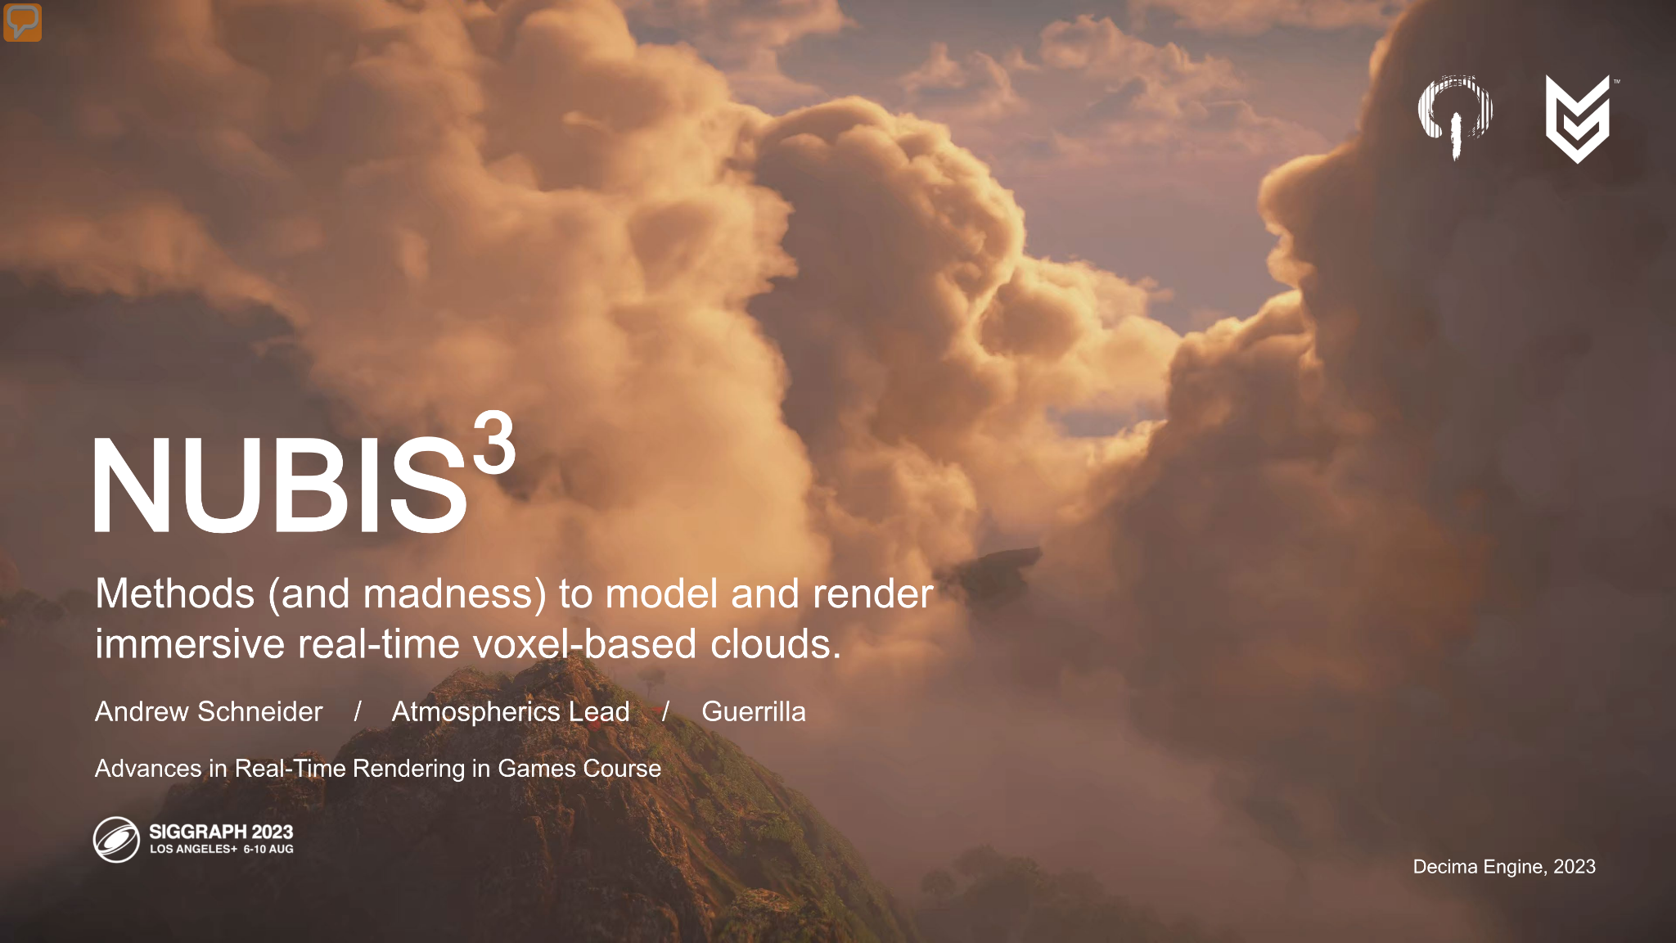
[ Nubis picture ]
Notes:
Nubis is the cloud system developed for Horizon Forbidden West. It was written by Andrew Schneider and Nathan Vos. They were constantly fighting to squeeze more performance out of the raymarch.

Slide 3

Notes:
At the heart of the system is a sphere trace.

Slide 4
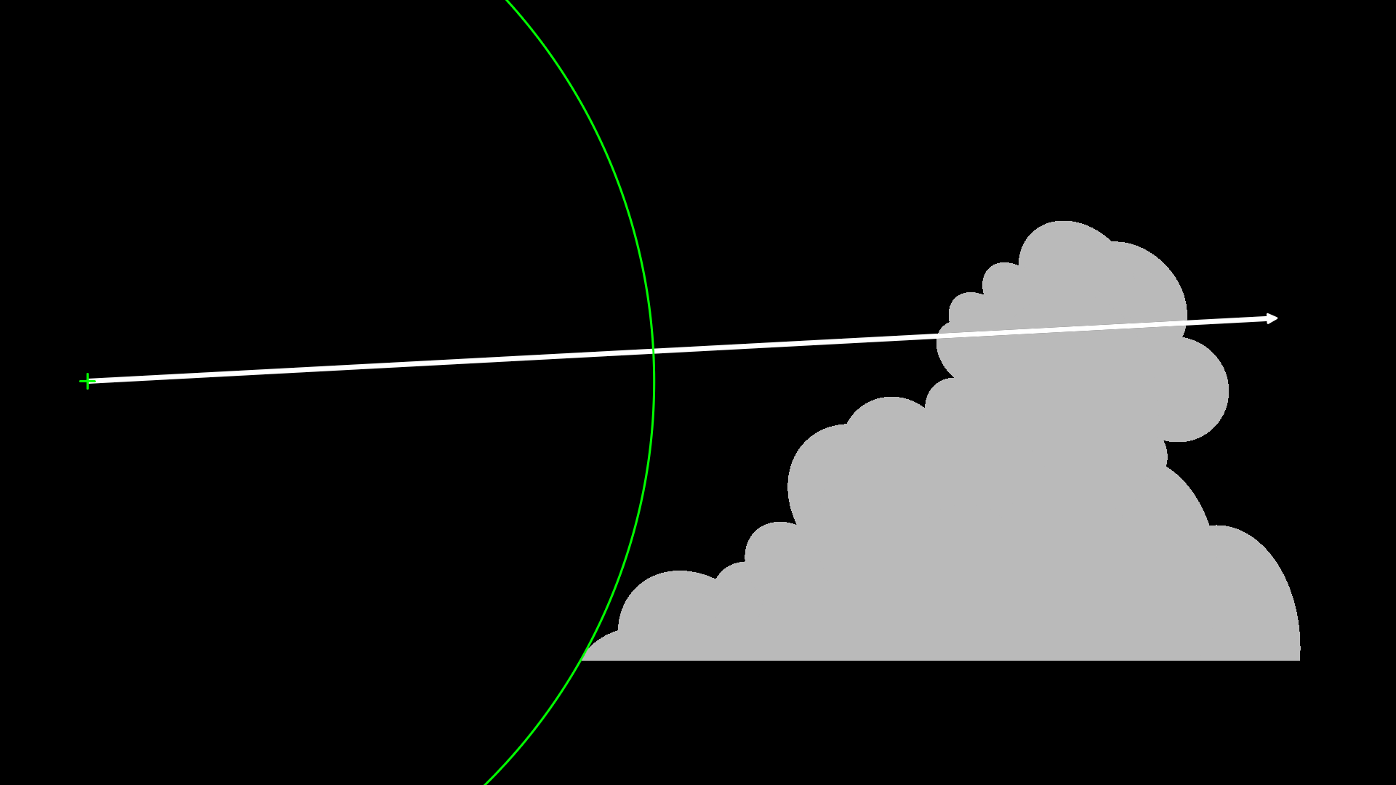
Notes:
The perf critical part samples a volume texture holding the distance to the closest surface point.

Slide 5
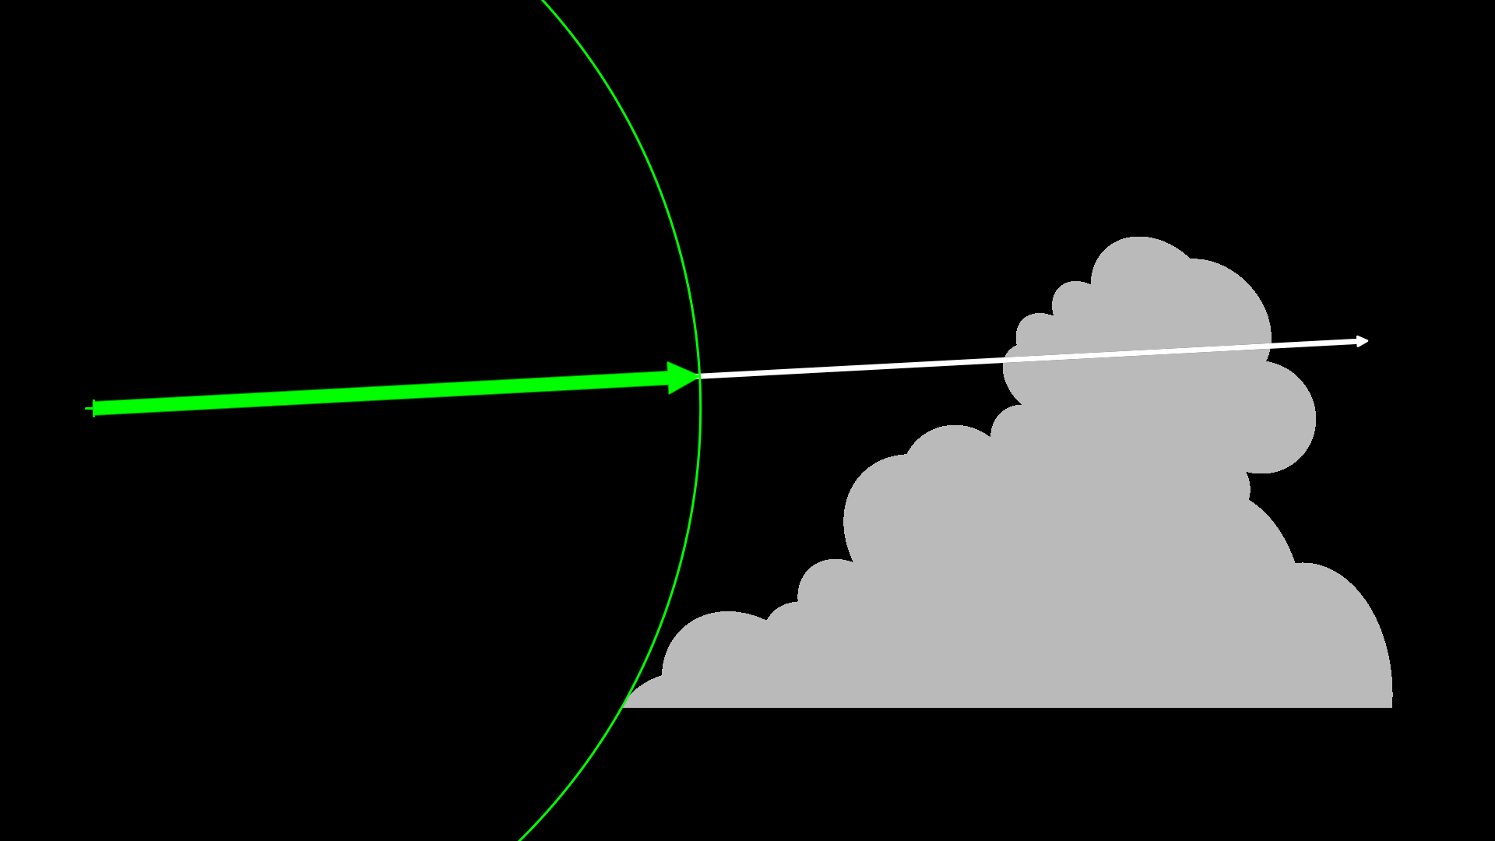
Notes:
Then step along the ray by that distance, which gets closer to the cloud surface without ever entering it.

Slide 6
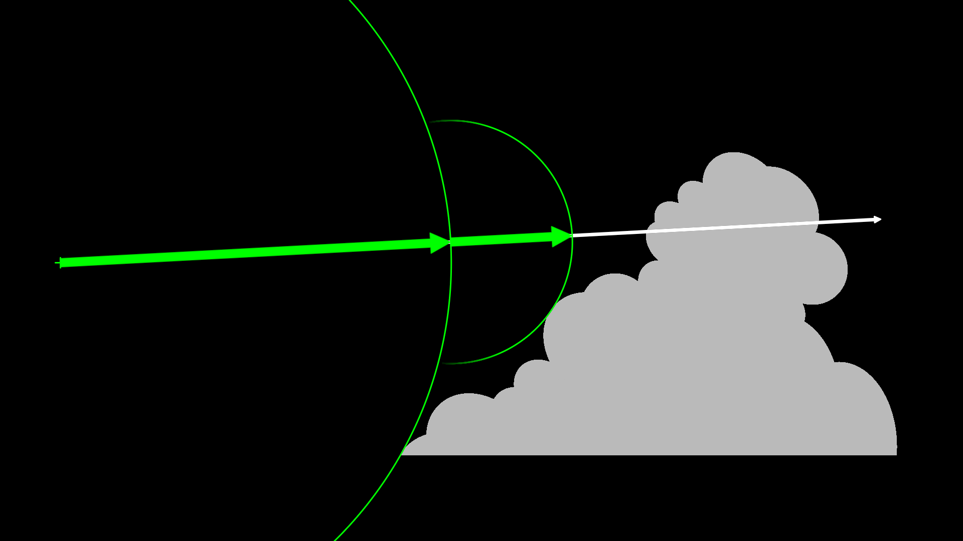
Notes:
Sample at the new position and keep step again…

Slide 7

Notes:
.. and again…

Slide 8
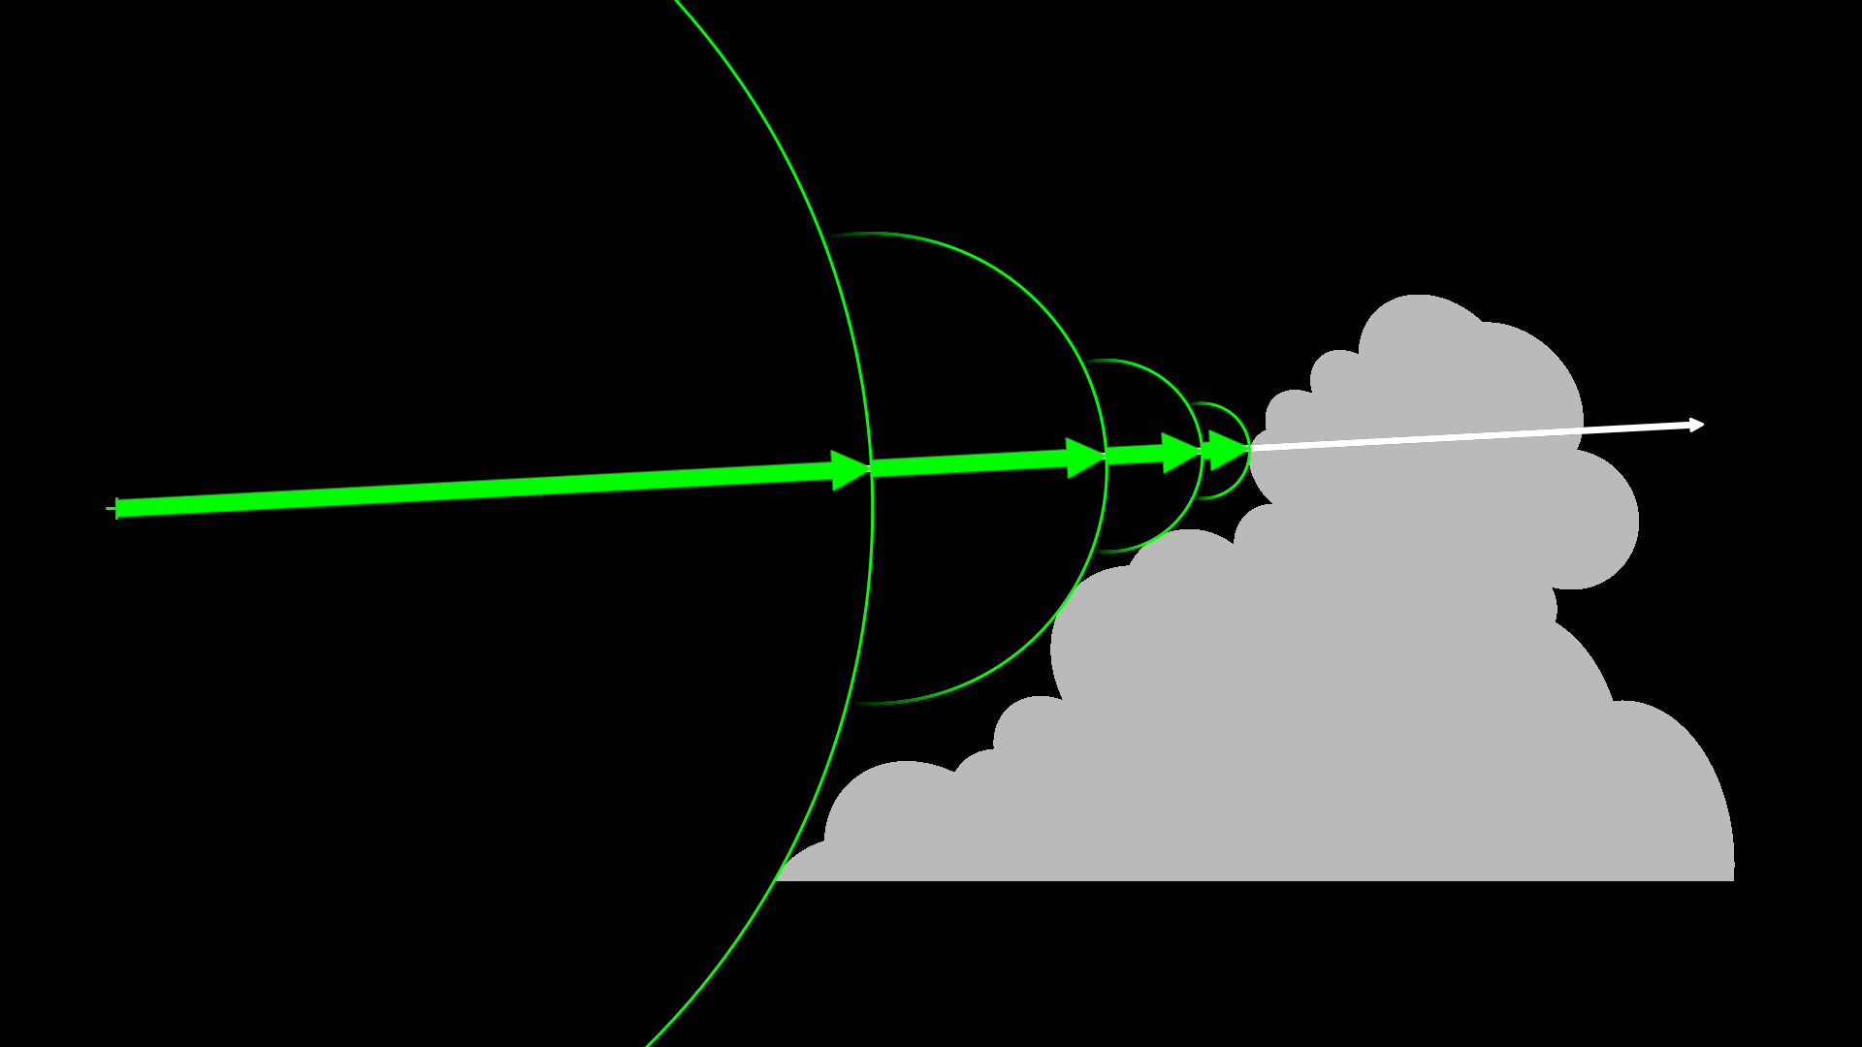
Notes:
Until the surface is found.
It was using a 16-bit per texel texture format. Memory bandwidth was a bottleneck, so switching to a format with fewer bits per texel would be a perf win, even if there’s a bit more ALU.
And it’s OK for the compressed value to be inaccurate, so long as it’s less than the high-quality original. That means the next raymarch won’t step as far as it could.

Slide 9
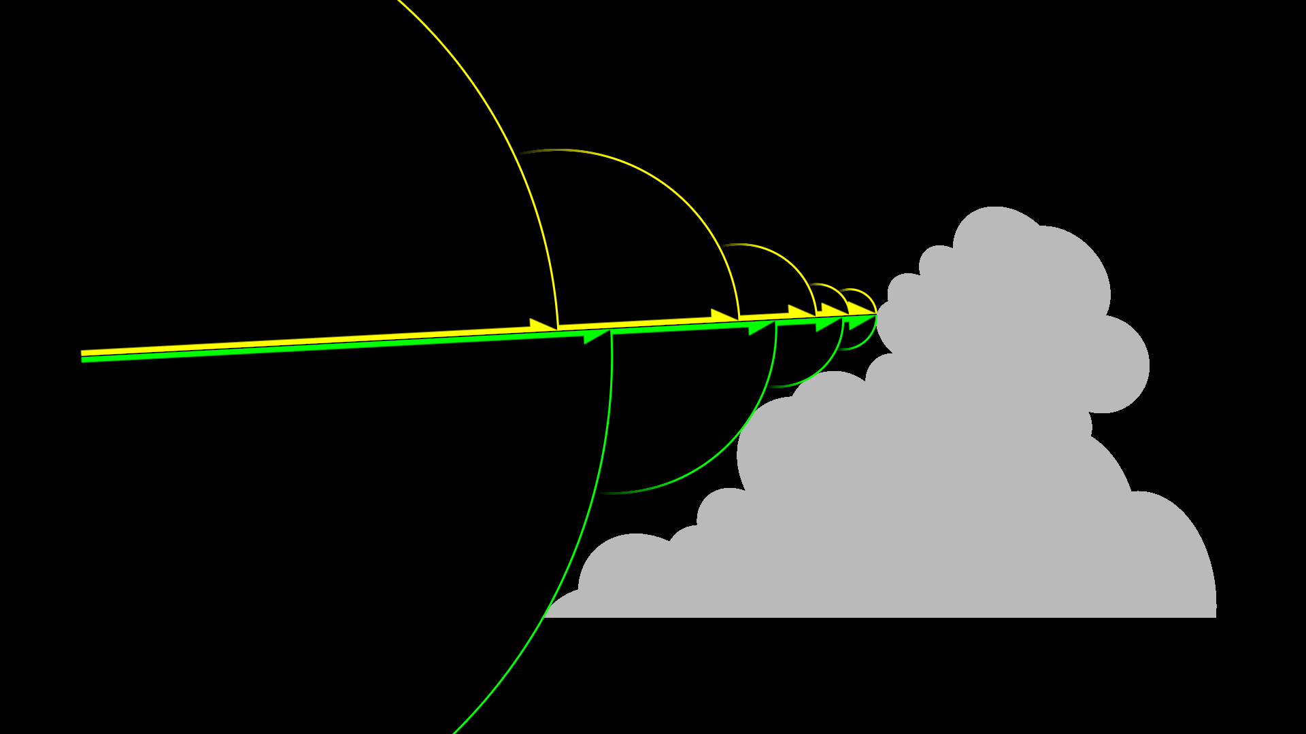
Approximate
Ideal
Notes:
Here’s an example, the yellow arrows show the steps that might be taken if the sampled radius was inaccurate and less than the ideal. It needs an extra step to find the surface.
If the approximate value is larger, there’s a danger that the raymarch will step into the cloud. Which is not a case you want to have to detect and cope with in a performance-critical inner loop. So this system is able to use an approximation for that volume texture, but we require that the approximate values are less than or equal to the ideal.

Slide 10
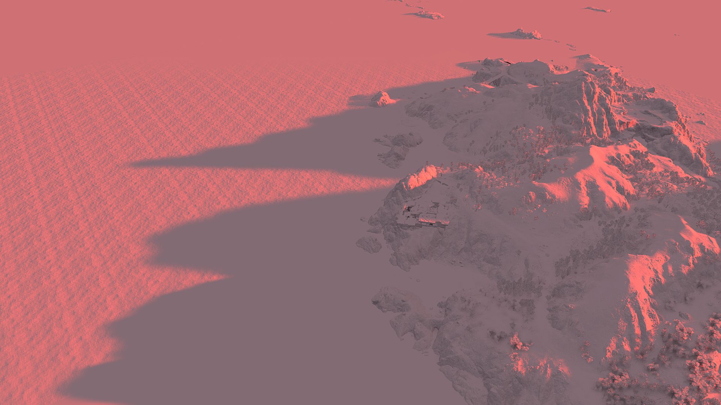

Picture of long distance shadows
Notes:
The second use case was heightfield shadows. That is, the shadow caster is a heightfield, and it’s swept out in the sunlight direction to create the shadow heightfield. Anything below that heightfield is in shadow. The inset picture shows a cross-section.
Horizon Forbidden West used heightfield shadows to provide shadows that could be several kilometers long, like the ones shown here.
The shadow caster was a world-covering heightfield.
The original data for it was 16 bits per texel. Memory is always a constraint, so it’d always be an advantage to switch to a format that uses fewer bits per texel.
Like with sphere tracing, it’s OK for the values to be inaccurate so long as they’re smaller. Smaller just means shorter shadows.
Larger is unacceptable, it can put the shadowcaster above the terrain and create shadows where it should be full sunlight.

Slide 11


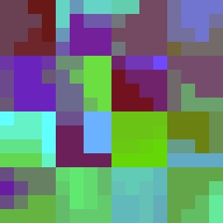
16bpp input >= 4bpp BC1 output
Notes:
So what I’m going to present here is a method to encode 16-bit scalars in BC1. 16 bits per pixel, down to 4 bits per pixel.
This will be lossy, that’s unavoidable. But the encoder will guarantee that the inaccurate encoded value is less than or equal to the input. Which is required for both the cloud rendering and long-distance heightfield shadows.

Slide 12
Requirements
BC1 overview
GPU sampling
RGB to scalar
Encoder
Results
Notes:
Here’s the roadmap for the presentation. We’ve already covered the requirements, so let’s talk about the BC1 texture format.
Then we’ll get deep into how the GPU samples BC1. How to map the sampled RGB to a scalar. With that info I’ll walk through how the encoder works, then show some results from in game.

Slide 13
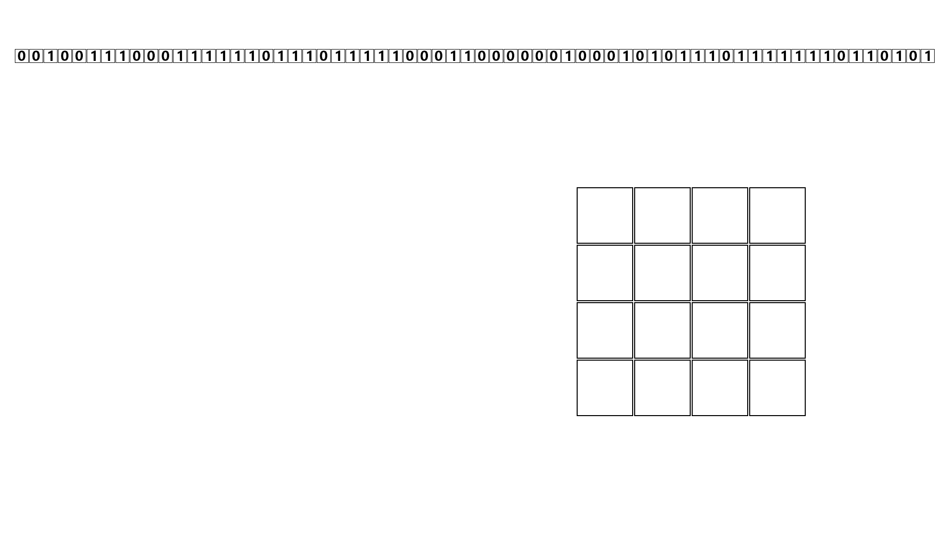
Notes:
Like all BC formats it encodes a 4x4 block of texels in a fixed size chunk. BC1 is 64 bit.

Slide 14
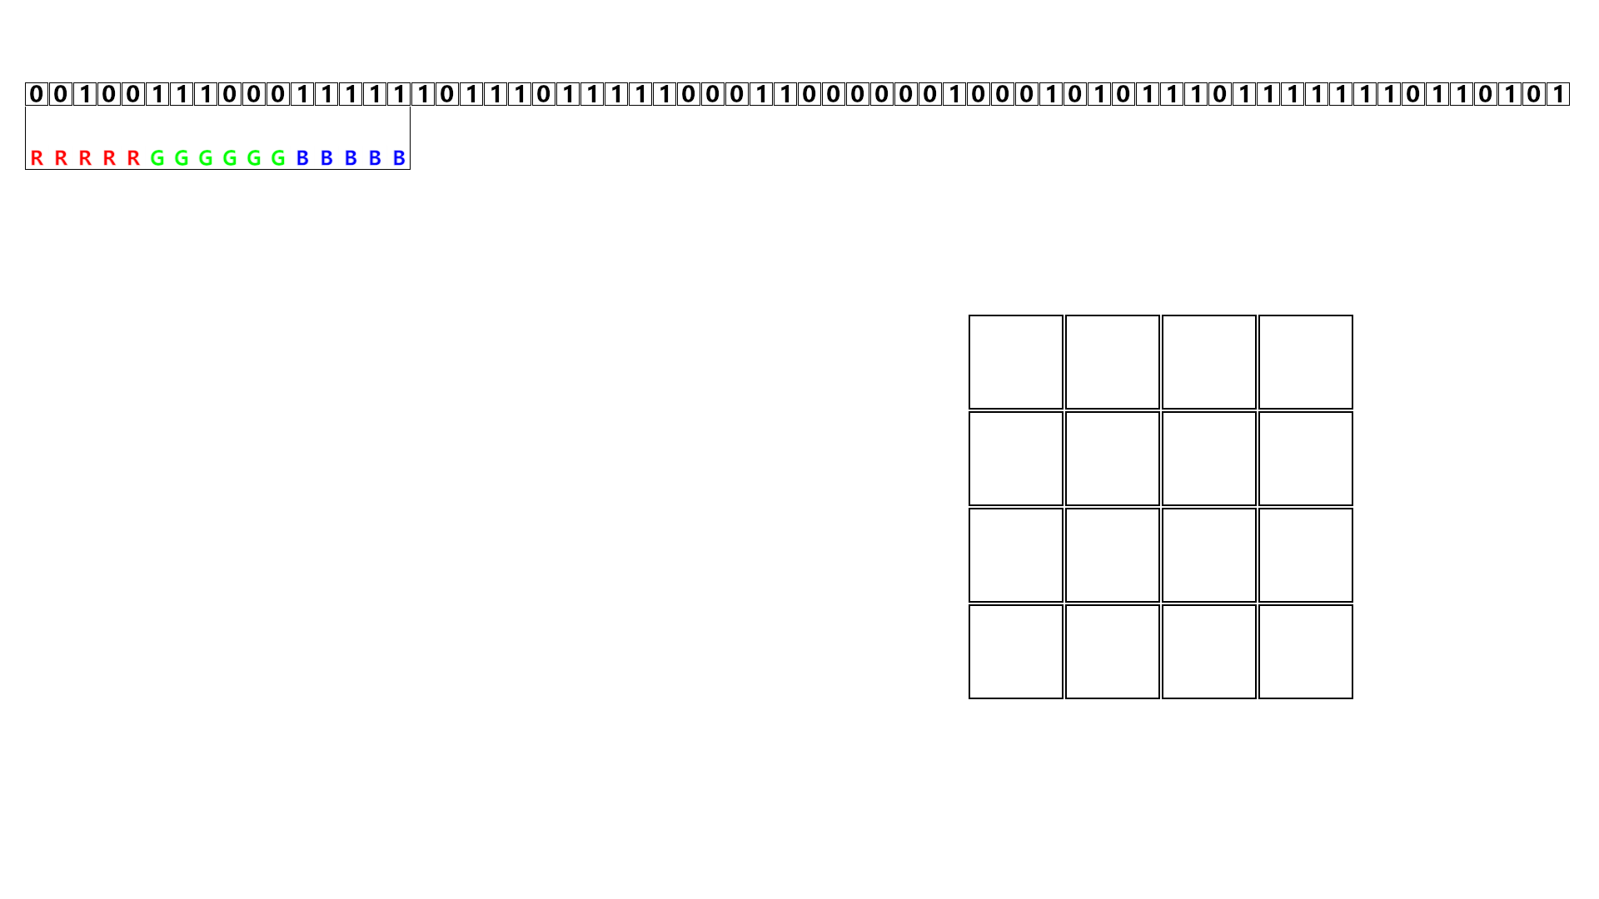
Notes:
The chunk contains two 16-bit color endpoints. 5 bits for red, 6 for green, 5 blue.

Slide 15
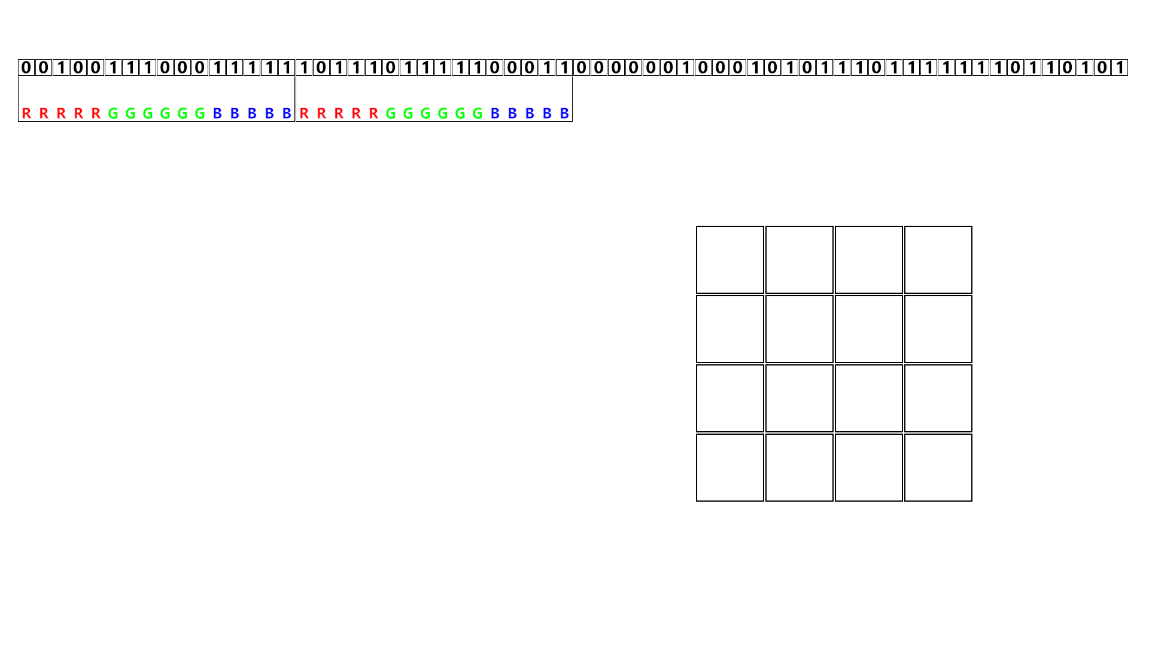
Notes:
The second endpoint color.

Slide 16
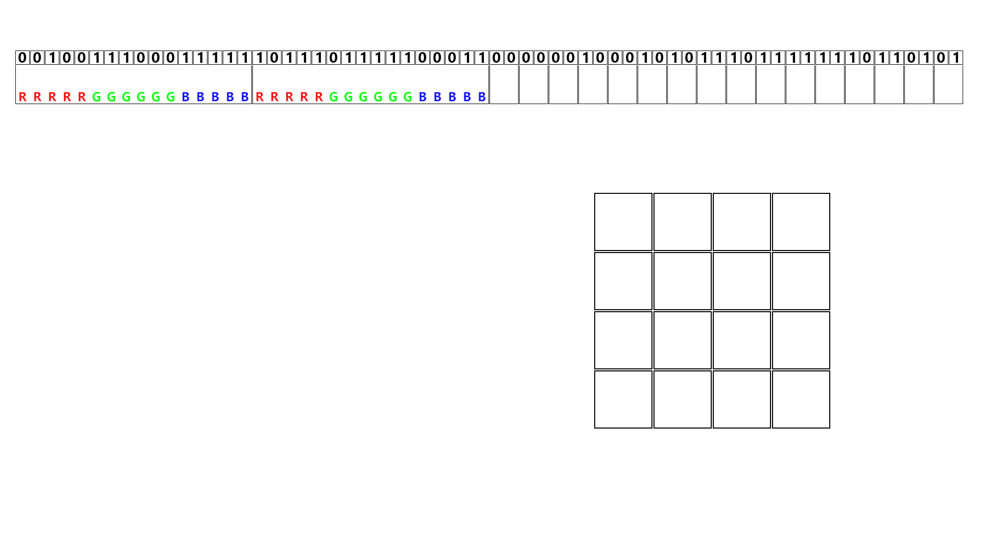
Notes:
And 2 bits for each of the 16 texels.

Slide 17
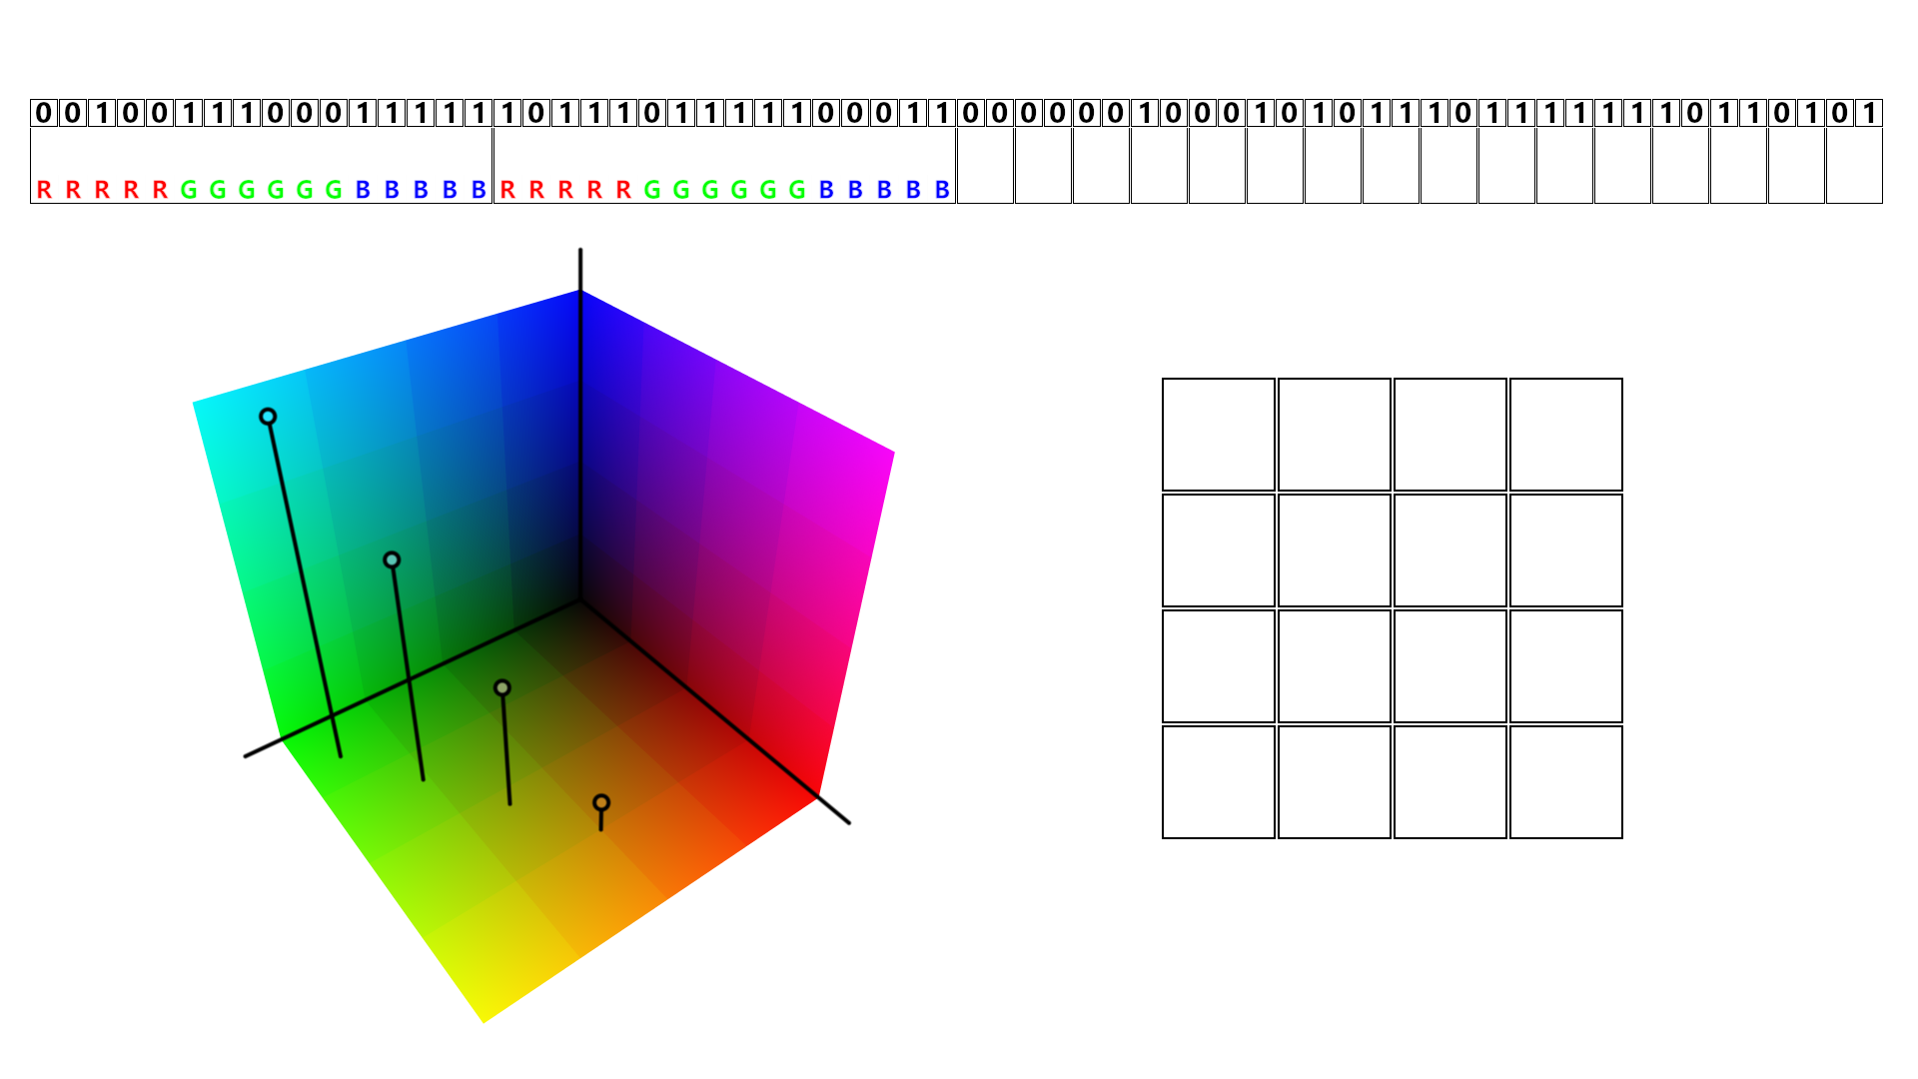
Notes:
We’re going to start with those two 16-bit colors, which make up the first 32 bits.
Each BC1 block defines a palette of four colors. Two of them are the endpoints. The other two are a ⅓ and ⅔ blend of them. So the four colors are a linear progression.

Slide 18
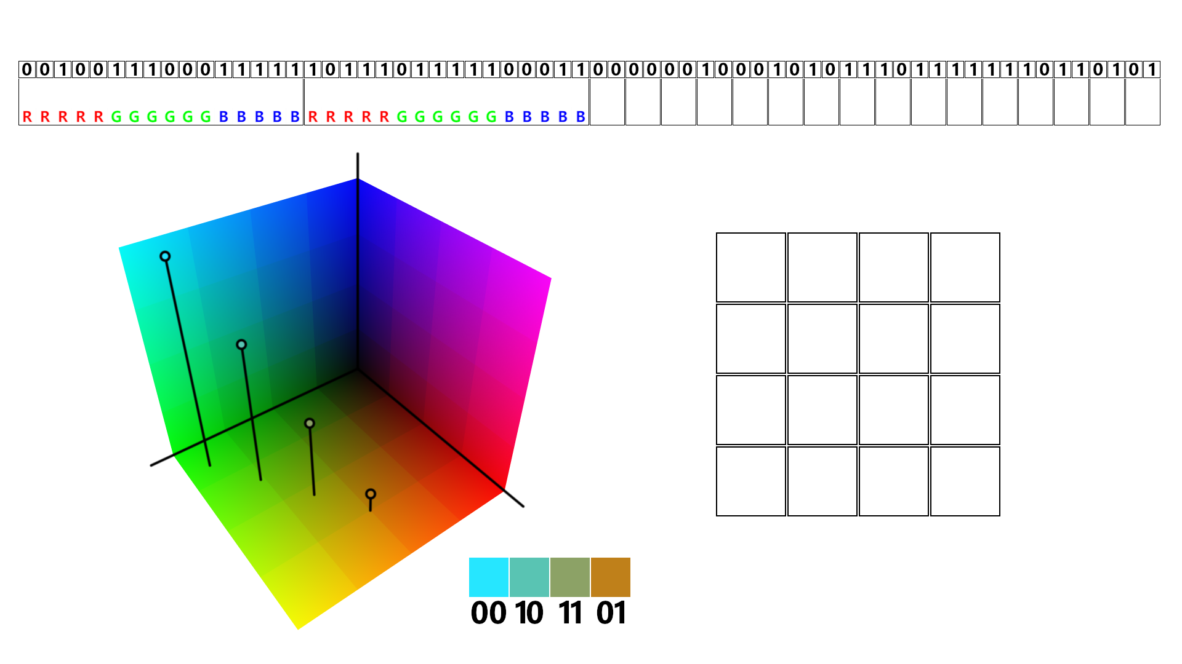
Notes:
Here’s the four colors and the corresponding two-bit index for each.
The order is weird, but unless you’re actually coding this yourself, it doesn’t matter.

Slide 19
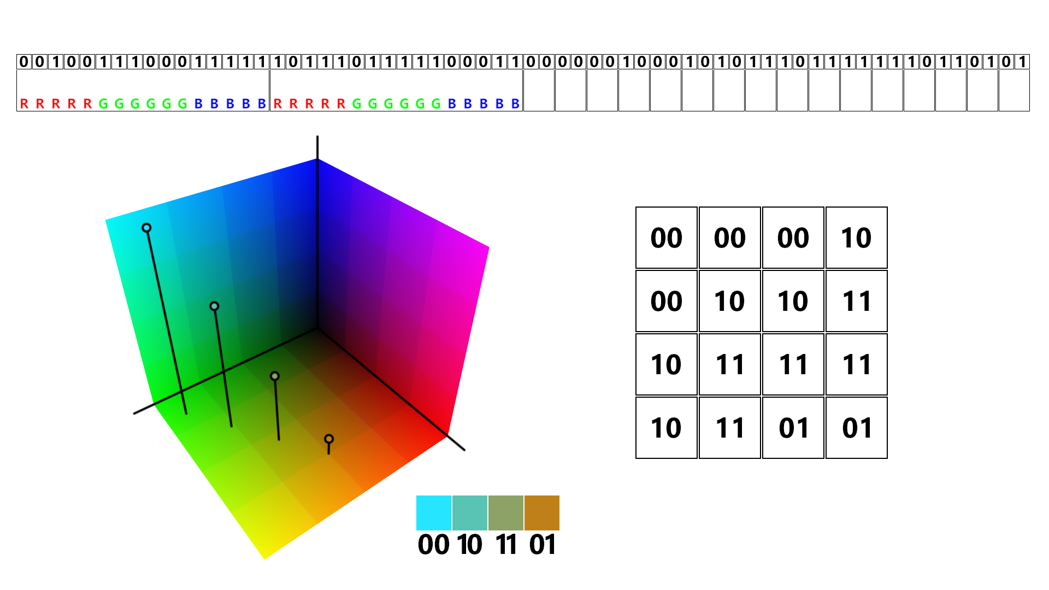
Notes:
Now let’s look at the last 32 bits of the block. It’s two-bit indices, one for each of the 16 texels.

Slide 20
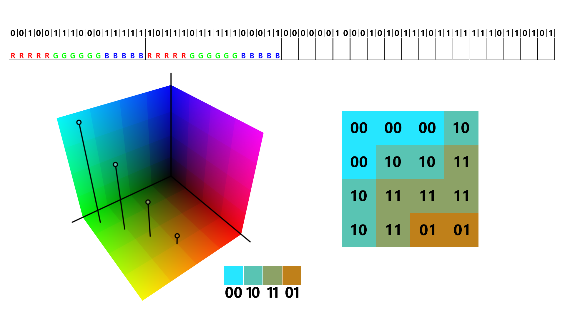
Notes:
The index defines which color to use from the palette.
And that’s how a 64 bit BC1 block defines a 4x4 block of texels.
This is probably familiar stuff for many people, because it’s basically a repeat of what’s in the BC1 specification.
Unfortunately, this is where things get complicated. The way the GPU interprets BC1 is not precisely defined in the spec. There are some strange historical quirks. And worse, there’s differences between vendors.
Since we’re working with 16 bit values, and have that less-than-or-equal requirement, we need to precisely understand the values the GPU will sample.
So we’ll start with the endpoint colors.

Slide 21
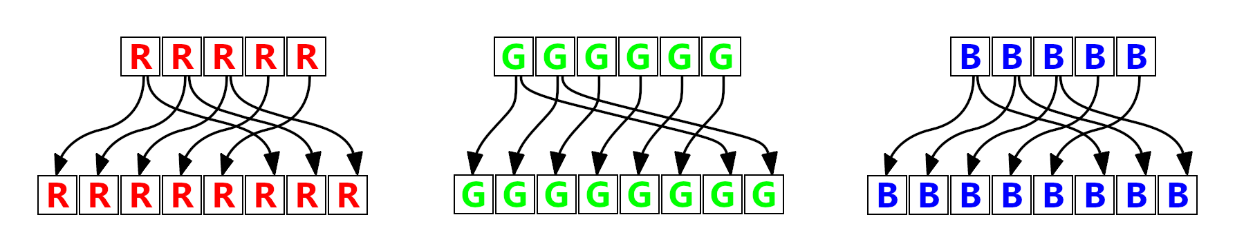
GPU sampling of endpoint colors
5-6-5 endpoint color
Expanded to 8-8-8
r<<3 | r>>2 g<<2 | g>>4 b<<3 | b>>2
Notes:
Recall that the endpoint colors are 16 bit. The GPU expands them to 8 bit per channel as shown here. This bit shuffling means the lowest and highest representable values map to 0 and 255 and monotonically increase.
Divide by 255 to remap to the unit interval, and it matches the value sampled by the GPU to within a bit or two in the last place.
Unfortunately the two interpolated colors are not so simple.

Slide 22
GPU sampling of interpolated colors on AMD
if (interpolation_mode == FourInterpolatedColors)
{
outColors[0] = color_0; // color_0 and color_1 are RGB888
outColors[1] = color_1;
outColors[2] = ((color_0 * 43) + (color_1 * 21) + IVec3(32, 32, 32)) / 64;
outColors[3] = ((color_0 * 21) + (color_1 * 43) + IVec3(32, 32, 32)) / 64;
}
else // ThreeInterpolatedColorsAndTransparentBlack
{ … }
Notes:
When describing BC1 I said the interpolated colors are a ⅓ and ⅔ blend of the endpoints. That’s not quite accurate. The AMD implementation is shown here: ⅓ and ⅔ are approximated by 21/64 and 43/64. The output colors are 8-bit per channel. Divide by 255 and it’ll match the GPU values to within a few ulps.
As you can guess from the slide title, the precise definition also varies between vendors. Code for nVidia and Intel is in the bonus slides.
Next let’s talk about how to map the RGB color to a scalar.

Slide 23
RGB to scalar requirements
float sampled_value = dot(
EncodedBC1Texture.Sample(uv).rgb,
unpack_constant.xyz
);
Notes:
We’re going to use a dotproduct. It’s the simplest and fastest option and avoids some numeric pitfalls I’ll cover in the bonus slides.
So, how to find unpack_constant?
To keep things simple, we’ll only consider unpacking to the unit range. We can trivially rescale to any other range we like afterwards. This restriction has the nice implication that the three components of unpack_constant must sum to 1.0, because full white has to map to 1.0.
Recall that for the clouds and heightfields the input values were 16-bit scalars. So we choose unpack_constant so it minimizes the error when encoding the full set of 16-bit endpoint values.

Slide 24
RGB to scalar dotproduct constant
float sampled_value = dot(
EncodedBC1Texture.Sample(uv).rgb,
float3(0.96414679, 0.03518212, 0.00067109) // 0.002% max error
);
Notes:
I used a brute force search. Since we have the constraint that the three components have to sum to 1.0, the search is on a 2D domain.
To evaluate a particular unpack_constant I’d loop over very possible 16-bit endpoint color. Expand to 8 bit and apply the dotproduct to simulate what value the GPU will sample. Put that in a lookup table.
Then for every possible 16 bit input value, find the best approximation available by consulting the lookup table. We have a requirement that the encoded value is less than the input value, so this means the error will always be in one direction. I tried to minimize the maximum error term, the best result is shown here in bold.
And it’s surprisingly good, it’s about one part in 50,000. So the worst case is only slightly more than the gap between adjacent input values.
Now let’s put all this together and use it to build the encoder.

Slide 25
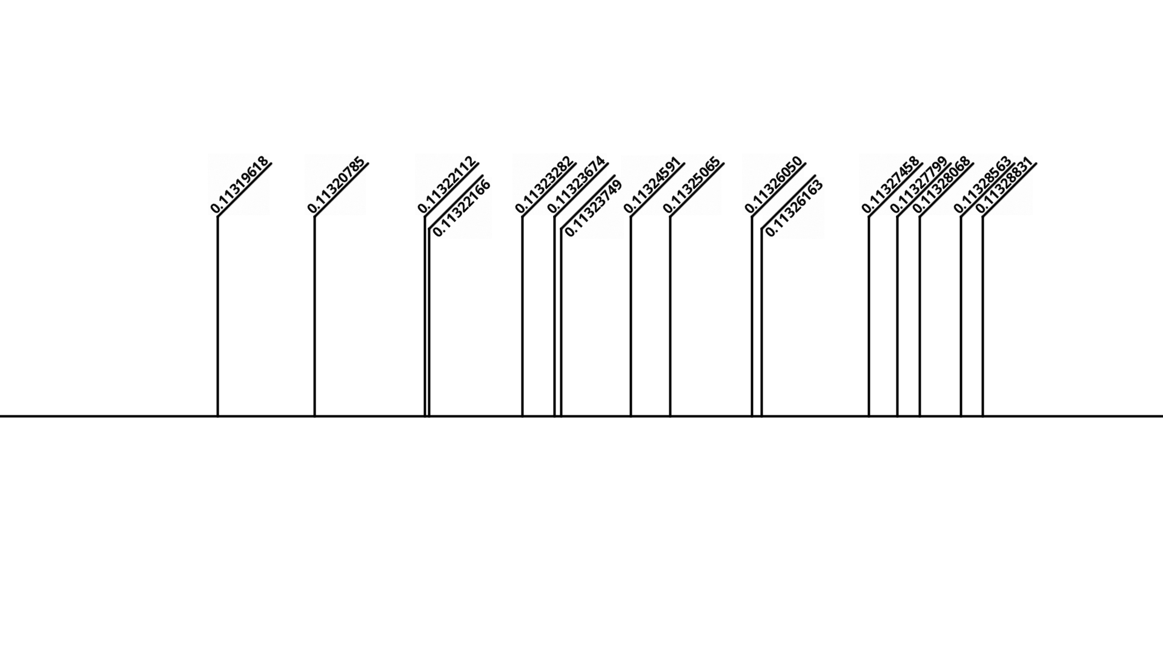
Encoder - 4x4 input values
Inputs
Notes:
We’re going to walk through the process of encoding a single BC1 block.
The input is 16 values in the [0, 1] range, like this example.

Slide 26
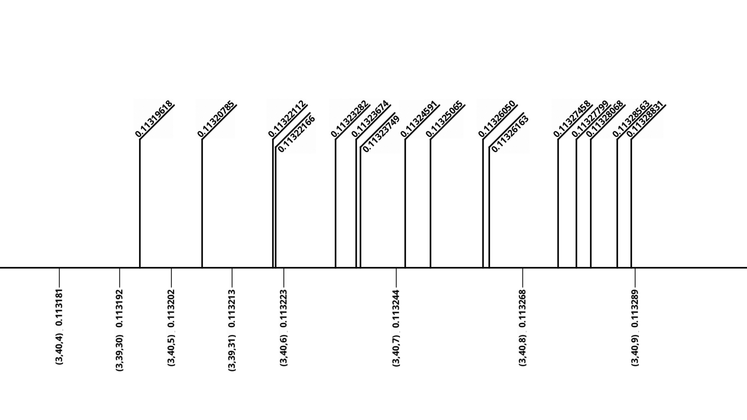
Encoder - possible endpoint colors and unpacked values
Inputs
Endpoints
Notes:
And here’s the nearby endpoint colors and unpacked values. Note that they’re closer on the left: when the blue channel drops back to zero and green increases the unpacked values decrease and creates a bit of overlap.
Remember that hard requirement that the encoded value be less than the input.
This means the low endpoint color is simple and unambiguous: choose the largest representable value that’s less than any of the input values. Anything higher than that would mean an input value would have to increase when encoded which is unacceptable. Anything lower is wasteful.

Slide 27
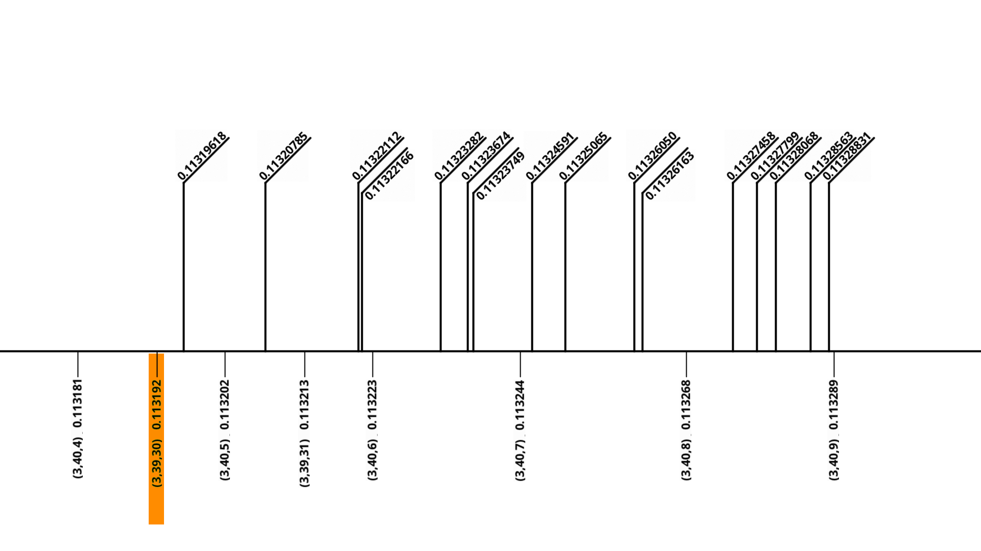
Encoder - Low endpoint color
Inputs
Endpoints
Notes:
So this is this low endpoint.
Choosing the high endpoint color isn’t so straightforward. The two endpoints together will define the interpolated colors. If the inputs are uniformly distributed we’d want the high endpoint to be roughly 75% of the way to the maximum input value, so the four possible values each gather about a quarter of the range of inputs. Recall the requirement that the encoded value is lower than the input. This means each texel chooses the highest option below it.
I opted to find the upper endpoint with a search. For each endpoint it goes through the process of encoding the input values and evaluates the error.

Slide 28
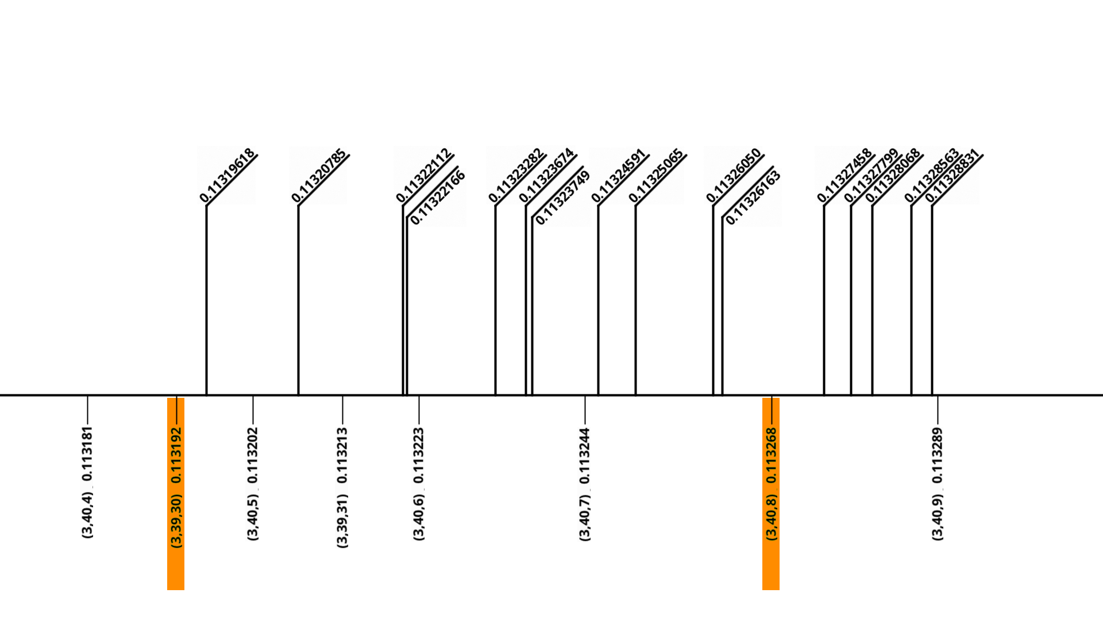
Encoder - Possible high endpoint
Inputs
Endpoints
Notes:
Here’s a hypothetical upper endpoint.

Slide 29
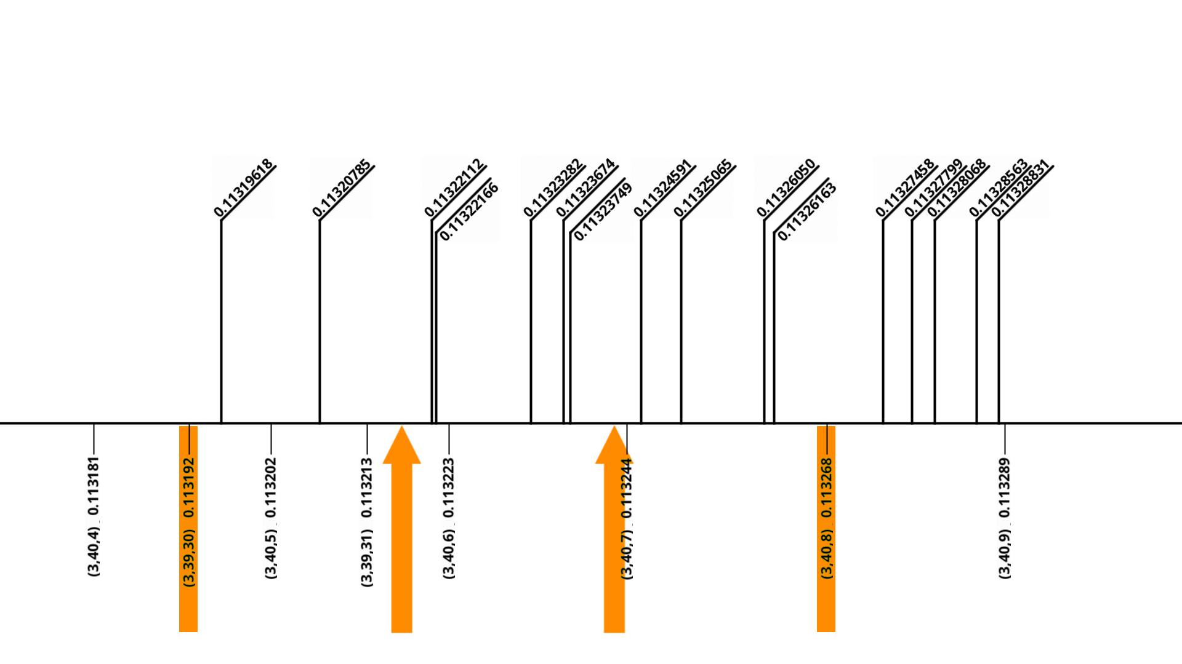
Encoder - Possible high endpoint and interpolated colors
Inputs
Endpoints
Notes:
We compute the two interpolated values, to build the palette of four values each texel can choose from. Recall that AMD, nVidia and Intel have different methods for computing the interpolated colors. The three are give pretty similar values, as you’d expect. But it’s best to evaluate all three and take the maximum.
Note that the two interpolated values may not match one of the endpoint values.
Each texel chooses the option that minimizes error, ie the one that’s highest but still less than or equal to the input.

Slide 30
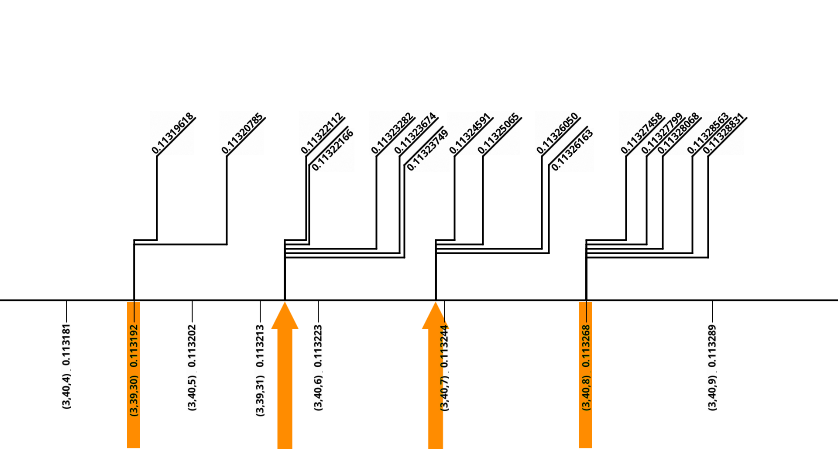
Encoder - Encoded value for each input
Inputs
Endpoints
Notes:
Which looks like this. The horizontal lines show how the difference between the input and encoded value.
Measure the error for this endpoint choice; I used root-mean-squared.
Then continue through the other endpoints, to find the one with the least error. This is a one-parameter search, the range is from the lower endpoint to the max input value, so it’s pretty small and fast.
What I’ve described is straightforward and fairly efficient, and does fine with evenly distributed points in a small range like the case shown here. But it has weaknesses, and maybe you need to search more widely. See the bonus slides for more details.
Anyway, that covers the whole process of encoding a BC1 block.
The next step is to scale it up to encode textures and volumes. Here’s some results.

Slide 31
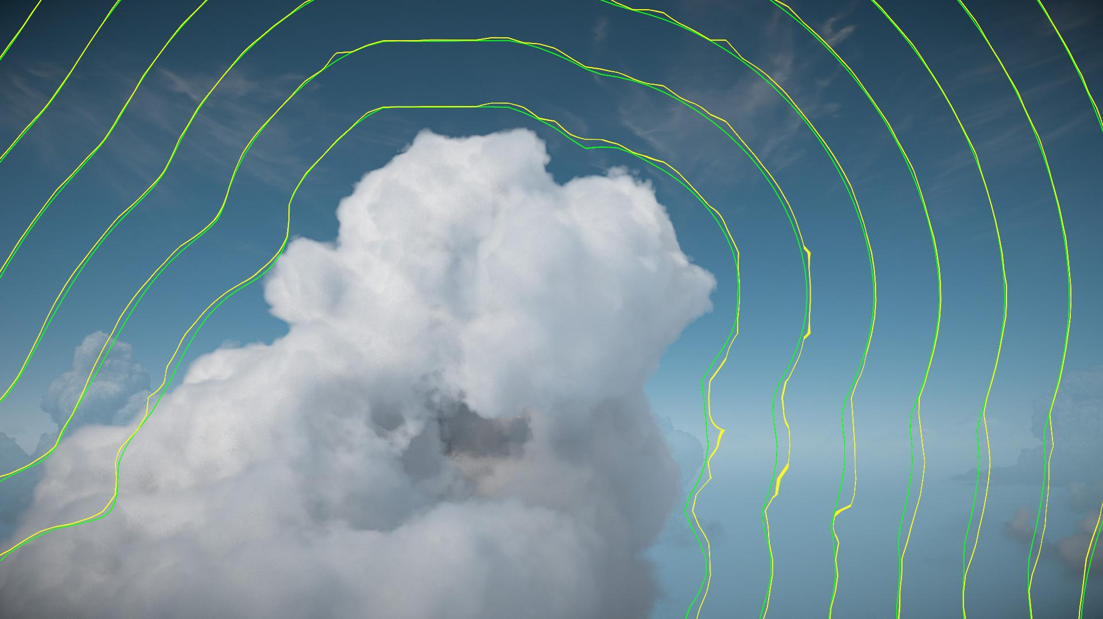
4bpp BC1
16bpp
Reduced cloud rendering time by 30%
Notes:
Here’s a view of a clouds in The Burning Shores DLC area showing a cross section of the sphere radius volume.
Green is contours of the original 16 bit per texel values, yellow is the DXT1 compressed version.
Each contour line is a certain sphere radius. You can see how when yellow lines aren’t accurate they’re always further away. This is the effect of the less-than-or-equal constraint in the encoder.
The reason we did this was performance, and this change reduced the cloud rendering time by about ⅓.
So if you’re doing sphere tracing, this is definitely worth investigating.

Slide 32
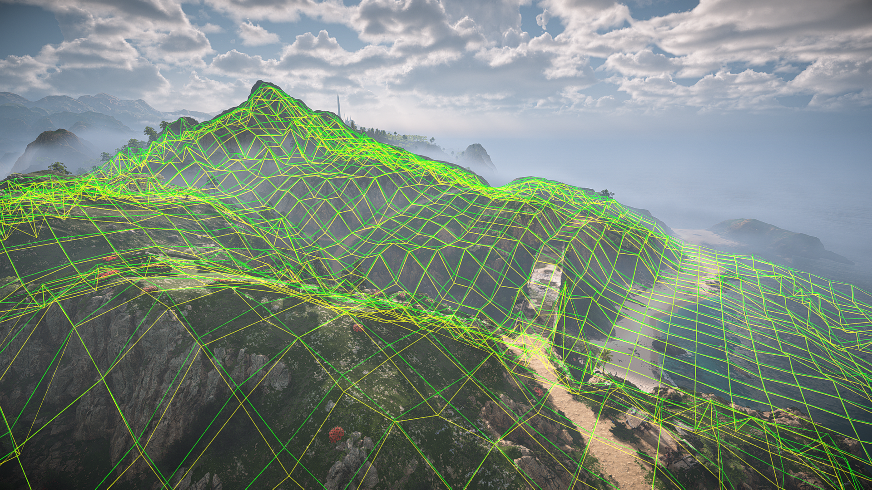
4bpp BC1
16bpp
Reduced texture size from 3.1MB to 0.78MB
[Replace with an image showing green hq heightfield and yellow BC1 heightfield].
Notes:
This screenshot shows the world-covering shadowcasting heightfield.
The green heightfield is the the original 16 bit data, yellow is the BC1 compressed version.
There’s some error but it’s pretty close, and definitely acceptable given the big size reduction and small consequences for errors.

Slide 33
https://fgiesen.wordpress.com/2021/10/04/gpu-bcn-decoding/
“[This] level of precision is unlikely to ever matter to anyone.”
Fabian “ryg” Giesen
Notes:
There wasn’t any relevant documentation on precise BC1 values when I originally wrote the encoder for the conservative heightfield and sphere radius volume. I had the endpoints exactly but I didn’t figure out the precise definition of the interpolated colors. I coded up something that mostly matched the data but it was not as accurate as I’d like.
This article by Fabian Giesen is what I wished I’d had. His code gives nearly bit-accurate values. Unfortunately it was posted a few months after I’d got my encoder working in production and moved on so we didn’t take advantage of it for Horizon Forbidden West.
And while he expects this level of precision is unlikely to ever matter to anyone: it really mattered for us! It’s vital for both the shadowcasting heightfields, and the cloud raymarch.
To pay this forward, I rewrote our encoder to use his maths, and an implementation is included in the presentation download. Hopefully it makes it easy to use high-precision BC1 encoding in your project!

Slide 34
Questions?

Slide 35
References
“GPU BCn decoding”, Fabien Giesen (2021) https://fgiesen.wordpress.com/2021/10/04/gpu-bcn-decoding/
“GPU DXT Decompression”, Ignacio Castaño (2009) https://www.ludicon.com/castano/blog/2009/03/gpu-dxt-decompression/
EXT_texture_compression_dxt1 definition (2008)
https://registry.khronos.org/OpenGL/extensions/EXT/EXT_texture_compression_dxt1.txt

Slide 36
BONUS SLIDES

Slide 37
Implementation
/*
16 bit scalar to BC1 encoder. The main entrypoint is:
void sBuildBC1Block(uint64 *outBCBlock, Span<float> inInputData, Vec3 inUnpackDot)
To convert this to your codebase, the following will need to be replaced with your version:
Vec3 - 3D vector, like float3
IVec3 - 3D integer, like int3 or uint3
gAssert
Span<type> - Like std::span
StaticArray<type, integer size> - Fixed size array. A C-style array on the stack, or std::array
*/
/**
@brief BC1 block definition; 64 bits
**/
struct BC1Block
{
uint64 mEndpoint0 : 16; // Bytes 0-1
uint64 mEndpoint1 : 16; // Bytes 2-3
uint64 mIndices : 32; // Bytes 4-7
};
static_assert(sizeof(BC1Block) == sizeof(uint64));
/**
@brief BC1 interpolation mode
**/
enum class BC1InterpolationMode : int
{
FourIntermediate,
ThreeIntermediateWithZero
};
/**
@brief Extend a 16-bit/RGB565 color to 24-bit/RGB888. Replicates GPU behaviour.
**/
static IVec3 sConvert565To888(uint16 in565Color)
{
uint channel_r = (in565Color >> 11) & 31;
uint channel_g = (in565Color >> 5) & 63;
uint channel_b = (in565Color) & 31;
gAssert((channel_r < 32) && (channel_g < 64) && (channel_b < 32));
return IVec3(
(channel_r << 3) | (channel_r >> 2),
(channel_g << 2) | (channel_g >> 4),
(channel_b << 3) | (channel_b >> 2));
}
/**
@brief Unpack an RGB888 to a scalar.
Factored out into shared code, because doing the dotproduct and /255 in different orders causes slight differences...
**/
static float sUnpackRGB888ToScalar(IVec3 inRGB888, Vec3 inUnpackDot)
{
Vec3 color_unit = inRGB888.ToVec3() / 255.0f;
float unpacked_value = color_unit.Dot(inUnpackDot);
return unpacked_value;
}
/**
@brief Unpack a 16-bit/RGB565 color to a float.
**/
static float sEvaluateEndpointColor(uint16 inColor, Vec3 inUnpackDot)
{
return sUnpackRGB888ToScalar(sConvert565To888(inColor), inUnpackDot);
}
/**
@brief Find the four interpolated color for a BC1 block, replicating the values sampled by AMD GPUs.
Input endpoint colors are expected to be 16-bit RGB565.
Output colors are RGB888.
Based on https://fgiesen.wordpress.com/2021/10/04/gpu-bcn-decoding/
**/
static void sBuildInterpolatedColors_AMD(Span<IVec3> outColors, uint16 inEndpointColor0, uint16 inEndpointColor1)
{
gAssert(outColors.Length() == 4);
IVec3 color_0 = sConvert565To888(inEndpointColor0);
IVec3 color_1 = sConvert565To888(inEndpointColor1);
BC1InterpolationMode interpolation_mode = (inEndpointColor0 > inEndpointColor1) ? BC1InterpolationMode::FourIntermediate : BC1InterpolationMode::ThreeIntermediateWithZero;
if (interpolation_mode == BC1InterpolationMode::FourIntermediate)
{
outColors[0] = color_0;
outColors[1] = color_1;
outColors[2] = ((color_0 * 43) + (color_1 * 21) + IVec3(32, 32, 32)) / 64;
outColors[3] = ((color_0 * 21) + (color_1 * 43) + IVec3(32, 32, 32)) / 64;
}
else if (interpolation_mode == BC1InterpolationMode::ThreeIntermediateWithZero)
{
outColors[0] = color_0;
outColors[1] = color_1;
outColors[2] = (color_0 + color_1 + IVec3(1, 1, 1)) / 2;
outColors[3] = IVec3(0, 0, 0); // We're ignoring alpha
}
}
/**
@brief Find the four interpolated color for a BC1 block, replicating the values sampled by nVidia GPUs.
Input endpoint colors are expected to be 16-bit RGB565.
Output colors are RGB888.
Based on https://fgiesen.wordpress.com/2021/10/04/gpu-bcn-decoding/
**/
static void sBuildInterpolatedColors_nVidia(Span<IVec3> outColors, uint16 inEndpointColor0, uint16 inEndpointColor1)
{
gAssert(outColors.Length() == 4);
IVec3 color_0 = sConvert565To888(inEndpointColor0);
IVec3 color_1 = sConvert565To888(inEndpointColor1);
// Extract 5-bit red and blue colors from input RGB565
uint channel_0_r = (inEndpointColor0 >> 11) & 31;
uint channel_0_b = (inEndpointColor0) & 31;
uint channel_1_r = (inEndpointColor1 >> 11) & 31;
uint channel_1_b = (inEndpointColor1) & 31;
BC1InterpolationMode interpolation_mode = (inEndpointColor0 > inEndpointColor1) ? BC1InterpolationMode::FourIntermediate : BC1InterpolationMode::ThreeIntermediateWithZero;
if (interpolation_mode == BC1InterpolationMode::FourIntermediate)
{
outColors[0] = color_0;
outColors[1] = color_1;
// Red and blue channels: input is 5-bit, output is 8 bit
outColors[2].mX = ((2 * channel_0_r + channel_1_r) * 22) >> 3;
outColors[2].mZ = ((2 * channel_0_b + channel_1_b) * 22) >> 3;
outColors[3].mX = ((channel_0_r + 2 * channel_1_r) * 22) >> 3;
outColors[3].mZ = ((channel_0_b + 2 * channel_1_b) * 22) >> 3;
// Green channel: input is 8 bit
int diff = color_1.mY - color_0.mY;
int scaled_diff = 80 * diff + (diff >> 2);
outColors[2].mY = color_0.mY + ((128 + scaled_diff) >> 8);
outColors[3].mY = color_1.mY + ((128 - scaled_diff) >> 8);
}
else if (interpolation_mode == BC1InterpolationMode::ThreeIntermediateWithZero)
{
outColors[0] = color_0;
outColors[1] = color_1;
// Red and blue channels: input is 5-bit, output is 8 bit
outColors[2].mX = ((channel_0_r + channel_1_r) * 33) >> 3;
outColors[2].mZ = ((channel_0_b + channel_1_b) * 33) >> 3;
// Green channel: input is 8 bit
int diff = color_1.mY - color_0.mY;
int scaled_diff = 128 * diff + (diff >> 2);
outColors[2].mY = color_0.mY + ((128 * scaled_diff) >> 8);
outColors[3] = IVec3(0, 0, 0); // We're ignoring alpha
}
}
/**
@brief Find the four interpolated color for a BC1 block, replicating the values sampled by Intel GPUs.
Input endpoint colors are expected to be 16-bit RGB565.
Output colors are RGB888.
Based on https://fgiesen.wordpress.com/2021/10/04/gpu-bcn-decoding/
**/
static void sBuildInterpolatedColors_Intel(Span<IVec3> outColors, uint16 inEndpointColor0, uint16 inEndpointColor1)
{
gAssert(outColors.Length() == 4);
IVec3 color_0 = sConvert565To888(inEndpointColor0);
IVec3 color_1 = sConvert565To888(inEndpointColor1);
BC1InterpolationMode interpolation_mode = (inEndpointColor0 > inEndpointColor1) ? BC1InterpolationMode::FourIntermediate : BC1InterpolationMode::ThreeIntermediateWithZero;
if (interpolation_mode == BC1InterpolationMode::FourIntermediate)
{
outColors[0] = color_0;
outColors[1] = color_1;
outColors[2] = ((color_0 * 171) + (color_1 * 85) + IVec3(128, 128, 128)) / 256;
outColors[3] = ((color_0 * 85) + (color_1 * 171) + IVec3(128, 128, 128)) / 256;
}
else if (interpolation_mode == BC1InterpolationMode::ThreeIntermediateWithZero)
{
outColors[0] = color_0;
outColors[1] = color_1;
outColors[2] = ((color_0 * 128) + (color_1 * 128) + IVec3(128, 128, 128)) / 256;
outColors[3] = IVec3(0, 0, 0); // We're ignoring alpha
}
}
/**
@brief Given a 4x4 list of input values, and a pair of endpoint colors, build a final 64-bit BC1 block
Input values are expected to be in [0, 1].
Outputs the error and the BC block
**/
static void sBuildBC1BlockAndEvaluateError(pFloat outNetError, uint64 *outBCBlock,
Span<float> inInputData, uint16 inEndpointColorLo, uint16 inEndpointColorHi, Vec3 inUnpackDot)
{
gAssert(inInputData.Length() == 16);
// Declare and initialize the block
BC1Block block = {};
// Set endpoints.
block.mEndpoint0 = gMax(inEndpointColorLo, inEndpointColorHi);
block.mEndpoint1 = gMin(inEndpointColorLo, inEndpointColorHi);
gAssert(block.mEndpoint0 > block.mEndpoint1); // Endpoint 0 is expected to be greater than 1 to select 4-color interpolation
// Find the four interpolated colors
StaticArray<IVec3, 4> interpolated_colors_amd;
sBuildInterpolatedColors_AMD(interpolated_colors_amd, block.mEndpoint0, block.mEndpoint1);
StaticArray<IVec3, 4> interpolated_colors_nvidia;
sBuildInterpolatedColors_nVidia(interpolated_colors_nvidia, block.mEndpoint0, block.mEndpoint1);
StaticArray<IVec3, 4> interpolated_colors_intel;
sBuildInterpolatedColors_Intel(interpolated_colors_intel, block.mEndpoint0, block.mEndpoint1);
// Find the four interpolated values. Work with the maximum possible value, to ensure the GPU sampled value is <= the source value on all platforms
StaticArray<float, 4> interpolated_values;
for (int i = 0; i < 4; i++)
interpolated_values[i] = gMax(
sUnpackRGB888ToScalar(interpolated_colors_amd[i], inUnpackDot),
sUnpackRGB888ToScalar(interpolated_colors_nvidia[i], inUnpackDot),
sUnpackRGB888ToScalar(interpolated_colors_intel[i], inUnpackDot));
// Choose the 2-bit index for each of the 4x4 values
float net_error = 0.0f;
for (int source_index = 0; source_index < 16; source_index++)
{
float source_value = inInputData[source_index];
float least_error = 1e10f;
int best_interpolated_index = -1;
for (int i = 0; i < 4; i++)
{
float delta = source_value - interpolated_values[i];
if ((delta >= 0.0f) && (delta < least_error))
{
// Interpolated value is lower than source, and improves error
least_error = delta;
best_interpolated_index = i;
}
}
gAssert(best_interpolated_index >= 0); // Verify that we found an interpolated value that meets our requirements
net_error += least_error * least_error; // Accumulate squared error
block.mIndices |= uint64(best_interpolated_index) << (source_index * 2);
}
*outNetError = net_error;
*outBCBlock = *(uint64*)&block;
}
/**
@brief Find the highest 16-bit endpoint color that's <= the input value.
This will quickly find a close approximation, but it's possible that it's not the best.
A lookup table may be better ...
**/
static uint16 sFindEndpointColor(float inValue, Vec3 inUnpackDot)
{
gAssert((inUnpackDot.mX > inUnpackDot.mY) && (inUnpackDot.mY > inUnpackDot.mZ), "Expecting red is most significant and blue is least."); // The code below sets up the components in order from most to least significant.
uint16 endpoint_color = 0;
for (int r_step = 16; r_step > 0; r_step /= 2) // R is in [0, 31]
{
uint16 hypothetical_endpoint_color = endpoint_color + (r_step << 11);
if (sEvaluateEndpointColor(hypothetical_endpoint_color, inUnpackDot) <= inValue)
endpoint_color = hypothetical_endpoint_color;
}
for (int g_step = 32; g_step > 0; g_step /= 2) // G is in [0, 63]
{
uint16 hypothetical_endpoint_color = endpoint_color + (g_step << 5);
if (sEvaluateEndpointColor(hypothetical_endpoint_color, inUnpackDot) <= inValue)
endpoint_color = hypothetical_endpoint_color;
}
for (int b_step = 16; b_step > 0; b_step /= 2) // B is in [0, 31]
{
uint16 hypothetical_endpoint_color = endpoint_color + b_step;
if (sEvaluateEndpointColor(hypothetical_endpoint_color, inUnpackDot) <= inValue)
endpoint_color = hypothetical_endpoint_color;
}
return endpoint_color;
}
/**
@brief BC1 block compression entrypoint. Input is a 4x4 set of values in [0, 1]; output is a 64-bit BC1 block.
A good value for inUnpackDot is (0.96414679f, 0.03518212f, 0.00067109f).
Searches different endpoint choices to find the encoding with least error for inInputData.
This implementation is best suited to input values that cover a relatively small range of the domain - such as when compressing smooth heightfields and distance fields.
It may not give good results with other data.
**/
static void sBuildBC1Block(uint64 *outBCBlock, Span<float> inInputData, Vec3 inUnpackDot)
{
gAssert(inInputData.Length() == 16);
// Find minimum and maximum input value
FRange input_value_range(+1e10f, -1e10f);
for (int i = 0; i < inInputData.Length(); i++)
input_value_range.Encapsulate(inInputData[i]);
gAssert((input_value_range.GetMin() >= 0.0f) && (input_value_range.GetMax() <= 1.0f)); // Input values are expected to be in [0, 1]!
// Find 16-bit endpoints. The two should be in order, and not equal.
uint16 endpoint_for_range_min = gMin(sFindEndpointColor(input_value_range.GetMin(), inUnpackDot), 65535 - 1); // endpoint_for_range_max>min, so min can't be 65535
uint16 endpoint_for_range_max = gMax(sFindEndpointColor(input_value_range.GetMax(), inUnpackDot), endpoint_for_range_min + 1);
gAssert(endpoint_for_range_min < endpoint_for_range_max);
float least_error = 1e10f;
uint64 best_bc_block = 0;
for (uint hypothetical_endpoint_hi = endpoint_for_range_min + 1; hypothetical_endpoint_hi <= endpoint_for_range_max; hypothetical_endpoint_hi++)
{
float curr_error = 1e10f;
uint64 curr_bc_block;
sBuildBC1BlockAndEvaluateError(&curr_error, &curr_bc_block, inInputData, endpoint_for_range_min, hypothetical_endpoint_hi, inUnpackDot);
if (curr_error < least_error)
{
least_error = curr_error;
best_bc_block = curr_bc_block;
}
}
*outBCBlock = best_bc_block;
}
Notes:
/*
16 bit scalar to BC1 encoder. The main entrypoint is:
void sBuildBC1Block(uint64 *outBCBlock, Span<float> inInputData, Vec3 inUnpackDot)
To convert this to your codebase, the following will need to be replaced with your version:
Vec3 - 3D vector, like float3
IVec3 - 3D integer, like int3 or uint3
gAssert
Span<type> - Like std::span
StaticArray<type, integer size> - Fixed size array. A C-style array on the stack, or std::array
*/
/**
@brief BC1 block definition; 64 bits
**/
struct BC1Block
{
uint64 mEndpoint0 : 16; // Bytes 0-1
uint64 mEndpoint1 : 16; // Bytes 2-3
uint64 mIndices : 32; // Bytes 4-7
};
static_assert(sizeof(BC1Block) == sizeof(uint64));
/**
@brief BC1 interpolation mode
**/
enum class BC1InterpolationMode : int
{
FourIntermediate,
ThreeIntermediateWithZero
};
/**
@brief Extend a 16-bit/RGB565 color to 24-bit/RGB888. Replicates GPU behaviour.
**/
static IVec3 sConvert565To888(uint16 in565Color)
{
uint channel_r = (in565Color >> 11) & 31;
uint channel_g = (in565Color >> 5) & 63;
uint channel_b = (in565Color) & 31;
gAssert((channel_r < 32) && (channel_g < 64) && (channel_b < 32));
return IVec3(
(channel_r << 3) | (channel_r >> 2),
(channel_g << 2) | (channel_g >> 4),
(channel_b << 3) | (channel_b >> 2));
}
/**
@brief Unpack an RGB888 to a scalar.
Factored out into shared code, because doing the dotproduct and /255 in different orders causes slight differences...
**/
static float sUnpackRGB888ToScalar(IVec3 inRGB888, Vec3 inUnpackDot)
{
Vec3 color_unit = inRGB888.ToVec3() / 255.0f;
float unpacked_value = color_unit.Dot(inUnpackDot);
return unpacked_value;
}
/**
@brief Unpack a 16-bit/RGB565 color to a float.
**/
static float sEvaluateEndpointColor(uint16 inColor, Vec3 inUnpackDot)
{
return sUnpackRGB888ToScalar(sConvert565To888(inColor), inUnpackDot);
}
/**
@brief Find the four interpolated color for a BC1 block, replicating the values sampled by AMD GPUs.
Input endpoint colors are expected to be 16-bit RGB565.
Output colors are RGB888.
Based on https://fgiesen.wordpress.com/2021/10/04/gpu-bcn-decoding/
**/
static void sBuildInterpolatedColors_AMD(Span<IVec3> outColors, uint16 inEndpointColor0, uint16 inEndpointColor1)
{
gAssert(outColors.Length() == 4);
IVec3 color_0 = sConvert565To888(inEndpointColor0);
IVec3 color_1 = sConvert565To888(inEndpointColor1);
BC1InterpolationMode interpolation_mode = (inEndpointColor0 > inEndpointColor1) ? BC1InterpolationMode::FourIntermediate : BC1InterpolationMode::ThreeIntermediateWithZero;
if (interpolation_mode == BC1InterpolationMode::FourIntermediate)
{
outColors[0] = color_0;
outColors[1] = color_1;
outColors[2] = ((color_0 * 43) + (color_1 * 21) + IVec3(32, 32, 32)) / 64;
outColors[3] = ((color_0 * 21) + (color_1 * 43) + IVec3(32, 32, 32)) / 64;
}
else if (interpolation_mode == BC1InterpolationMode::ThreeIntermediateWithZero)
{
outColors[0] = color_0;
outColors[1] = color_1;
outColors[2] = (color_0 + color_1 + IVec3(1, 1, 1)) / 2;
outColors[3] = IVec3(0, 0, 0); // We're ignoring alpha
}
}
/**
@brief Find the four interpolated color for a BC1 block, replicating the values sampled by nVidia GPUs.
Input endpoint colors are expected to be 16-bit RGB565.
Output colors are RGB888.
Based on https://fgiesen.wordpress.com/2021/10/04/gpu-bcn-decoding/
**/
static void sBuildInterpolatedColors_nVidia(Span<IVec3> outColors, uint16 inEndpointColor0, uint16 inEndpointColor1)
{
gAssert(outColors.Length() == 4);
IVec3 color_0 = sConvert565To888(inEndpointColor0);
IVec3 color_1 = sConvert565To888(inEndpointColor1);
// Extract 5-bit red and blue colors from input RGB565
uint channel_0_r = (inEndpointColor0 >> 11) & 31;
uint channel_0_b = (inEndpointColor0) & 31;
uint channel_1_r = (inEndpointColor1 >> 11) & 31;
uint channel_1_b = (inEndpointColor1) & 31;
BC1InterpolationMode interpolation_mode = (inEndpointColor0 > inEndpointColor1) ? BC1InterpolationMode::FourIntermediate : BC1InterpolationMode::ThreeIntermediateWithZero;
if (interpolation_mode == BC1InterpolationMode::FourIntermediate)
{
outColors[0] = color_0;
outColors[1] = color_1;
// Red and blue channels: input is 5-bit, output is 8 bit
outColors[2].mX = ((2 * channel_0_r + channel_1_r) * 22) >> 3;
outColors[2].mZ = ((2 * channel_0_b + channel_1_b) * 22) >> 3;
outColors[3].mX = ((channel_0_r + 2 * channel_1_r) * 22) >> 3;
outColors[3].mZ = ((channel_0_b + 2 * channel_1_b) * 22) >> 3;
// Green channel: input is 8 bit
int diff = color_1.mY - color_0.mY;
int scaled_diff = 80 * diff + (diff >> 2);
outColors[2].mY = color_0.mY + ((128 + scaled_diff) >> 8);
outColors[3].mY = color_1.mY + ((128 - scaled_diff) >> 8);
}
else if (interpolation_mode == BC1InterpolationMode::ThreeIntermediateWithZero)
{
outColors[0] = color_0;
outColors[1] = color_1;
// Red and blue channels: input is 5-bit, output is 8 bit
outColors[2].mX = ((channel_0_r + channel_1_r) * 33) >> 3;
outColors[2].mZ = ((channel_0_b + channel_1_b) * 33) >> 3;
// Green channel: input is 8 bit
int diff = color_1.mY - color_0.mY;
int scaled_diff = 128 * diff + (diff >> 2);
outColors[2].mY = color_0.mY + ((128 * scaled_diff) >> 8);
outColors[3] = IVec3(0, 0, 0); // We're ignoring alpha
}
}
/**
@brief Find the four interpolated color for a BC1 block, replicating the values sampled by Intel GPUs.
Input endpoint colors are expected to be 16-bit RGB565.
Output colors are RGB888.
Based on https://fgiesen.wordpress.com/2021/10/04/gpu-bcn-decoding/
**/
static void sBuildInterpolatedColors_Intel(Span<IVec3> outColors, uint16 inEndpointColor0, uint16 inEndpointColor1)
{
gAssert(outColors.Length() == 4);
IVec3 color_0 = sConvert565To888(inEndpointColor0);
IVec3 color_1 = sConvert565To888(inEndpointColor1);
BC1InterpolationMode interpolation_mode = (inEndpointColor0 > inEndpointColor1) ? BC1InterpolationMode::FourIntermediate : BC1InterpolationMode::ThreeIntermediateWithZero;
if (interpolation_mode == BC1InterpolationMode::FourIntermediate)
{
outColors[0] = color_0;
outColors[1] = color_1;
outColors[2] = ((color_0 * 171) + (color_1 * 85) + IVec3(128, 128, 128)) / 256;
outColors[3] = ((color_0 * 85) + (color_1 * 171) + IVec3(128, 128, 128)) / 256;
}
else if (interpolation_mode == BC1InterpolationMode::ThreeIntermediateWithZero)
{
outColors[0] = color_0;
outColors[1] = color_1;
outColors[2] = ((color_0 * 128) + (color_1 * 128) + IVec3(128, 128, 128)) / 256;
outColors[3] = IVec3(0, 0, 0); // We're ignoring alpha
}
}
/**
@brief Given a 4x4 list of input values, and a pair of endpoint colors, build a final 64-bit BC1 block
Input values are expected to be in [0, 1].
Outputs the error and the BC block
**/
static void sBuildBC1BlockAndEvaluateError(pFloat outNetError, uint64 *outBCBlock,
Span<float> inInputData, uint16 inEndpointColorLo, uint16 inEndpointColorHi, Vec3 inUnpackDot)
{
gAssert(inInputData.Length() == 16);
// Declare and initialize the block
BC1Block block = {};
// Set endpoints.
block.mEndpoint0 = gMax(inEndpointColorLo, inEndpointColorHi);
block.mEndpoint1 = gMin(inEndpointColorLo, inEndpointColorHi);
gAssert(block.mEndpoint0 > block.mEndpoint1); // Endpoint 0 is expected to be greater than 1 to select 4-color interpolation
// Find the four interpolated colors
StaticArray<IVec3, 4> interpolated_colors_amd;
sBuildInterpolatedColors_AMD(interpolated_colors_amd, block.mEndpoint0, block.mEndpoint1);
StaticArray<IVec3, 4> interpolated_colors_nvidia;
sBuildInterpolatedColors_nVidia(interpolated_colors_nvidia, block.mEndpoint0, block.mEndpoint1);
StaticArray<IVec3, 4> interpolated_colors_intel;
sBuildInterpolatedColors_Intel(interpolated_colors_intel, block.mEndpoint0, block.mEndpoint1);
// Find the four interpolated values. Work with the maximum possible value, to ensure the GPU sampled value is <= the source value on all platforms
StaticArray<float, 4> interpolated_values;
for (int i = 0; i < 4; i++)
interpolated_values[i] = gMax(
sUnpackRGB888ToScalar(interpolated_colors_amd[i], inUnpackDot),
sUnpackRGB888ToScalar(interpolated_colors_nvidia[i], inUnpackDot),
sUnpackRGB888ToScalar(interpolated_colors_intel[i], inUnpackDot));
// Choose the 2-bit index for each of the 4x4 values
float net_error = 0.0f;
for (int source_index = 0; source_index < 16; source_index++)
{
float source_value = inInputData[source_index];
float least_error = 1e10f;
int best_interpolated_index = -1;
for (int i = 0; i < 4; i++)
{
float delta = source_value - interpolated_values[i];
if ((delta >= 0.0f) && (delta < least_error))
{
// Interpolated value is lower than source, and improves error
least_error = delta;
best_interpolated_index = i;
}
}
gAssert(best_interpolated_index >= 0); // Verify that we found an interpolated value that meets our requirements
net_error += least_error * least_error; // Accumulate squared error
block.mIndices |= uint64(best_interpolated_index) << (source_index * 2);
}
*outNetError = net_error;
*outBCBlock = *(uint64*)&block;
}
/**
@brief Find the highest 16-bit endpoint color that's <= the input value.
This will quickly find a close approximation, but it's possible that it's not the best.
A lookup table may be better ...
**/
static uint16 sFindEndpointColor(float inValue, Vec3 inUnpackDot)
{
gAssert((inUnpackDot.mX > inUnpackDot.mY) && (inUnpackDot.mY > inUnpackDot.mZ), "Expecting red is most significant and blue is least."); // The code below sets up the components in order from most to least significant.
uint16 endpoint_color = 0;
for (int r_step = 16; r_step > 0; r_step /= 2) // R is in [0, 31]
{
uint16 hypothetical_endpoint_color = endpoint_color + (r_step << 11);
if (sEvaluateEndpointColor(hypothetical_endpoint_color, inUnpackDot) <= inValue)
endpoint_color = hypothetical_endpoint_color;
}
for (int g_step = 32; g_step > 0; g_step /= 2) // G is in [0, 63]
{
uint16 hypothetical_endpoint_color = endpoint_color + (g_step << 5);
if (sEvaluateEndpointColor(hypothetical_endpoint_color, inUnpackDot) <= inValue)
endpoint_color = hypothetical_endpoint_color;
}
for (int b_step = 16; b_step > 0; b_step /= 2) // B is in [0, 31]
{
uint16 hypothetical_endpoint_color = endpoint_color + b_step;
if (sEvaluateEndpointColor(hypothetical_endpoint_color, inUnpackDot) <= inValue)
endpoint_color = hypothetical_endpoint_color;
}
return endpoint_color;
}
/**
@brief BC1 block compression entrypoint. Input is a 4x4 set of values in [0, 1]; output is a 64-bit BC1 block.
A good value for inUnpackDot is (0.96414679f, 0.03518212f, 0.00067109f).
Searches different endpoint choices to find the encoding with least error for inInputData.
This implementation is best suited to input values that cover a relatively small range of the domain - such as when compressing smooth heightfields and distance fields.
It may not give good results with other data.
**/
static void sBuildBC1Block(uint64 *outBCBlock, Span<float> inInputData, Vec3 inUnpackDot)
{
gAssert(inInputData.Length() == 16);
// Find minimum and maximum input value
FRange input_value_range(+1e10f, -1e10f);
for (int i = 0; i < inInputData.Length(); i++)
input_value_range.Encapsulate(inInputData[i]);
gAssert((input_value_range.GetMin() >= 0.0f) && (input_value_range.GetMax() <= 1.0f)); // Input values are expected to be in [0, 1]!
// Find 16-bit endpoints. The two should be in order, and not equal.
uint16 endpoint_for_range_min = gMin(sFindEndpointColor(input_value_range.GetMin(), inUnpackDot), 65535 - 1); // endpoint_for_range_max>min, so min can't be 65535
uint16 endpoint_for_range_max = gMax(sFindEndpointColor(input_value_range.GetMax(), inUnpackDot), endpoint_for_range_min + 1);
gAssert(endpoint_for_range_min < endpoint_for_range_max);
float least_error = 1e10f;
uint64 best_bc_block = 0;
for (uint hypothetical_endpoint_hi = endpoint_for_range_min + 1; hypothetical_endpoint_hi <= endpoint_for_range_max; hypothetical_endpoint_hi++)
{
float curr_error = 1e10f;
uint64 curr_bc_block;
sBuildBC1BlockAndEvaluateError(&curr_error, &curr_bc_block, inInputData, endpoint_for_range_min, hypothetical_endpoint_hi, inUnpackDot);
if (curr_error < least_error)
{
least_error = curr_error;
best_bc_block = curr_bc_block;
}
}
*outBCBlock = best_bc_block;
}

Slide 38
Failure cases with the basic endpoint search

Slide 39
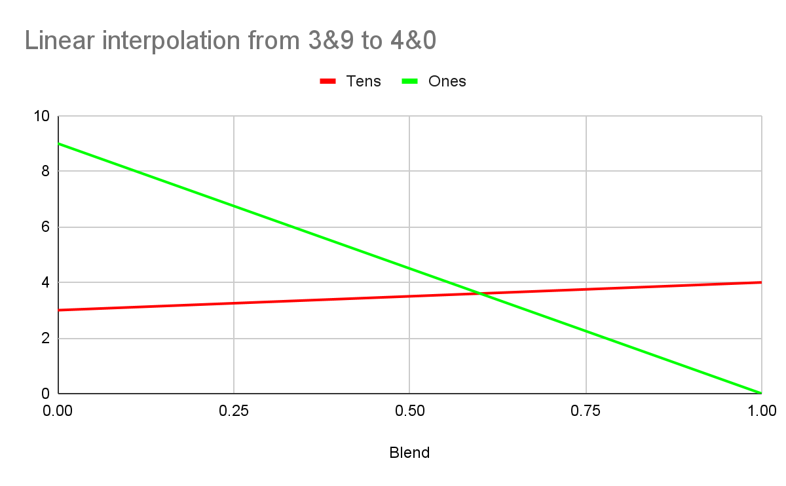

Bilinear sampling
R=3
G=9
R=4
G=0
Notes:
The red channel is most significant, green contributes much less, blue least of all. As the values increase blue will go up until it hits the maximum, drop to zero and green will increase slightly to compensate.
If we do a bilinear sample and dotproduct, does the unpacked value give a smooth result? Or do we get artifacts at the color discontinuities?
Here’s a simplified example to illustrate. Imagine we’re storing numbers with the tens digit in the red channel and the ones digit in the green channel. Unpack with red*10 + green.
We have two texels. 39 is on the left, ie red is 3 and green is 9. The right texel holds 40, which is red=4 and green=0. We’re going to sample the blended color.
Does a 50% blend unpack to 39.5? Does a sample from 20% of the distance between unpack to 39.2? Does it hold up when we’re doing bilinear interpolation on a 2D domain, instead of this simplified 1D example?
The short answer is that it’s a linear combination of linear functions so the result has to be linear. Dotproduct is a linear function, bilinear interpolation is a linear combination of inputs.
The long answer is a page of maths…

Slide 40
BC5
Notes:
8 bits per texel.
Two channels. Each has two 8-bit endpoints and three bits per texel.
The reason this is a bonus slide is that the interpolated values are lerps with parameter 0/7, 1/7, 2/7 … 7/7. No weird precision quirks.

